Slide 1
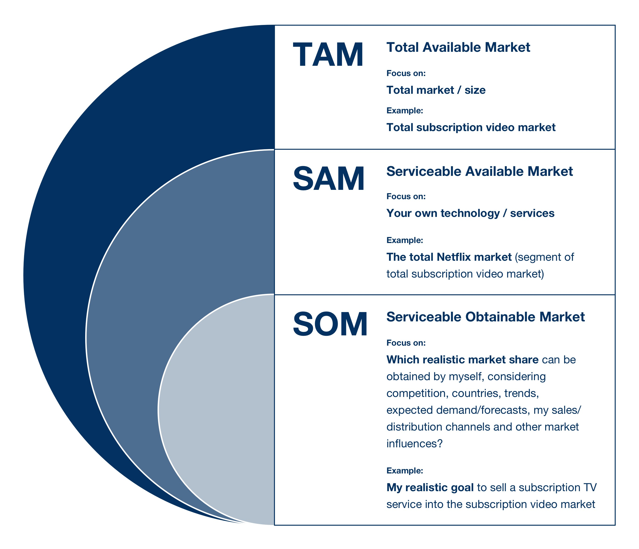
Content To Cover (if possible!)

