Slide 1
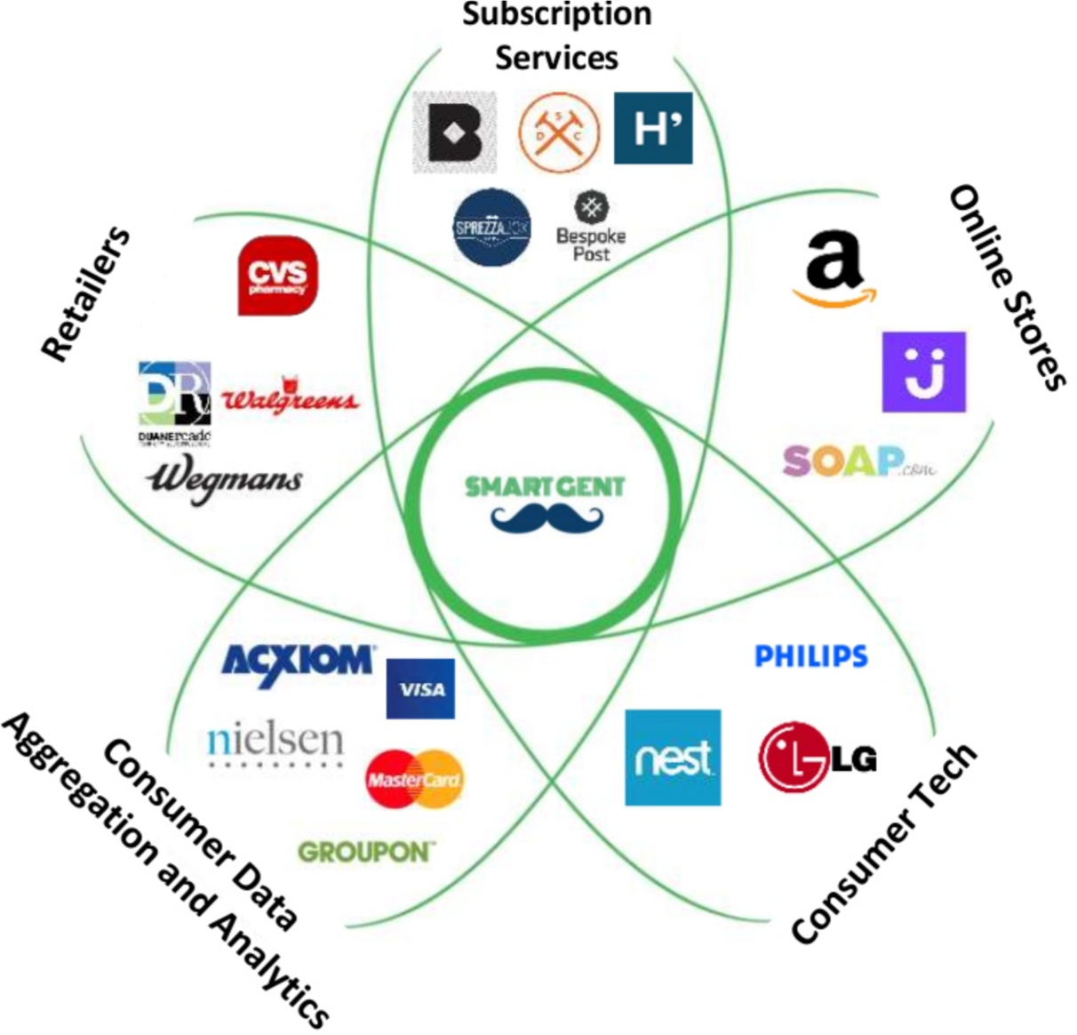
Competition petal diagram (Try your own)

