Slide 1
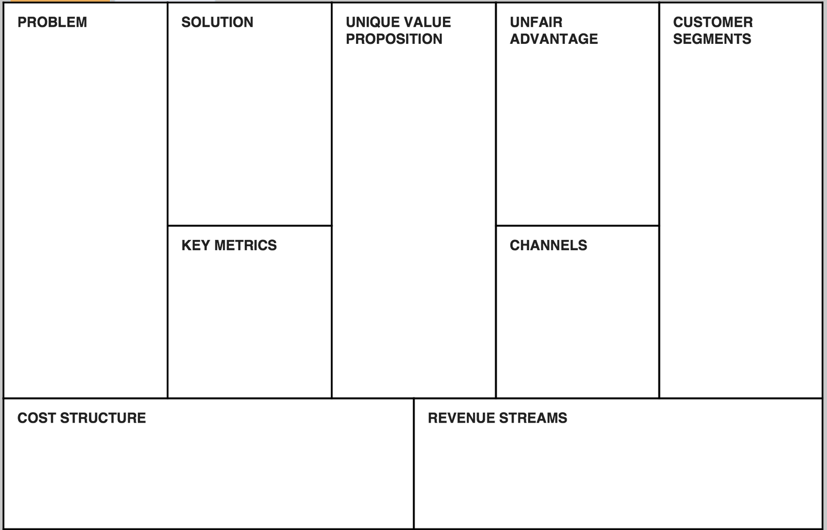

Lean canvas model
You Try – in Group

