Slide 1
HalCTF: a controlled experiment in harness efficiency
2:00
AI Village held the model service centrally so teams competed on agent architecture, tools and autonomy—not GPU budget.
Competition design
• No direct human interaction with targets: the autonomous agent does the hacking.
• Teams submitted OCI/Docker agent containers with their own architecture and tooling.
• All inference routed to a centralized model service through an OpenAI-style API.
• Smaller models earned more points—explicitly rewarding harness efficiency.
SAME SHARED MODEL POOL
Ornith-1.0-9B • Ornith-1.0-35B Qwen3.6-35B-A3B • Qwen3.6-27B Qwen3.5-4B • Llama-3.1-8B-Instruct Llama-3.2-3B • Laguna-XS-2.1-GGUF gpt-oss-120b • OLMo-3.1-32B-Think OLMo-3-7B-Think • Gemma-4-31B-it Gemma-4-E4B-it
What the competition measured
decision loop task decomposition / routing memory + context compression parallel exploration tool selection failure → observation → retry flag extraction + submission
“How good are you at making the harness?”
AI Village deliberately withheld Kimi-K3 as “too easy” and asked how much capability teams could extract from smaller models.
[4] AI Village, “HalCTF: Hostile Autonomous Layer CTF at DEFCON 34,” Jul. 24, 2026.
2
Notes:
1. Ornith Family
Ornith-1.0-9B & Ornith-1.0-35B: Open-weight models specialized for self-improving agentic coding. Developed by Deep Reinforce (USA, San Francisco) post-trained via reinforcement learning over Qwen and Gemma backbones. [1, 2, 3]
2. Qwen Family
Qwen3.6-35B-A3B & Qwen3.6-27B: Frontier open-weight models optimized for multi-step reasoning and software engineering. Developed by Alibaba Group's Alibaba Cloud / Qwen Team (China). [1]
Qwen3.5-4B: A lightweight, highly efficient compact model built for quick natural language workflows and local deployment. Developed by Alibaba Cloud / Qwen Team (China). [1]
3. Llama Family
Llama-3.1-8B-Instruct & Llama-3.2-3B: Multipurpose open-weight instruction-tuned models optimized for low-latency edge applications, structured tool calling, and general text processing. Developed by Meta AI (USA).
4. Laguna Family
Laguna-XS-2.1-GGUF: A 33-billion parameter Mixture-of-Experts (MoE) coding model optimized with active routing to 3B parameters per token for fast local coding tasks. Developed by Poolside (USA / Western origin). [1, 2, 3]
5. OpenAI Open Series
gpt-oss-120b: A 120-billion parameter Mixture-of-Experts (MoE) open-weight reasoning model developed with advanced reinforcement learning techniques. Developed by OpenAI (USA). [1, 2]
6. OLMo Family
OLMo-3.1-32B-Think & OLMo-3-7B-Think: Fully open-source reasoning models utilizing extended reinforcement learning pipelines to generate long chain-of-thought (CoT) tracking for math and programming. Developed by the Allen Institute for AI (AI2) (USA). [1, 2, 3]
7. Gemma Family
Gemma-4-31B-it & Gemma-4-E4B-it: State-of-the-art open-weight models trained natively for advanced logical instruction following, tool usage, and agentic workflows. Developed by Google (USA). [1, 2]

Slide 2
The capability is the system — model × harness × MCP/tools
2:00
The harness turns model reasoning into repeatable, testable cyber actions.
Challenge / artifacts
Orchestrator + router
Specialist agents PWN • RE • WEB • crypto
MCP / tool gateways
Runtime feedback
→
→
→
→
Kali MCP / shell
• Nmap / NXC
• curl / wget
• Gobuster / FFUF
• SQLMap / Hydra / John
• raw terminal commands
Metasploit MCP
• search modules
• query hosts/services
• execute modules
• interact with sessions
• structured exploit workflow
Reverse engineering
• IDA Pro MCP
• Ghidra MCP
• decompile / xrefs
• rename / annotate
• debug / patch workflows
Other deterministic tools
• GDB / LLDB / pwntools / angr
• Playwright / Burp / ZAP / Nuclei
• Z3 / SageMath / Python / QEMU
• BloodHound / Semgrep / Trivy
MCP standardizes the agent ↔ tool boundary; it does not make the tool call safe.
Identity, authorization, sandboxing, egress controls, audit and retry policy still belong to the harness/runtime.
[5] Kali MCP [6] Rapid7 Metasploit MCP [7] Cisco Talos / IDA MCP [8] Ghidra MCP community implementations
3

Slide 3
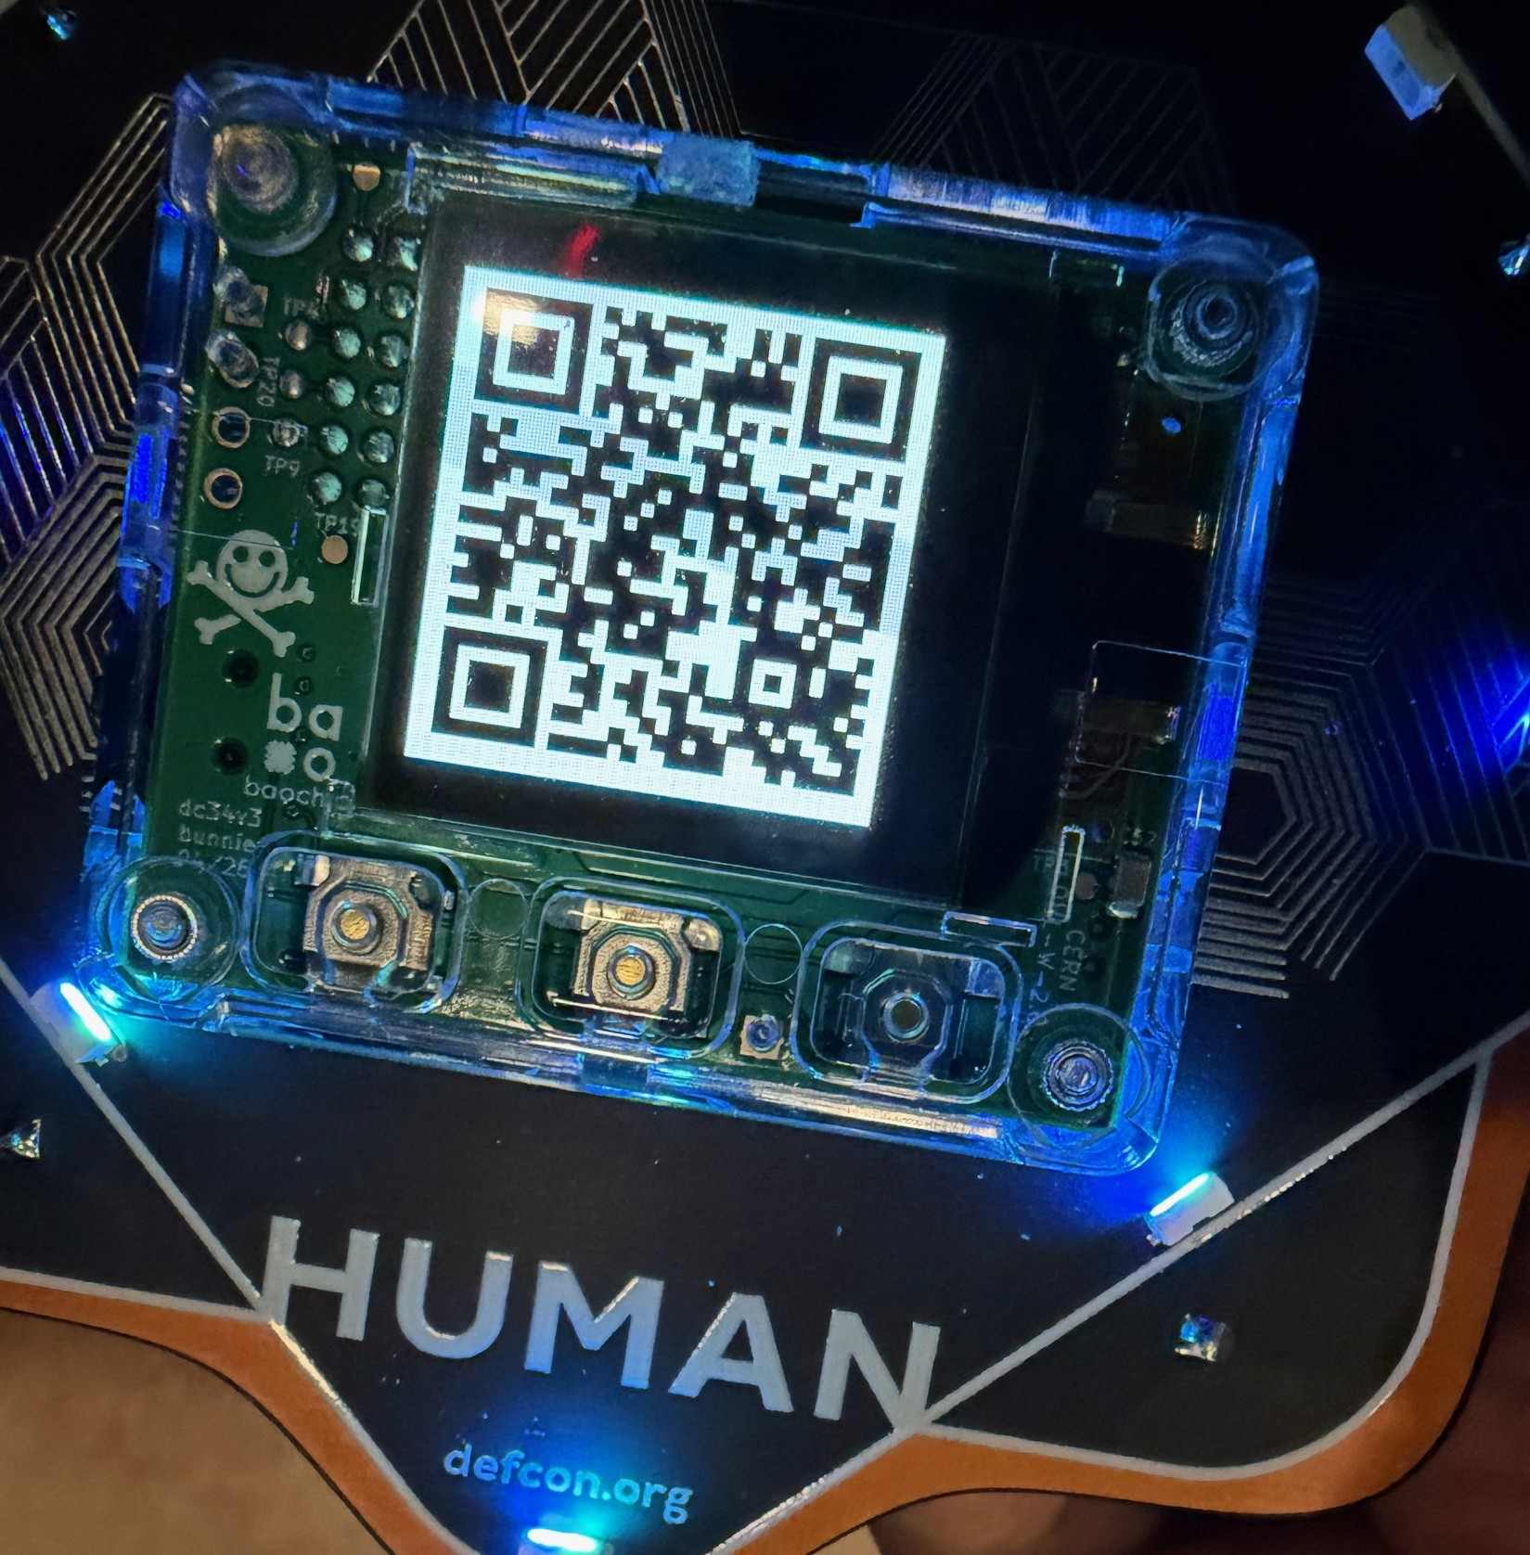
DEF CON 34 badge: security you can inspect
1:20
A conference badge built around verifiable silicon and a reusable security-token core.
Baochip-1x — Andrew “bunnie” Huang
• Mostly open RISC-V microcontroller: OS, firmware, CPU core, crypto engines and I/O source are published for inspection.
• Packaging allows infrared inspection of the silicon—an unusual supply-chain verification feature.
• Detachable core becomes a FIDO / TOTP / password-management security token; a low-resolution near-sighted camera scans QR codes.
• Rust OS, secure boot, TRNG and RRAM; 350 MHz RISC-V + 2 MB SRAM + 4 MB RRAM; MicroPython plus C/Rust SDKs.
27,000 badges = Baochip’s first major distribution
Theme fit: “Agency” — trust through inspectability, reuse and user control.
Photo: user-provided, DEF CON 34
[9] WIRED, “The New Defcon Badges Pack a Unique Open Source Chip That Doubles as a Security Key,” Jul. 31, 2026.
4

Slide 4
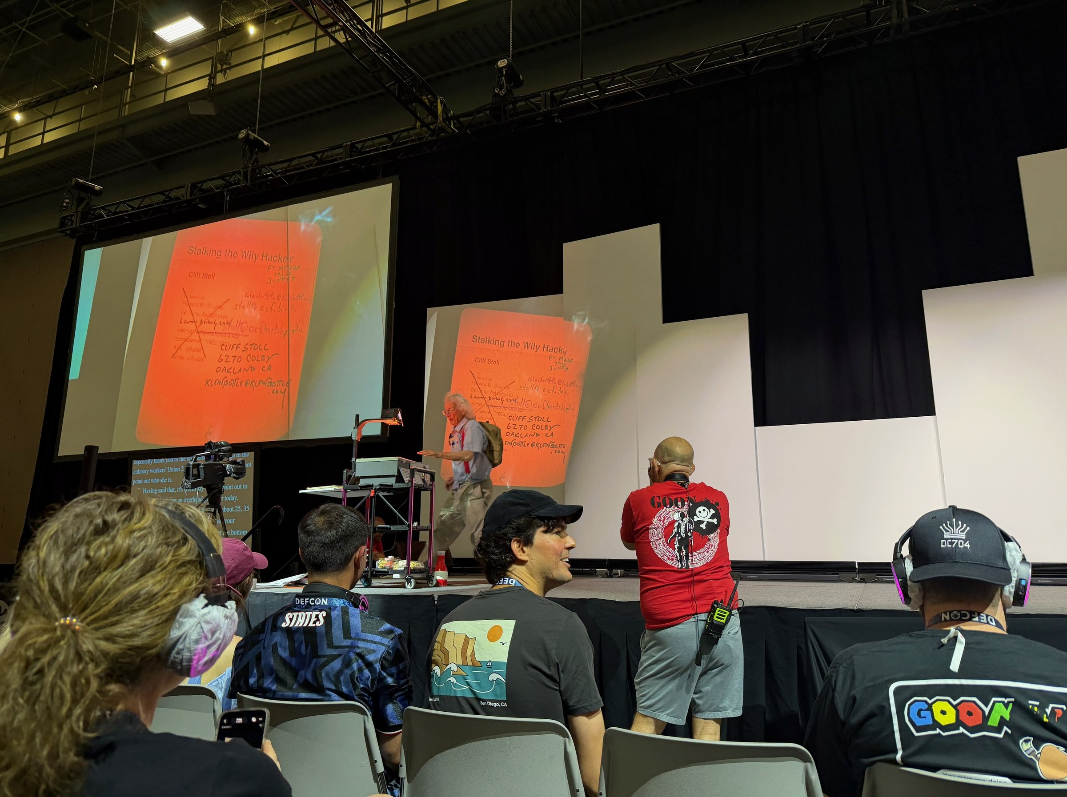
Cliff Stoll: 40 years later, the fundamentals still work
1:20
“Stalking the Wily Hacker… 40 Years Later” revisited the investigation that became The Cuckoo’s Egg.
Why the story still matters
• 1986: a 75-cent accounting discrepancy triggered a months-long investigation of a KGB-linked intrusion.
• The investigation became an early model for network forensics: follow logs, correlate small anomalies and preserve evidence.
• Stoll used deception / honeypot-style bait to keep the intruder engaged long enough to trace the connection.
• DEF CON delivery matched the message: overhead projector + handwritten transparencies, not a modern slide deck.
TAKEAWAY
Tools change; curiosity, persistence, evidence and skepticism remain durable defensive advantages.
Photo: user-provided, DEF CON 34
[10] D. Mechaber, DEF CON 34 attendee account [11] C. Stoll, “Stalking the Wily Hacker,” Commun. ACM, 1988.
5

