Slide 1
Satellite Imagery

Slide 2
Team members:-
Esraa Gamal
Esraa Amr
Rawaa Ahmed
Abeer Hussein

Slide 3
01
Preprocessing

Slide 4
Convert image to grayscale
Flatten image and resize by (400*400)

Slide 5
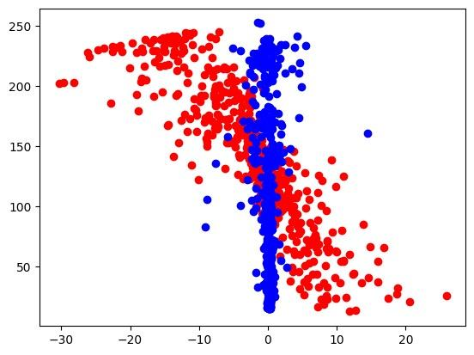
Visualization:-

Slide 6
02
Feature Extraction

Slide 7
Local Binary Pattern
LBP works by comparing each pixel in an image with its surrounding neighbors to build a binary pattern. The binary pattern is then used to represent the texture of the image.
Texture analysis

Slide 8
03
Models

Slide 9
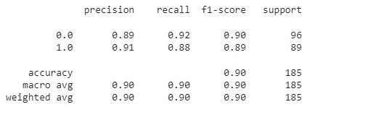
Supervised Models:
SVM

Slide 10
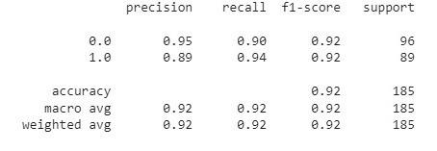
Supervised Models:
Random forest

Slide 11
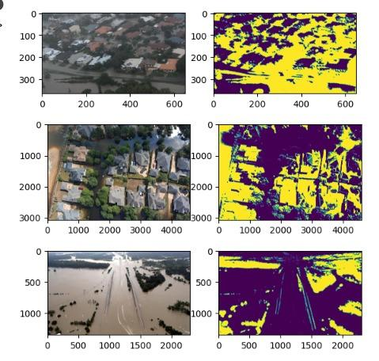
Color Segmentation:-
K Mean k=2

Slide 12
Deep learning Model:-
Flood Detection using Deep Learning (Finetuning MobileNet, KERAS)
Layers:
Store all layers of the original mobilenet except the last 5 layers in variable x
Also, we will be only training the last 12 layers of the mobilenet during finetuning as we want it to keep all of the previously learned weights
Create global pooling, dropout and a binary output layer, as we want our model to be a binary classifier

Slide 13
Thanks!

