Slide 1

YARMOUK UNIVERSITY • FACULTY OF COMPUTER SCIENCE AND INFORMATION TECHNOLOGY
Car Price Prediction
Using Machine Learning
DA220 — Machine Learning Project
روعه حسن الحوراني — 2023057048

Slide 2


The Problem
Used-car prices depend on many interacting factors
Many characteristics drive price
Problem Type
Supervised Learning
Regression
Target: selling_price
Manufacturing year, kilometers driven, fuel type, seller type, transmission, ownership, company, and model all affect how a used car is priced.
Goal
Build regression models that predict a used car's selling price from its characteristics, then compare models to find the best performer.
Hypothesis
Car characteristics have a learnable relationship with selling price — machine learning models can capture this pattern and produce reasonable price estimates.

Slide 3

The Data
Kaggle used-car dataset — Indian market, prices in INR
4,340
8
0
Records
Variables
Missing values
Variables Used
Preprocessing Steps
name → split into company / model
year — manufacturing year
km_driven — kilometers driven
fuel — fuel type
seller_type — type of seller
transmission — manual / automatic
owner — ownership status
selling_price — target variable
Checked structure, types & descriptive stats
No missing values found
Removed duplicate records
Split name into company + model
Encoded categorical features
Standardized numerical features
Split into train / test sets

Slide 4
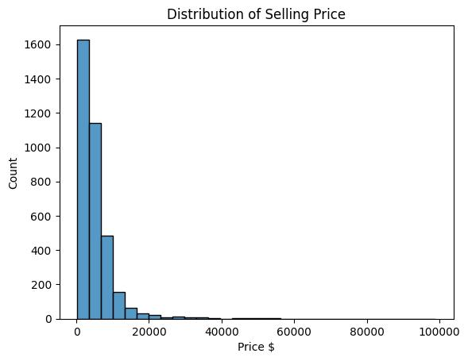
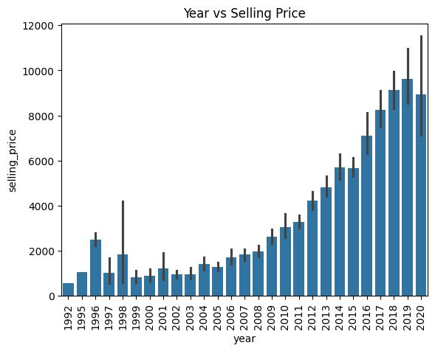
Exploratory Data Analysis
Price distribution and the effect of car age
Right-skewed: most cars are priced low, with a small number of high-price outliers.
Newer manufacturing years are clearly associated with higher selling prices.

Slide 5
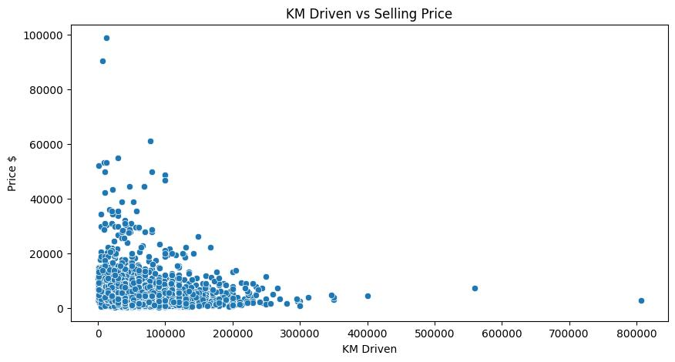
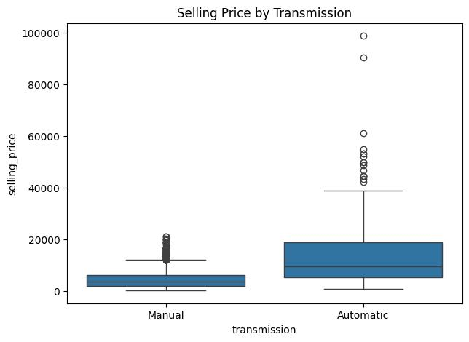
Exploratory Data Analysis
Mileage and transmission effects on price
Higher mileage generally means lower price, with a few high-mileage outliers.
Automatic cars tend to sell for more than manual cars, though both have high-price outliers.

Slide 6
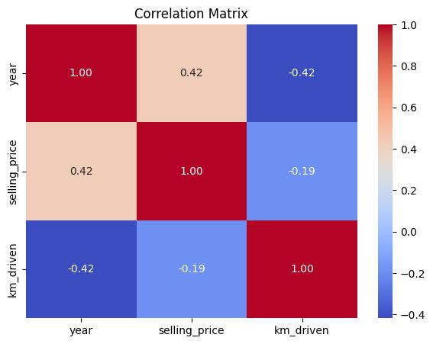
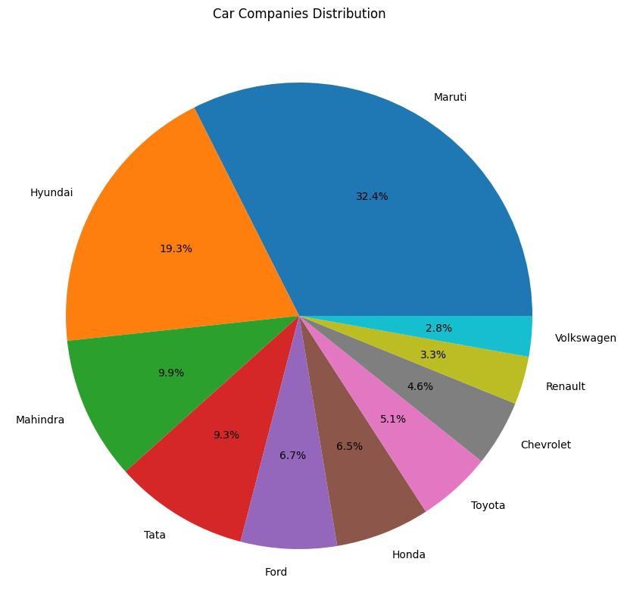
Exploratory Data Analysis
Feature correlation and market composition
Year correlates positively with price (0.42); km driven correlates negatively (-0.19).
Maruti (32.4%) and Hyundai (19.3%) dominate the dataset's car brands.

Slide 7



Modeling Approach
Four regression models trained and compared
Linear Regression
Random Forest
Gradient Boosting
CatBoost
Simple baseline to estimate the relationship between features and price.
Combines multiple decision trees to capture complex, nonlinear relationships.
Sequentially combines weak models, each correcting the previous model's errors.
Handles categorical features natively and captures nonlinear patterns effectively.
BEST MODEL

Slide 8
Model Results
CatBoost achieved the best overall performance
Evaluation Metrics
Model | MAE | RMSE | R²
Linear Regression | 1440.08 | 3181.61 | 0.7478
Random Forest | 1468.26 | 3439.51 | 0.7053
Gradient Boosting | 1679.23 | 3253.84 | 0.7362
CatBoost | 1549.45 | 3132.27 | 0.7556
Best model: CatBoost
Highest R² (0.7556) and lowest RMSE (3132.27) among all tested models — selected for the final application.

Slide 9
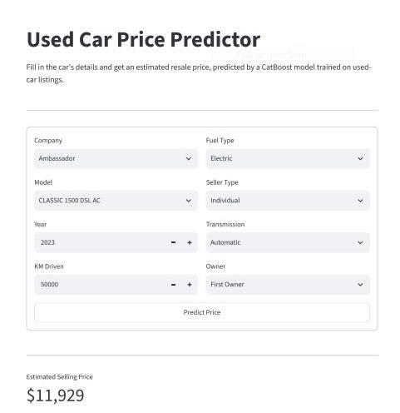

The Application
A Streamlit GUI puts the CatBoost model in users' hands
User Inputs
Company
Model
Year
Kilometers driven
Fuel type
Seller type
Transmission
Owner
How it works
The user enters car details and clicks Predict Price. The app runs the saved preprocessing pipeline, feeds the result to the saved CatBoost model, and displays the estimated selling price instantly.
Example output: $11,929

Slide 10

Conclusion
A complete ML pipeline — from raw data to a usable app.
The dataset was cleaned and explored, four regression models were trained and evaluated, and the best model was deployed in an interactive Streamlit application.
0.7556
3132.27
4
Best R² — CatBoost
Lowest RMSE
Models compared
Practical takeaway: machine learning can reliably estimate used-car prices from everyday listing details, and a simple GUI makes that capability accessible to non-technical users.

