Slide 1
American Express
Campus Challenge 2021
Data Science
Final Submission

Slide 2
Team Details
Team Name : Dataholic
Name | College | Course | Batch Year | Roll No | Mobile Number | College Email Id
Akash Kumar | IIT Kanpur | Mechanical Engineering | 2017 | 17807069 | 735 509 2930 | akashkr@iitk.ac.in
Nishtha | IIT Kanpur | Computer Science & Engineering | 2018 | 180489 | 987 853 4050 | nishthaa@iitk.ac.in

Slide 3
Introduction – Team Members
Akash Kumar:
Business Development & Strategist Intern at Smurfo House: Developed long-term technical solutions and evaluated new business initiatives to increase growth. Assisted in the development of video similarity computation feature of the courses using OpenCV.
AMEX ‘Analyze This 2020’: Developed ML models for customer segmentation based on profitability to increase customer referral penetration through high incentives. Awarded a Pre-placement offer for bagging top position amongst 55 teams at IIT Kanpur.
IBM Capstone Project- Performed exploratory data analysis to predict market value of football players participating in FIFA 19 cup.
Coordinator- Dance Club: Spearheaded a team of 35 members to victory in InterIIT Cultural Meet and Antaragni. Improved club finances by 30% and increased social media engagement by 40%.
Nishtha:
Junior Analyst Intern at Citibank: Developed an NLP based model to predict GRC process labels from corresponding RCM Processes. Received the Citi Gratitude Award from my mentor for remarkable performance, on-time delivery & utmost sincerity.
Practical ML@Kaggle: Competed with 500+ members on ML based application on real-world issues & bagged top ranks on 2 tasks.
Discovering Artificial Neural Networks@SnT-IITK: A project exploring various applications of NN, DNN, RNN and CNN.
Coordinator - Fine Arts Club: Spearheaded and managed financial and managerial work of the club increasing digital reach by 60% on Facebook, and 150% on Instagram. Founding member of Inter Institute Art Competition amongst IITs.
*Please Include any relevant past experience or projects, club membership, relevant past competitions or hackathons you’ve been part of & the like

Slide 4


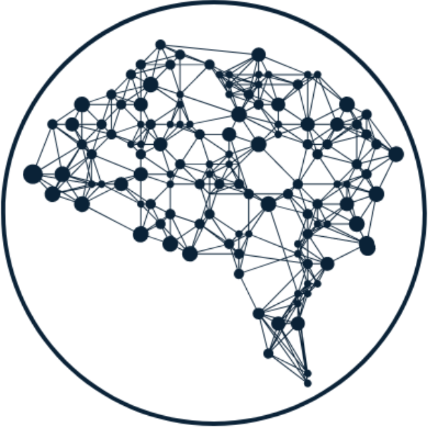

Problem Statement
Classify the text that might appear in an invoice image into pre-defined categories
Annotations
IN
Test data containing text annotations
Validate
Train
Prediction
OUT
Predicted classes for each text annotation
Given: Training data with text annotation of 900 images containing text & their classes
Machine learning based multiclass prediction model

Slide 5
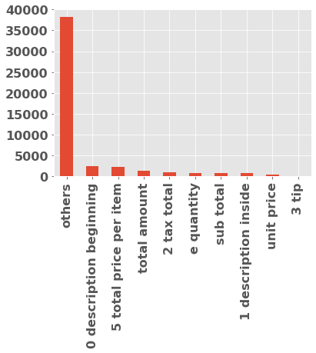















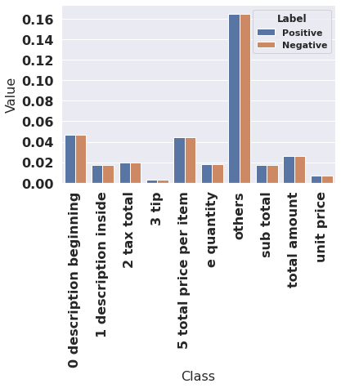


Methodology
Data imbalance
#Occurences
Loading Data & Cleaning
Embedding & Preprocessing
Handling Imbalance
Model 1
Combining Predictions
  Import the dataset from the JSON files
  Removing punctuation marks and converting text to lowercase
  Dropping the redundant coordinates (top right and bottom left) of the bounding box for decreasing multicollinearity
  Combined the text descriptions of train, round1 and round2 text to train Word2Vec model providing 100 dimension embedding for each word.
  Joined normalized 2 pairs of x and y coordinates to get 104 dimensions input instances.
  Stratified split of train dataset for validation
  Defined a weighted cross entropy loss with equal positive and negative contribution by assigning positive weight as negative frequency and negative weight as positive frequency for each class.
  Trained the Model 1 on this weighted loss function
  Trained ANN on the joined word embedding and normalized bbox coordinates.
  Combined predictions from both models assigning more weights to data analytics model.
  All the labels where prediction from data analytics has ‘others’ class but ANN prediction was different were replaced by ANN prediction increasing F1 score from 0.39 to 0.51
Model 2
Class frequency scaled to remove imbalance
  Data analytics assumption based-model on patterns in instance text and neighboring bbox texts

Slide 6



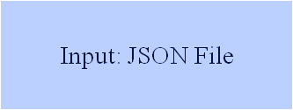






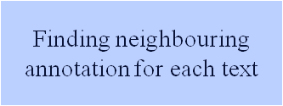
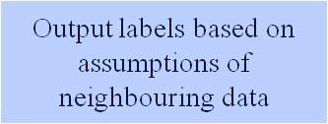
Algorithm – Approach & Details
Model Architecture
+
MODEL 1
MODEL 2

Slide 7
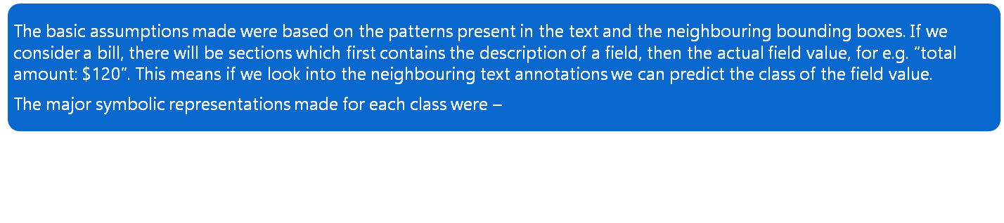
Assumptions
“total amount”: [‘grand total’, ‘total’, ‘amount’, ‘due’, ‘amount payable’, etc.]
“sub total”: [‘subtotal’, ‘sub-total’, ‘sub. total’, ‘taxable’, etc.]
“2 tax total”: [‘gst’, ‘cgst’, ‘vat’, ‘cess’, ‘sgst’, etc.]
“3 tip”: [‘tip’]
“e quantity”: [‘qty’, ‘quantity’]
“unit price”: [‘price/item’, ‘price’, ‘rate’, etc.]
“5 total price per item”: [‘amount’, ‘amnt’]
“0 description”: [‘description’, ‘item’, ‘item name’, ‘menu name’, etc.]
We assumed all classes to have default “others” class initially then verified whether the keywords for each class given above are present in the neighbourhood or not using the bounding boxes and classes are assigned according to that. The output from neural network was used to combine predictions also to achieve better results.
MODEL 1
+
MODEL 2

Slide 8

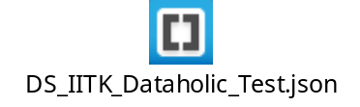
Results
Embedded Validation Results (Round 1)
Embedded Test Results (Round 2)
F1 score on Leaderboard:
0.505905
*Add validation results

Slide 9
THANK YOU

