Slide 1
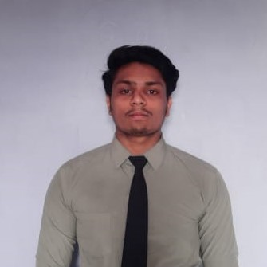
PARAG RAWAL
Analyst/Software Engineer
Bachelor of Engineering
Computer Science and Engineering :2017-2021
Mumbai
Skills
parag.rawal@capgemini.com
Java | Java Basics, OOPS, Generics, Collections, Arrays, Loops , Data Types in Java .
Spring Boot | Spring Boot fundamental, Building API, Dependency Injection .
UI Framework-React | Fundamentals components ,Java Script, Working with states & props in React , Event Handling in React , Routing ,Life Cycle Method, Working with HTTP in React.
React | Components, Services, Modules, Routing, Forms & Validation, Testing using Jasmin & Karma
Database | MONGODB
UI Tech | HTML 5 & CSS 3,JavaScript, Optimized UI Designed
Tools | IntelliJ, Visual Studio code, Swagger, Postman.
Add On skills | Communications, Team management. Peer learning
+91 9115490821
A4
Proficient in Java and OOPs concepts.
Hands on experience in creating Web Application with Spring Boot Application , Web API, React.
Practical Understanding of Query Language Like MONGODB
Hands on experience in developing web pages using HTML5, CSS3, Object Oriented Programming, JSON, XML. Good understanding of Document Object Model (DOM) and DOM Functions.
Practical understanding of rendering Spring Boot Application, REST API.
Proficient React developer with working knowledge on React.
Implemented Web API and React in case study and up skilling this knowledge continuously.
Hotel Management System
Working on case study of Hotel Management System Application along with authentication, Swagger and React used for user interface and MOONGODB as database.
HTML , CSS and JS course completed with Coursera
Completed this course with optimal Knowledge of HTML, CSS and JS.

