Slide 1

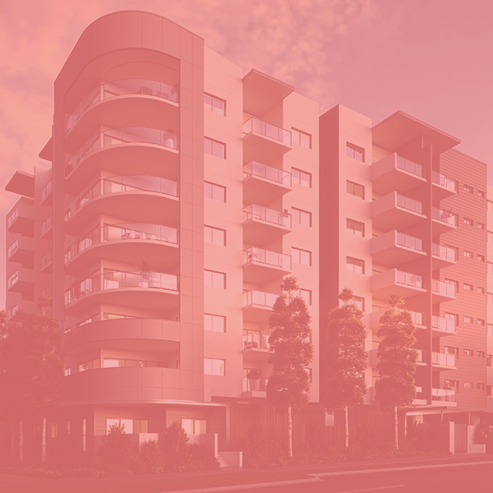
STUDENT HOUSING BV
Rawan Abou Dehn
Femke Duijzings
Baian Khir Allah
21-01-2020
Notes:
Introduce the team members.
(Contents / introduction in next slides)

Slide 2

Contents
The client
Their problems
Our solutions
Demo
Notes:
What we’re going to talk about:
The client
Their problems
Our solutions
Demo

Slide 3

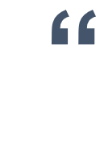
The client
We’ve received complaints about students not following the rules and completing their tasks. We need a software solution to this issue.
Notes:
Introduce the company Student Housing BV. - One building in Eindhoven, NL - Students have their own room - Students share facilities, like toilets, a bathroom and a kitchen.
Read the quote: “We’ve received complaints about students not following the rules and completing their tasks. We need a software solution to this issue.”
Talk about the main issue: - Students don’t follow house rules - Students don’t complete their tasks, such as cleaning, groceries or taking out the garbage. - There is currently no way for students to view a schedule for these tasks.
Tell them we took the main issue and broke this apart into smaller problems. This is what we’re going to talk about in the next slides.

Slide 4
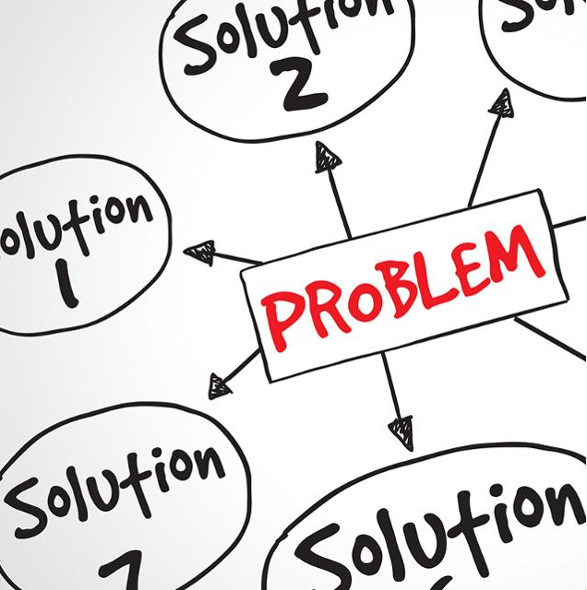
Problems
Students do not follow the rules.
Appointed student does not complete his task (cleaning, garbage or groceries).
Problems surrounding groceries.
Unannounced parties.
Notes:
Just introduce the problems by reading them.

Slide 5
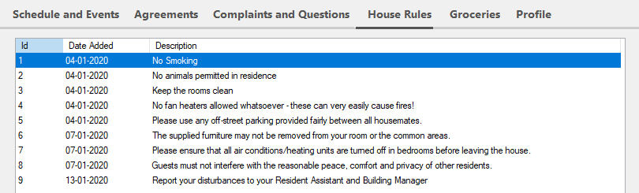
Problem 1
Students do not follow the rules.
Our solution:
Students can view the rules at any time in the application.
Admins can update the rules and students will immediately see any changes.

Slide 6
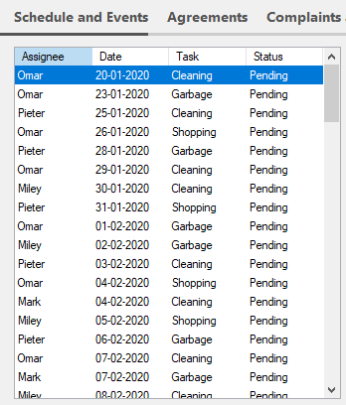

Problem 2
Appointed student does not complete his task.
Our solution:
Students can see a schedule with everyone’s task.
Admins can also see the schedule and administrate this.
Notes:
“Admins administrate” means they can mark a task as incomplete.

Slide 7
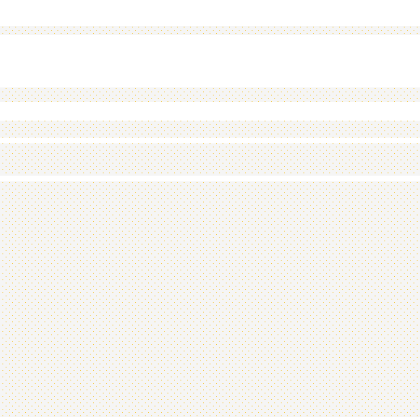
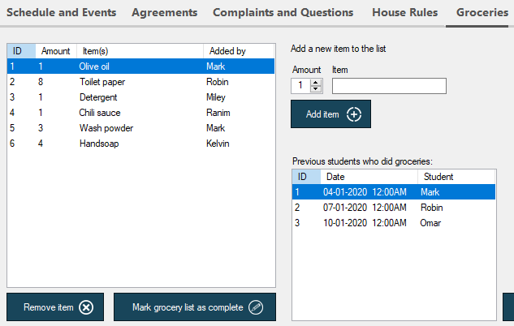
Problem 3
Problems surrounding groceries.
Our solution:
Students can view the grocery list and add new items.
Students can view grocery history.

Slide 8
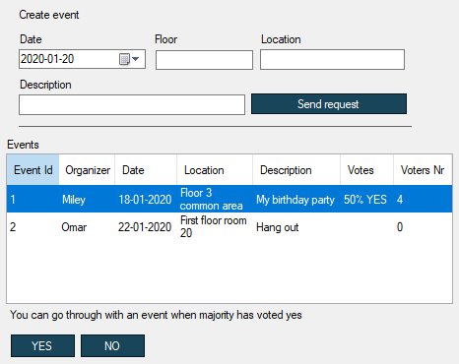
Problem 4
Unannounced parties.
Our solution:
Students can create an event.
Students can see a schedule for events and vote for it.

Slide 9
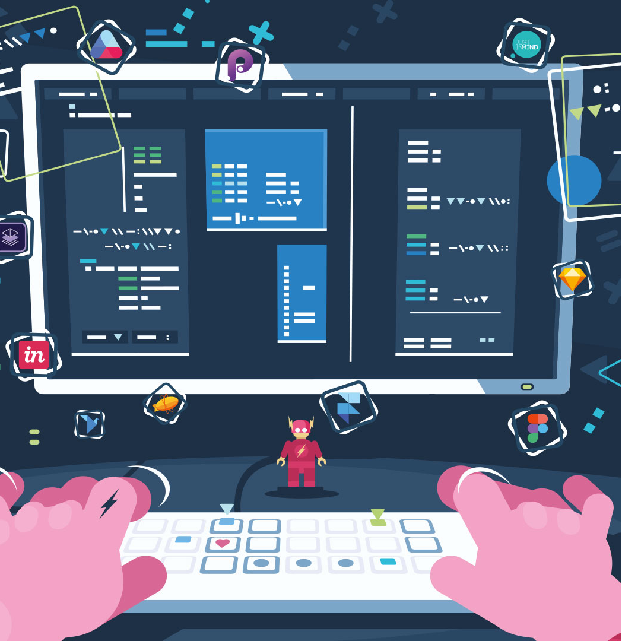
Our software solution
Three interfaces:
Login
Student
Admin

Slide 10
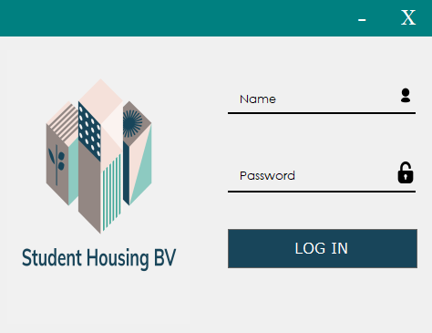
Login interface
Notes:
Users fill in username (email) and password.
We will be showing this feature in the demo.

Slide 11
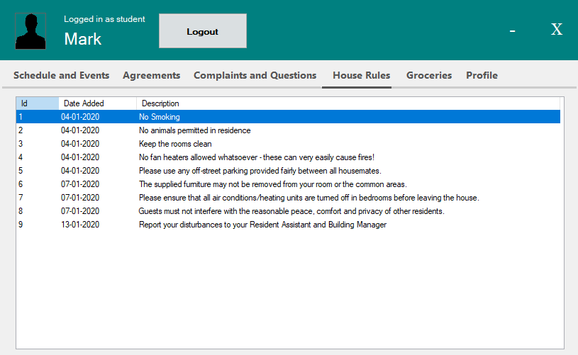
Student interface
Notes:
The student interface.
Here you can see the solutions to the problems we mentioned before.
There are also additional features. All features are organized in separate tabs, they include:
Viewing a schedule and events
Viewing and making agreements with other students
Viewing and making complaints and questions anonymously
Viewing house rules
Viewing the grocery list
Viewing the profile and editing personal information.
We will be showing all of these features and tab pages in the demo.

Slide 12
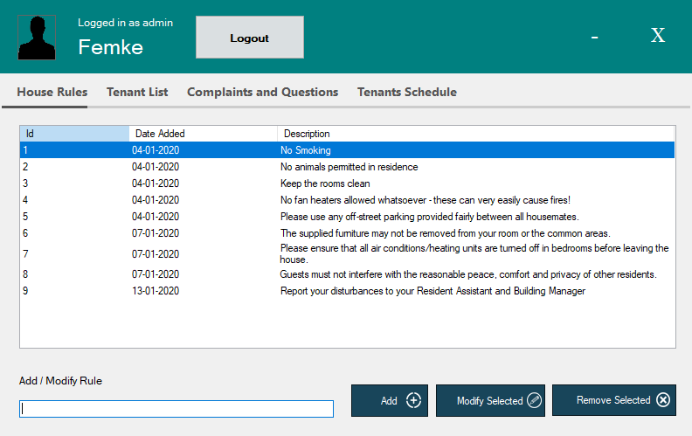
Student interface
Notes:
The admin interface.
Here you can see the solutions to the problems we mentioned before.
There are also additional features. All features are organized in separate tabs, they include:
Viewing the house rules and editing them
Viewing the tenant list and creating new accounts (tenants)
Viewing the complaints or questions that students sent
Viewing the schedule of the tenants and modifying if necessary
We will be showing all of these features and tab pages in the demo.

Slide 13

DEMO
Notes:
Demo.
1. Baian starts with login.
2. Femke does Student Form.
3. Rawan does Admin Form.
4. Femke shows applied changes in Student form.

