Slide 1
Car Rental System
Online Car Rental Website — ASP.NET Core MVC Capstone Project
ASP.NET CORE MVC
ENTITY FRAMEWORK CORE
SQL SERVER
ASP.NET CORE IDENTITY

Slide 2





Project Idea & Problem Statement
The Car Rental System enables customers to browse, search, and reserve vehicles online — replacing the traditional manual rental process with a streamlined digital experience.
Browse Cars
Select Car
Choose Dates
Check Availability
Reserve
Traditional Problems
System Solution
Manual reservation requiring office visits or phone calls
No real-time visibility of available cars
Manual price calculations prone to error
Booking conflicts and double-reservations
Online browsing, search & filtering
Automatic price calculation
Real-time availability checking
Role-based admin management

Slide 3

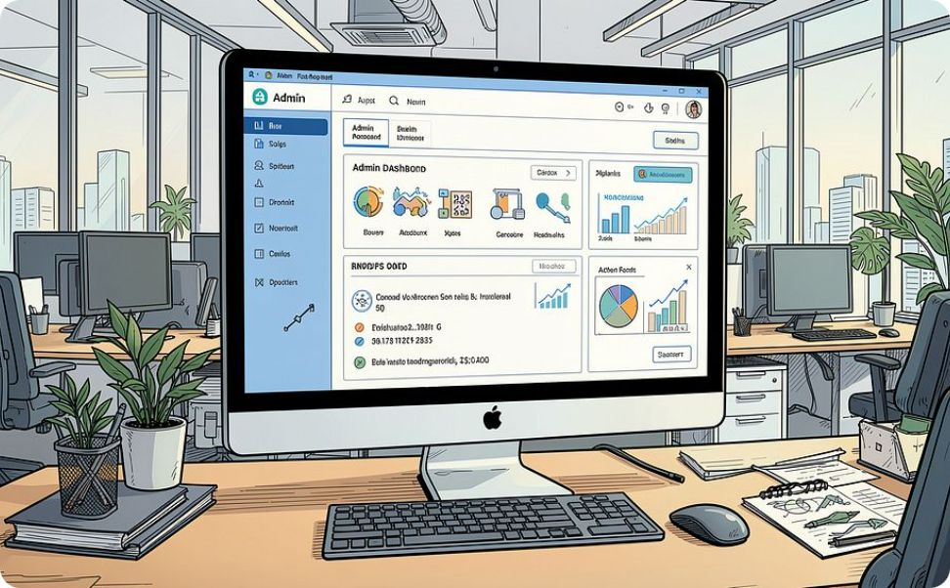
System Users
The system defines two distinct user roles, each with a tailored set of features and access permissions.
Customer
Admin
Register & Login
Browse, search & filter cars
View car details & select rental dates
Make reservations & view status
Manage cars, categories & customers
View & manage all reservations
Approve or reject reservations
Update car status & availability

Slide 4
Customer Features & Car Search
Customers follow a clear, guided workflow from registration to confirmed reservation. Search and filtering help them quickly find the right vehicle.
01
02
03
Register / Login
Browse Available Cars
Search & Filter
By brand, category, or price
04
05
06
View Car Details
Select Start & End Dates
Check Availability
07
08
09
Calculate Total Price
Confirm Reservation
View Reservation Status
Search & Filter Options
Car Details Display
Brand — Filter by manufacturer
Category — Sedan, SUV, Luxury, etc.
Price — Within budget range
Brand, Model & Year
Category & Daily Rental Price
Availability Status
Car Image
Rental date picker

Slide 5

Reservation Process & Pricing
The system automatically calculates the total rental cost and validates availability before confirming any reservation.
Select Car
Calculate Price
Choose vehicle and rental dates
System computes total cost
Confirm Reservation
Check Availability
Verify vehicle is free for dates
Complete booking and payment
Pricing Formula
Validation Rules
Total Price = Rental Days × Daily Rate
Example: $50/day × 4 days = $200
Start date must be before end date
Car must be in Available status
No overlapping reservations allowed
All required fields must be completed

Slide 6
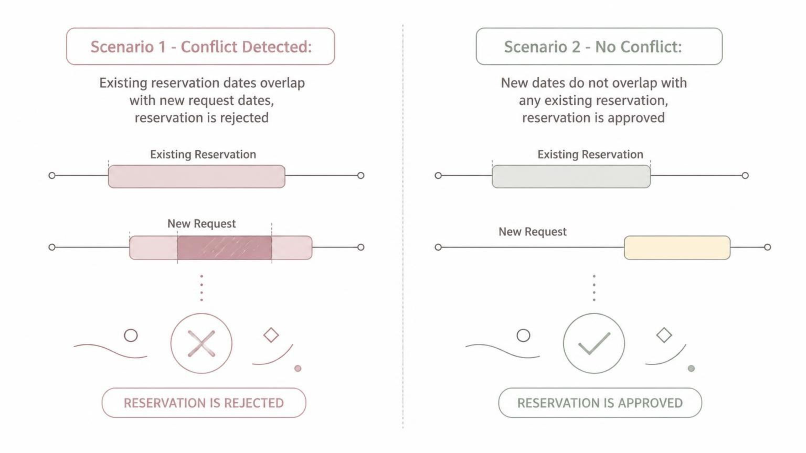
Availability & Booking Conflict Logic
Before confirming any reservation, the system checks for date overlaps with existing bookings. A reservation is only created if the car is free for the entire selected period.

Slide 7
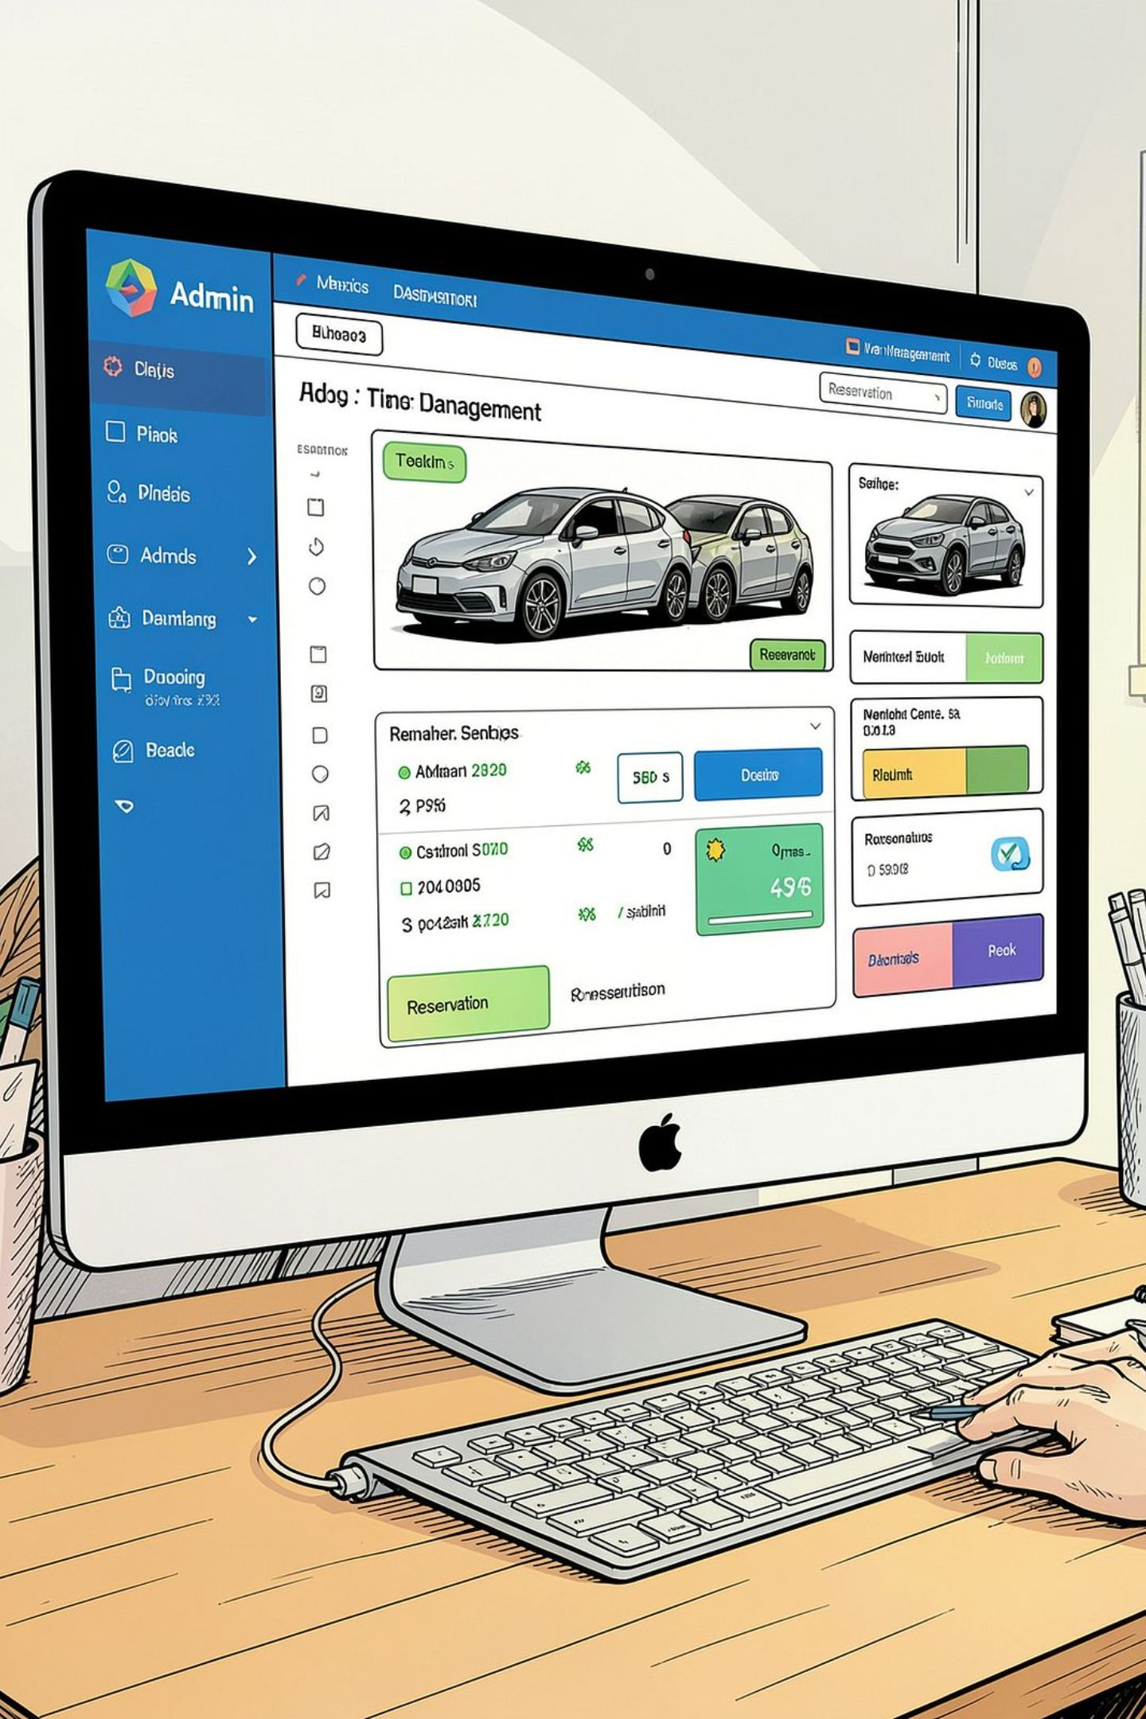

Admin Features & Authentication
The Admin Dashboard provides complete control over the rental system. Access is protected by role-based authorization via ASP.NET Core Identity.
Manage Cars
Add, edit, delete cars and update status
Manage Categories
Organize vehicles by category
Manage Customers
View and manage customer accounts
Manage Reservations
Approve or reject bookings
Authentication verifies identity (Register/Login via ASP.NET Core Identity). Authorization controls access — Customers see rental features, Admins access the dashboard and management tools.

Slide 8
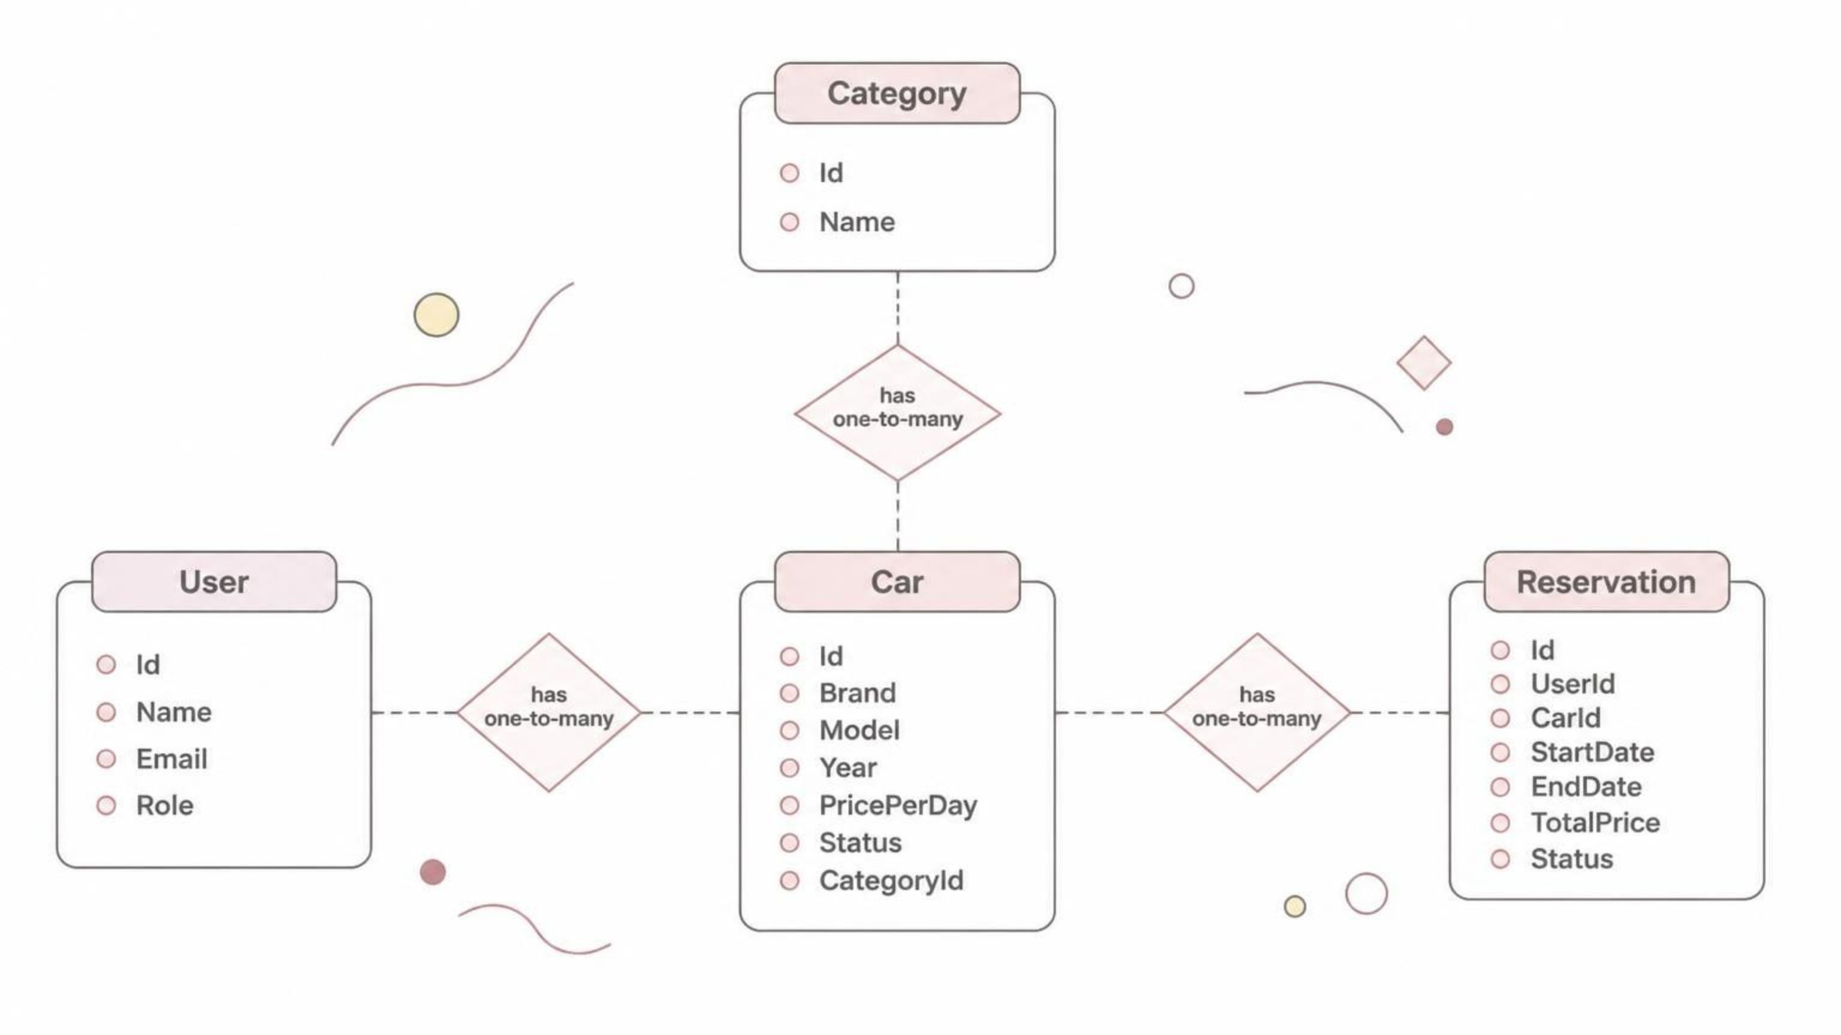
Database & Entity Relationships
The system uses four core entities connected through Entity Framework Core with SQL Server.

Slide 9
Technology Stack & Core Features
Frontend
Core Features
HTML & CSS
Bootstrap
Razor Views
Authentication & Authorization
CRUD Operations
Search & Filtering
Reservation System
Availability Checking
Booking Conflict Detection
Automatic Price Calculation
Role-Based Access Control
Backend
ASP.NET Core MVC
C#
Database
SQL Server
Entity Framework Core
Authentication
ASP.NET Core Identity

Slide 10
Future Enhancements & Conclusion
The following features are planned for future iterations, beyond the current project scope.
Payments & Notifications
Reports & Analytics
Customer Reviews
Online payment integration, email & SMS notifications
Admin dashboard with reports, reservation history & analytics
Rating and review system for rented vehicles
The Car Rental System delivers a complete online solution — simplifying reservations for customers and giving admins full control. It demonstrates practical implementation of ASP.NET Core MVC, Entity Framework Core, SQL Server, and ASP.NET Core Identity.

