Slide 1
Heapsort nonrecursive algorithm
Rawan Walid Mostafa

Slide 2
Table of contents
01
02
03
04
The ploblem
The strategy
Background about heaps and heapsort
The strategy that used in the heapsort algorithm and why choose it
The algorithm
The analysis
Explain the algorithm
The time complexity of algorithm

Slide 3
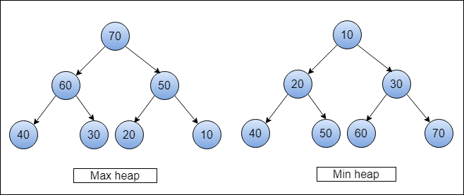
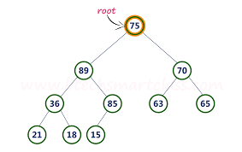
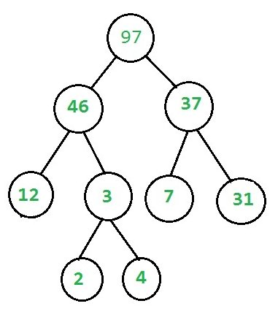
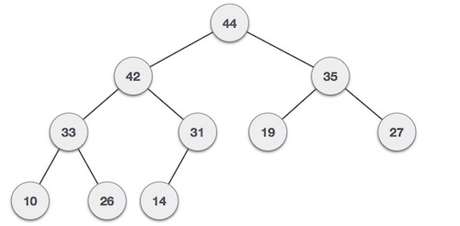
The problem
Heapsort is a binary tree
There are two types of heaps
How can we know if the tree is heap or not?
incorrect
incorrect
Correct

Slide 4
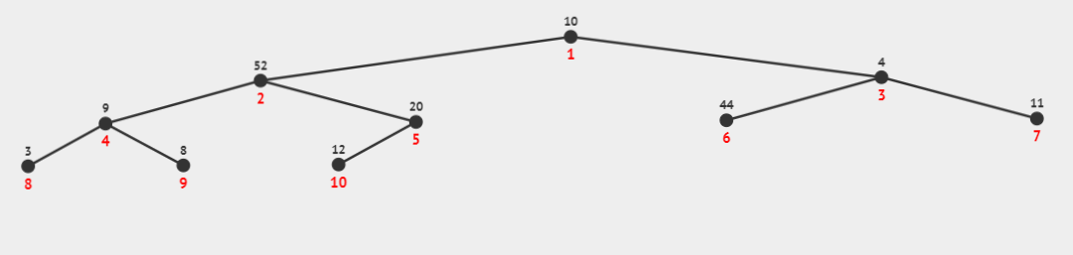
Continue the problem
Heap can represent as an array
Left children of node i is at position 2i
Right children of node is at 2j+1
The problem is sort this array using heap array = [10, 52, 4, 9, 20, 44, 11, 3, 8, 12]
You can enter a subtitle here if you need it

Slide 5
strategy
Using transform and conquer algorithm (representation change)
Why using transform and conquer?
Efficient to select max element
Easy to implementation
Do not need extra data structure

Slide 6
The algorithm
Def non_recursive_heapsort(array): n = len(array) i = (n // 2) - 1 while i >= 0: heapify(array, i, n) i -= 1 i = n - 1 while i > 0: swap(array, i, 0) heapify(array, 0, i) i -= 1
def heapify(array, start, end): current = start while (current * 2 + 1) < end: left_child = current * 2 + 1 right_child = current * 2 + 2 if left_child < end and array[current] < array[left_child]: current = left_child if right_child < end and array[current] < array[right_child]: current = right_child if current != start: swap(array, current, start) start = current else: break
array = [10, 52, 4, 9, 20, 44, 11, 3, 8, 12] non_recursive_heapsort(array) print(array)
def swap(array, i_one, i_two): array[i_one], array[i_two] = array[i_two], array[i_one]

Slide 7
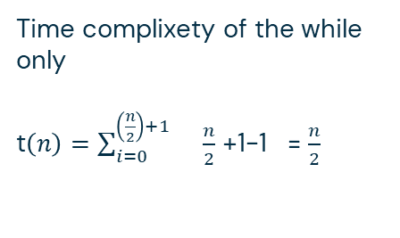

Time complexity
In the first while loop
i = (n // 2) - 1 while i >= 0: heapify (array, I , n) i -= 1
T total for this while(n)=t(n)in heapif*t(n)of the while
Heapif in this case called n/2 times and only travers the parenets nodes and do not travers any leaf nodes so the complixity of iit in this case Օlog(n)
Time complixety of the while only
t$\left(n\right)=\sum_{i=0}^{\left(\frac{n}{2}\right)+1}{ \frac{n}{2}}$ +1-1 = $\frac{n}{2}$
T total for this while(n)= $\frac{n}{2} ∗$Օlog(n)=n log(n)

Slide 8
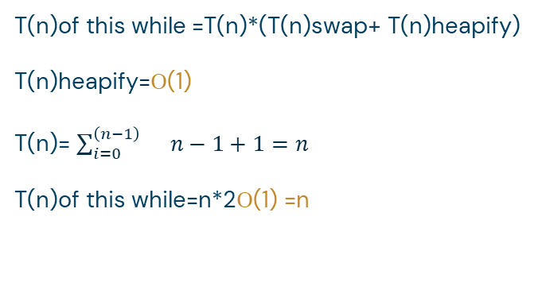
Continue time complexity
T(n)= n log(n)+n
= Օ n log(n)+
i = n - 1 while i > 0: swap(array, i, 0) heapify(array, 0, i) i -= 1
Օ(1)
T(n)of this while =T(n)*(T(n)swap+ T(n)heapify)
T(n)heapify=Օ(1)
T(n)= $\sum_{i=0}^{\left(n−1\right)}{ n−1+1=n}$
T(n)of this while=n*2Օ(1) =n

Slide 9
Thanks!
Do you have any questions?

