Slide 1

Injury Prediction for Competitive Runners
Rawan Mansour
Abdulwahab Al-Subit

Slide 2


Table of Contents
Introduction
Dataset
Data Cleaning
Visualization
Data Model
Conclusion & Tools

Slide 3
Introduction
Staying injury free is a major factor for success in sports. Our purpose was to use machine learning for the prediction of injuries in runners, based on detailed training logs.

Slide 4
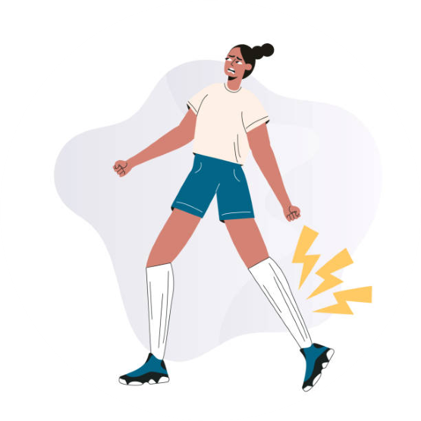
Dataset
Injury Prediction In Competitive RunnersDataset provided by Kaggle website
Dataset was obtained from kaggle in form (.csv)
Has 13 columns and 42766 rows.
Include a binary column indicating whether
this training setup resulted in an injury (1) or not (0).
The target I want to predict is “injury”.

Slide 5


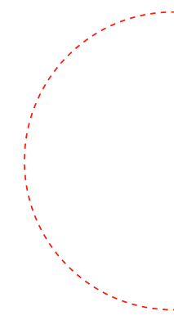
Cleaning data
01
Missing
02
Filling the missing value
Unnecessary
Drop the unnecessary features
03
Duplicate
04
Check for duplicates data
Type
Checking features type

Slide 6
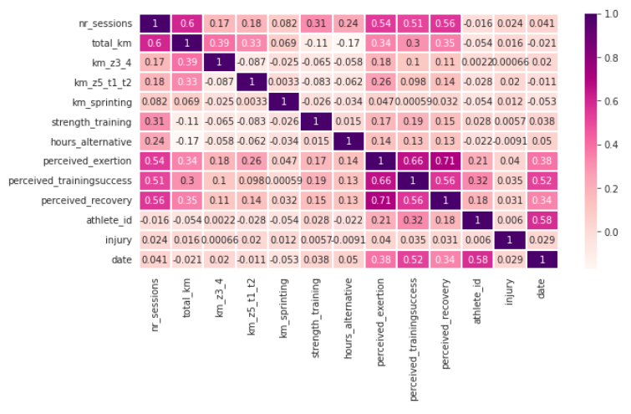

Visualization
Exploring Data Analysis
(EDA)
The correlation heatmap was used to find the correlation between factors

Slide 7
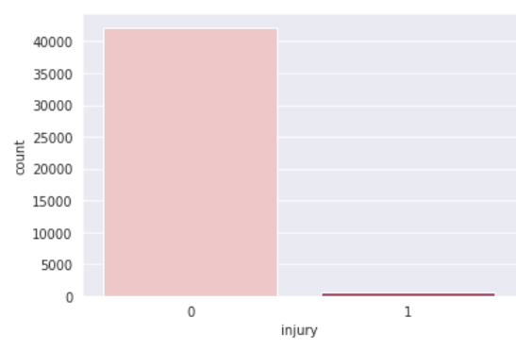
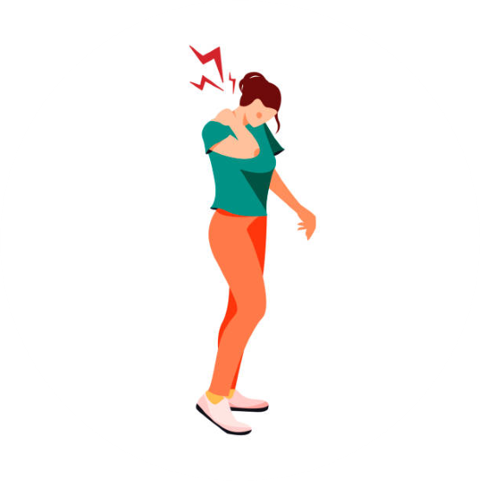
This plot shows there is unbalance between in the dataset so, in preprocessing part I will balance between them using SMOTE.

Slide 8
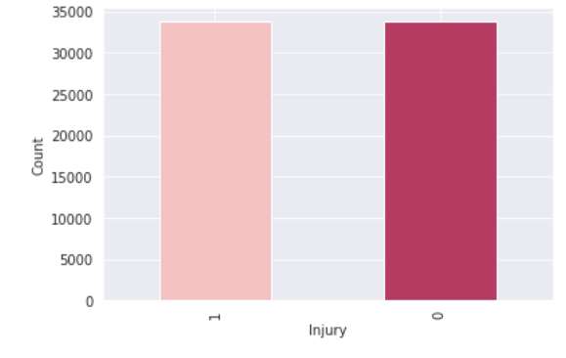

After balancing data.

Slide 9

The Model Used
Logistic Regression.
Xgboost.
KNN.

Slide 10
Comparison Models
 | xgboost | Logistic Regression | KNN
Accuracy | 86% | 62% | 98%
Recall | 0.63 | 0.87 | 0.96
f1-score | 0.62 | 0.86 | 0.98

Slide 11
Conclusion
KNN
Is the best model to predict the possibility of Injury for Competitive Runners.

Slide 12
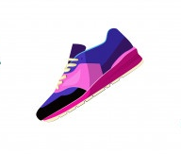
Tools Used
For Data Processing
- Pandas.
- NumPy.
For Building The Model
- Scikit-learn library.
- Imblearn.
- XGBoost
For Visualization
- Matplotlib.
- Seaborn.

Slide 13

Thanks!
Do you have any questions?

