Slide 1

VACCINE RESEARCH & DEVELOPMENT MANAGEMENT SYSTEM
A Data-Driven Approach to Clinical Trial Monitoring and Candidate Tracking
Course: Fundamentals of Databases | Rawan Mohamed 231002210

Slide 2
Background & Clinical Problem
Complex vaccine R&D generates large amounts of data
Data may become fragmented across spreadsheets and files
Participant confidentiality must be protected
Adverse events need efficient tracking
Centralized database reduces data fragmentation and errors

Slide 3
System Purpose & Core Objectives
Centralized Data Management
Vaccine candidates, antigens, formulations, and batches
Clinical Trial Management
Research sites and Phases I, II & III
Participant Safety
Anonymized participants and adverse events
Data Integrity
Expiration-date validation and structured lab records

Slide 4
Clinical & Biological Data Flow
Vaccine Design
Target disease & technology platform
Molecular antigen registration
Formulation & Manufacturing
Formulation specifications
Production & expiration dates
Clinical Trials
Research sites & trial phases
Anonymized participant enrollment
Monitoring & Evaluation
Adverse events
Laboratory test results

Slide 5
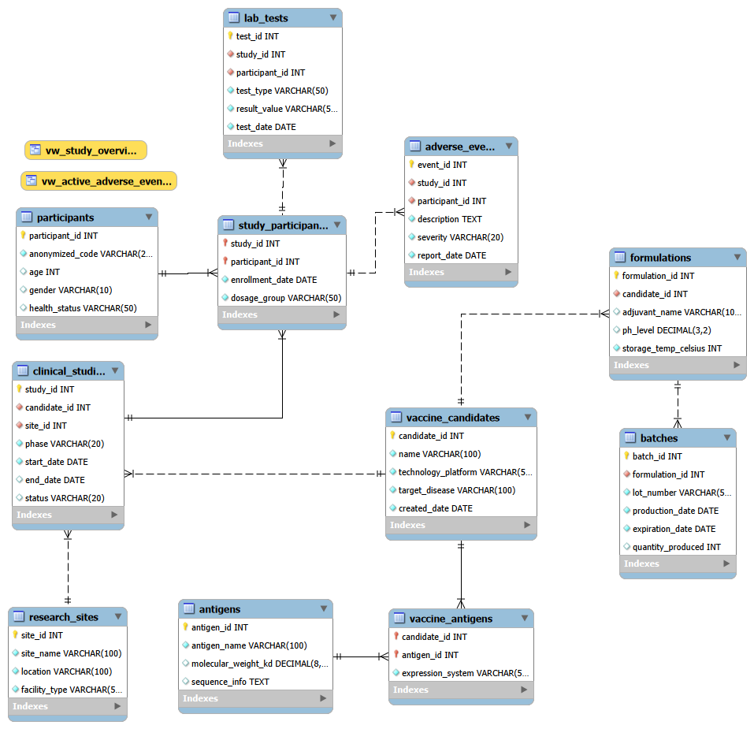
Relational Data Architecture
Biological Domain
Vaccine Candidates
Antigens
Formulations
Batches
Clinical Domain
Research Sites
Clinical Studies
Participants
Adverse Events
Lab Tests
11 Relational Tables
Primary & Foreign Key Relationships

Slide 6

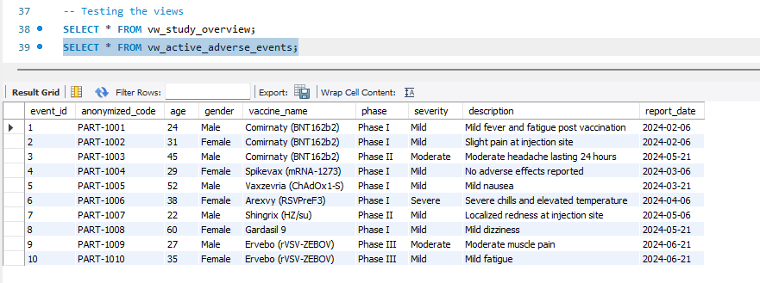
Clinical Safety Monitoring
Participant Anonymization
Generated anonymized identifiers
Adverse Event Tracking
Severity
Description
Report date
Safety Monitoring
Identify severe adverse events
Link events to studies and participants
Active Adverse Events View
Centralized safety information

Slide 7
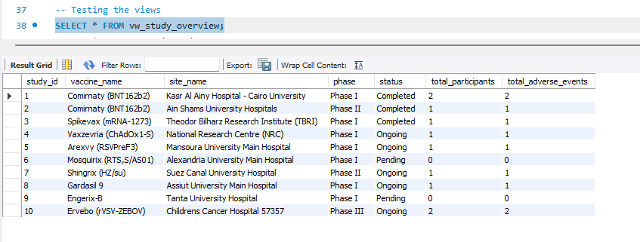
R&D Analytics & Trial Metrics
Participant Enrollment
Count participants per clinical study
Trial Monitoring
Active Phase I, II & III studies
Adverse Event Analysis
Filter severe reactions
Study Overview
Trial metrics
Candidate & site details
Enrollment and event counts

Slide 8
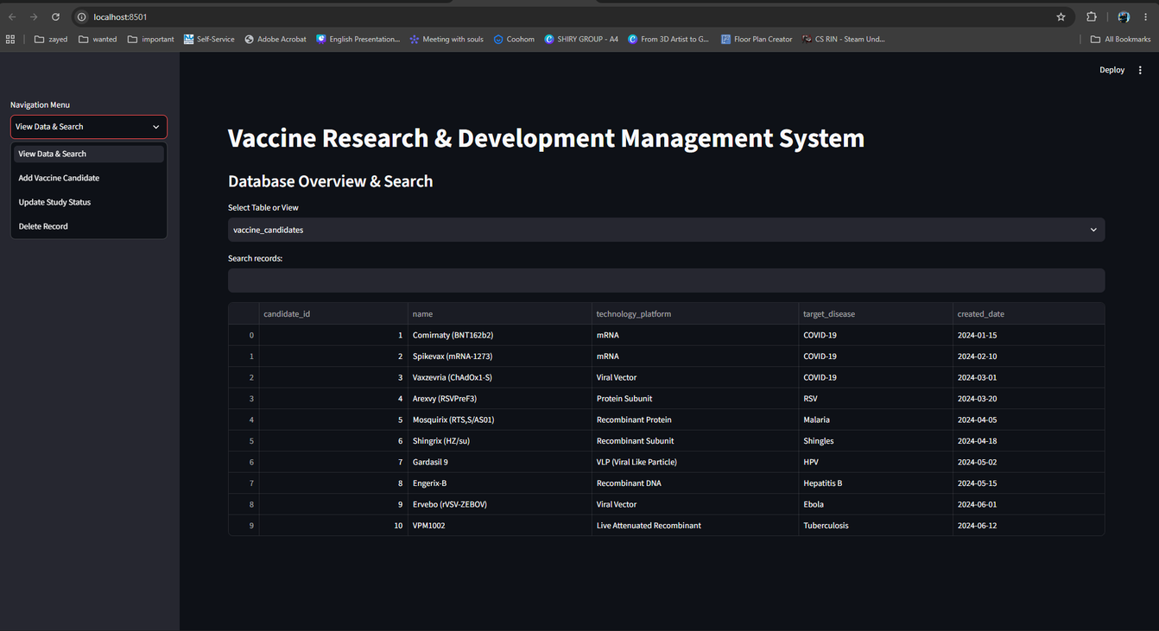
Interactive R&D Portal
User-Friendly Interface
No direct SQL knowledge required
Database Browsing
Search tables and views
CRUD Operations
Add
Update
Delete
Real-Time Integration
Changes are stored directly in MySQL
Data Verification
Confirm successful record insertion

Slide 9
Future Scope & Scalability
Database Scalability
Support additional vaccine candidates
Support additional clinical studies
Advanced Analytics
More SQL queries and relational views
Automated Business Logic
Expand stored procedures
Application Expansion
Extend Streamlit CRUD functionality
Multi-Study Management
Manage growing clinical trial datasets

Slide 10
Conclusion
Centralized R&D Database
Connects biological and clinical data
Supports clinical trial monitoring
Protects participant confidentiality
Enables adverse event analysis

Slide 11
Thank You
Questions?

