Slide 1
DATA ANALYSIS PROJECT
440,832
Customer Churn
Analysis
customers analysed
20
columns after cleaning and enrichment
15
Why customers leave, and who is most at risk
business questions answered

Slide 2
The data and our goal
440,832 subscription customers | 12 raw columns, one row per customer
Customer
Behavior
WHAT WE WANT TO REACH
customer_id unique ID
age 18 to 65
gender Male / Female
tenure months as a customer
usage_frequency how often they use the service
support_calls calls to support
payment_delay days late paying
last_interaction days since last contact
Understand why customers leave and who is most at risk
1
How big is the problem?
Contract & spend
subscription_type Basic / Standard / Premium
contract_length Monthly / Quarterly / Annual
total_spend total amount spent
2
What drives churn?
3
Who is most at risk?
Target
churn 1 = left, 0 = stayed
Then: targeted retention actions for the riskiest customers

Slide 3
Python: from raw file to clean data
PYTHON
440,833 × 12
1
0
12 → 20
rows and columns loaded
empty row removed
duplicates, 0 missing values
columns after 8 new ones
What I did
What I found
How it helped
Loaded the CSV with pandas and checked its shape and types
Standardized column names (lowercase, underscores)
Checked missing values and duplicate customer_id
Fixed data types (float to int) and cleaned the text columns
Checked impossible values: age, tenure, spend
Created 8 new columns: churn_label, 6 group columns, avg_monthly_spend
An almost clean file: one empty row, with no customer data, was removed
0 duplicate customers and 0 missing values left
All ranges are valid: age ≥ 18, tenure ≥ 1, spend ≥ 100
440,832 reliable customers, ready to analyse
Consistent names and types made the SQL queries simpler to write
Groups (age, tenure, spend, calls, delay, inactivity) let us compare segments instead of raw numbers
churn_label turns 1 and 0 into Churned and Stayed
One clean file, churn_clean.csv, feeds the SQL analysis

Slide 4
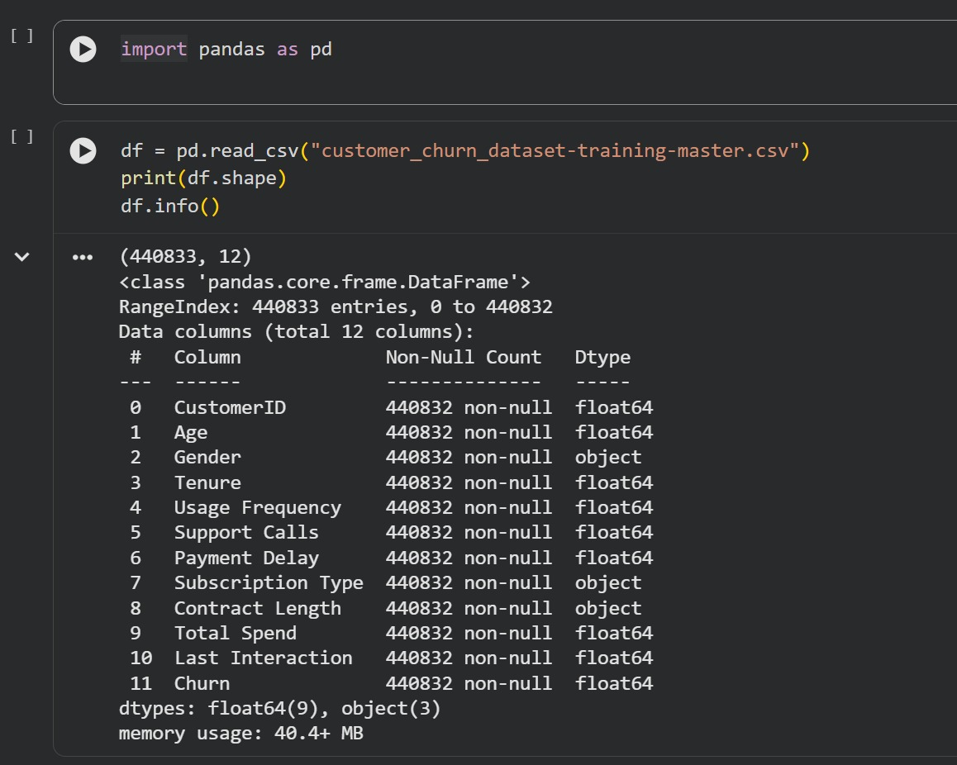
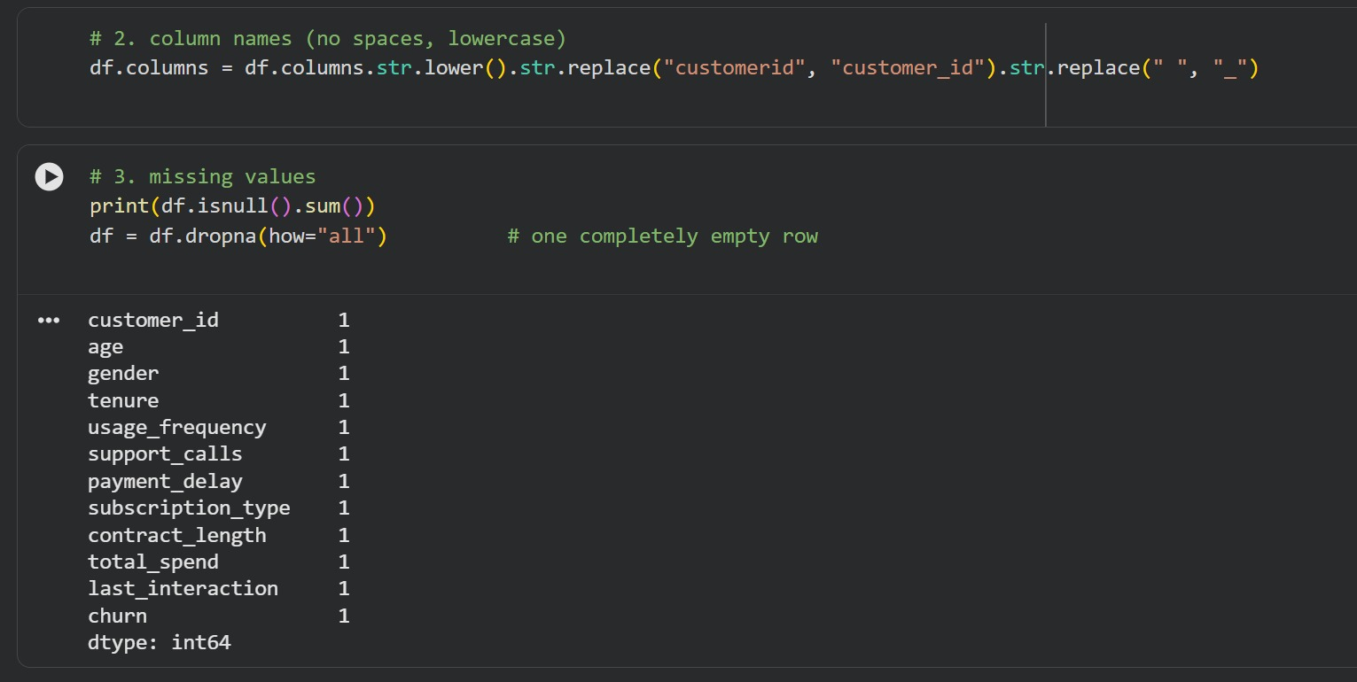
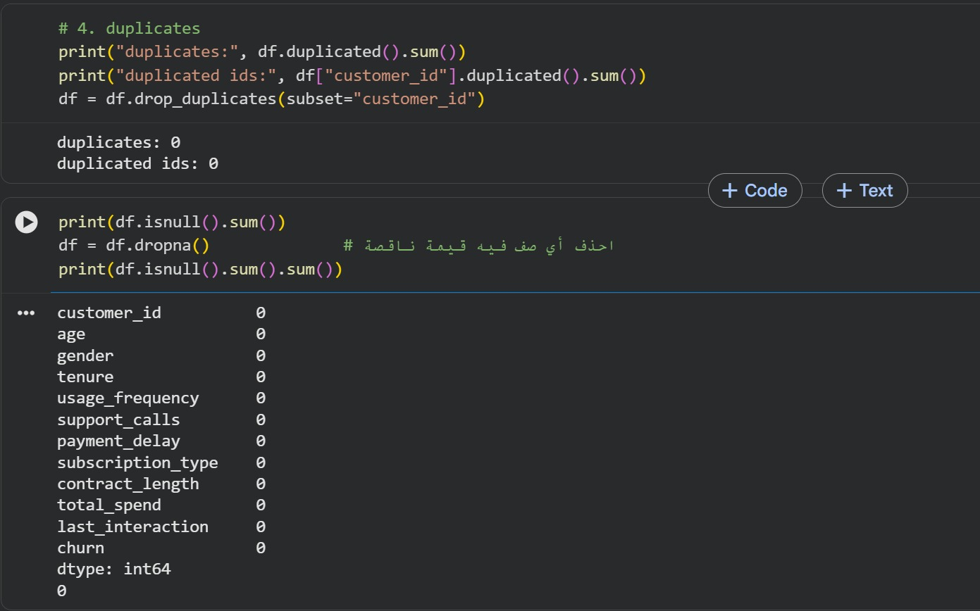
Python in action: loading & cleaning
PYTHON
Load & inspect the file → standardize column names → check duplicates and missing values

Slide 5
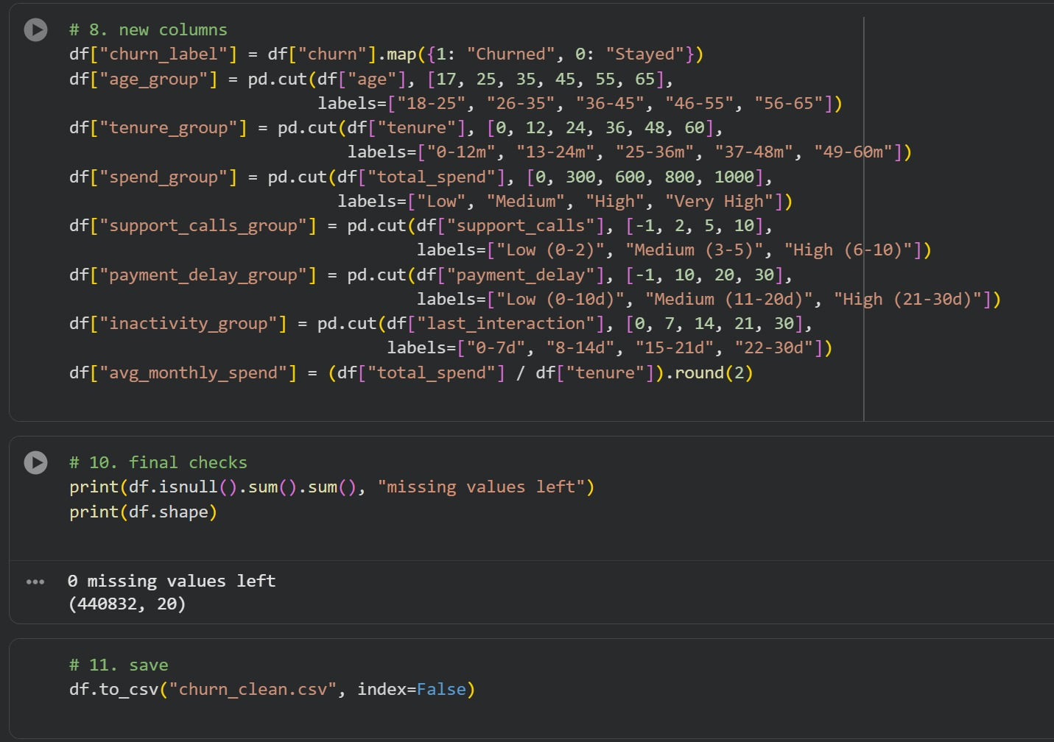
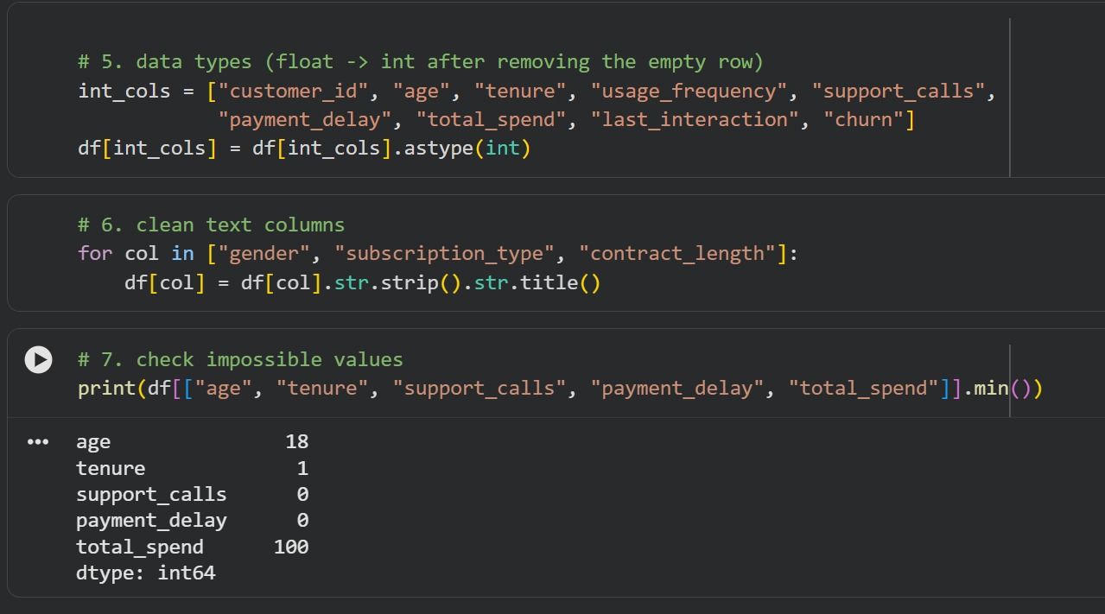
Python in action: types, new columns & export
PYTHON
Fix data types and text → check impossible values → create 8 new feature columns → save churn_clean.csv
440,832 × 20
Valid ranges
6 new groups
clean table, 0 missing values
age ≥ 18, tenure ≥ 1, spend ≥ 100
age, tenure, spend, support calls, payment delay, inactivity

Slide 6
From clean data to answers
SQL SERVER
churn_clean.csv is loaded into SQL Server, where 15 business questions answer the three goals
Python
→
SQL Server
→
Power BI
clean & enrich
15 business questions
interactive dashboard
The SQL analysis in four steps
1
2
3
4
Customer base
Churn overview
Churn drivers
Behaviour & risk
Q1 to Q4
Q5 to Q6
Q7 to Q9
Q10 to Q15
Who are our customers?
How big is the problem?
Does plan, contract or gender matter?
Calls, payments, spend, then risk levels

Slide 7
SQL: Customer base overview
SQL SERVER
Q1
Total number of customers
SQL Server Management Studio
1
2
3
4
5
create database customer_churn;
use customer_churn;
-- Total number of customers
SELECT COUNT(*) AS Total_Customers
FROM [churn_clean (3)];
Results
Messages
 | Total_Customers
1 | 440832
440,832 customers in the clean table
Query executed successfully.
customer_churn | 1 row
Q2
Customers by gender
SQL Server Management Studio
1
2
3
4
5
6
7
-- Customers by gender
SELECT
Gender,
COUNT(*) AS Customer_Count
FROM [churn_clean (3)]
GROUP BY Gender
ORDER BY Customer_Count DESC;
Results
Messages
 | Gender | Customer_Count
1 | Male | 250252
2 | Female | 190580
Male customers are the larger group (about 57%)
Query executed successfully.
customer_churn | 2 rows

Slide 8
SQL: Age and subscription plans
SQL SERVER
Q3
Average customer age
SQL Server Management Studio
1
2
3
-- Average customer age
SELECT ROUND(AVG(Age), 2) AS Average_Age
FROM [churn_clean (3)];
Results
Messages
 | Average_Age
1 | 39
The average customer is 39 years old
Query executed successfully.
customer_churn | 1 row
Q4
Customers per subscription type
SQL Server Management Studio
1
2
3
4
5
6
7
-- Customers per subscription type
SELECT
[subscription_type],
COUNT(*) AS Customer_Count
FROM [churn_clean (3)]
GROUP BY [subscription_type]
ORDER BY Customer_Count DESC;
Results
Messages
 | subscription_type | Customer_Count
1 | Standard | 149128
2 | Premium | 148678
3 | Basic | 143026
Customers are balanced across the three plans
Query executed successfully.
customer_churn | 3 rows

Slide 9
SQL: Churn overview
SQL SERVER
Q5
Customers who left vs. stayed
SQL Server Management Studio
1
2
3
4
5
6
-- Customers who left vs. stayed
SELECT
Churn,
COUNT(*) AS Customer_Count
FROM [churn_clean (3)]
GROUP BY Churn;
Results
Messages
 | Churn | Customer_Count
1 | 0 | 190833
2 | 1 | 249999
249,999 customers left, 190,833 stayed
Query executed successfully.
customer_churn | 2 rows
Q6
Overall churn rate
SQL Server Management Studio
1
2
3
4
5
6
7
-- Overall churn rate
SELECT
CAST(
100.0 * SUM(CASE WHEN Churn = 1 THEN 1 ELSE 0 END) / COUNT(*)
AS DECIMAL(5,2)
) AS Churn_Rate
FROM [churn_clean (3)];
Results
Messages
 | Churn_Rate
1 | 56.71
56.71% churn: more than half have already left
Query executed successfully.
customer_churn | 1 row

Slide 10
SQL: Churn by subscription plan
SQL SERVER
Q7
Does subscription type affect churn?
SQL Server Management Studio
1
2
3
4
5
6
7
8
9
10
11
12
-- Does subscription type affect churn?
SELECT
[Subscription_Type],
COUNT(*) AS Total_Customers,
SUM(CASE WHEN Churn = 1 THEN 1 ELSE 0 END) AS Churned_Customers,
CAST(
100.0 * SUM(CASE WHEN Churn = 1 THEN 1 ELSE 0 END) / COUNT(*)
AS DECIMAL(5,2)
) AS Churn_Rate
FROM [churn_clean (3)]
GROUP BY [Subscription_Type]
ORDER BY Churn_Rate DESC;
Results
Messages
 | Subscription_Type | Total_Customers | Churned_Customers | Churn_Rate
1 | Basic | 143026 | 83210 | 58.18
2 | Standard | 149128 | 83616 | 56.07
3 | Premium | 148678 | 83173 | 55.94
Query executed successfully.
customer_churn | 3 rows
KEY TAKEAWAY Plan type matters little: only about 2 points separate the three plans

Slide 11
SQL: Churn by contract length
SQL SERVER
Q8
Churn by contract length
SQL Server Management Studio
1
2
3
4
5
6
7
8
9
10
11
12
-- Churn by contract length
SELECT
[Contract_Length],
COUNT(*) AS Total_Customers,
SUM(CASE WHEN Churn = 1 THEN 1 ELSE 0 END) AS Churned_Customers,
CAST(
100.0 * SUM(CASE WHEN Churn = 1 THEN 1 ELSE 0 END) / COUNT(*)
AS DECIMAL(5,2)
) AS Churn_Rate
FROM [churn_clean (3)]
GROUP BY [Contract_Length]
ORDER BY Churn_Rate DESC;
Results
Messages
 | Contract_Length | Total_Customers | Churned_Customers | Churn_Rate
1 | Monthly | 87104 | 87104 | 100.00
2 | Annual | 177198 | 81646 | 46.08
3 | Quarterly | 176530 | 81249 | 46.03
Query executed successfully.
customer_churn | 3 rows
KEY TAKEAWAY Contract length is the strongest signal: every Monthly customer churned

Slide 12
SQL: Churn by gender
SQL SERVER
Q9
Is there a churn difference between males and females?
SQL Server Management Studio
1
2
3
4
5
6
7
8
9
10
11
12
-- Is there a churn difference between males and females?
SELECT
Gender,
COUNT(*) AS Total_Customers,
SUM(CASE WHEN Churn = 1 THEN 1 ELSE 0 END) AS Churned_Customers,
CAST(
100.0 * SUM(CASE WHEN Churn = 1 THEN 1 ELSE 0 END) / COUNT(*)
AS DECIMAL(5,2)
) AS Churn_Rate
FROM [churn_clean (3)]
GROUP BY Gender
ORDER BY Churn_Rate DESC;
Results
Messages
 | Gender | Total_Customers | Churned_Customers | Churn_Rate
1 | Female | 190580 | 127058 | 66.67
2 | Male | 250252 | 122941 | 49.13
Query executed successfully.
customer_churn | 2 rows
KEY TAKEAWAY Women churn about 17.5 points more than men

Slide 13
SQL: Support calls and payment delay
SQL SERVER
Q10
Are more support calls linked to churn?
SQL Server Management Studio
1
2
3
4
5
6
-- Are more support calls linked to churn?
SELECT
Churn,
ROUND(AVG([support_calls]), 2) AS Average_Support_Calls
FROM [churn_clean (3)]
GROUP BY Churn;
Results
Messages
 | Churn | Average_Support_Calls
1 | 0 | 1
2 | 1 | 5
Churned customers called support 5 times on average vs 1
Query executed successfully.
customer_churn | 2 rows
Q11
Is payment delay linked to churn?
SQL Server Management Studio
1
2
3
4
5
6
-- Is payment delay linked to churn?
SELECT
Churn,
ROUND(AVG([payment_delay]), 2) AS Average_Payment_Delay
FROM [churn_clean (3)]
GROUP BY Churn;
Results
Messages
 | Churn | Average_Payment_Delay
1 | 0 | 10
2 | 1 | 15
Churned customers paid 15 days late on average vs 10
Query executed successfully.
customer_churn | 2 rows

Slide 14
SQL: Tenure and total spend
SQL SERVER
Q12
Do longer-tenured customers churn less?
SQL Server Management Studio
1
2
3
4
5
6
-- Do longer-tenured customers churn less?
SELECT
Churn,
ROUND(AVG(Tenure), 2) AS Average_Tenure
FROM [churn_clean (3)]
GROUP BY Churn;
Results
Messages
 | Churn | Average_Tenure
1 | 0 | 32
2 | 1 | 30
Tenure is similar (32 vs 30 months): a weak signal
Query executed successfully.
customer_churn | 2 rows
Q13
Do higher-spending customers churn less?
SQL Server Management Studio
1
2
3
4
5
6
-- Do higher-spending customers churn less?
SELECT
Churn,
CAST(AVG([total_spend]) AS DECIMAL(10,2)) AS Average_Total_Spend
FROM [churn_clean (3)]
GROUP BY Churn;
Results
Messages
 | Churn | Average_Total_Spend
1 | 0 | 749.47
2 | 1 | 541.18
Churned customers spent less: 541.18 vs 749.47
Query executed successfully.
customer_churn | 2 rows

Slide 15
SQL: Last interaction
SQL SERVER
Q14
Does a longer gap since last interaction raise churn?
SQL Server Management Studio
1
2
3
4
5
6
-- Does a longer gap since last interaction raise churn?
SELECT
Churn,
CAST(AVG([last_interaction]) AS DECIMAL(10,2)) AS Average_Last_Interaction
FROM [churn_clean (3)]
GROUP BY Churn;
Results
Messages
 | Churn | Average_Last_Interaction
1 | 0 | 13.00
2 | 1 | 15.00
Query executed successfully.
customer_churn | 2 rows
KEY TAKEAWAY Churned customers went longer without contact: 15 days on average vs 13 for those who stayed

Slide 16
SQL: Risk levels
SQL SERVER
Q15
Customers per risk level
SQL Server Management Studio
1
2
3
4
5
6
7
8
9
10
11
12
13
-- Customers per risk level
SELECT Risk_Level, COUNT(*) AS Customer_Count
FROM (
SELECT
CASE
WHEN [support_calls] >= 8 AND [payment_delay] >= 15 THEN 'High Risk'
WHEN [support_calls] >= 5 OR [payment_delay] >= 10 THEN 'Medium Risk'
ELSE 'Low Risk'
END AS Risk_Level
FROM [churn_clean (3)]
) AS Risk_Table
GROUP BY Risk_Level
ORDER BY Customer_Count DESC;
Results
Messages
 | Risk_Level | Customer_Count
1 | Medium Risk | 281265
2 | Low Risk | 122819
3 | High Risk | 36748
Query executed successfully.
customer_churn | 3 rows
KEY TAKEAWAY 36,748 High Risk customers (calls ≥ 8 and delay ≥ 15) are the first retention target

Slide 17
Key findings and what to do
56.71%
100%
66.7% vs 49.1%
overall churn rate
of Monthly contracts churned
women vs men churn rate
249,999 of 440,832 customers left
all 87,104 Monthly customers left
about 17.5 points higher for women
→ Retention should be the top priority
→ Offer incentives to move to longer contracts
→ Look into why women leave more
5 vs 1
541 vs 749
36,748
avg support calls
avg total spend
High Risk customers
churned vs stayed customers
churned vs stayed customers
calls ≥ 8 and payment delay ≥ 15 days
→ Flag customers with many support calls early
→ Watch low-spend customers closely
→ Contact them first
Next: exploring these findings interactively in the Power BI dashboard

Slide 18
NEXT: LIVE DASHBOARD
From numbers to an
interactive dashboard
The same three questions, now with filters you can click: how big is the problem, what drives it, who is at risk
1
Overview
2
Risk Drivers
3
Weak Factors
The big picture: churn rate, age group, gender and the revenue of churned customers
What pushes customers out: contract, support calls, payment delay, spend, risk levels
What does not matter: subscription plan, tenure, usage frequency
Switching to Power BI

