Slide 1
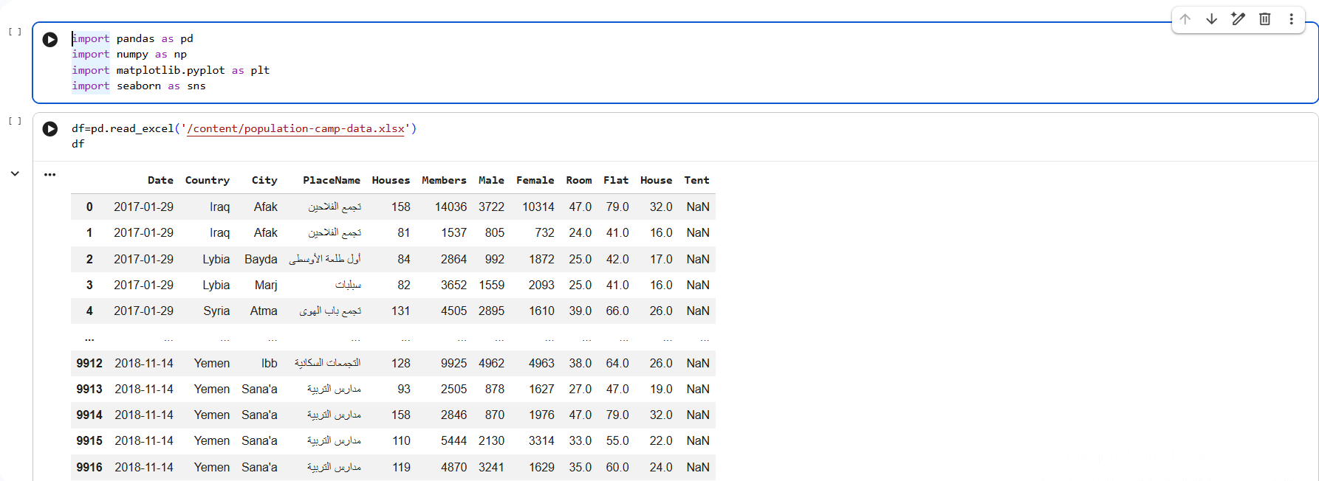
01
Loading the Data
PYTHON
Importing the camp dataset with pandas, NumPy, Matplotlib and Seaborn
Population & Camp Analytics | Excel · Python
04 / 11

Slide 2
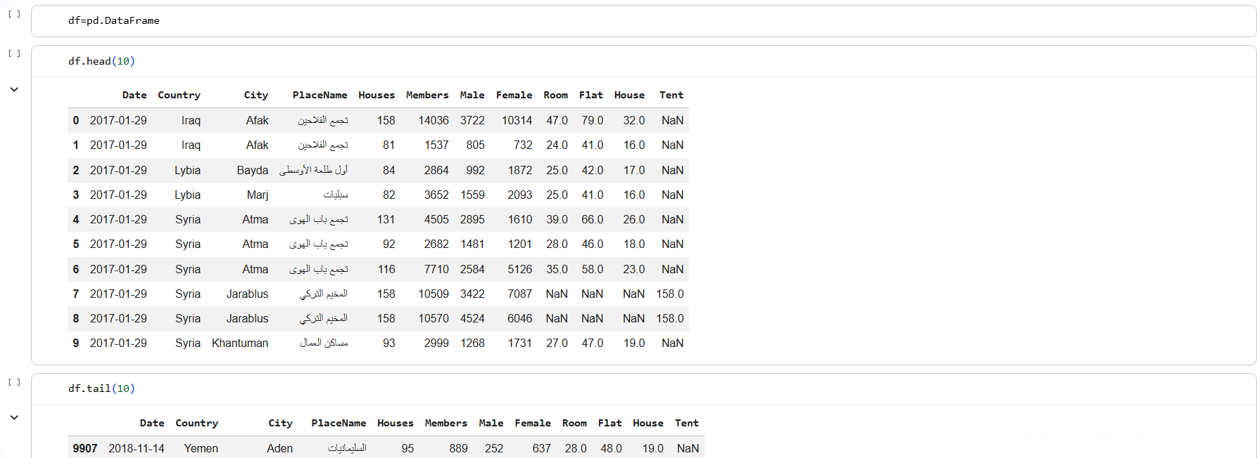
02
Data Preview
PYTHON
First and last records of the dataset, January 2017 to November 2018
Population & Camp Analytics | Excel · Python
05 / 11

Slide 3
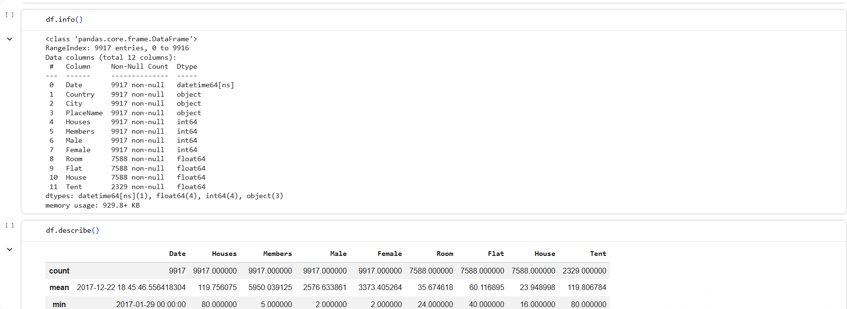
03
Structure & Statistics
PYTHON
9,917 records across 12 columns, with data types and descriptive statistics
Population & Camp Analytics | Excel · Python
06 / 11

Slide 4
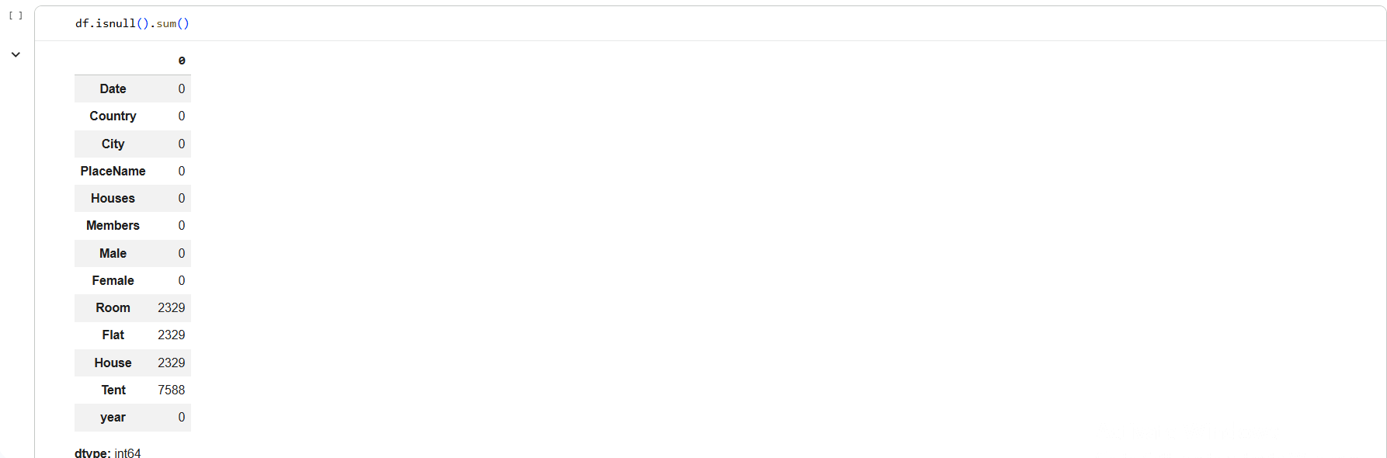
04
Missing-Values Audit
PYTHON
Null count per column: gaps appear only in Room, Flat, House and Tent
Population & Camp Analytics | Excel · Python
07 / 11

Slide 5
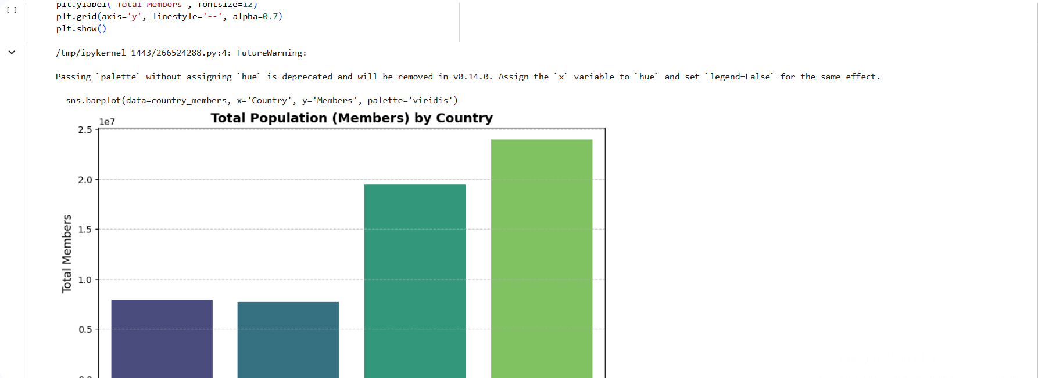
05
Population by Country
PYTHON
Total members per country, shown as a Seaborn bar chart
Population & Camp Analytics | Excel · Python
08 / 11

Slide 6
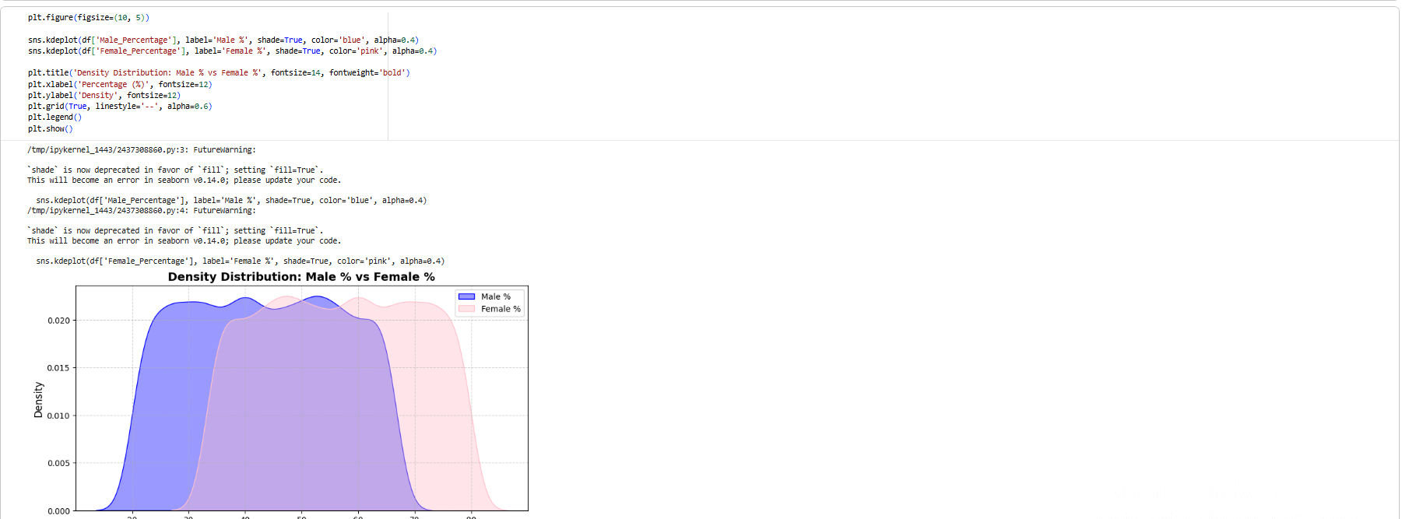
06
Gender Distribution
PYTHON
Density of male % vs female % across camp records
Population & Camp Analytics | Excel · Python
09 / 11

Slide 7
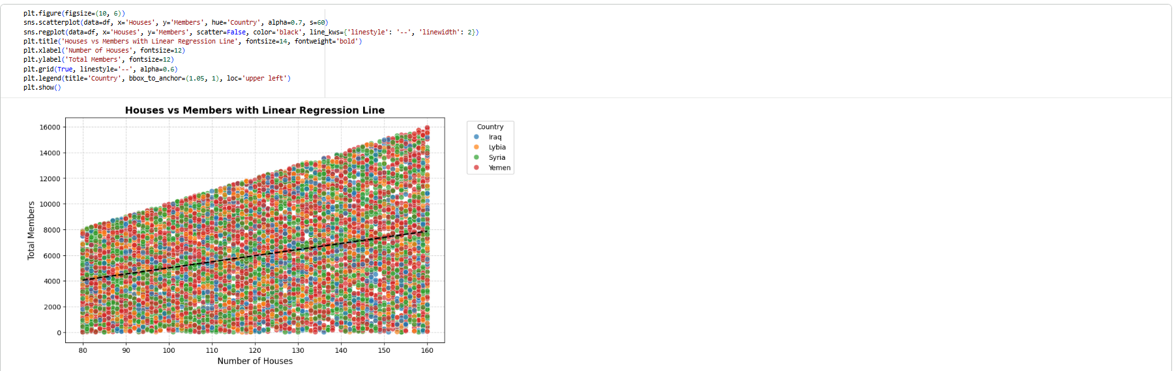
07
Houses vs Members
PYTHON
Scatter plot by country with a linear regression line
Population & Camp Analytics | Excel · Python
10 / 11

Slide 8
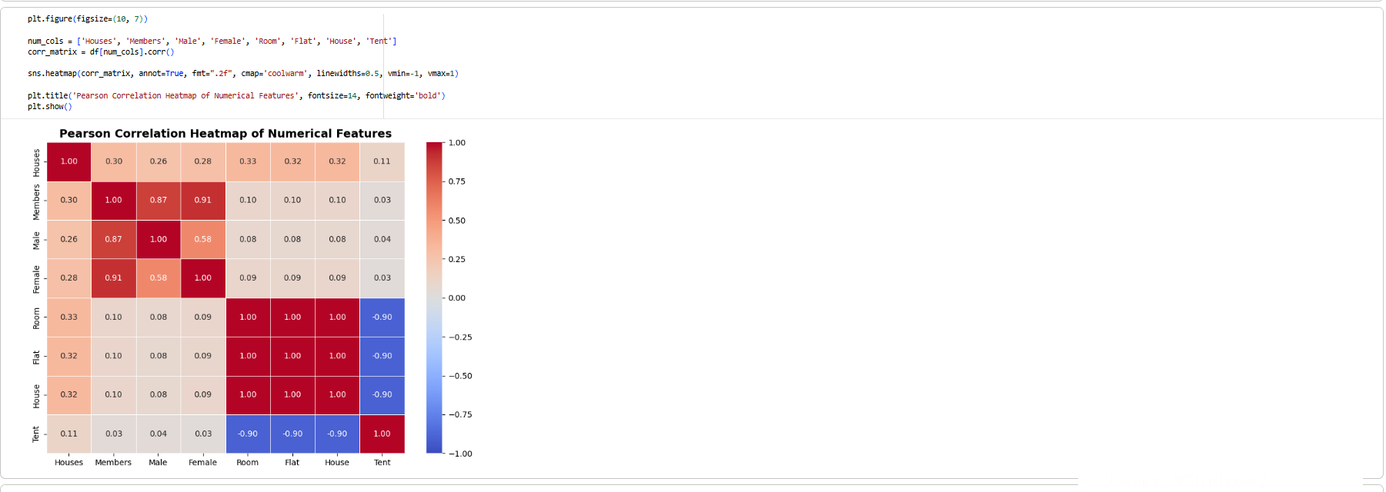
08
Correlation Analysis
PYTHON
Pearson correlation heatmap of the numerical features
Population & Camp Analytics | Excel · Python
11 / 11

Slide 9
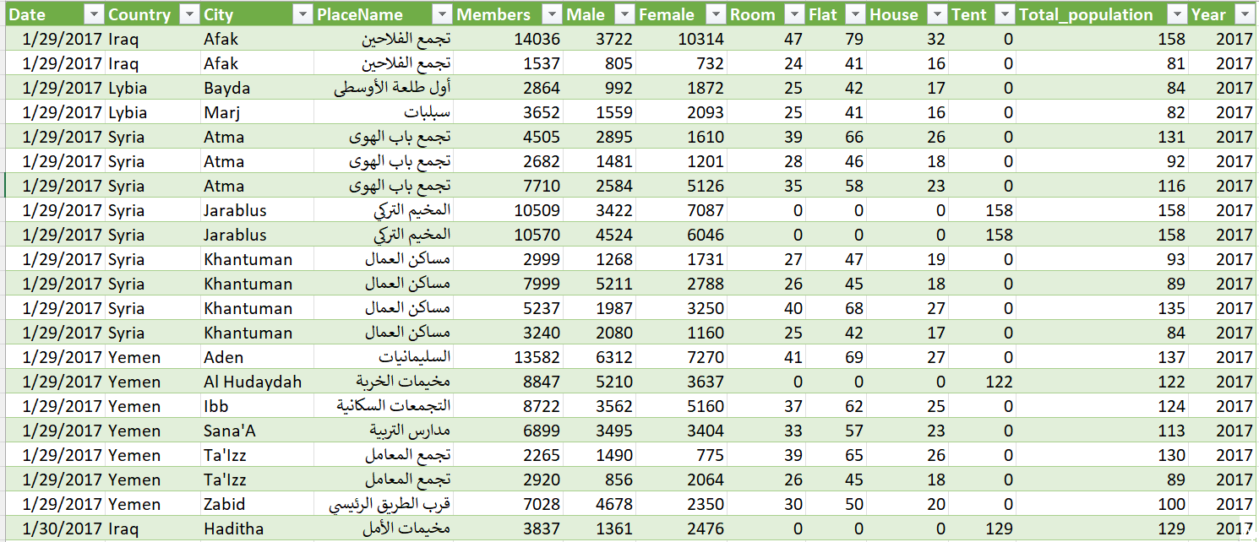
09
Source Dataset
EXCEL
Population & camp records by country, city and site, 2017–2018
Population & Camp Analytics | Excel · Python
01 / 11

Slide 10
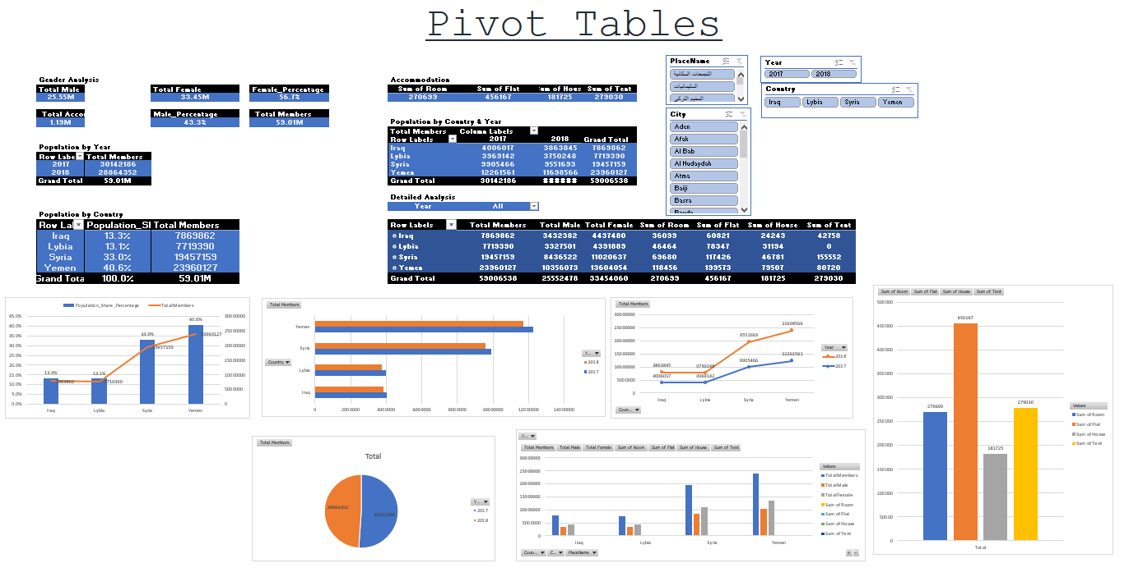
10
PivotTable Analysis
EXCEL
Population by year, country and accommodation type, with interactive slicers
Population & Camp Analytics | Excel · Python
02 / 11

Slide 11
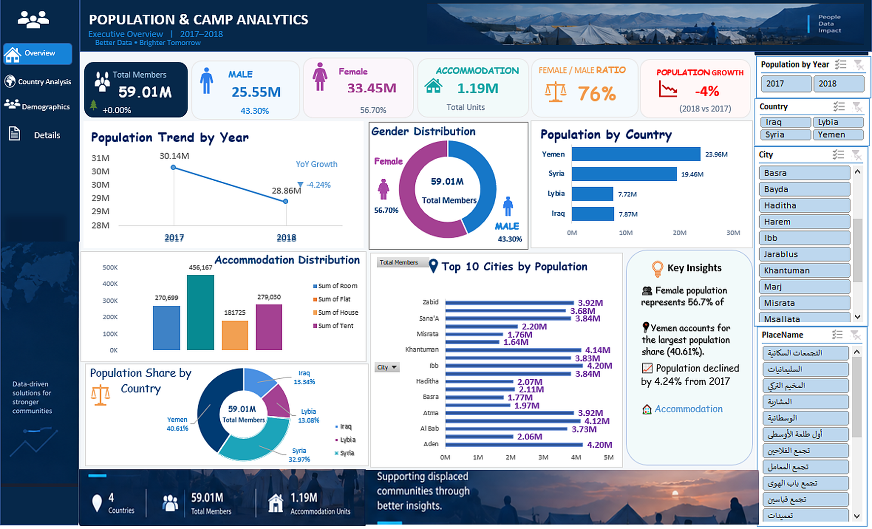
11
Interactive Dashboard
EXCEL
KPIs, gender split and rankings, filterable by year, country, city and site
Population & Camp Analytics | Excel · Python
03 / 11

