Slide 1

Sales Performance Dashboard
NEXORA RETAIL GROUP (Fictional) • Power BI | Sales Analytics
PORTFOLIO CASE STUDY

Slide 2
Project Overview
01
A compact end-to-end retail analytics case study.
01
02
03
04
Transform
Model
Analyze
Visualize
Clean and standardize the retail dataset
Build a reusable star schema
Create DAX KPIs and comparisons
Communicate findings in Power BI
Project scope
DATASET
PERIOD
U.S. retail sales
2015–2018
ROWS / COLUMNS
FOCUS
9,800 / 18
Sales • Customers • Products • Segments • Regions • Shipping
NEXORA RETAIL GROUP • Fictional Portfolio Project
2

Slide 3
Data Preparation & Modeling
02
From raw rows to an analysis-ready star schema.
Raw CSV
Clean
Transform
Validate
→
→
→
9,800 rows
18 columns
Types • text
missing values
Shipping Days
Product Key
Duplicates • quality
checks
Star schema
DimCustomer
FactSales
DimDate
793 rows
Dedicated date table
Orders • Sales • Shipping • Geography
DimProduct
1,893 keys
11 missing Postal Code values were replaced with “Unknown”; Shipping Days = Ship Date − Order Date.
NEXORA RETAIL GROUP • Fictional Portfolio Project
3

Slide 4
KPI & DAX Framework
03
Five core measures anchor the dashboard.
TOTAL SALES
TOTAL ORDERS
TOTAL CUSTOMERS
AVERAGE ORDER VALUE
AVERAGE SHIPPING
$2.26M
4,922
793
$459.48
3.96 days
Measure framework
Total Sales
SUM(FactSales[Sales])
Total Orders
DISTINCTCOUNT(FactSales[Order ID])
Total Customers
DISTINCTCOUNT(FactSales[Customer ID])
Average Order Value
DIVIDE([Total Sales],[Total Orders])
Avg Shipping Days
AVERAGE(FactSales[Shipping Days])
Validated against the project dashboard totals.
NEXORA RETAIL GROUP • Fictional Portfolio Project
4

Slide 5
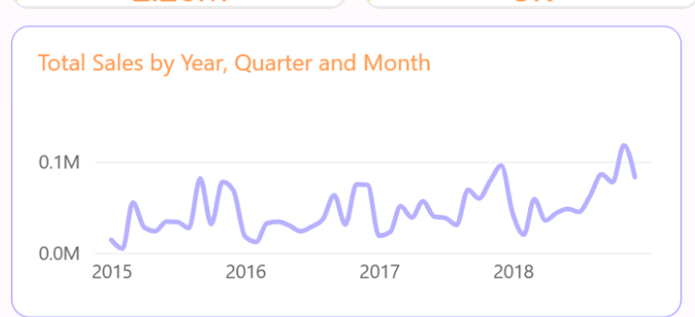
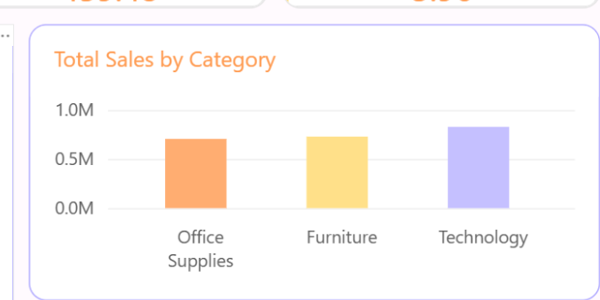
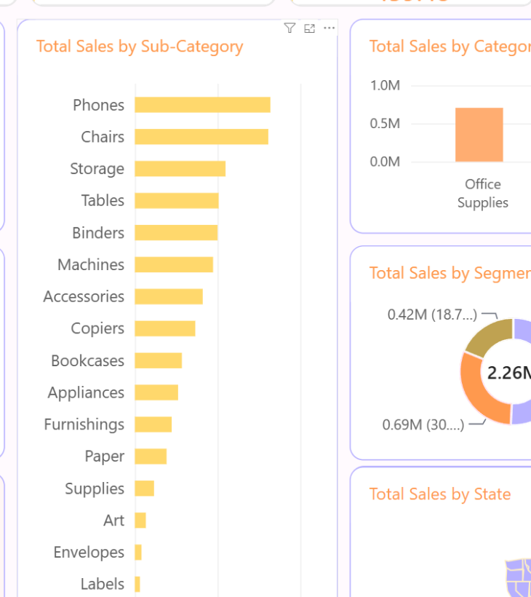
Sales & Product Performance
04
Observed sales patterns across time, categories and sub-categories.
Verified product findings
Technology
Highest-performing category
Furniture
Second in category ranking
Office Supplies
Third in category ranking
Phones
Top sub-category in the dashboard
NEXORA RETAIL GROUP • Fictional Portfolio Project
5

Slide 6
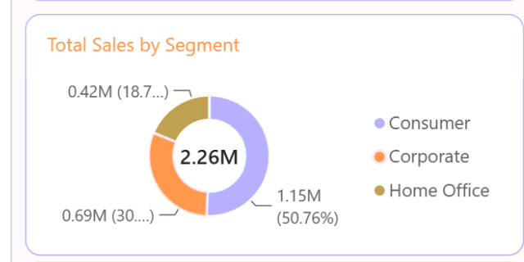
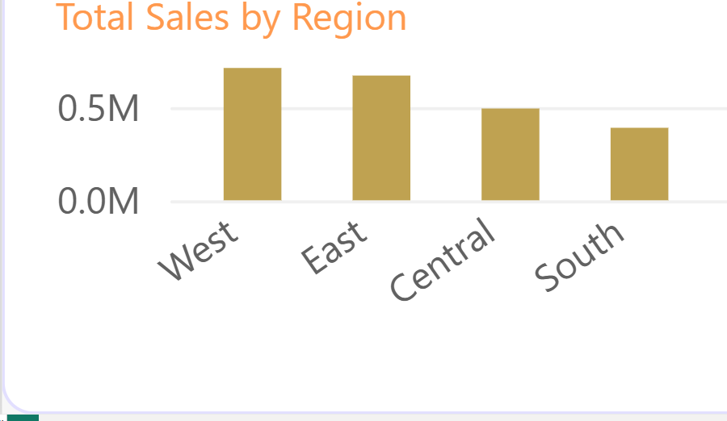
Customer & Regional Performance
05
Who contributes to sales — and where?
Customer segment
Regional ranking
Consumer is the largest segment in the dashboard.
1 West
2 East
3 Central
4 South
NEXORA RETAIL GROUP • Fictional Portfolio Project
6

Slide 7
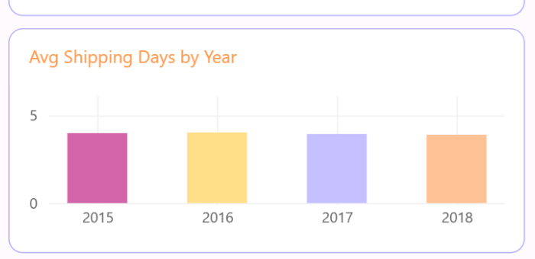
Category × Region & Shipping
06
Two complementary views: cross-region category comparison and shipping duration.
Category × Region
Category
Central
East
South
West
Furniture
160,317
206,461
116,531
—
Office Supplies
163,590
199,941
124,425
—
The visible project matrix supports direct category/region comparison; “—” is intentionally left where the supplied screenshot did not show a West value.
Shipping Days
Range
0–7 days
Average
3.96 days
NEXORA RETAIL GROUP • Fictional Portfolio Project
7

Slide 8
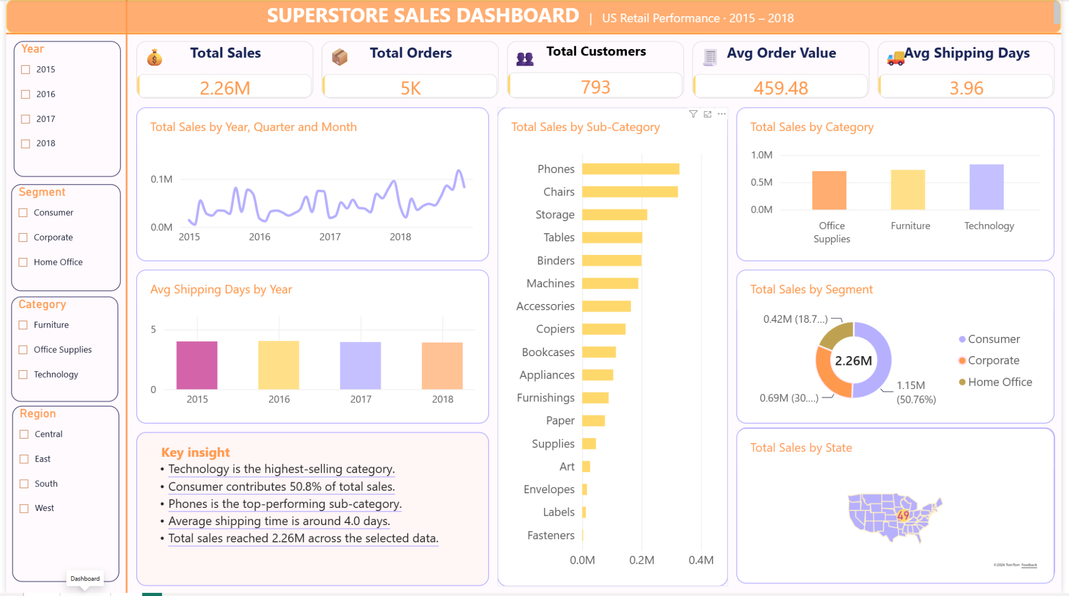
Power BI Dashboard Walkthrough
07
The dashboard combines KPI cards, trends, product, segment and geography views.
KPI cards
Sales trend
Product analysis
Segment analysis
Regional map
Interactive slicers
The supplied dashboard screenshot is shown at full aspect ratio to avoid cropping.
NEXORA RETAIL GROUP • Fictional Portfolio Project
8

Slide 9
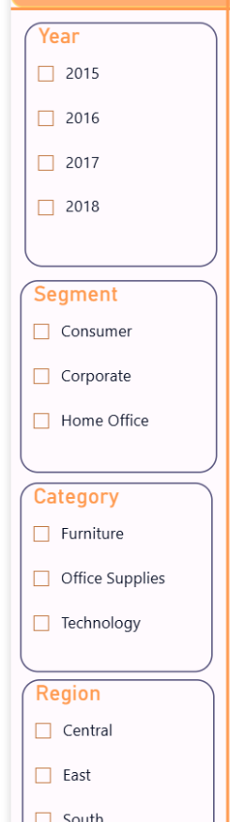
Interactivity & Key Insights
08
Key data observations
Interactive filters
$2.26M
Total sales
4,922
Distinct orders
793
Distinct customers
$459.48
Average order value
3.96 days
Average shipping
Technology
Highest category
Available slicers
Consumer
Largest segment
West
Highest region
Year
Region
Segment
NEXORA RETAIL GROUP • Fictional Portfolio Project
9

Slide 10
Final Takeaways
09
A complete Power BI workflow — presented as a portfolio case study.
Data
Model
DAX
Dashboard
Transformed and validated
Structured star schema
Core KPI measures
Interactive sales storytelling
Transform
→
Model
→
Analyze
→
Visualize
Power BI • Power Query • DAX • Data Visualization
Thank you
NEXORA RETAIL GROUP • Fictional Portfolio Project
10

