Slide 1
GRADUATION PROJECT
AI Resume Matcher
Matching Candidates to Jobs with Semantic AI — from Raw Data to a Deployed App
Prepared By
1
Rama Ali Taha
2
Shahd Elsayed Hosny
3
Rawan Abdelhamid
AI Resume Matcher
1

Slide 2
STEP 1 · GETTING STARTED
The Dataset & Importing Libraries
About the Dataset
Importing Libraries
all_job_post.csv
pandas & numpy — data loading and manipulation
1,167
5
ast — parse the stored skill-set strings into lists
Rows (job postings)
Columns
sentence-transformers (SentenceTransformer, util) — semantic embeddings & similarity
torch — tensor computation behind the model
Columns: job_id, category, job_title, job_description, job_skill_set
streamlit — build the interactive web app
Real job postings spanning 5 categories — IT, Business Development, Finance, Sales, and HR — each with a full description and a required-skills list. This is the pool of jobs a candidate's CV is matched against.
pdfplumber — extract text from an uploaded CV (PDF)
pyngrok — expose the app with a public URL
AI Resume Matcher
2

Slide 3
STEP 2 · UNDERSTANDING THE DATA
Data Exploration & Preparing
Exploration
Preparing
Functions used to get to know the data before touching it:
Turning the raw columns into clean, usable data:
.shape — 1,167 rows × 5 columns
jobs.drop(columns=["job_id"]) — removed, not useful for modelling
.head() / .tail() — first & last rows
.info() — column types & non-null counts
.describe() — quick statistical summary
tech_jobs = jobs[jobs.category == "INFORMATION-TECHNOLOGY"] — example category filter
.duplicated().sum() — check for duplicate rows
.isnull().sum() — check for missing values
.value_counts() — most common job titles / categories
jobs["job_skill_set"].apply(ast.literal_eval) — converts the stored text into a real Python list of skills, ready to compare against a CV
.unique() — the list of distinct categories
AI Resume Matcher
3

Slide 4
STEP 3 · BUILDING THE SYSTEM
Modeling, Encoding & Deployment
Modeling
Encoding
Deployment
SentenceTransformer(
"paraphrase-MiniLM-L3-v2")
job_embeddings = model.encode(job_description list)
pip install streamlit, pyngrok, pdfplumber
cv_embedding = model.encode(cv_text)
app.py written with %%writefile
Used first for experimentation in the notebook.
similarities = util.cos_sim(cv, jobs)
ngrok.set_auth_token(...)
Deployed app upgraded to
"all-MiniLM-L6-v2" for better accuracy.
best_index / best_job selected
streamlit run app.py --server.port 8501
matched vs. missing skills + skills_score
ngrok.connect(8501) → public URL
Together, these three stages take the notebook's logic and turn it into a live app: the model embeds text into vectors, encoding compares a CV against every job, and deployment makes it accessible through a shareable link.
AI Resume Matcher
4

Slide 5
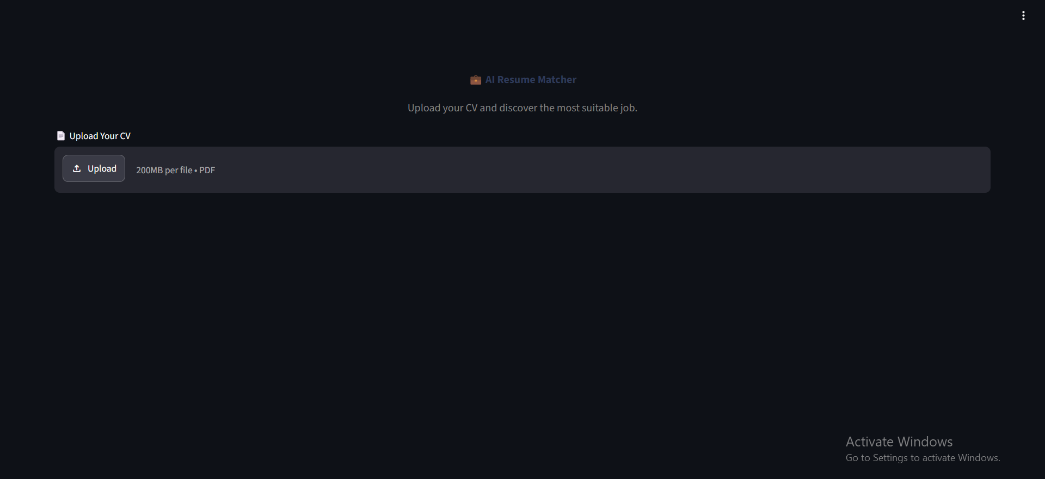
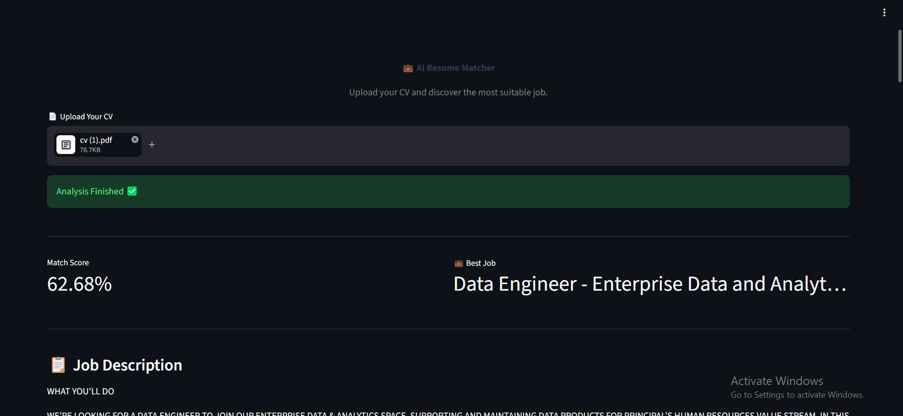
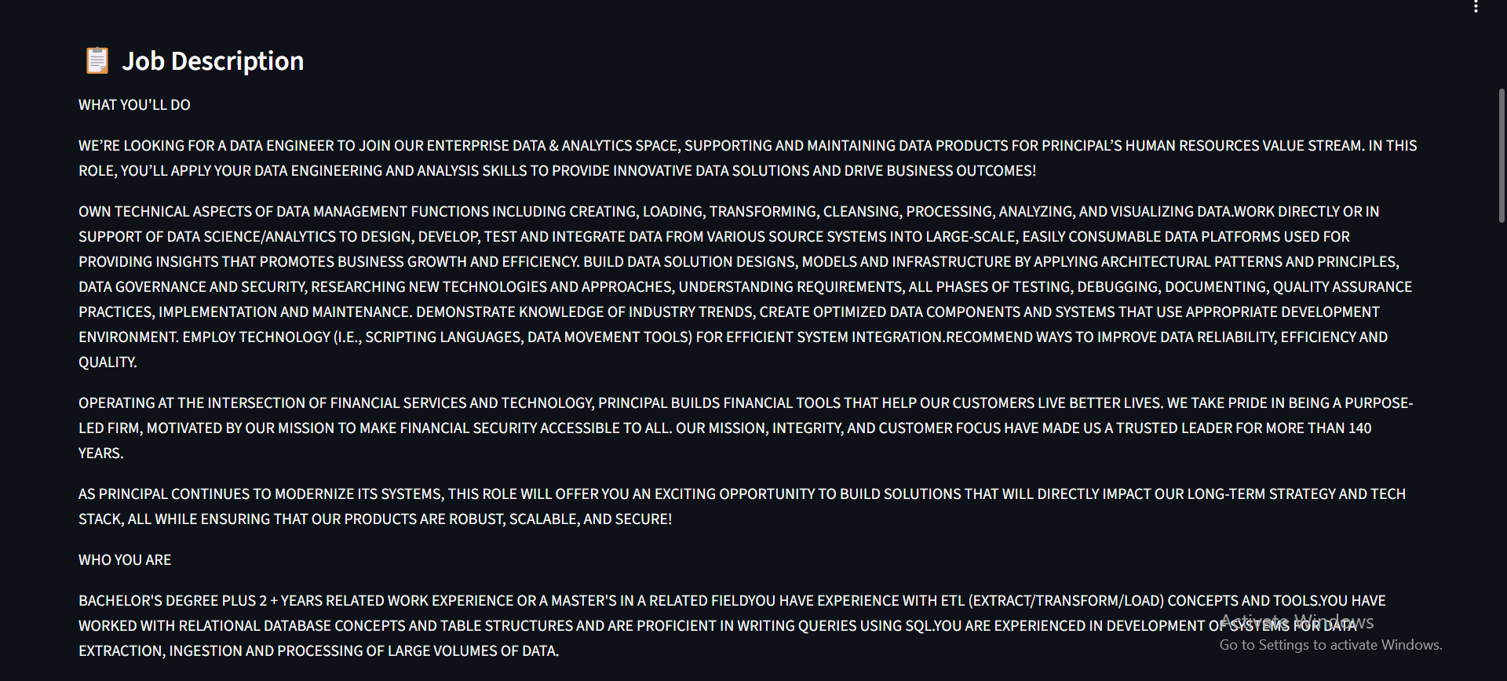
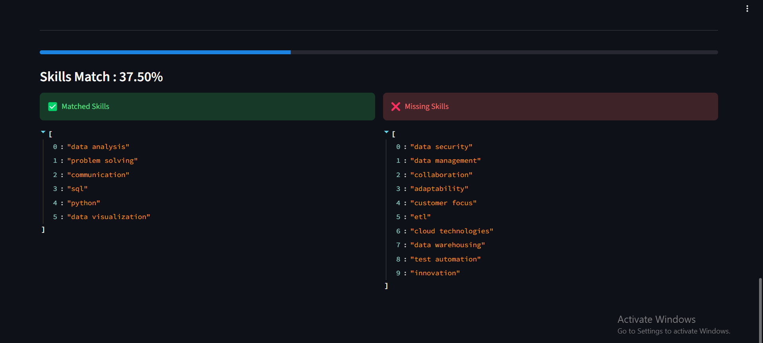
RESOURCES & LIVE DEMO
Notebook & The App in Action
Full Notebook:
https://drive.google.com/file/d/14dWPiErSkSPpa8ub6QcGOHSiabe0eIYW/view?usp=drive_link
Upload screen
Match score & best job
Full job description
Matched vs. missing skills
A fully working Streamlit application: upload a CV, get the best-matching job, and see exactly which skills to work on.
Thank You
Questions welcome
AI Resume Matcher
5

