Slide 1



Slide 2

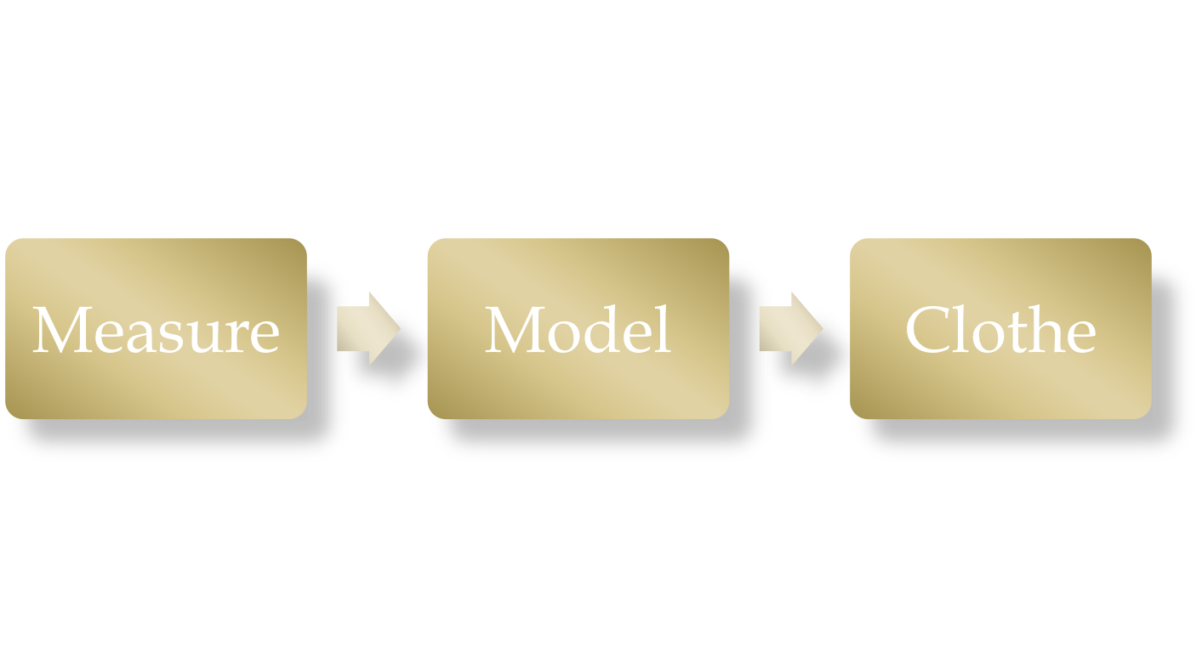

Slide 3

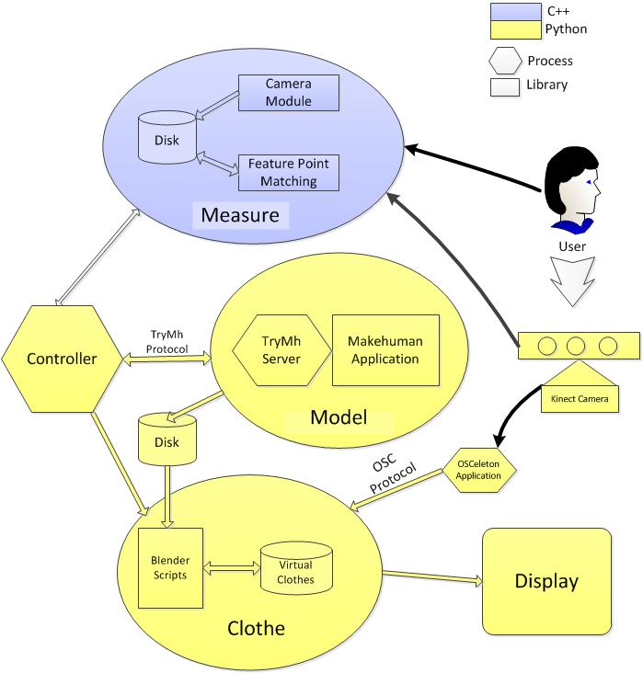

Slide 4

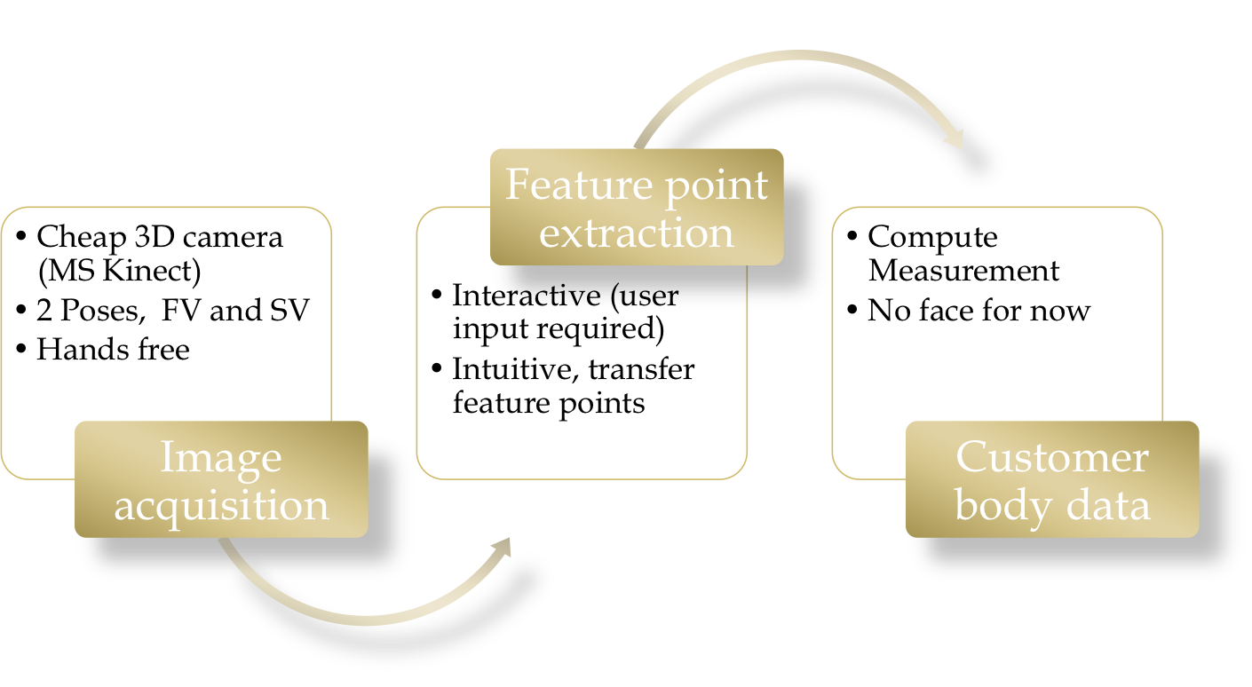

Slide 5

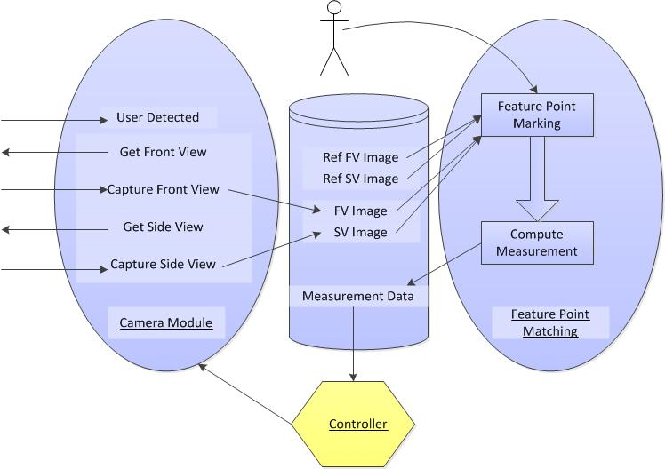

Slide 6

Underlying engine is makehuman application
Makehuman cant handle direct measurements
Try Plugin
Works in 2 phases
Offline phase (Measure all variations)
Online Phase, Search for best fit
Or use binary search, (currently deprecated)

Slide 7

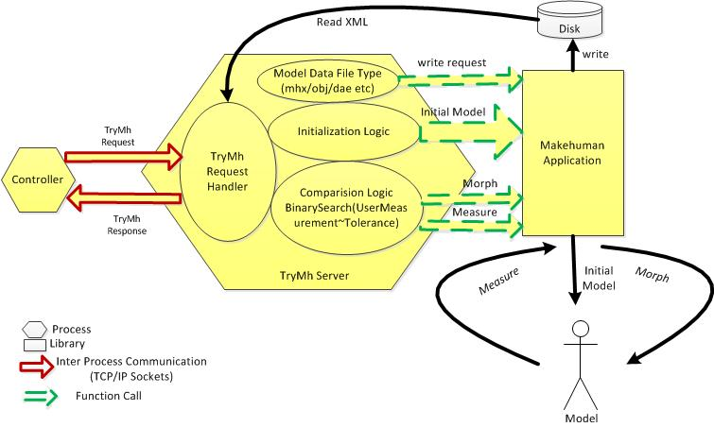

Slide 8


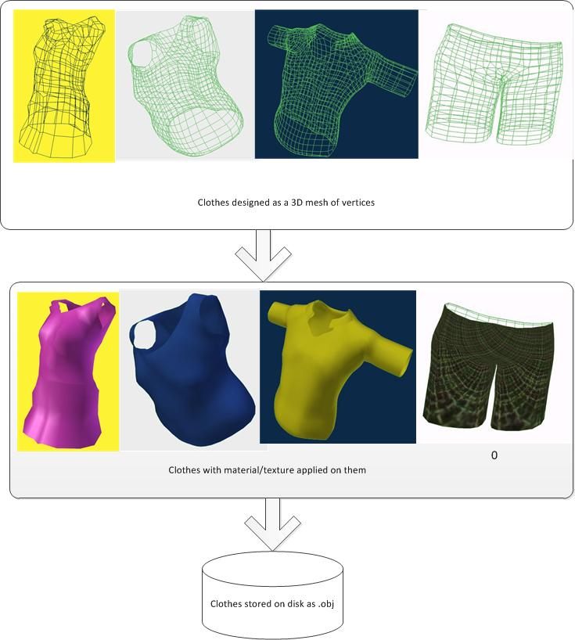

Slide 9

Static
Animated
Gesture mimic (incomplete)

Slide 10

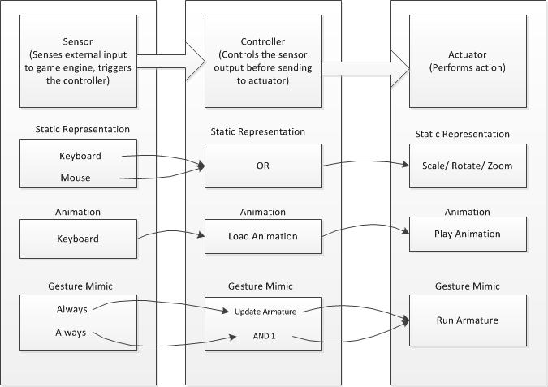

Slide 11
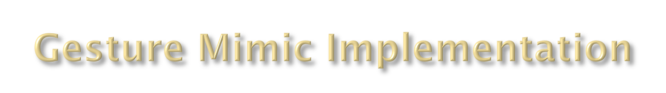
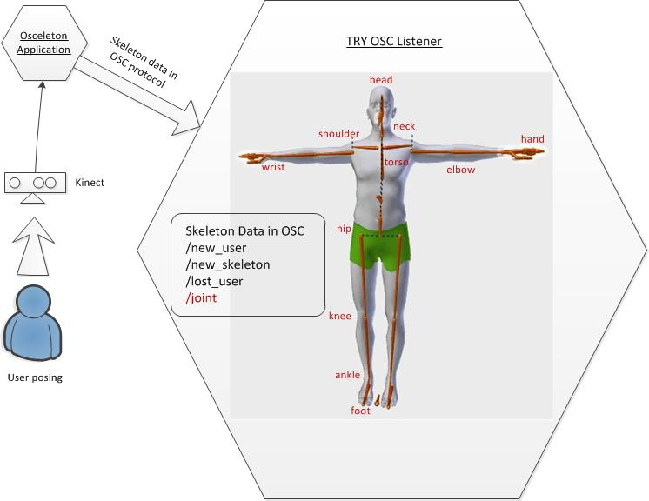

Slide 12

Measure (OpenCv, OpenNI )
Model ( Makehuman + Blender)
Cloth simulation (Blender)
Presentation (Blender)
Development C++, Qt, Python

Slide 13

Code reuse ( 3 levels: App, Lib, Snippets )
Headaches of broad scope
Vast array of technologies and tools (Blender,OpenCV, OpenGL, OpenNI, OpenCL
Qt, Python, 3D Graphics)
Experience Reuse. Forums StackOverflow, makehuman
Integrating different code bases, (cons of Code reuse)

Slide 14


