Slide 1



Slide 2

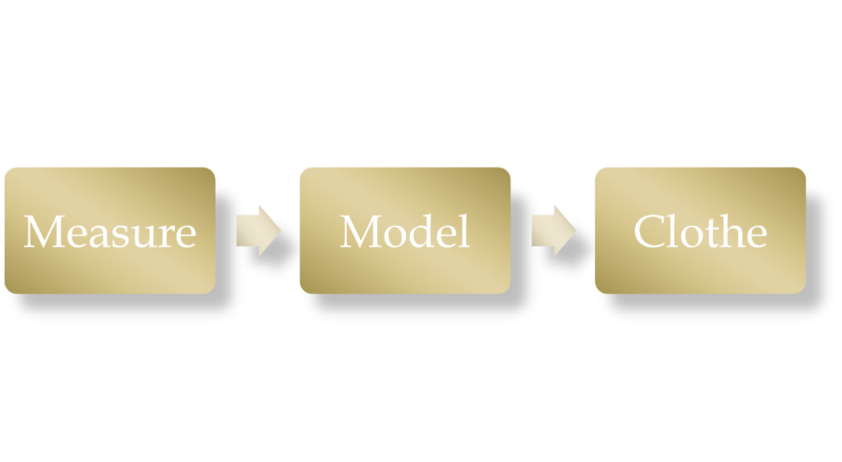

Slide 3

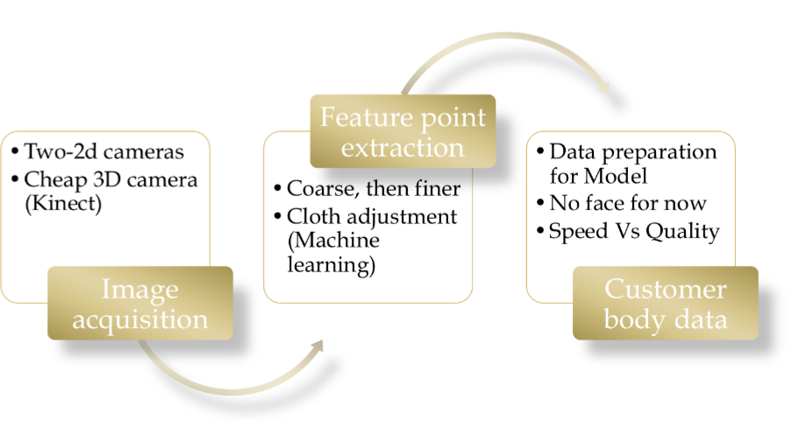

Slide 4

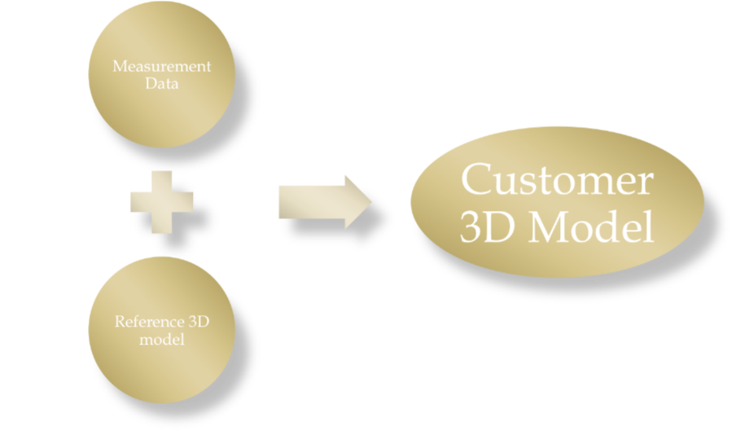

Slide 5

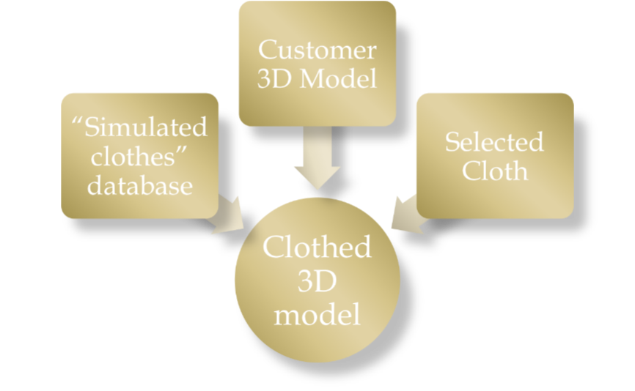

Slide 6

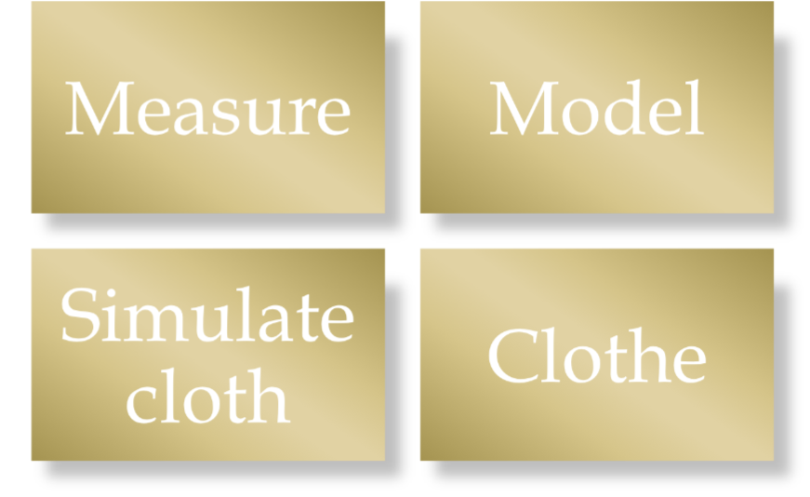

Slide 7

Pattern Recognition
Machine Learning
Noise elimination
2D or 3D input image data?

Slide 8

Single human reference model
Reference model is deformed to fit Measure data
Geometric + Anthropometric Vs Physical + Anatomic
Deformation Techniques

Slide 9

Simple set of clothes to be simulated initially
Tool will be used to generate virtual clothes. (Blender )
TRY will be responsible for application of cloth on model
Focus on real time garment simulation
Low level cloth dynamics like collision processing, numerical integration etc. is abstracted

Slide 10

The Usage Model

Slide 11
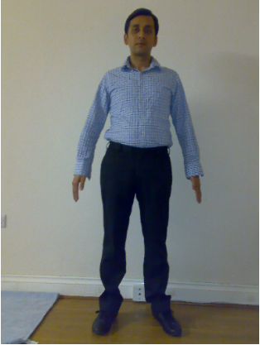
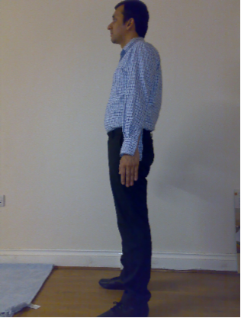

Slide 12
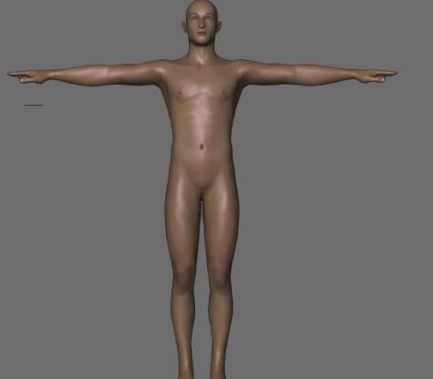
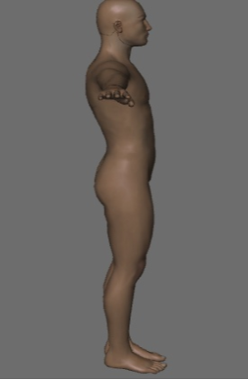

Slide 13

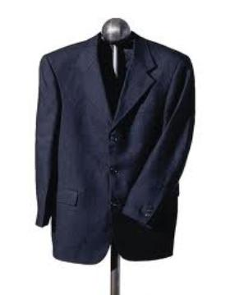
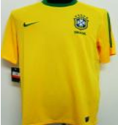
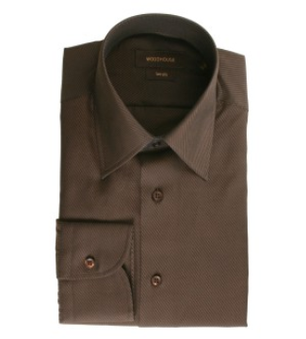
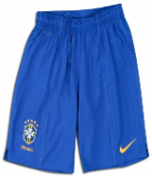

Slide 14

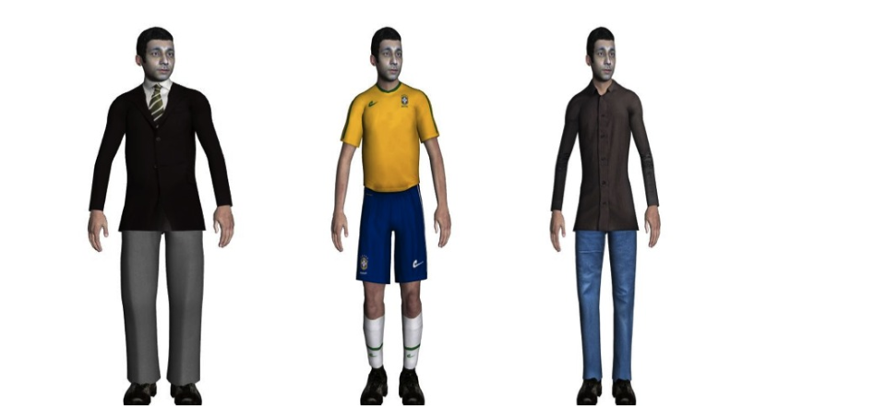

Slide 15

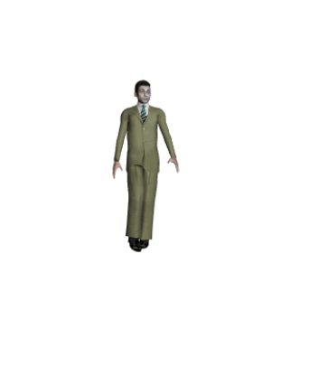
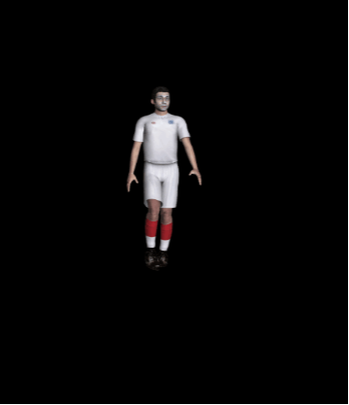

Slide 16

Measure (None)
Model ( Makehuman + Blender)
Cloth simulation (Blender)
Clothe (Blender)
Development C++, OpenGL, boost,

Slide 17

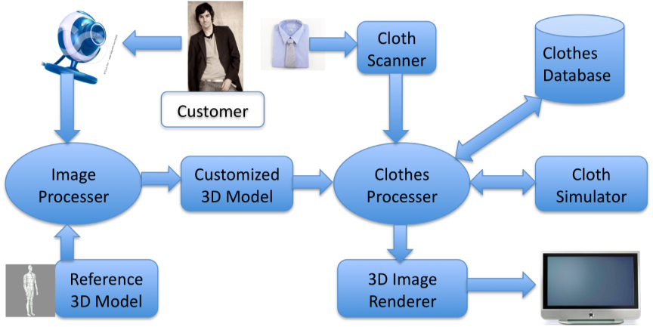

Slide 18

Automation
Real time performance
Time constraint
Broad Scope (Measure, Model, Cloth each area project in itself)
Integration

Slide 19

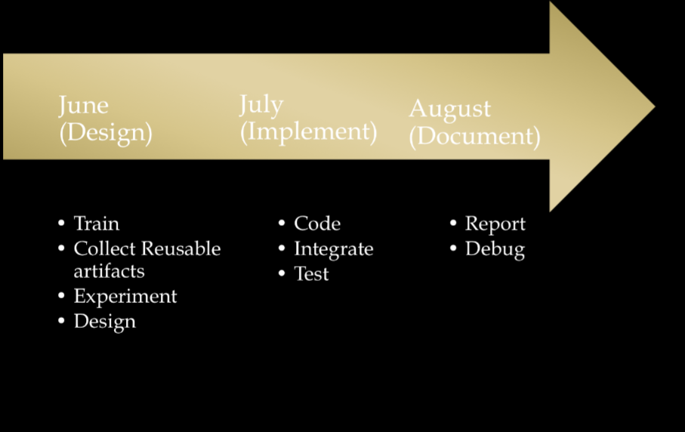

Slide 20

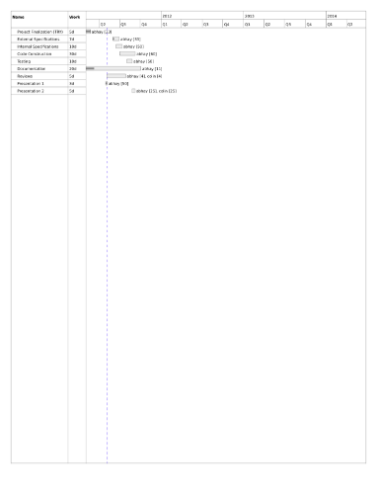

Slide 21


