Slide 1
Knowledge Distillation
A Survey
Team Members:
Divit Gupta
Kshitij Gupta
Nikita Rawat
Team Name:
We Tried

Slide 2
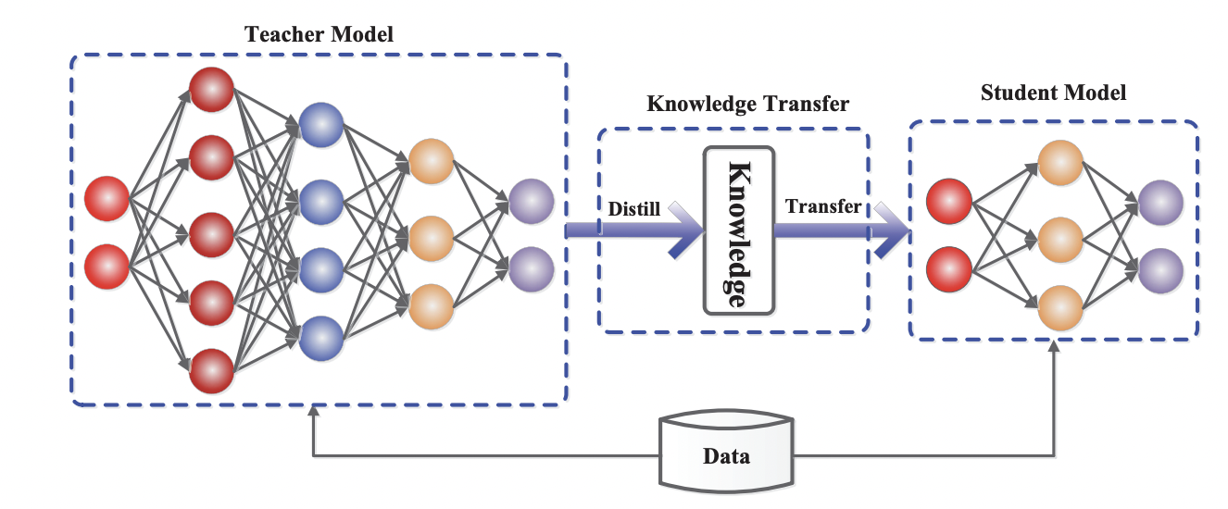
Problem Statement
The paper discusses about knowledge distillation to train a smaller models using larger models for better accuracy and faster training.

Slide 3
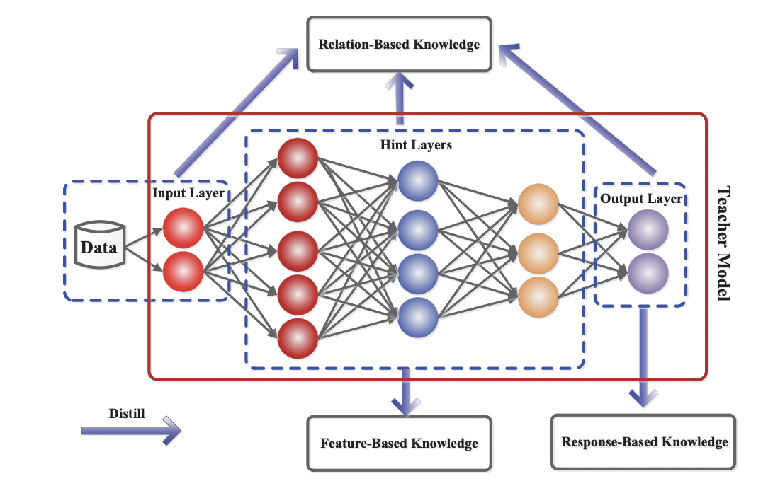
Knowledge Distillation - Training Schemes

Slide 4
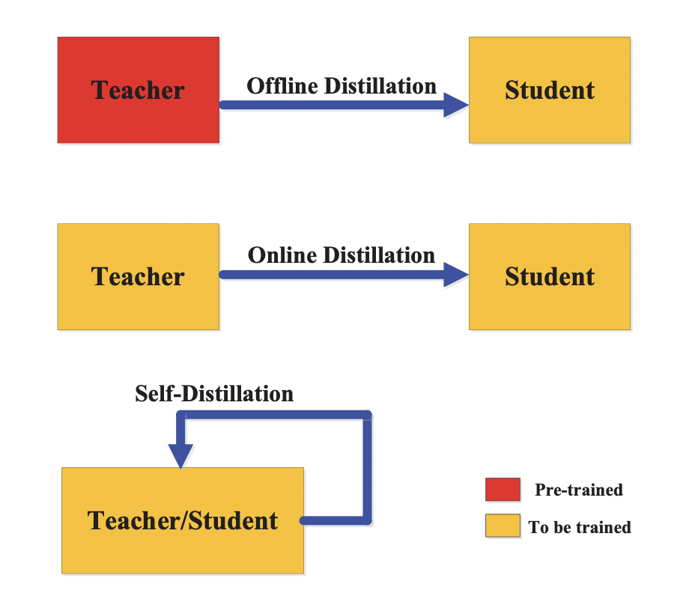
Knowledge Distillation - Distillation Schemes

Slide 5
Previous Work and Literature Review
Hinton et al introduced Knowledge distillation using response based learning. Which is widely popular as “Soft Targets”
“FitNets”(Romero et al) builded upon Hinton et al and added feature based learning by making use of Hint and Guided layers from Teacher and Student models respectively.

Slide 6
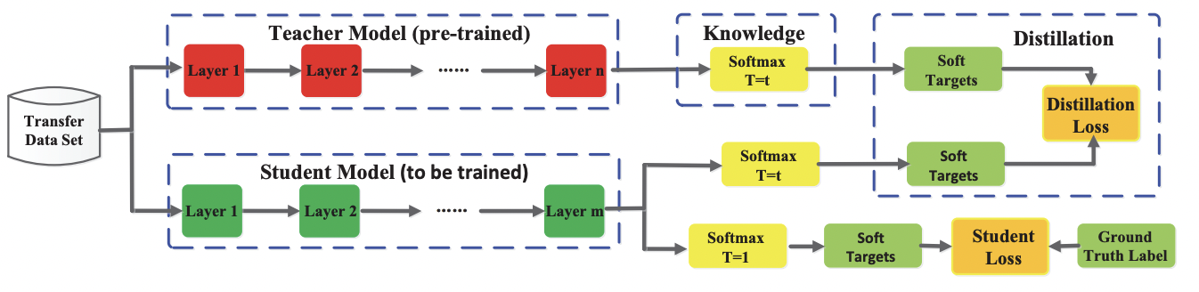
Paper 1: Hinton et Al
Response Based Learning Architecture:

Slide 7
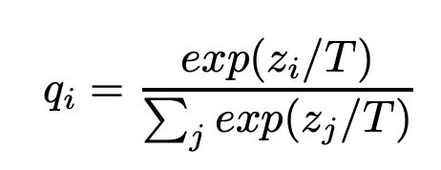
Paper 1: Hinton et Al
Modified Softmax: Converting Hard labels to Soft labels using Temperature “T”

Slide 8
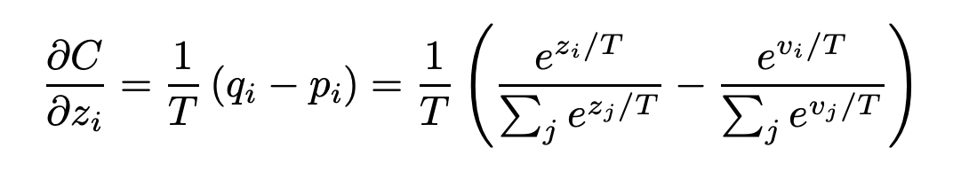
Paper 1: Hinton et Al
Matching logits of teacher and student model is a special case of distillation

Slide 9
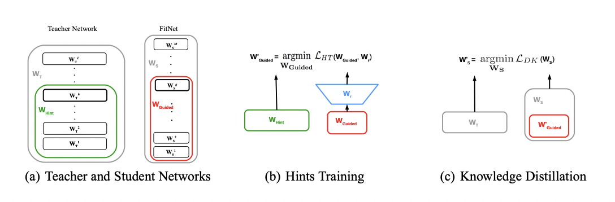
Paper 2: FitNets (Romero et al.)
Hint-Based Learning:

Slide 10

Paper 2: FitNets (Romero et al.)
Hint-Based Learning Loss function:

Slide 11
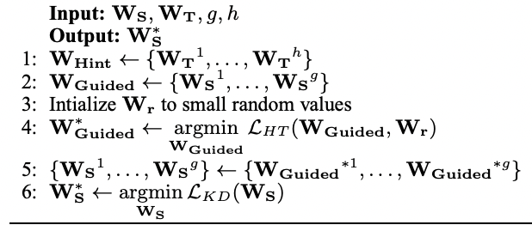
Paper 2: FitNets (Romero et al.)
Training Algorithm:

Slide 12
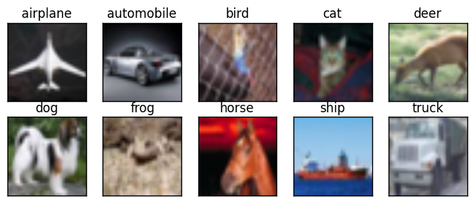
Data Description
Our Model is trained on CIFAR-10 dataset.
The CIFAR-10 dataset consists of 60000 32x32x3 colour images in 10 classes, with 6000 images per class. There are 50000 training images and 10000 test images.

Slide 13
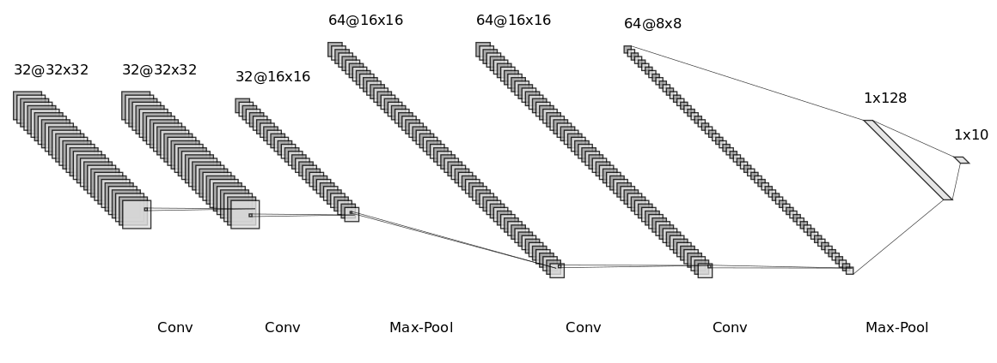
Our Teacher Model Architecture

Slide 14
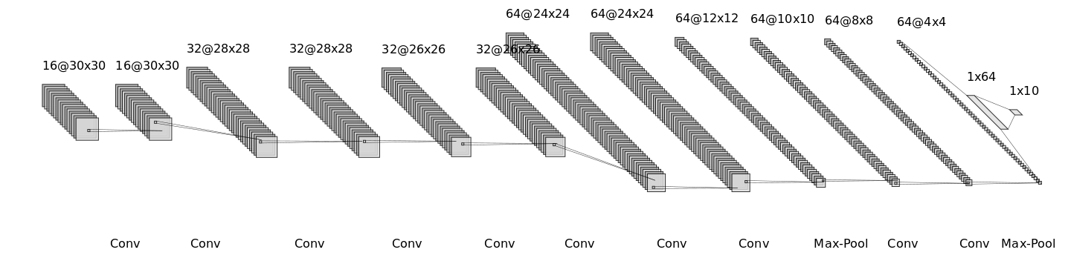
Our Student Model Architecture

Slide 15
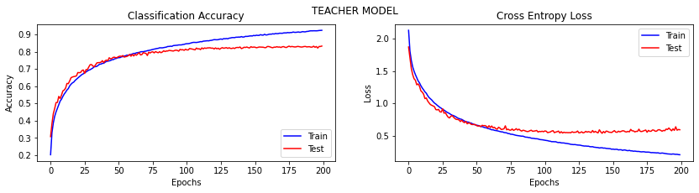
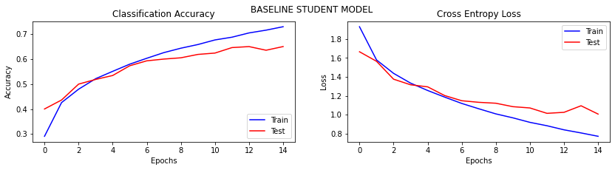

Slide 16
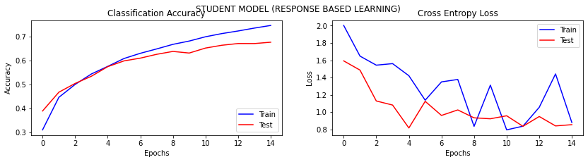
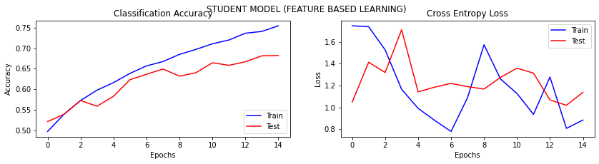

Slide 17
Final Results:
Models | Test Accuracy | Loss
Trained Teacher | 83.30% | 0.5933
Baseline Student | 64.96% | 1.0080
Response-Based KD | 67.58% | 0.9540
Feature-Based + Response-Based KD | 68.20% | 0.9203

Slide 18
Thank You

