Slide 1
Data Collection Utility Maximization via Near Optimal Path Prediction for UAV and UGV
Made BY: Akshat Bhatnagar, Harsh Pratik and Raghunandan Rawat
Supervisor: Dr. Ajay Pratap

Slide 2
Objective
The objective of this project is to maximize data collection from Wireless Sensor Networks (WSN) in Precision Agriculture using an Unmanned Aerial Vehicle (UAV) and an Unmanned Ground Vehicle (UGV) while minimizing the energy consumption of both.
There are AIoT sensors placed in the agricultural field which collect and store sensor data. This data is periodically collected by the UAV and UGV deployed from the data center.
Our objective is to determine a closed tour that maximizes data collection utility and minimizes energy consumption for UAV and UGV.

Slide 3
Motivation
Automation of agriculture through IoT can change the agriculture sector from being static and manual to dynamic and smart, which helps in increasing production and reducing human involvement.
Precision Agriculture(PA) and WSNs are the main drivers of automation in this domain.
We consider a combined UAV and UGV model in which both follow the near optimal path to collect data from AIoT sensors placed across the field.
Due to physical constraints of the field, UGV can’t reach all the sensors. UGV collects data from the sensors that are reachable by it. Data from rest of the sensors is collected by UAV.
After collecting data UAV and UGV return to data center.

Slide 4
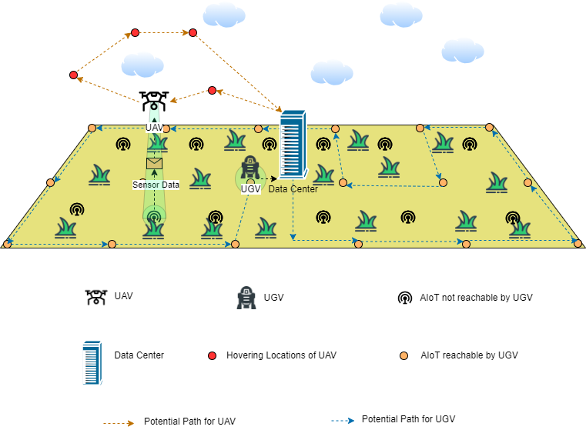
Proposed Model

Slide 5
contribution
The main contributions of this project are as follows:
We are using a single UAV and UGV for the data collection from different AIoT sensor devices in the agricultural field.
We use the utility associated with every AIoT sensor to optimize data collection by both UAV and UGV where the data collection function and priority of that sensor contribute to the utility associated with that sensor.
We use the Greedy Randomized Adaptive Search Procedure (GRASP) algorithm to solve the data collection maximization problem by reducing it to the Orienteering Problem(OP).

Slide 6
RESULTS
The Proposed Algorithm for the OP provides solutions with the competitive solution quality to the solutions provided by the evaluated existing methods, the GSOA, VNS and unmodified GRASP.
In several cases, especially for relatively large instances, the proposed GRASP-based method provides the best results among the evaluated trials.
The Proposed Algorithm outperforms the existing approaches to the OP in terms of the solution quality (in comparison to the GSOA) and computational requirements (in comparison to the VNS).
The use of both UAV and UGV for the collection of data gives the Proposed Algorithm an edge over other approaches by reducing the overall cost and boosting the utility.

Slide 7


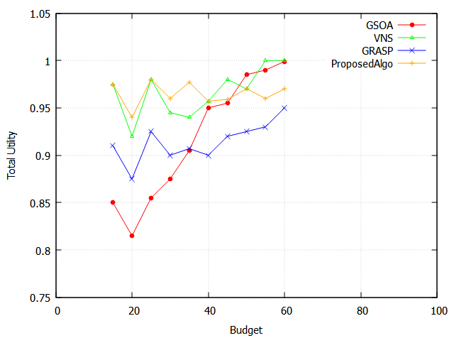
The given graph provides a comparison between the evaluated approaches to the problem.
We can see that the Proposed Algorithm provided optimal results most of the time in comparison with the other approaches.

