Slide 1

INDUSTRY 4.0 what it is? Why it matters?
BY : SHUBHAM RAWAT
ELECTRONIC & TELECOMMUNICATION
150060102063

Slide 2
CONTENTS
Industrial Evolution
Phases of earlier 3 industrial revolution
4th Industrial Revolution
Cyber Physical System
Six design principles
Examples
Examples of product evolution
Impact of Industry 4.0
Challenges

Slide 3

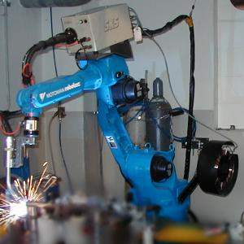
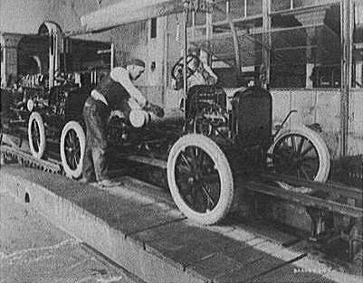
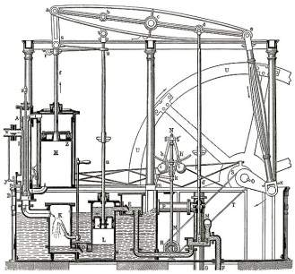
Industrial Evolution
4. Industrial revolution
Based on cyber-physical-
systems
3. Industrial revolution
Through the use of electronics
and IT further progression in
autonomous production
2. Industrial revolution
Introducing mass production
lines powered by electric
energy
Level of complexity
1. Industrial revolution
Introducing mechanical
production machines powered
by water and steam
Industry 1.0
Industry 2.0
Industry 3.0
Industry 4.0
End of the
18th century.
Beginning of the
20th century
Beginning of the
70th
Today

Slide 4

Phases of earlier 3 Industrial Revolutions
1760 to 1840 - Ushered in Mechanical production; railways and steam engine
1870 to 1940 - Mass production; electricity and assembly line
1960 to 2010 - Computers; semi conductors, main frame computing, personal devices, internet
Notes:
It is possible to apply this template to exiting presentations.
Have the latest presentation template open
Click on the View tab and select Normal
Delete all unwanted slides
Click on the Insert tab from the menu bar and select Slides from Files
Click on Browse. Navigate to the presentation you wish to update with the new template. Highlight the presentation and click Open
Wait for the slides from the presentation to load and click on Insert All. Then click Close
Check the inserted slides to ensure that the most appropriate master slide has been used on each slide
To change the master applied to a slide select the slide you wish to apply a different master to then click on the Format tab from the menu bar and select Slide Design
From the Used in This Presentation section choose the master you wish to apply to the slide and hover over it to reveal a drop-down arrow. Click on the arrow and select Apply to Selected Slides
It is important to thoroughly check the presentation to ensure that no further formatting is needed.

Slide 5
Industry 4.0
Industry 4.0 is a name given to the current trend of automation and data exchange in manufacturing technologies. Based on the technological concepts of cyber-physical systems, the Internet of Things and the Internet of Services, it facilitates the vision of the Smart Factory.
Within the modular structured Smart Factories of Industry 4.0, cyber-physical systems monitor physical processes, create a virtual copy of the physical world and make decentralized decisions.
Over the Internet of Things, Cyber-physical systems communicate & cooperate with each other & humans in real time. Via the Internet of Services, both internal & cross-organizational services are offered & utilized by participants of the value chain.
Notes:
It is possible to apply this template to exiting presentations.
Have the latest presentation template open
Click on the View tab and select Normal
Delete all unwanted slides
Click on the Insert tab from the menu bar and select Slides from Files
Click on Browse. Navigate to the presentation you wish to update with the new template. Highlight the presentation and click Open
Wait for the slides from the presentation to load and click on Insert All. Then click Close
Check the inserted slides to ensure that the most appropriate master slide has been used on each slide
To change the master applied to a slide select the slide you wish to apply a different master to then click on the Format tab from the menu bar and select Slide Design
From the Used in This Presentation section choose the master you wish to apply to the slide and hover over it to reveal a drop-down arrow. Click on the arrow and select Apply to Selected Slides
It is important to thoroughly check the presentation to ensure that no further formatting is needed.

Slide 6
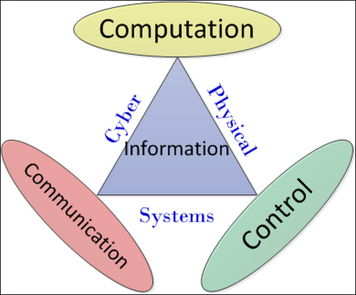
Cyber Physical Systems
A cyber-physical system (CPS) is a system of collaborating computational elements controlling physical entities. CPS are physical and engineered systems whose operations are monitored, coordinated, controlled and integrated by a computing and communication core. They allow us to add capabilities to physical systems by merging computing and communication with physical processes.
Notes:
CPS benefits:
• Safer and more efficient systems
• Reduce the cost of building and operating the systems
• Build complex systems that provide new capabilities
• Reduced cost of computation, networking, and sensing
• Enables national or global scale CPS’s

Slide 7
Industry 4.0 Six Design Principles
Interoperability: the ability of cyber-physical systems (i.e. work piece carriers, assembly stations and products), humans and Smart Factories to connect and communicate with each other via the Internet of Things and the Internet of Services
Virtualization: a virtual copy of the Smart Factory which is created by linking sensor data (from monitoring physical processes) with virtual plant models and simulation models
Decentralization: the ability of cyber-physical systems within Smart Factories to make decisions on their own
Real-Time Capability: the capability to collect and analyze data and provide the insights immediately
Service Orientation: offering of services (of cyber-physical systems, humans and Smart Factories) via the Internet of Services
Modularity: flexible adaptation of Smart Factories for changing requirements of individual modules

Slide 8
Building blocks of Industry 4.0
Industry 4.0
Autonomous Robots
Simulation
Horizontal and vertical system integration
Additive
Mfg
Industrial Internet of Things
Augmented reality
Big data analytics
Cyber Security

Slide 9
EXAMPLE Siemens
German manufacturing giant Siemens, an industrial user, is implementing an Industry 4.0 solution in medical engineering. For years, artificial knee and hip joints were standardized products, with engineers needing several days to customize them for patients. Now, new software and steering solutions enable Siemens to produce an implant within 3 to 4 hours.

Slide 10
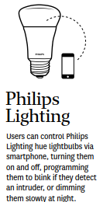


Examples of Product evolution: Connected and smart products

Slide 11
Impact
Economy
Industry 4.0
Individual
Business
Impact
Society
National & Global
Notes:
It is possible to apply this template to exiting presentations.
Have the latest presentation template open
Click on the View tab and select Normal
Delete all unwanted slides
Click on the Insert tab from the menu bar and select Slides from Files
Click on Browse. Navigate to the presentation you wish to update with the new template. Highlight the presentation and click Open
Wait for the slides from the presentation to load and click on Insert All. Then click Close
Check the inserted slides to ensure that the most appropriate master slide has been used on each slide
To change the master applied to a slide select the slide you wish to apply a different master to then click on the Format tab from the menu bar and select Slide Design
From the Used in This Presentation section choose the master you wish to apply to the slide and hover over it to reveal a drop-down arrow. Click on the arrow and select Apply to Selected Slides
It is important to thoroughly check the presentation to ensure that no further formatting is needed.

Slide 12
Impact Economy
Growth
Productivity
Employment
Labor substitution
The nature of Work
Notes:
It is possible to apply this template to exiting presentations.
Have the latest presentation template open
Click on the View tab and select Normal
Delete all unwanted slides
Click on the Insert tab from the menu bar and select Slides from Files
Click on Browse. Navigate to the presentation you wish to update with the new template. Highlight the presentation and click Open
Wait for the slides from the presentation to load and click on Insert All. Then click Close
Check the inserted slides to ensure that the most appropriate master slide has been used on each slide
To change the master applied to a slide select the slide you wish to apply a different master to then click on the Format tab from the menu bar and select Slide Design
From the Used in This Presentation section choose the master you wish to apply to the slide and hover over it to reveal a drop-down arrow. Click on the arrow and select Apply to Selected Slides
It is important to thoroughly check the presentation to ensure that no further formatting is needed.

Slide 13
Impact Business
Customer expectations
Data enhanced products
Improve decision
New operating models
Combining digital, physical and biological worlds
Notes:
It is possible to apply this template to exiting presentations.
Have the latest presentation template open
Click on the View tab and select Normal
Delete all unwanted slides
Click on the Insert tab from the menu bar and select Slides from Files
Click on Browse. Navigate to the presentation you wish to update with the new template. Highlight the presentation and click Open
Wait for the slides from the presentation to load and click on Insert All. Then click Close
Check the inserted slides to ensure that the most appropriate master slide has been used on each slide
To change the master applied to a slide select the slide you wish to apply a different master to then click on the Format tab from the menu bar and select Slide Design
From the Used in This Presentation section choose the master you wish to apply to the slide and hover over it to reveal a drop-down arrow. Click on the arrow and select Apply to Selected Slides
It is important to thoroughly check the presentation to ensure that no further formatting is needed.

Slide 14
Impact
National & Global
Governments
Countries, regions & cities
International security
Society
Inequality
The Individual
Identity, morality & ethics
Human connection
Notes:
It is possible to apply this template to exiting presentations.
Have the latest presentation template open
Click on the View tab and select Normal
Delete all unwanted slides
Click on the Insert tab from the menu bar and select Slides from Files
Click on Browse. Navigate to the presentation you wish to update with the new template. Highlight the presentation and click Open
Wait for the slides from the presentation to load and click on Insert All. Then click Close
Check the inserted slides to ensure that the most appropriate master slide has been used on each slide
To change the master applied to a slide select the slide you wish to apply a different master to then click on the Format tab from the menu bar and select Slide Design
From the Used in This Presentation section choose the master you wish to apply to the slide and hover over it to reveal a drop-down arrow. Click on the arrow and select Apply to Selected Slides
It is important to thoroughly check the presentation to ensure that no further formatting is needed.

Slide 15
CHALLENGES
IT security issues
Reliability and stability needed for critical machine-to-machine communication.
Lack of adequate skill-sets to expedite the march towards fourth industrial revolution
Loss of many jobs to automatic processes and IT- controlled processes, especially for lower educated parts of society
Insufficient qualification of employees

Slide 16
Thank YOU

