Slide 1
ReelFlip
Swipe. Chart. Trade.
A TikTok-style crypto trading app on Solana
Solana Hackathon 2026

Slide 2


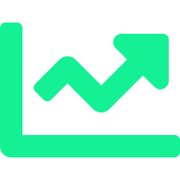
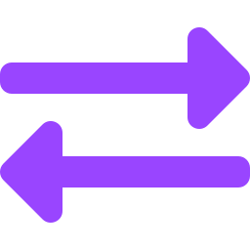
The Problem
Crypto trading is intimidating, fragmented, and built for power users.
Overwhelming UIs
Complex dashboards with dozens of charts, order books, and indicators scare away casual users.
Discovery is broken
Finding trending tokens means jumping between Twitter, DEX screeners, and Telegram groups.
High friction to trade
Multiple steps: find token, check chart, go to DEX, connect wallet, approve, swap.

Slide 3

The Solution
ReelFlip turns token discovery and trading into a scroll-and-swipe experience.
01
Vertical Feed
Full-screen cards with live price charts — just like TikTok, but for tokens.
02
One-Tap Swap
See a token you like? Buy it right there. No switching apps, no copy-pasting addresses.
03
Smart Discovery
Curated feed surfaces trending tokens based on momentum, volume, and community activity.

Slide 4


How It Works
1
2
3
4
Open App
Scroll Feed
View Chart
Swap
Launch ReelFlip
on your phone
Swipe through
live token cards
Tap for realtime
price action
One tap to buy
or sell instantly
Built with
Expo / React Native
Solana Web3.js
Fastify Backend
WebSocket Charts

Slide 5


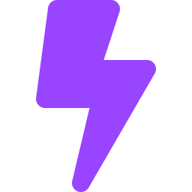
Why Now
Three forces are converging to make this the perfect moment.
Solana Mobile is exploding
Saga Chapter 2 shipped 100K+ devices. Mobile-first crypto is no longer theoretical — it's happening now.
Gen Z expects short-form UX
The TikTok generation doesn't read dashboards. They scroll, swipe, and decide in seconds.
DeFi needs a consumer moment
DEX volume is at all-time highs, but the interfaces are still built for traders, not normal people.

Slide 6
Market & Users
420M+
1.5B+
Global crypto holders
TikTok monthly active users
65%
$150B+
Of crypto traders are under 35
Monthly DEX trading volume
Target user: crypto-curious Gen Z & millennials who discover assets through social feeds, not trading terminals.

Slide 7

Traction & Validation
Early stage — built and functional, not yet launched.
✓
Full-stack app built (Expo + Fastify)
✓
Realtime chart engine (WebSocket + SSE + polling fallback)
✓
Swap execution pipeline (quote → build → submit)
✓
Onboarding flow with wallet integration
✓
Backend with Redis caching and Supabase integration
→
Testflight / closed beta launch

Slide 8


Tech & Innovation
Three-tier chart transport
WebSocket primary, SSE fallback, polling as last resort. Always-on realtime data, even on poor connections.
FeedChartStore architecture
Singleton store with useSyncExternalStore — zero re-renders on price ticks outside visible cards.
Atomic swap pipeline
Quote → Build → Submit in one flow. 15s timeout with abort. Users never leave the feed to trade.
Solana-native wallet
Deep integration with Mobile Wallet Adapter. No browser extensions, no seed phrase popups.

Slide 9

Vision
Make crypto trading as natural as scrolling your social feed.
Now
Next
Future
Token feed + swap on Solana
Social features (follow traders, share wins)
Multi-chain support
Realtime charts
Portfolio tracking
Copy-trading
Mobile-first UX
Push notifications on price moves
Token launch feed integration

Slide 10

Team
Eugene
Founder & Product Designer
Based in Cyprus
Solo-building the full stack: design, mobile app, backend, and infrastructure.

Slide 11
Let's Connect
ReelFlip is live on devnet and ready for your feedback.
GitHub Repo
Try the Demo
Contact
github.com/reelflip
demo.reelflip.app
ulyaeugene@gmail.com
Swipe. Chart. Trade. The future of crypto is mobile.

