Slide 1
Weather Prediction ML Model
Supervised by : ENG/ Mohamed Ebrahim

Slide 2
Team Members
01
02
03
04
05
06
Rawda Essam
Nariman Emam
Alyaa Emad
Ghada Said
Donia Ahmed
Mariam Ramadan

Slide 3
Project Overview
In an era where accurate weather forecasting is crucial for everything from agriculture to aviation, our project aims to harness the power of data to predict weather patterns with precision. Using historical data from the Visual Crossing Weather API, we delved deep into factors such as wind speed, humidity, and temperature to build a model that can anticipate future weather conditions. With each team member playing a pivotal role—from data collection and analysis to developing an interactive interface using Streamlit .

Slide 4
Dataset Information
Source : Visual Crossing Weather API
Number of rows : 5369
Number of columns : 34

Slide 5
Project Outline
1
2
Data Loading and Exploration
Data Cleaning
Import Libraries
Load Dataset
Initial Exploration
Remove Unnecessary Columns
Handle Missing Values
Check for Duplicates
Convert Data Types
Visualizing Data

Slide 6
3
4
Outlier Detection
Feature Engineering
Handle Outliers
Correlation Analysis
Create New Features
Drop Irrelevant Features

Slide 7
5
Data Analysis
Distribution of icon Type
Year-over-Year Changes in Recorded Features(Month)
Year-over-Year Changes in Recorded Features(Year)
Distribution of Temperature
The 6 Condition Frequency
Temperature trend over time
Temperature vs. Humidity

Slide 8
8. Wind Speed and Wind Gust Analysis
9. Cloud Cover vs. Solar Radiation
10. Visibility and Conditions
11. Solar Energy by Month
12. Wind Direction Distribution
13. UV Index and Conditions
14. Temperature, Sunrise, and Sunset Timing

Slide 9
5
Modeling
Apply machine learning algorithms :
Linear Regression
R² Score: 0.96251
Mean Squared Error: 4.63278
K-Nearest Neighbors (KNN)
R² Score: 0.96321
Mean Squared Error: 4.54734
Support Vector Regression (SVR)
R² Score: 0.68788
Mean Squared Error: 38.5732

Slide 10
Decision Tree
R² Score: 0.98281
Mean Squared Error: 2.12432
Random Forest
R² Score: 0.99320
Mean Squared Error: 0.84081

Slide 11
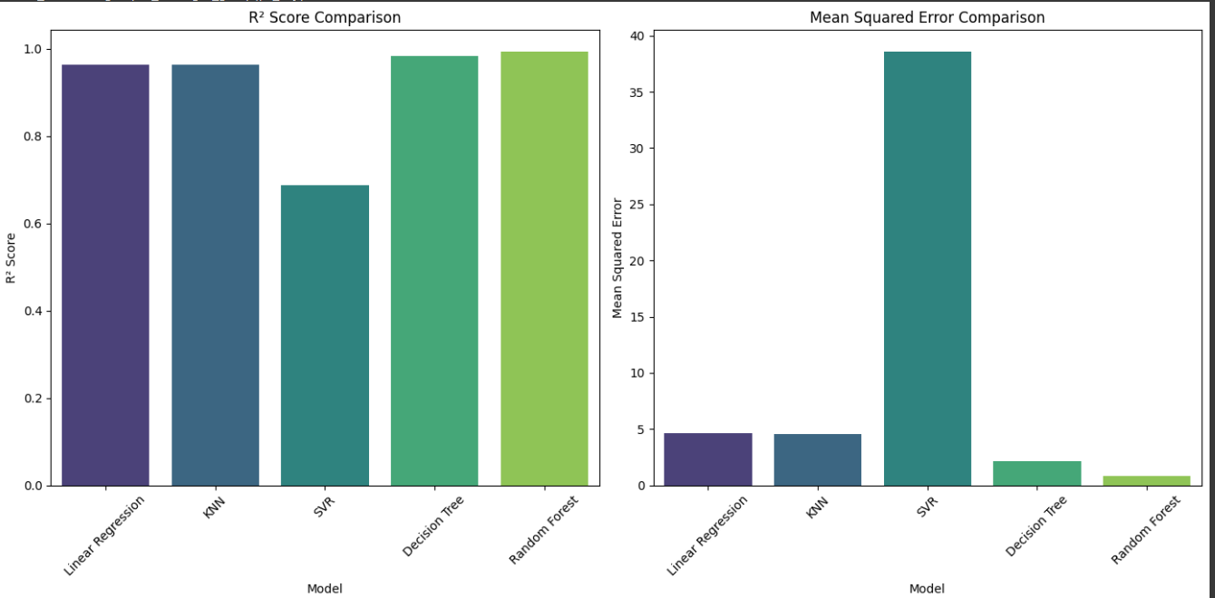
Models Comparison

Slide 12
Streamlit
Purpose: Predicts temperature based on user inputs for weather conditions using a pre-trained machine learning model.
Key Features:
Interactive Input: Users can adjust 14 weather parameters, like Wind Speed, Humidity, and Solar Radiation.
Real-Time Predictions: After clicking "Predict Temperature," results are shown instantly.
User-Friendly Design: Default values help guide input, but users can fully customize all fields.

Slide 13
User Flow:
Enter Weather Data: Users input values for various weather conditions (e.g., Dew Point, UV Index).
Click Predict: The app processes the input and generates a prediction.
View Prediction: The predicted temperature is displayed immediately.
Key Benefit:
The app provides quick, real-time feedback with easy-to-use inputs, allowing for instant temperature predictions.

Slide 14
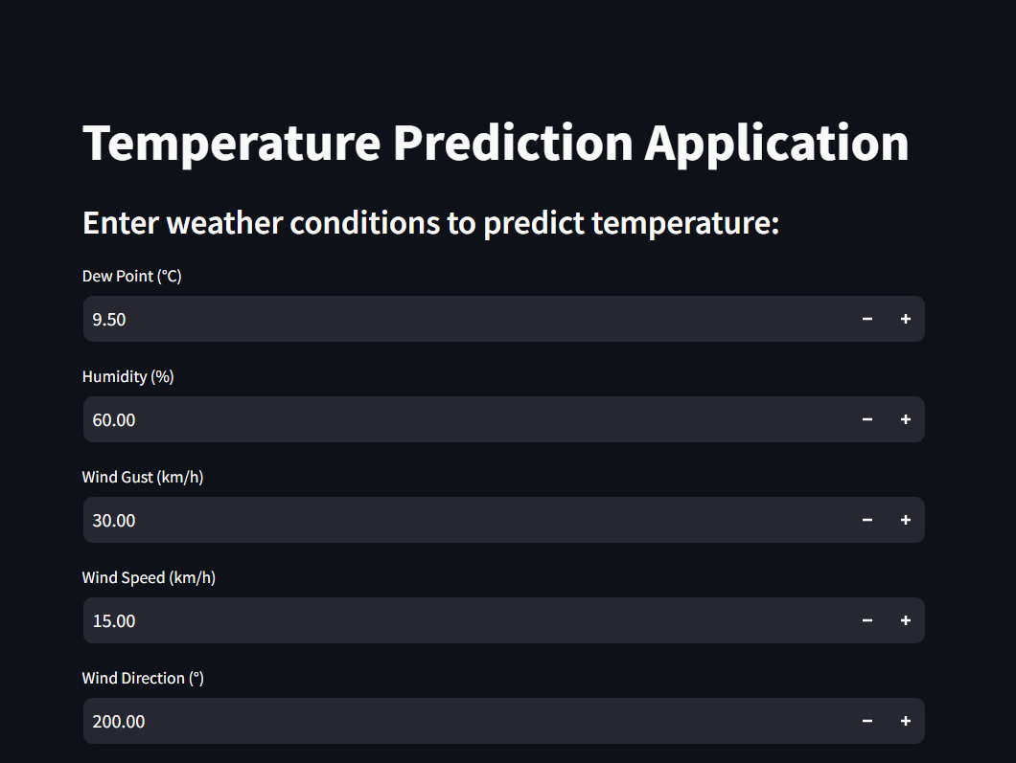
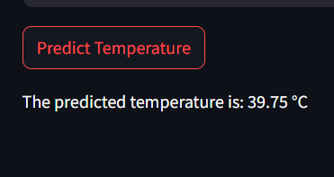

Slide 15
Thanks!
Do you have any questions?

