Slide 1

Great Catch
Group 2 - HELP
Team Member
Tianze Bai*
Daniel Grayson*
Alexander Manning*
Yupeng Sun*
Wenyu Xin†
Advisor/Sponsor
Dr. Christopher Yang*
* Drexel University College of Computing & Informatics
† Drexel University School of Biomedical Engineering, Science, and Health Systems
Notes:
Wenyu

Slide 2
Introduction
Target Users & Benefits & Limitation
Key Features
Use Cases
Context Diagram
DFD, ERD
User Documentation
Demo
Reference
Overview| 2
Notes:
Wenyu

Slide 3
Introduction – Needs [1]
In 2014, there are 46.2 million people 65 years or older, which is 14.2% of total U.S. population.
1 in 7 people are elderly.
Prediction shows, by 2060, there will be 98 million older population.
About 28% or 12.5 million older persons live alone.
Notes:
Wenyu

Slide 4
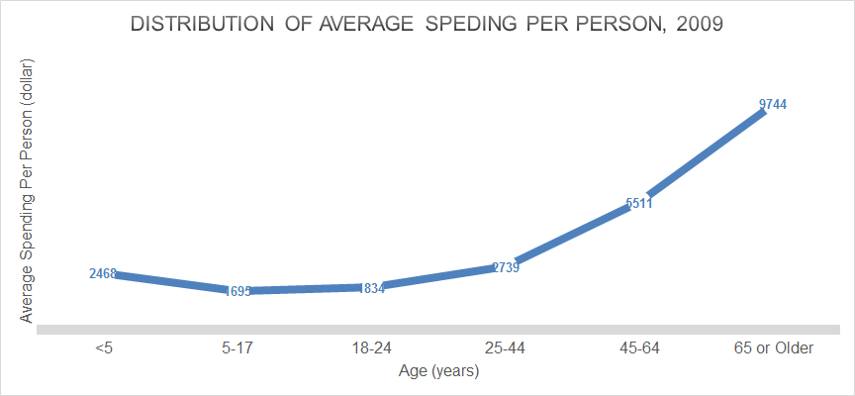
Introduction – Needs (con’t) [2]
That is roughly $ 460,000,000,000 or $460 billion in cost to caring elderly each year
Notes:
Wenyu

Slide 5
Introduction – Needs (con’t) [3]
“Those living alone were more likely to report fair to poor health, poor vision, difficulties in instrumental and basic activity, poorer diet, worsening function, risk of social isolation, hazardous alcohol use, having no emergency carer, and multiple falls in the previous 12 months.”
Kalpa Kharicha et al.
Which translates to higher medical cost
Notes:
Wenyu

Slide 6
Introduction – Solution
Great Catch – a health monitoring system that catches preventable health issues early
Helps monitor health of elderly
Especially those who live alone
Reduces unnecessary medical cost
Notes:
Wenyu

Slide 7
Introduction – Existing System [4][5]
 | Great Catch | Fitbit | iWatch | Lively Wearable by GreatCall
Has built-in intelligence using statistics and API | Yes | No | No | No
Offer alert features to notify designed contact person | Yes, but can send different alerts to different contacts based on issue severity | Yes, limited function as reminder | Yes, limited function as reminder | Yes, only if fall is detected
Provides reporting option on selected data | Yes, integrated into the main system | Yes, integrated into the main system | No, need 3rd party tool | No, need 3rd party tool
Notes:
Wenyu

Slide 8
Introduction – Existing System (con’t) [4][5]
 | Great Catch | Fitbit | iWatch | Lively Wearable by GreatCall
Wirelessly and automatically syncing data between wearable sensors and application | Yes | Yes | Yes | Yes
Allows optional user data input | Yes, but with more focus on medical information | Yes, but limited to sleep and other fitness information | Yes, but limited to sleep and other fitness information | No
Protect user’s privacy | Yes | Yes | Yes | Yes
Notes:
Wenyu

Slide 9
Introduction – Differences
Great Catch make uses of collected data while other do not
Analyzes data to detect potential abnormal pattern using statistics and API
Alerts any abnormal patterns and correlated user information to caregiver and user
Offers raw data or summarized report to assist health professionals with diagnosis if needed
Notes:
Wenyu

Slide 10
Introduction – On-Going Research[6]
Can machine-learning improve cardiovascular risk prediction using routine clinical data?
Stephen F. Weng et al
Heart Attacks
AI algorithm vs Doctors
predicted 7.6% more events
1.6% fewer false alarms
Notes:
Wenyu

Slide 11
Targeted Users & Benefits & Limitation
Target:
Older population with no age cutoff
Likely those 65 years or older
Especially those elderly who live alone
Limitation:
No diagnostic functionality
Benefits:
Live a happier and longer life
Reduce medical cost
Business Model:
Will consult with business personnel
Notes:
Tianze

Slide 12
Key Features
Enables wirelessly and automatically syncing data between wearable device and Great Catch
Allows optional user data input like medicines
Provides data privacy
Uses statistic and API to detect abnormal data trends
Pushes alerts to caregivers and users
Provides reporting option on selected data
Is easy to use and affordable
Notes:
Tianze

Slide 13
Major Use Cases
Seniors want to track their current health status using their past data
Seniors’ caretakers want to keep an eye on seniors’ health status
Health professionals want another set of variables to do diagnosis
Notes:
Daniel

Slide 14
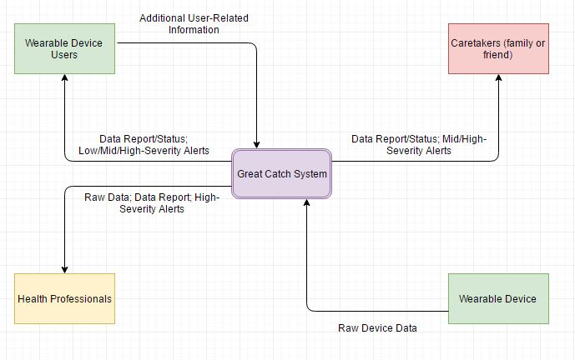
Context Diagram – Level 0
Notes:
Yupeng

Slide 15
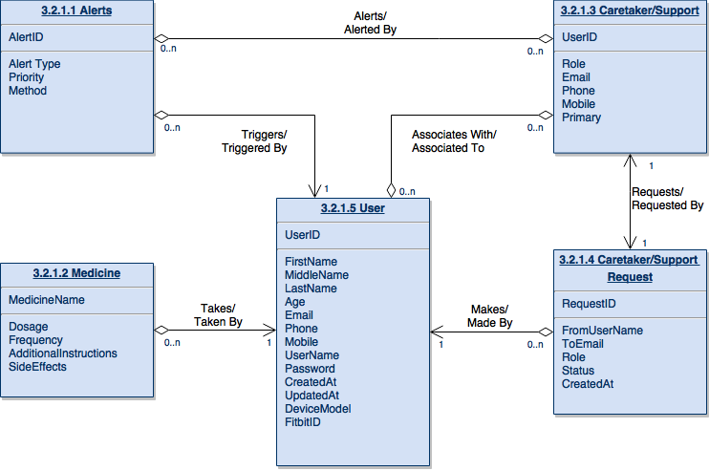
ERD
Notes:
Yupeng

Slide 16
User Document
 | User | Caretaker | Physician
Account Setup | Type in information for each field and click on submit button | Type in information for each field and click on submit button | None
Login/out | Type in username and password and click on submit button | Type in username and password and click on submit button | None
View Report | Select data type, starting date, and data range, and click on submit | Select data type, starting date, and data range, and click on submit | None
Authorize Fitbit API | Click on Authorize button and follow through Fitbit website instruction | None | None
Notes:
Wenyu

Slide 17
Demo - Statics
Determine Standard Deviation (STD)
Step Counts, less than 1 STD → abnormal
Heart Rates, greater or less than 1 STD → abnormal
2. Correlations
Step Counts:
Weather (rain, fog, hail, thunderstorm, etc)
Medicine (contain fatigue side effect)
Heart Rates:
Step Counts (normal vs abnormal)
Medicine (contain hypertension side effect)
Notes:
Wenyu

Slide 18
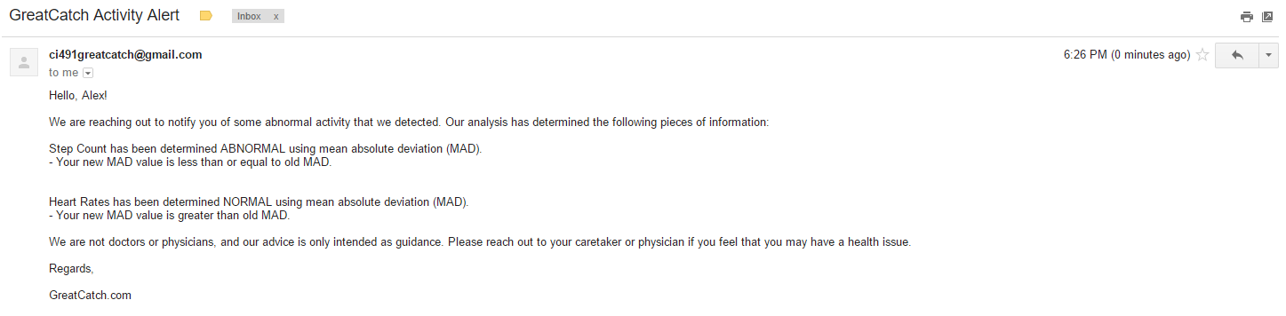
Generate Alert Email
Notes:
Alex

Slide 19
Demo
http://greatcatchhelp.com/
Notes:
Alex

Slide 20
References
[1] Administration for Community Living, “Administration on Aging - highlights”, Administration for Community Living, 2014. [Online]. Available: http://www.aoa.acl.gov/aging_statistics/profile/2014/2.aspx/. [Accessed Nov. 27, 2016]
[2] Kaiser Family Foundation, “Health Care Costs: A Primer”, Kaiser Family Foundation, May 01, 2012. [Online]. Available: http://kff.org/report-section/health-care-costs-a-primer-2012-report/. [Accessed Nov. 27, 2016]
[3] K. Kharicha, D. Harari, C. Swift, G. Gillmann, A.E. Stuck, “Health risk appraisal in older people 1: ara older people living alone an ‘at-risk’ group?”, BJGP, 57(537): 271-276, April 2007.
[4] greatcall, “Lively Wearable”, greatcall, 2016. [Online]. Available: https://www.greatcall.com/devices/lively-wearable-senior-activity-tracker/. [Accessed Nov. 27, 2016]
[5] fitbit, “The fitness app for everyone”, fitbit, 2016. [Online]. Available: https://www.fitbit.com/app/. [Accessed Nov. 27, 2016]
[6] engadget, “AI can predict heart attack more accurately than doctors”. [Online]. Available: https://www.engadget.com/2017/04/16/ai-can-predict-heart-attacks-more-accurately-than-doctors/. [Accessed May. 19, 2017]
Notes:
Wenyu

Slide 21
End of Presentation
Thank you!
Congratulations Seniors!
Notes:
Wenyu

