Slide 1

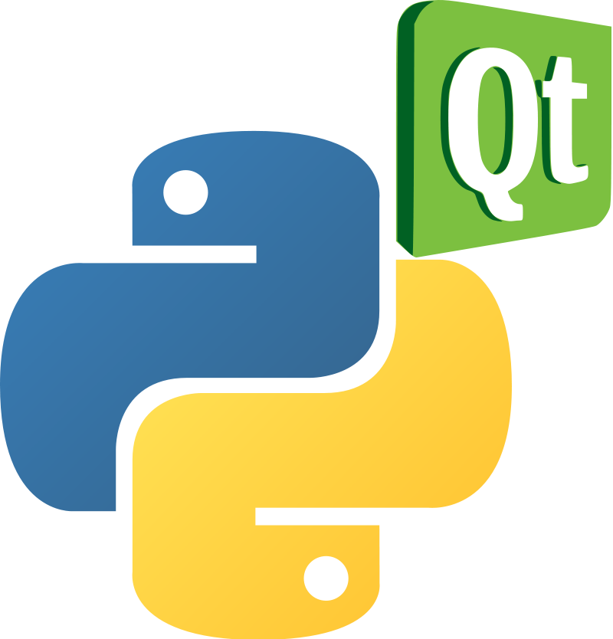
PyQt5
PyQt is a Python binding of the cross-platform GUI toolkit Qt, implemented as a Python plug-in. PyQt is free software developed by the British firm Riverbank Computing

Slide 2
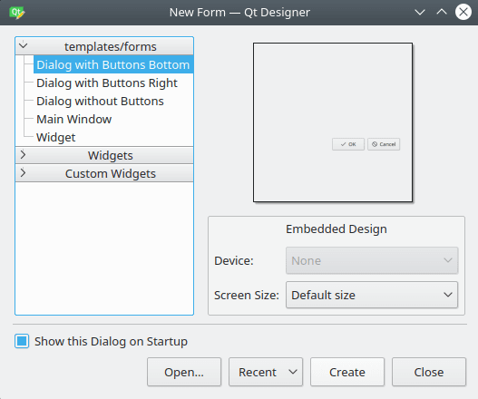
PyQt5 Vs TKinter
Both Tkinter and PyQt are useful for designing acceptable GUI’s, but at the same time, they differ in terms of adaptability and functionality.
Mostly, Tkinter is all about writing GUI yourself, program your settings or functionality in the same script.
On the other hand, in PyQt, you separate GUI in a script, and use your Python knowledge from another script
Instead of creating your own code for the user interface, you can simply adopt the Qt Designer functions to develop your application.
Therefore, let’s see what the main differences and advantages of PyQt vs. Tkinter
<number>

Slide 3
Comparison
PyQt
TKinter
Advantages of using PyQt.
Coding flexibility – GUI programming with Qt is designed around the concept of signals and slots for establishing communication amongst objects. That permits flexibility when dealing with GUI events and results in a smoother codebase.
More than a framework – Qt uses a wide array of native platform APIs for the purpose of networking, database creation, and many more. It offers primary access to them via a unique API.
Various UI components – Qt offers several widgets, such as buttons or menus, all designed with a basic appearance across all supported platforms.
Various learning resources – because PyQt is one of the most used UI frameworks for Python, you can get easy access to a wide array of documentation.
Easy to master – PyQt comes with a user-friendly, straightforward API functionality, along with specific classes linked to Qt C++. This allows the user to use previous knowledge from either Qt or C++, making PyQt easy to understand.
Advantages of using Tkinter
Available out-of-charge for commercial usage.
It is featured in the underlying Python library.
Creating executables for Tkinter apps is more accessible since Tkinter is included in Python, and, as a consequence, it comes with no other dependencies.
Simple to understand and master, as Tkinter is a limited library with a simple API, being the primary choice for creating fast GUIs for Python scripts.
<number>

Slide 4
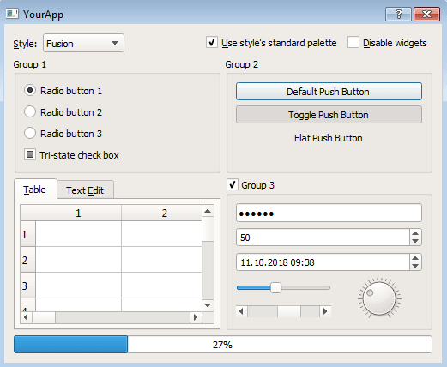
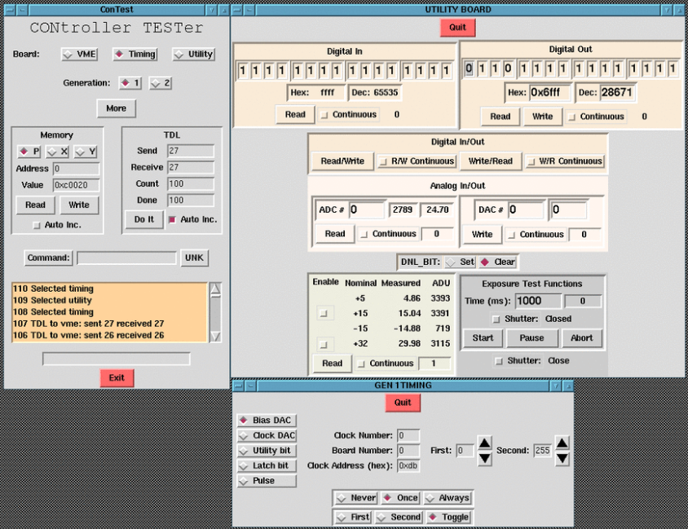
Comparison
PyQt
TKinter
Disadvantages of using PyQt
Lack of Python-specific documentation for classes in PyQt5
It requires a lot of time for understanding all the details of PyQt, meaning it is a quite steep learning curve
Disadvantages of using Tkinter
Tkinter does not include advanced widgets.
It has no similar tool as Qt Designer for Tkinter.
It doesn't have a native look and feel
<number>

Slide 5

Installing And Using PyQt5
<number>

Slide 6
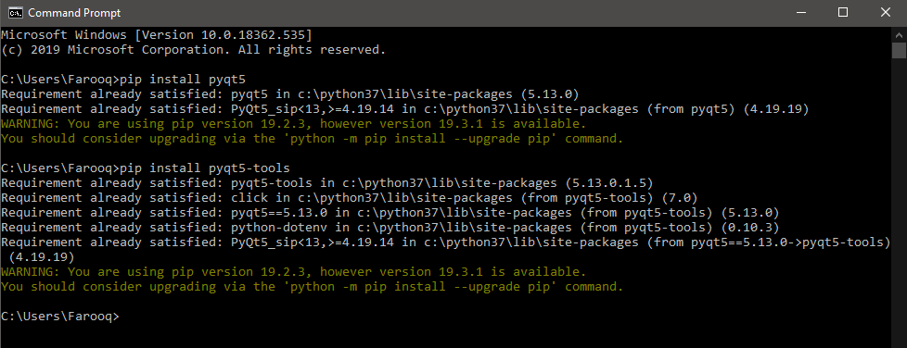
Installing PyQt5
pip install pyqt5
pip install pyqt5-tools
<number>

Slide 7
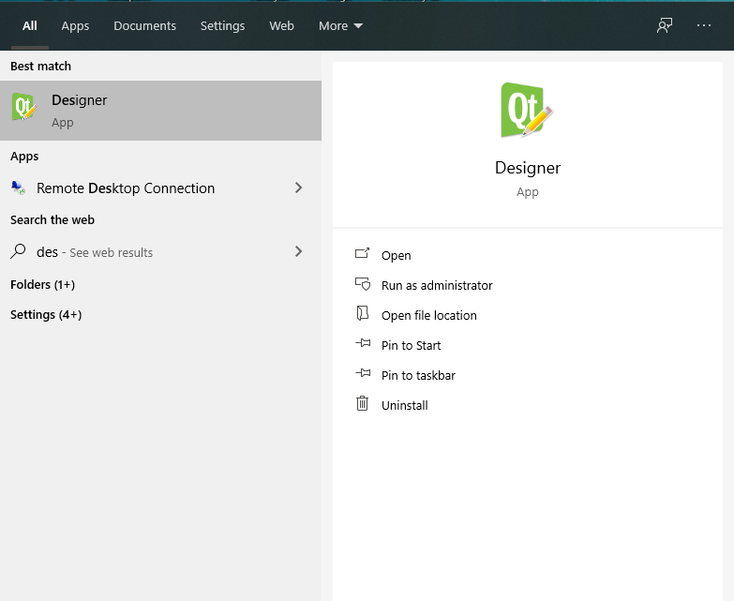
Qt Designer
<number>

Slide 8

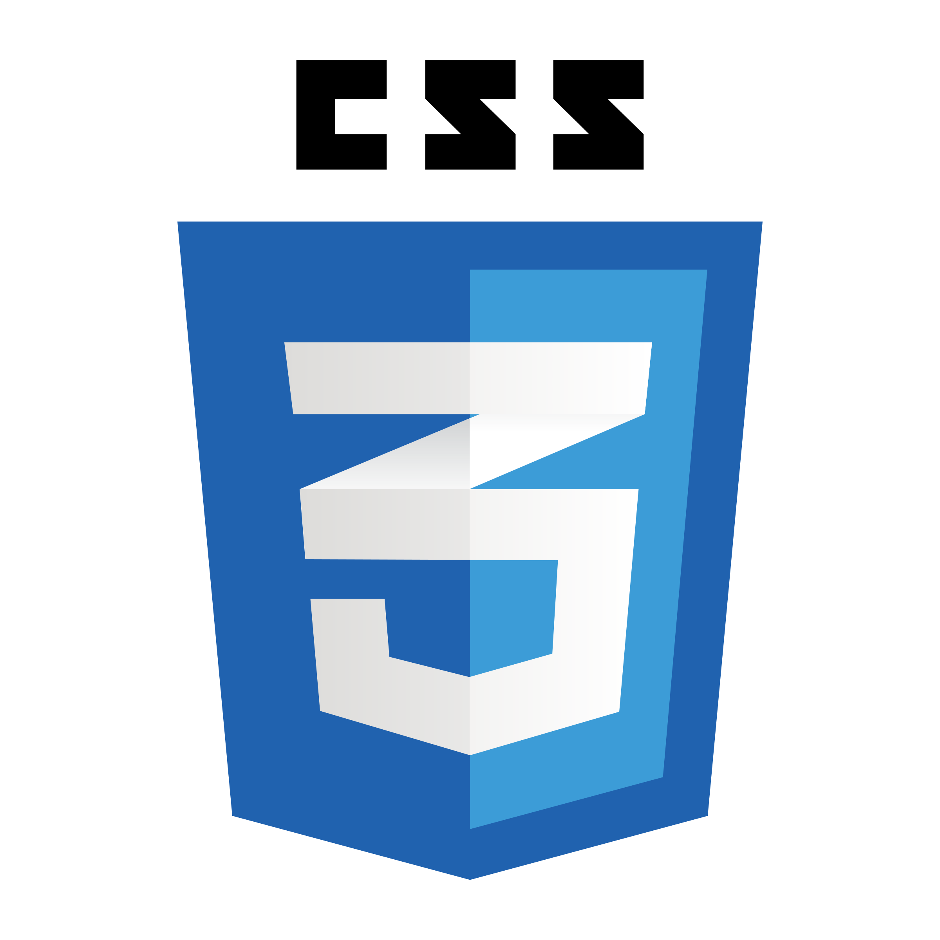
PyQt5 and CSS
+
<number>

Slide 9
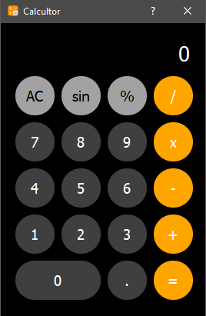
PyQt5 and CSS
CSS Properties
Foreground-Color Property
color: rgb(0,0,0); “RGB”
color: #ffffff; “Hex”
color: black; “Name”
Background-Color Property
background-color: rgb(255,255,255); “RGB”
background-color: #ffffff; “Hex”
Background-color: transparent; “Name”
Border Properties
border: 5px solid black; “width style color”
border-radius : 10px 5px 0px 8px; “Top Right Bottom Left”
border-width: 5px;
border-style: dashed;
Border-color: black;
:hover
The :hover CSS pseudo-class matches when the user interacts with an element with a pointing device, but does not necessarily activate it. It is generally triggered when the user hovers over an element with the cursor
<number>

Slide 10
Conversion to python script
<number>

Slide 11
ui to py conversion
pyuic5 -x filename.ui -o filename.py
pyrcc5 -x imagefilename.qrc -o imagefilename.py
py to exe conversion
pip install pyinstaller
pyinstaller --onefile –w calculator.py
<number>

Slide 12

Thank You
farooq@students.uit.edu
Tamir@students.uit.edu
raheelsiddiqqui@ieee.org

