Slide 1
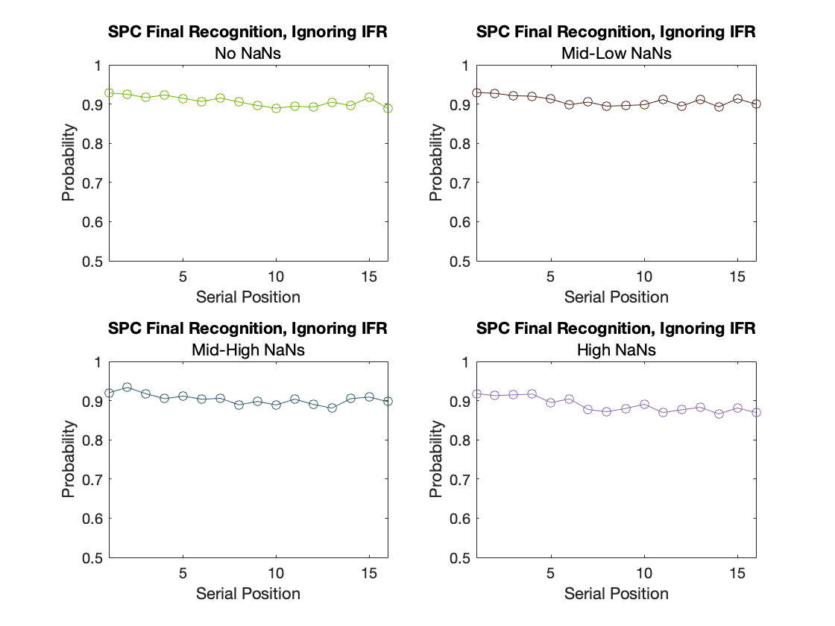
SPC Final Recognition: Ignoring IFR

Slide 2
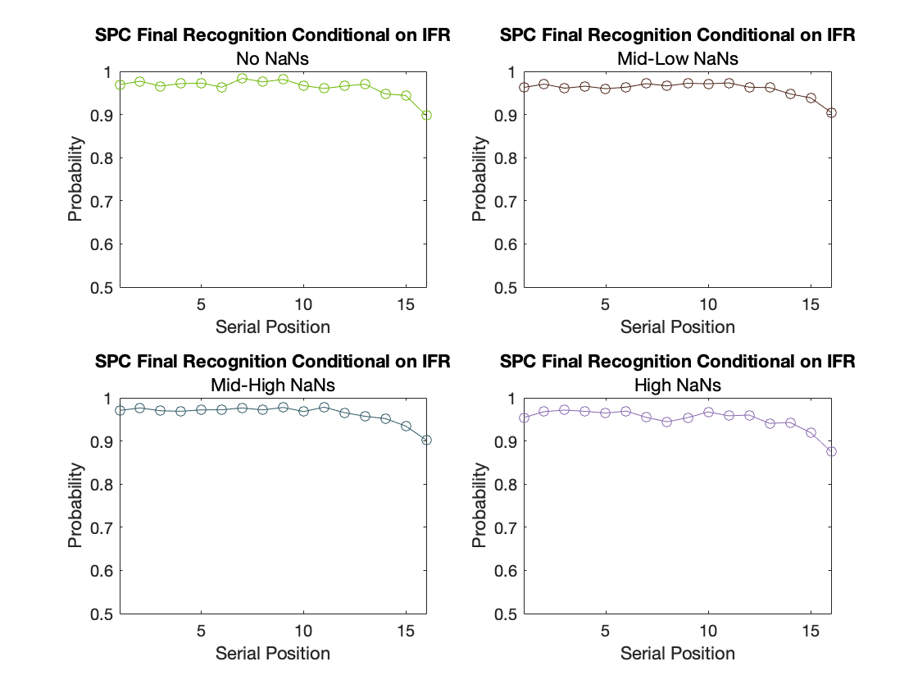
SPC Final Recognition: Conditional on IFR

Slide 3
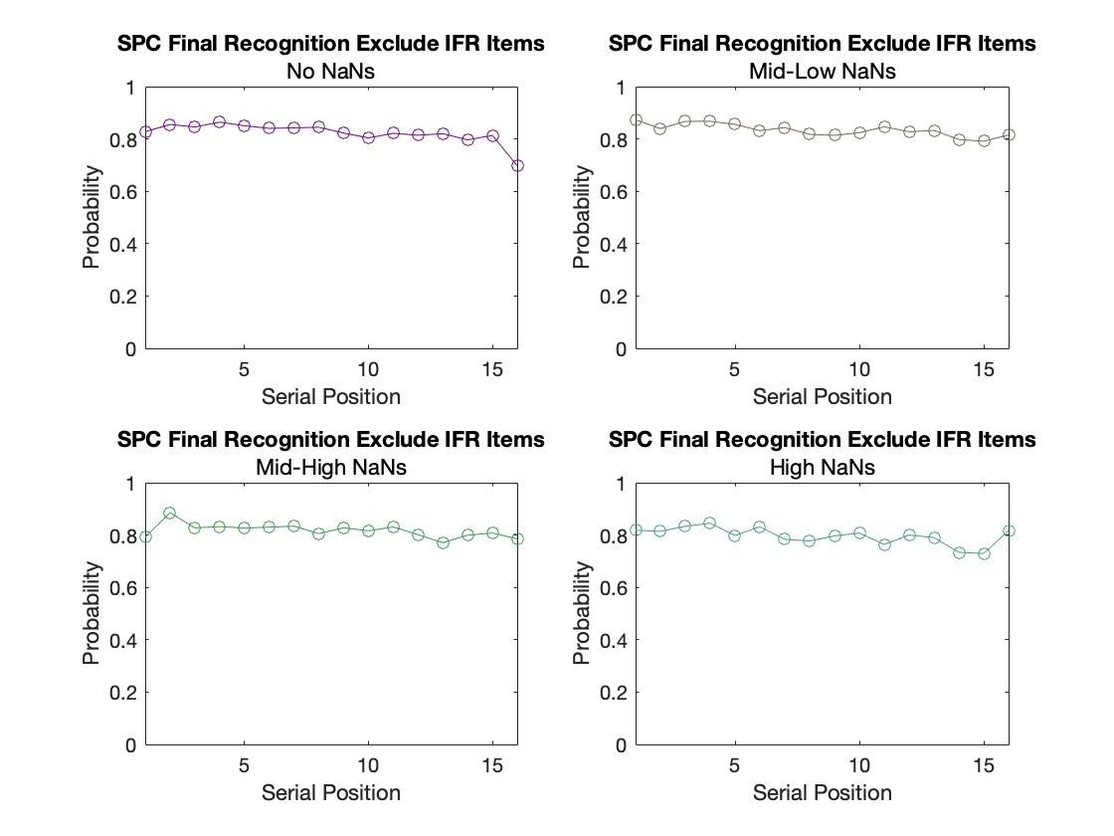
SPC Final Recognition: Exclude IFR Items

Slide 4
SPC Final Recognition: Ignore IFR
Final Recognized Items in SP (i) ÷ All Opportunities to Recognize Items from SP (i)

Slide 5
SPC Final Recognition: Conditional on IFR
Final Recognized Items that were IFR / All IFR Items Testing in Final Recognition

Slide 6
SPC Final Recognition: Excluding IFR
Final Recognized Items (Not IFR)/ All Opportunities to Recognize an Items (Not IFR) from SP (i).

Slide 7
