Slide 1
Recognition Models
07-24-2021

Slide 2
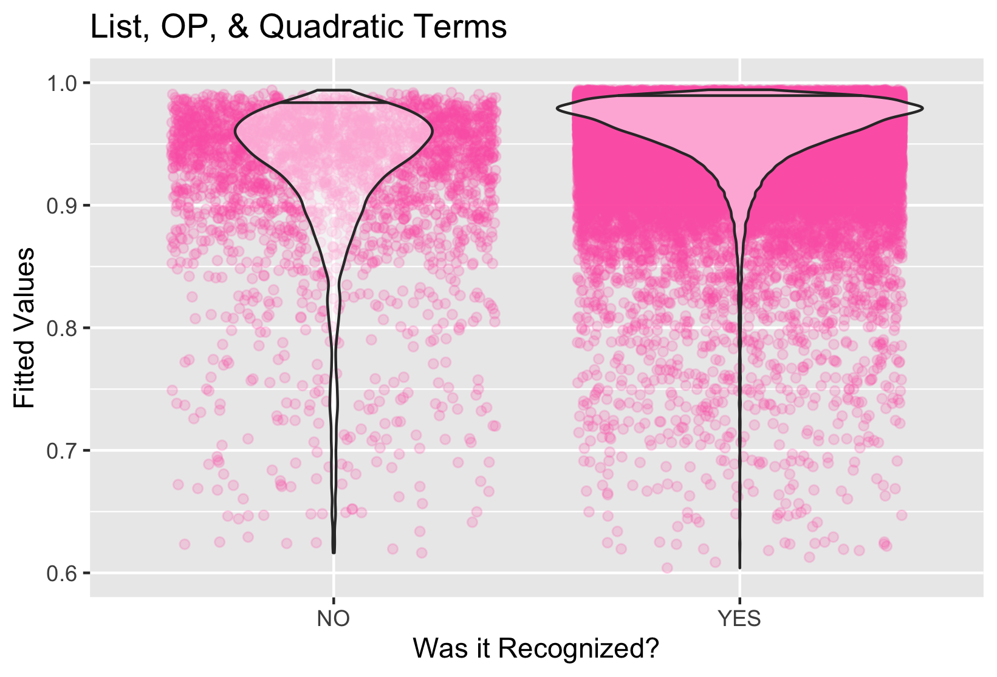
BIC:22910.7
R^2: 0.1657
Betas
OP= -0.0416
OP^2= -0.0038
List= 0.0133
List^2= -0.0012
P Values
OP= 0.02*
OP2 < 0.001***
List= 0.44
List2= 0.217

Slide 3
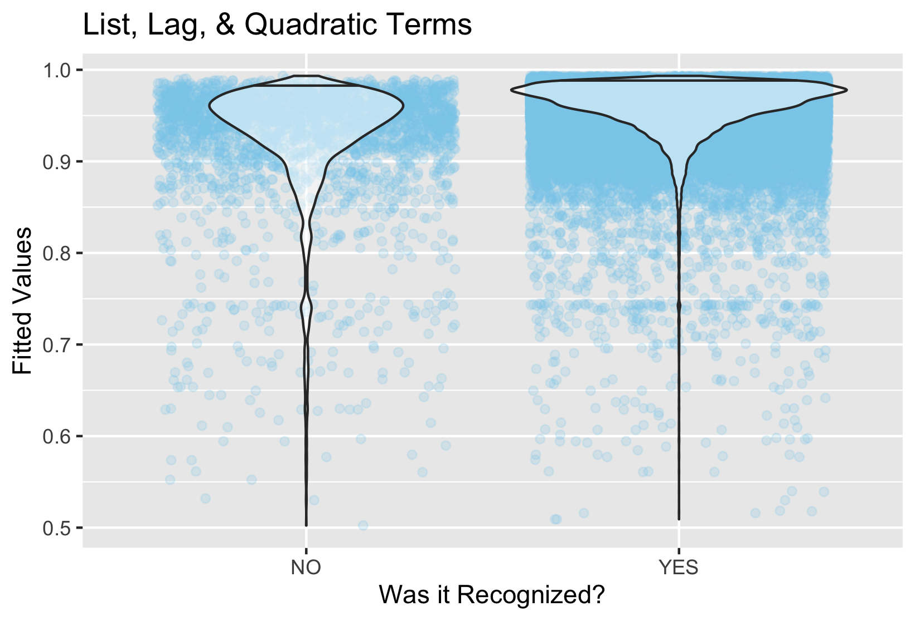
BIC:23063.7
R^2: 0.14613
Betas
Lag= -0.0416
Lag^2= -0.0038
List= 0.0172
List^2= -0.0015
P Values
Lag= 0.317
Lag2 < 0.001***
List= 0.321
List2= 0.136

Slide 4
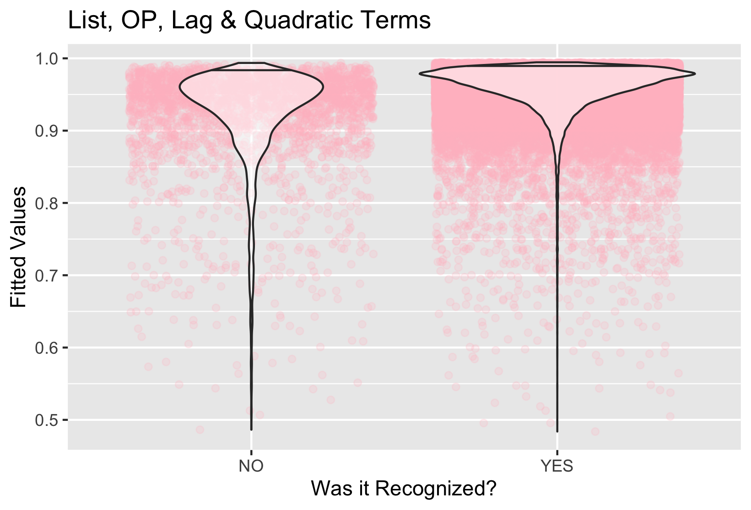
BIC: 22923.36
R^2: 0.16499471
Betas
OP= -0.0798048
OP^2= -0.0013647
Lag= 0.0349803
Lag^2= 0.0349803
List= 0.0133723
List^2= -0.0012326
P Values
OP= 0.00311
OP^2= 0.36448
Lag= 0.00771 **
Lag^2= 0.00208 **
List= 0.44
List2= 0.217

Slide 5
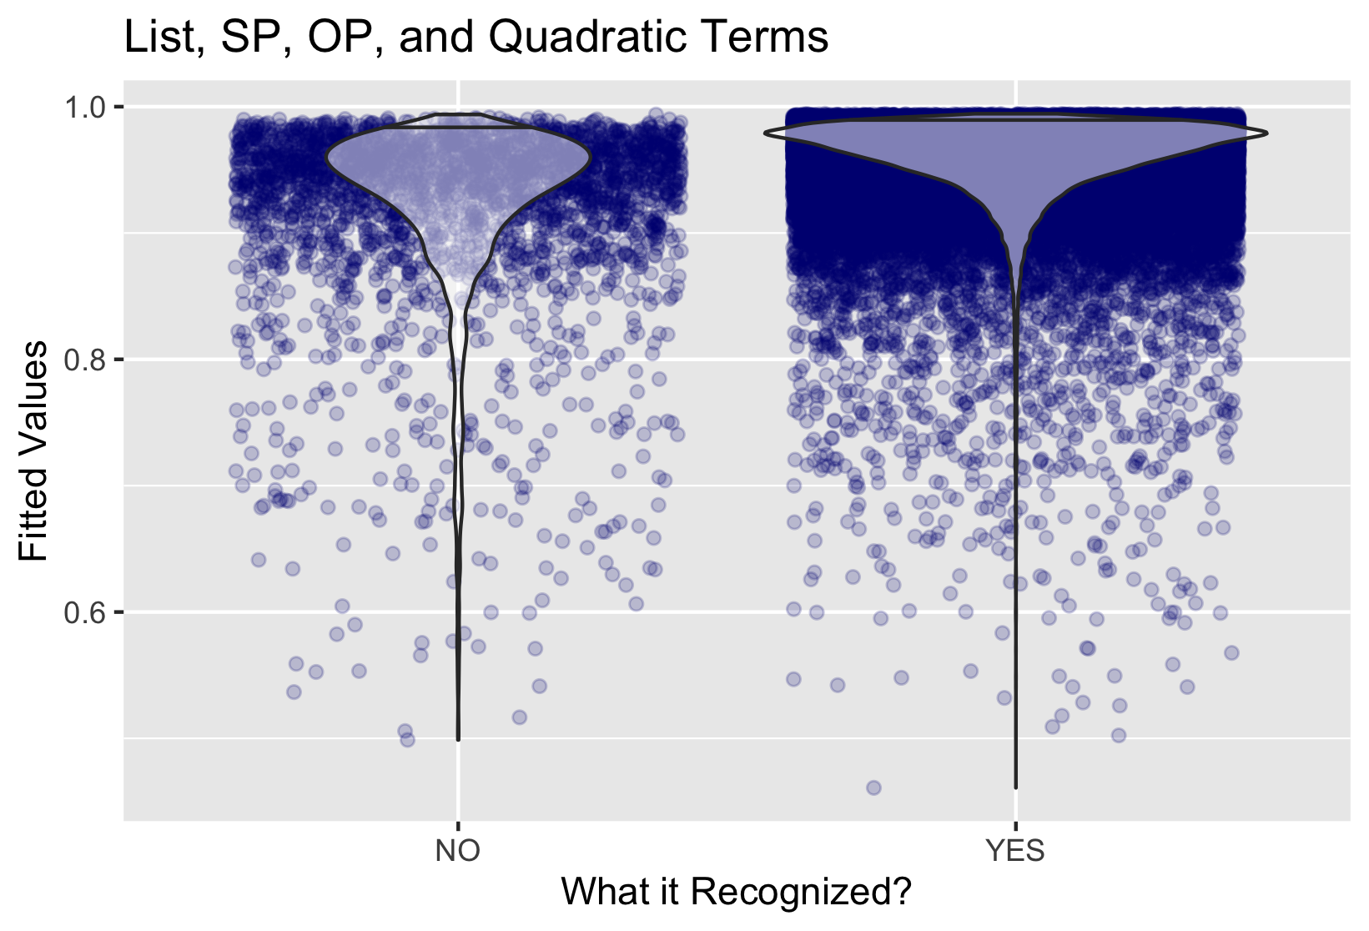
BIC:22926.8
R^2: 0.1660482
Betas
OP= -0.0549277
OP^2= -0.0032196
SP= 0.045
SP^2= -0.003
List= 0.0135
List^2= -0.0012340
P Values
OP= 0.0093**
OP2 < 0.0098**
SP= 0.011*
SP^2= 0.014*
List= 0.4382
List2= 0.21376

Slide 6
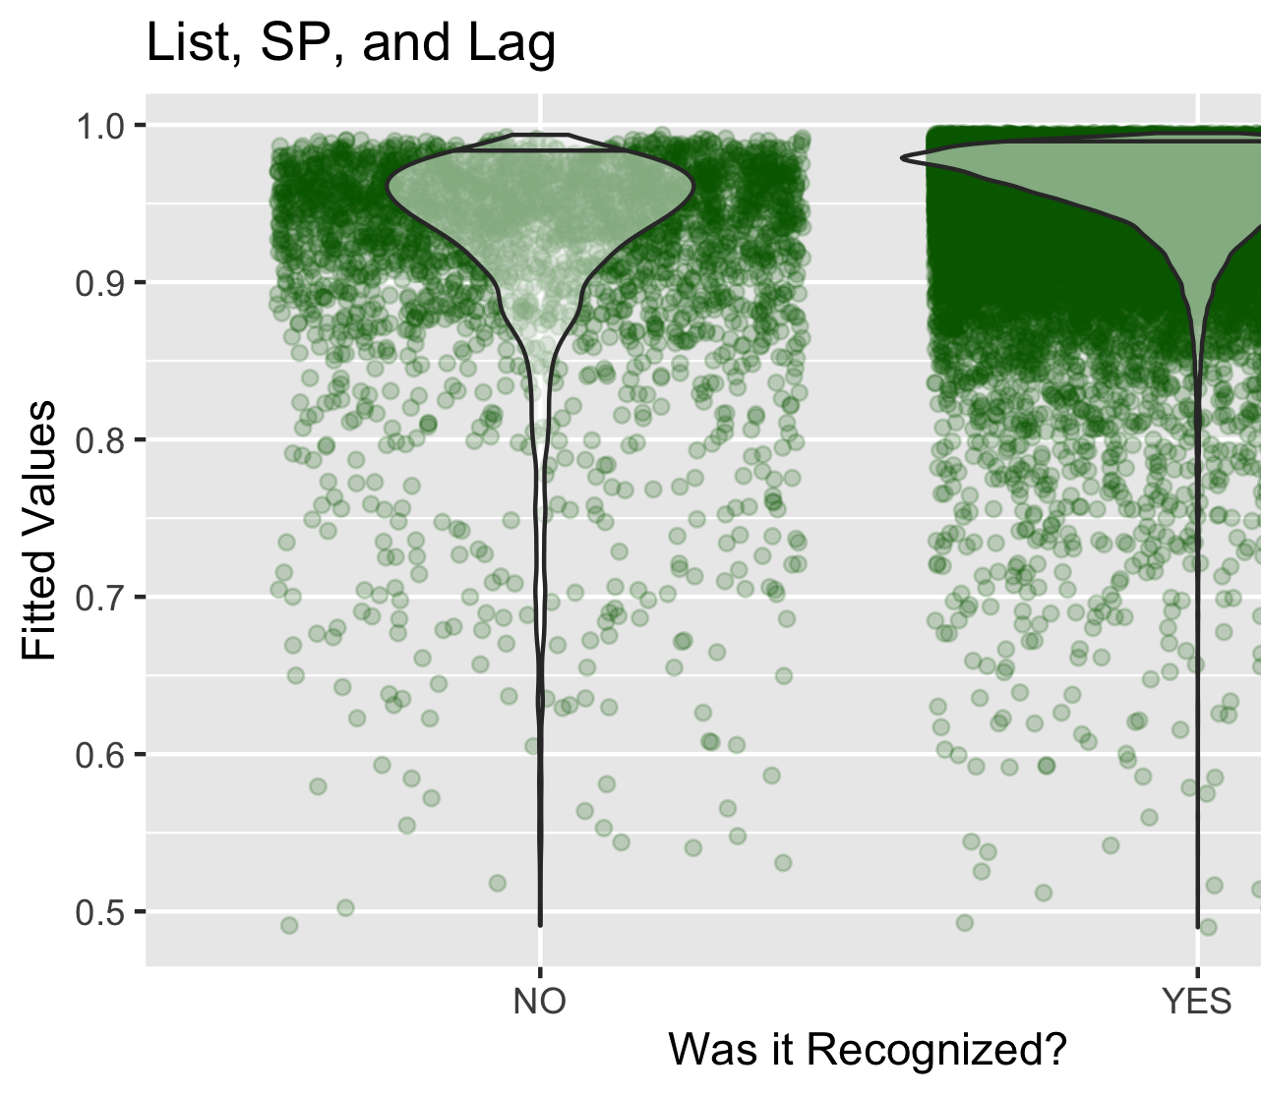
BIC: 22923.9
R^2: 0.16550089
Betas
SP= -0.0932522
SP^2= -0.0006800
Lag= -0.0654295
Lag^2= -0.0014671
List= 0.0130973
List^2= -0.0012212
P Values
SP <0.001***
SP^2= 0.6216
Lag< 0.001*
Lag^2 = 0.002***
List= 0.45185
List2= 0.21864

