Slide 1
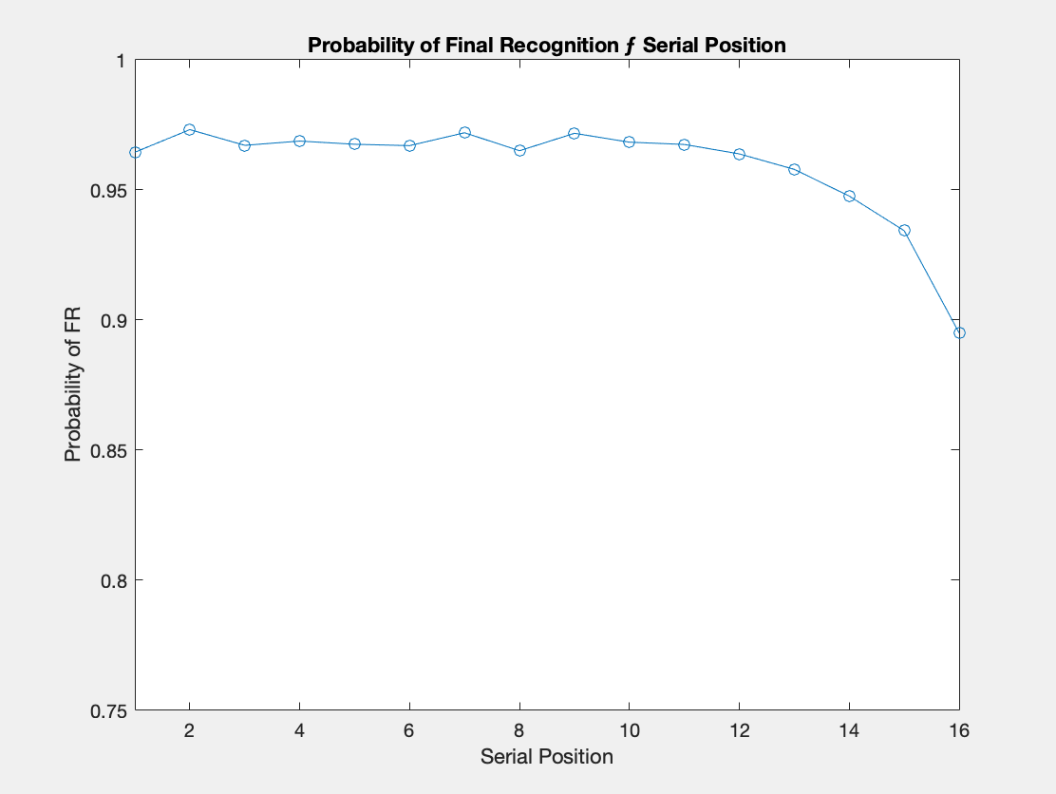
Serial Position (IFR & FR Only) ÷ IFR

Slide 2
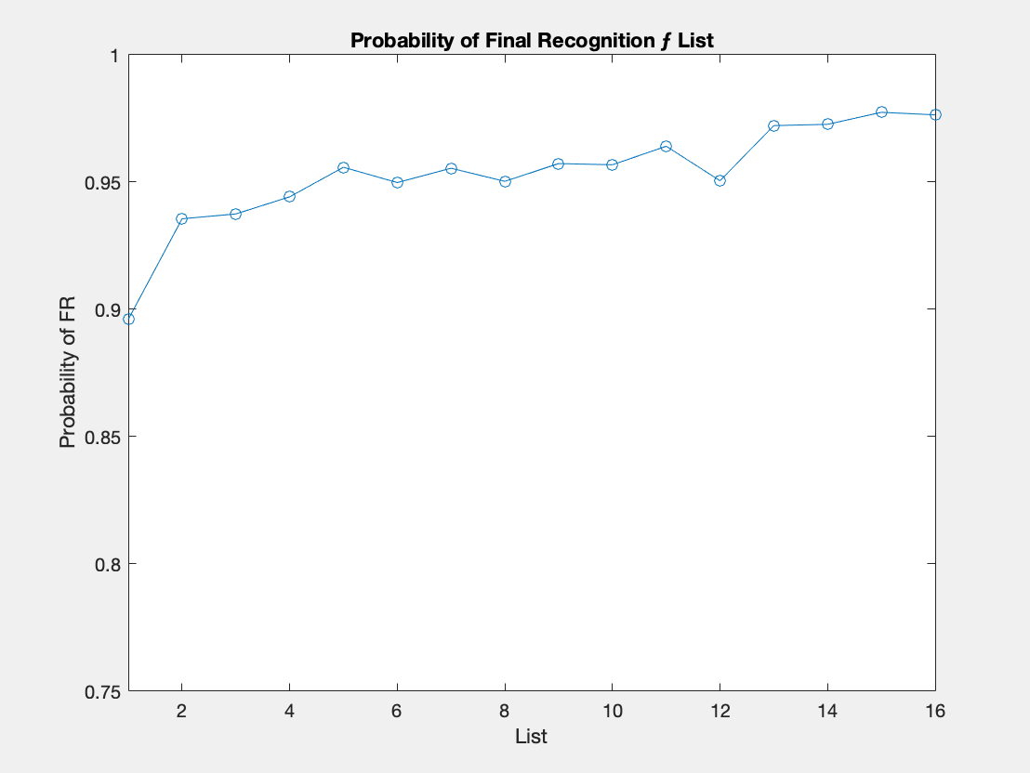
List (IFR & FR Only) ÷ IFR

Slide 3
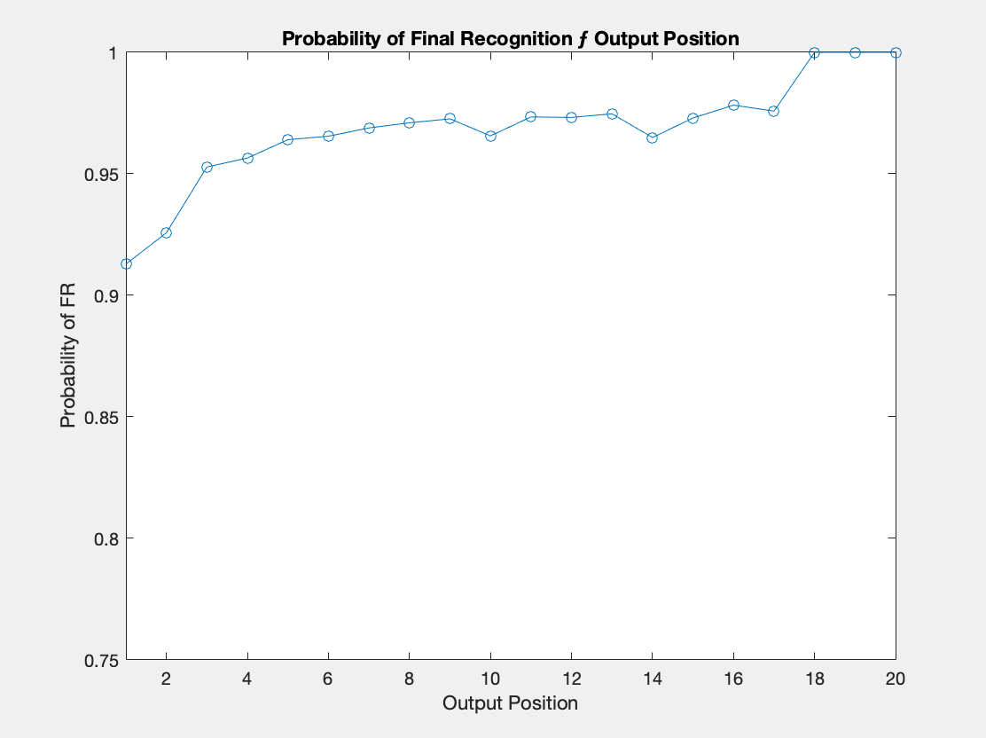
Output Position (IFR & FR Only) ÷ IFR

Slide 4
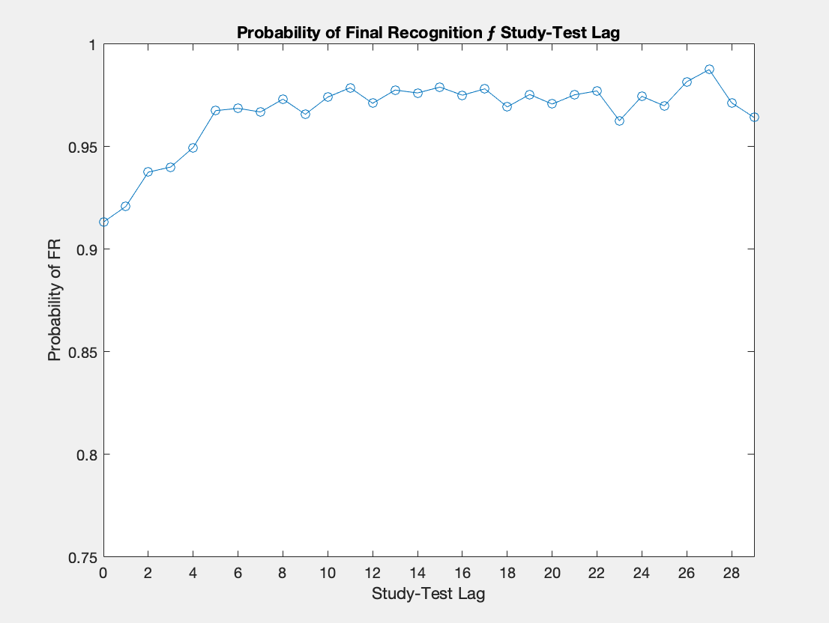
Study-Test Lag (IFR & FR Only) ÷ IFR

