Slide 1
Recognition Models
07-24-2021

Slide 2
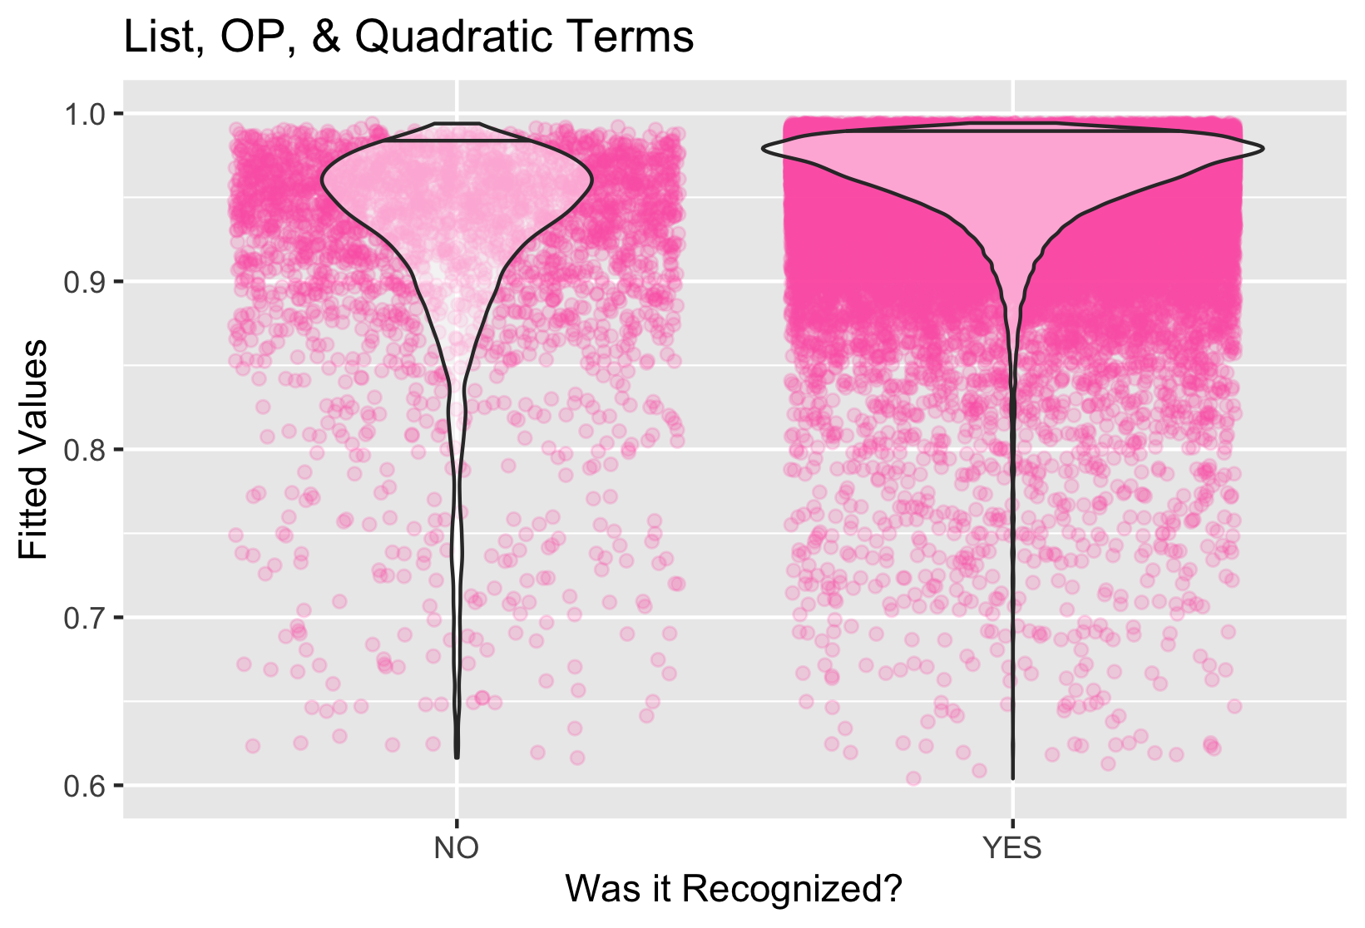
BIC = 22910.75, R^2= 0.166, OP (p)= 0.02* , OP^2 (p)= <0.001*, List (p)= 0.44, List^2 (p)= 0.21 β_OP= -0.04, β_op2= -0.004, list= 0.013, list2= -0.001

Slide 3
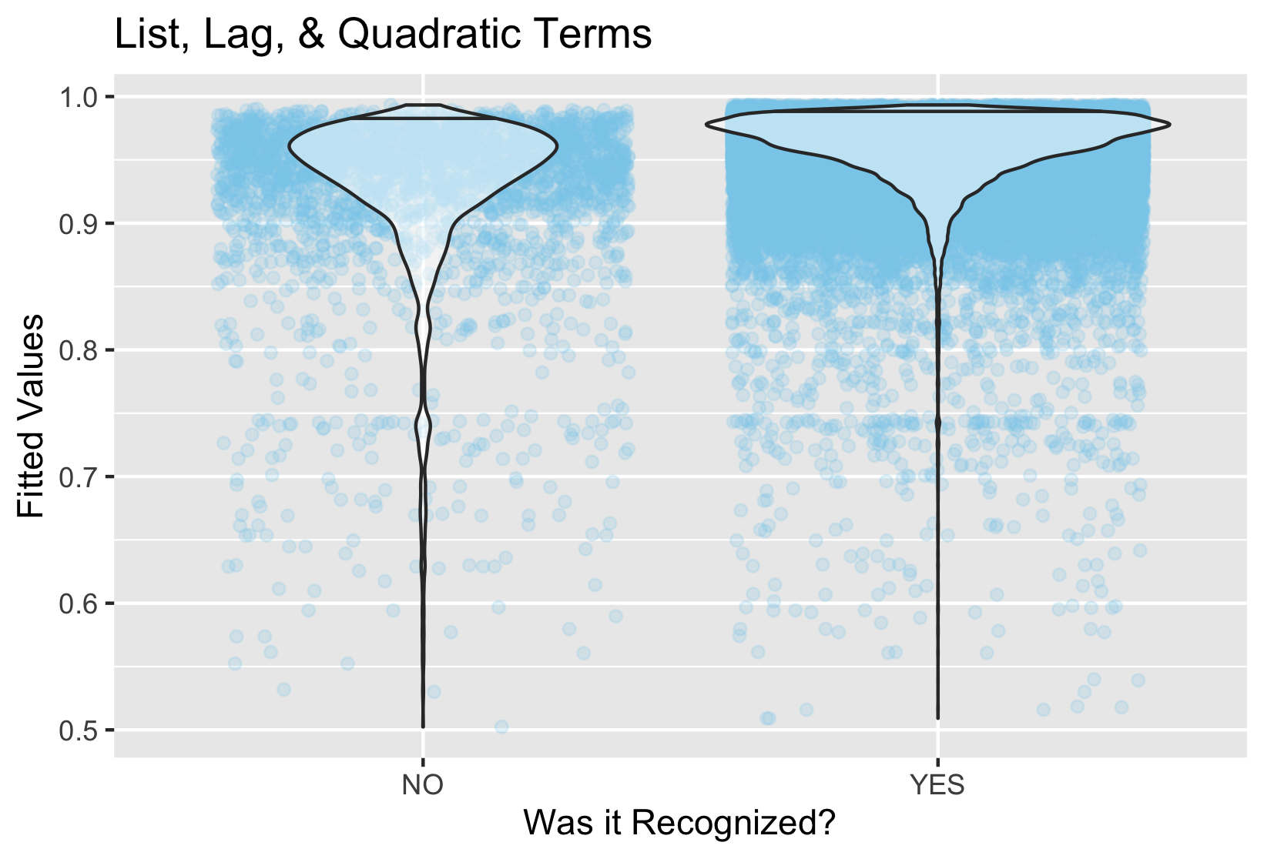
BIC = 23063.7, R^2= 0.146, Lag(p)= 0.317, Lag^2 (p)= <0.001***, List (p)= 0.321, List^2 (p)= 0.136 β_OP= -0.04, β_op2= -0.004, β_list= 0.017, β_list2= -0.0015

Slide 4
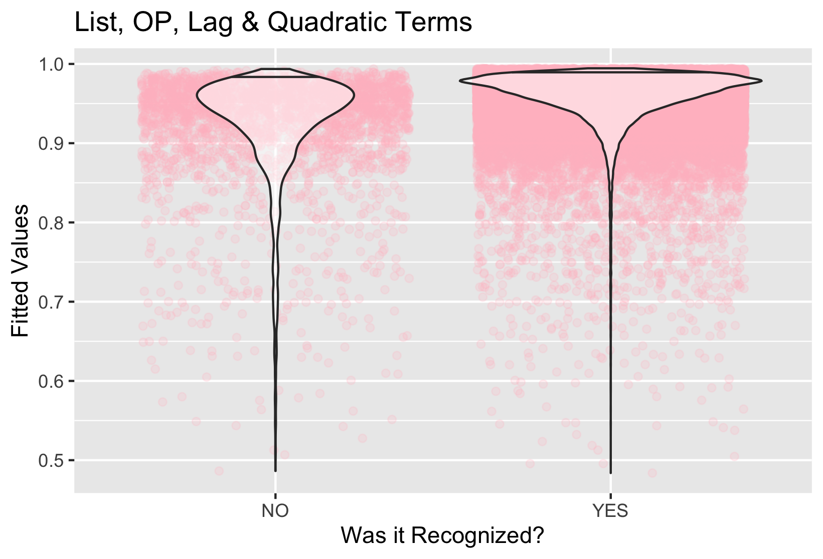

Slide 5
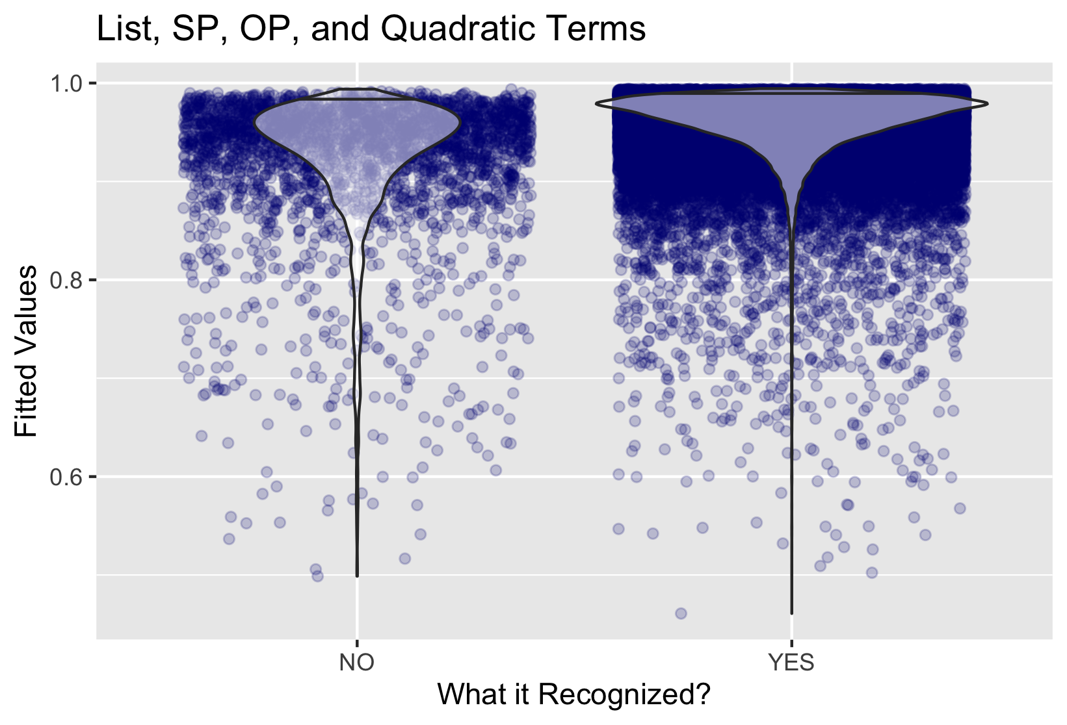

Slide 6
