Slide 1
Make A Copy Of This Deck And Update The Red Ink Based On Your Notebook Results

Slide 2

Instructor Kick-off
Analyze A/B Test Results
© 2019 Udacity. All rights reserved.

Slide 3
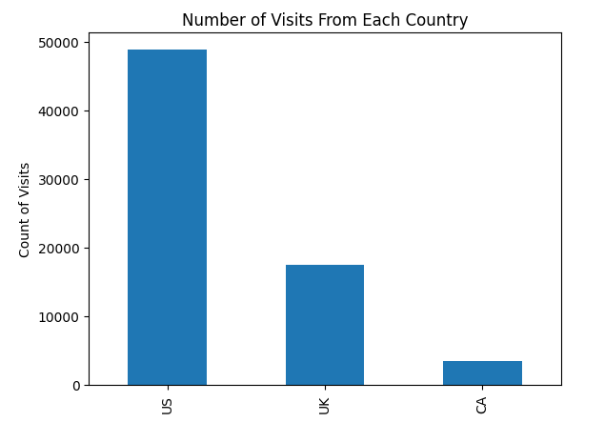
How Was The Experiment Implemented?​
Total Variant Visitors: 35211
Total Control Participants:​ 34678

Slide 4
Conversion Rates
 | U.S. | U.K. | CA
Control | 10.7% | 10.2% | 9.4%
Treatment | 15.8% | 14.9% | 15.4%
Executive Summary: Those with the treatment converted more versus those in the control group. The country appears to have a low impact on the rate of conversion.

Slide 5
Experiment Results
Treatment Conversion Rate: 15.53%
Control Conversion Rate:​ 10.52%
Delta in Treatment vs. Control Conversion Rate:​ 5.01%
p-value:​ 0.02250
Conclusion:​ The treatment group was more effective in converting individuals. It is statistically significant enough to argue that the treatment group was more effective.

Slide 6
Country Results
Conclusion:​ Between countries, there was a larger conversion rate in the control and treatment groups for the US in comparison to the other countries.

