Slide 1

CORE-COURSE PROJECT
Reduction of power, area and delay of 4-bit Vedic multiplier using fast adders
GUIDE : Dr.R.M.BOMMI
TEAM:
1.SRIRAM R
2.SUNIL KRISHNA P J
4.RAWIN PRAKASH S

Slide 2
OBJECTIVE :
The abstract of the project is to reduce the time delay (propagation delay), power consumed, and the area occupied by the 4-bit Vedic multiplier by using the fast adder made using 10 transistors rather than using the conventional CMOS logic that requires 24 transistors. By using the fast adder, 2-bit Vedic multiplier is build which acts as a building block of the 4-bit Vedic multiplier.

Slide 3
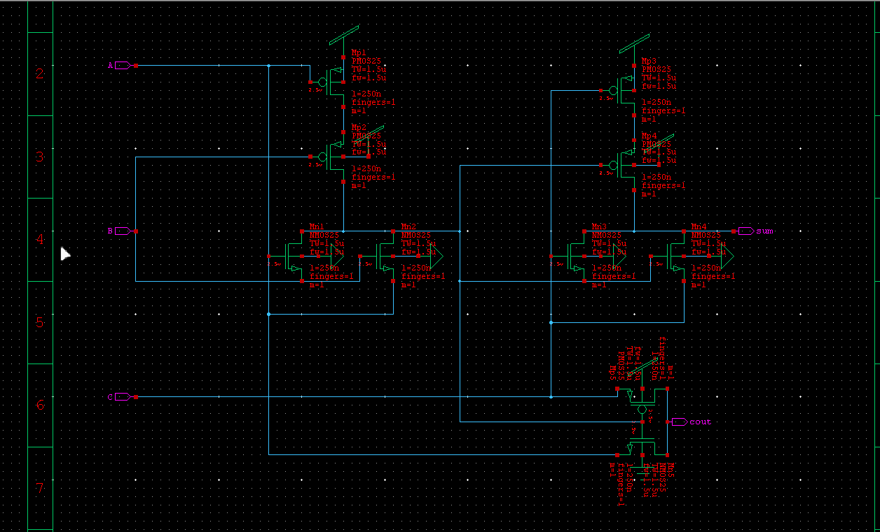
NOVELTY
Our novelty is that , we developed fastadder using SERF (Static Energy Full Adder) technology based on PTL (Pass Transistor Logic).

Slide 4
LITERATURE REVIEW :
This project uses proposed fulladder schematic diagram from the published paper “ Performance Evaluation of High Speed Compressors for High Speed Multipliers Using 90nm Technology “ by N. Ravi1 , T. Jayachandra Prasad2 , M. Umamahesh3 , RGM College of Engineering & Technology, JNT University, Anantapur, AP-518501, India.
In this paper Fig.2(a) depicts a Transmission Function Full Adder (TFA) based on the theory, while Fig.2(b) shows a Transmission-Gate Adder (TGA) using CMOS transmission gates. Both use pass-transistor logic circuits with pMOS and nMOS transistors controlled by complementary signals. Fig.2(c) presents a 14-T full adder with output glitches and subthreshold leakage due to incomplete voltage swing. Fig.2(d) showcases a 16-T full adder with improved speed and lower power consumption. Fig.2(e) displays a Pass Transistor Logic-based Static Energy-Recovery Full (SERF) adder with superior energy efficiency. These adders are tested at 2.0V and 1.0V in a 90nm technology for low power and high-speed performance. The 16-T design offers better results.

Slide 5
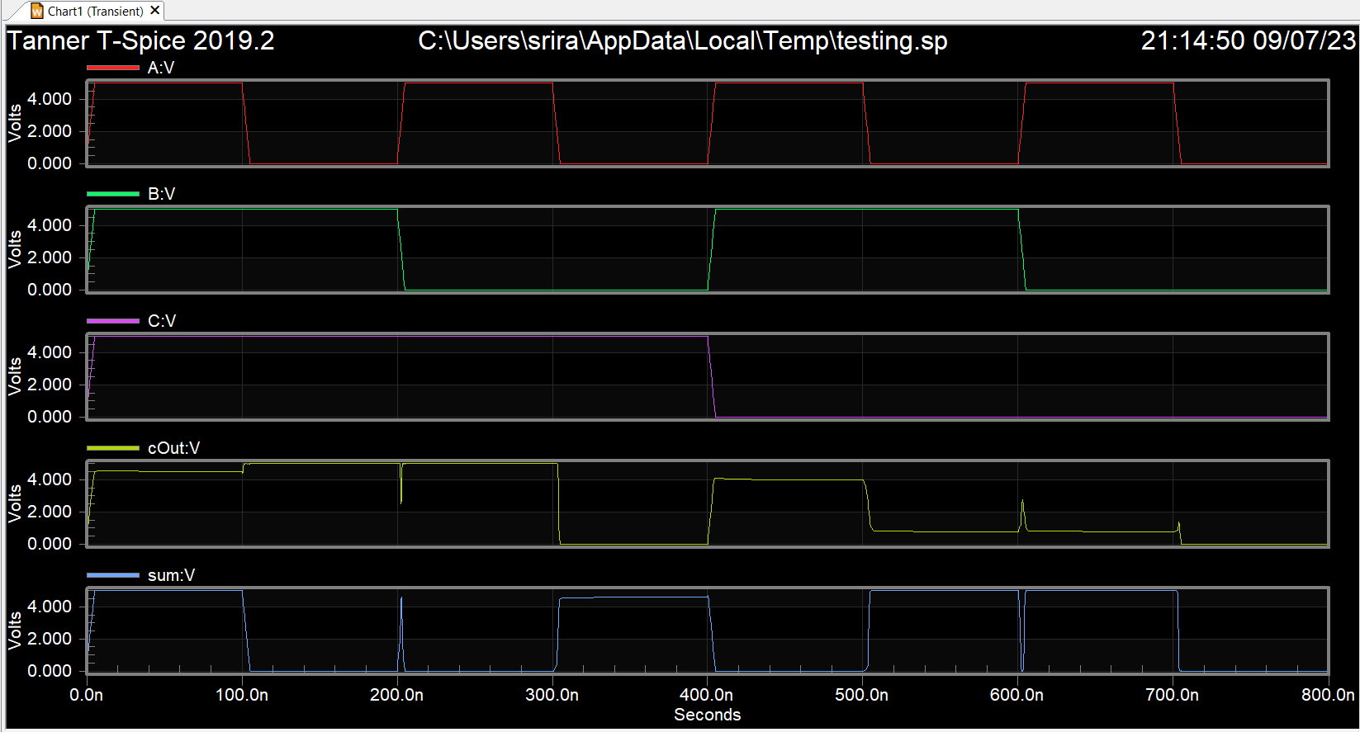
FAST ADDER :
A fast adder is a full-adder that uses only 10 transistors rather than the conventional full adder that consists of two ex-or gates , two and gates with an or gate with the overall transistor count of 32 .

Slide 6
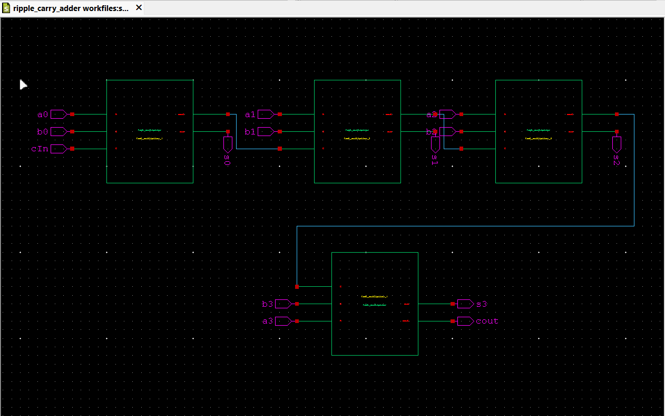
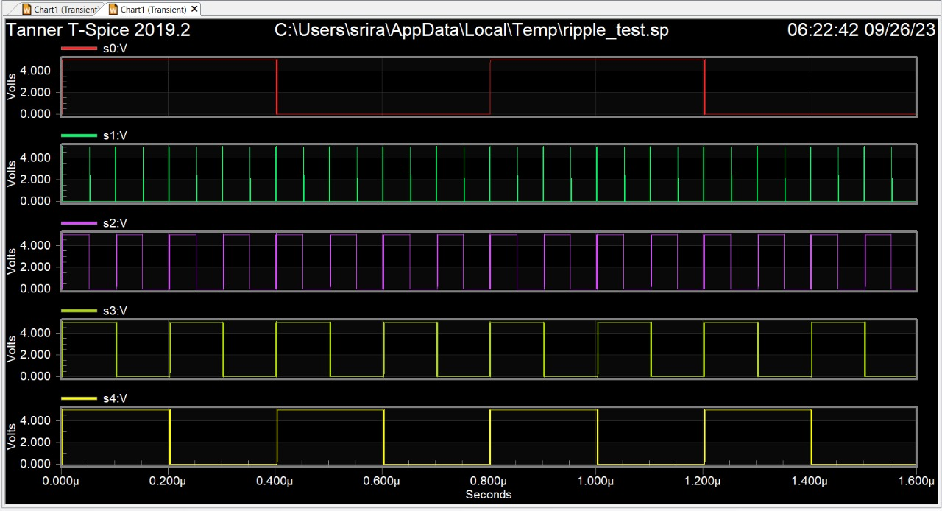
RIPPLE CARRY ADDER :
Ripple Carry Adder is a combinational logic circuit . It is used for the purpose of adding two n-bit binary numbers . It requires n full adders in its circuit for adding two n-bit binary numbers. It is also known as n-bit parallel adder. Here it is built using 4 – fast adders(4-bit ripple carry adder).

Slide 7
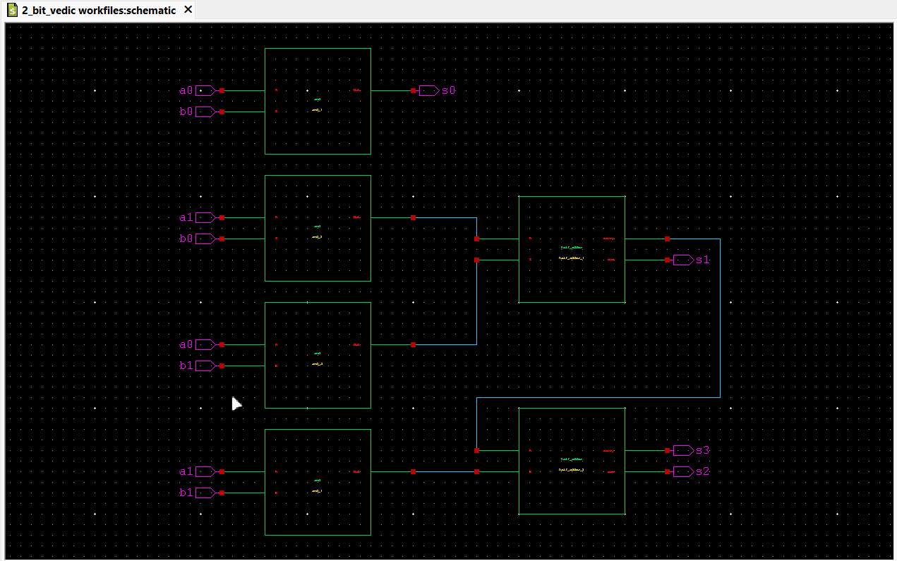
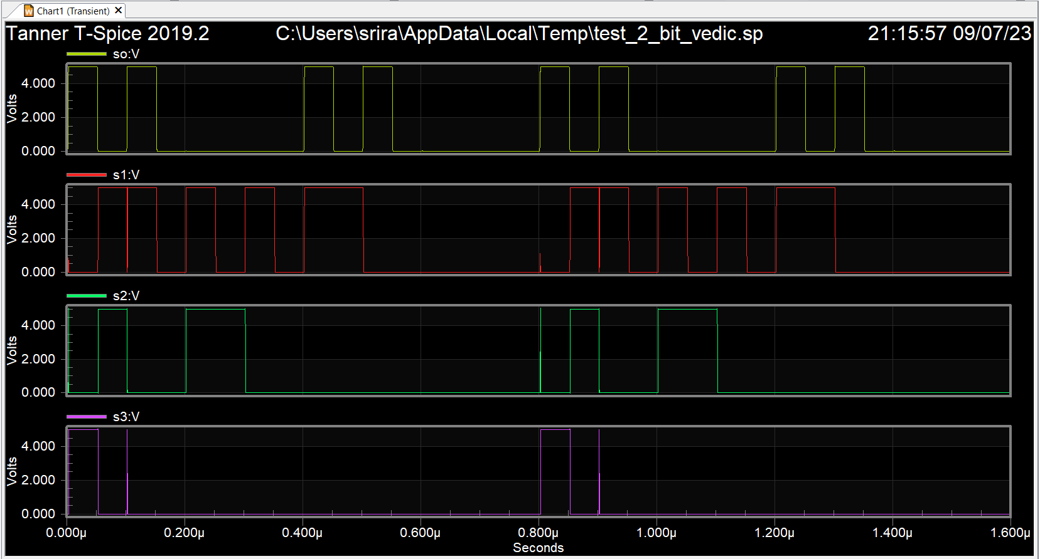
2 – BIT VEDIC MULTIPLIER :
A 2-bit Vedic multiplier is a digital circuit or mathematical technique used to multiply two binary numbers, each consisting of two bits (0 or 1), using the principles of Vedic mathematics. It is built using four and gates and 2 fast adders (with carry in =0)

Slide 8
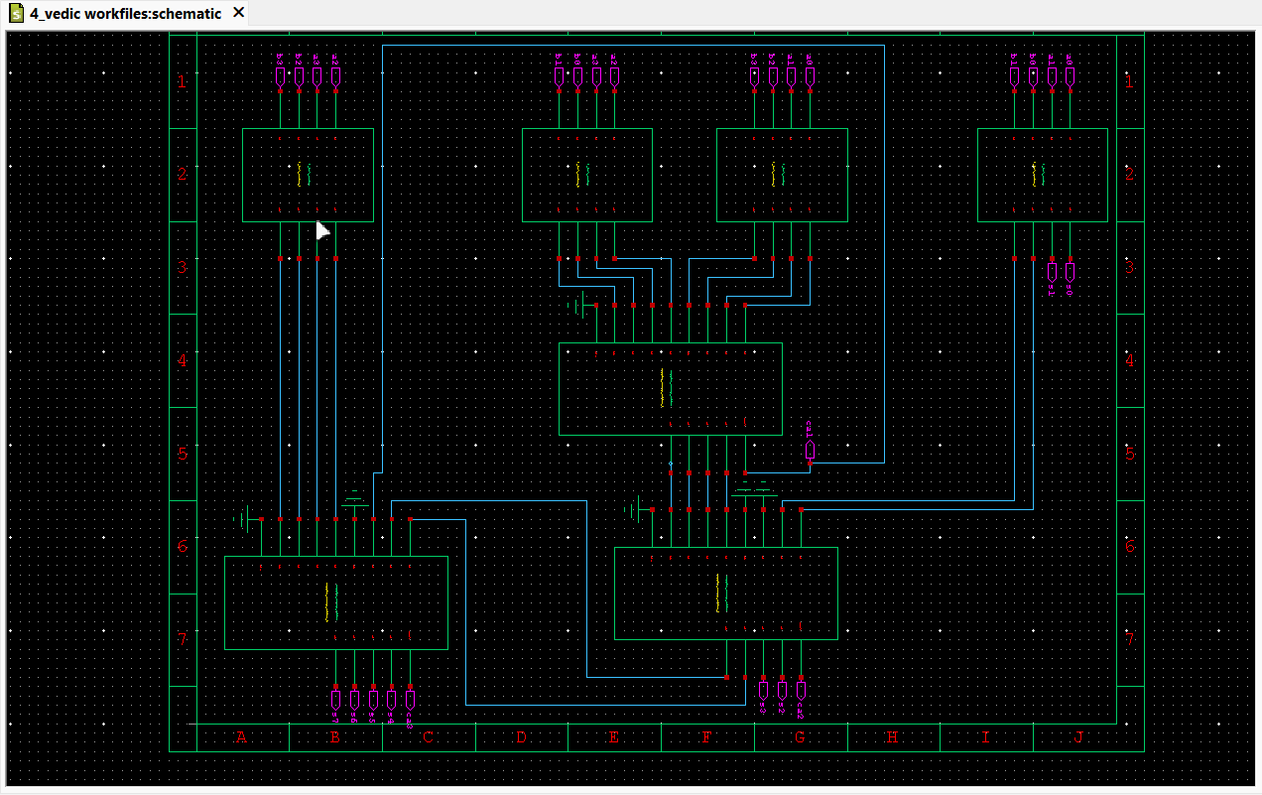
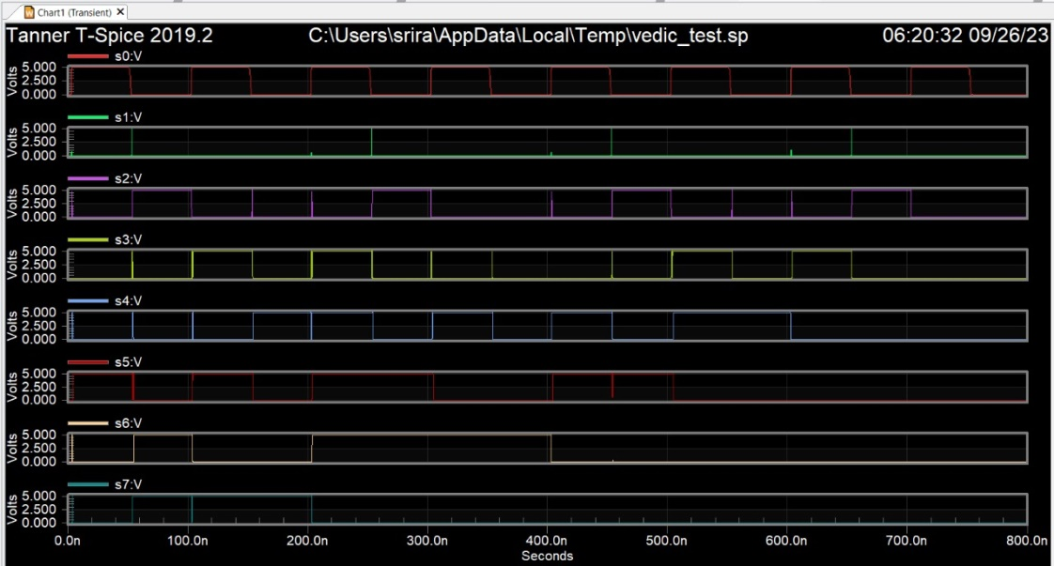
A 4-bit Vedic multiplier is a digital circuit or mathematical technique used to multiply two 4-bit binary numbers using Vedic mathematics principles. It operates on two 4-bit binary inputs, typically labeled as A (the multiplicand) and B (the multiplier), and produces an 8-bit binary output as the product of the multiplication. It is built using four 2-bit Vedic multiplier and 3 ripple carry adder
4 – BIT VEDIC MULTIPLIER :

Slide 9
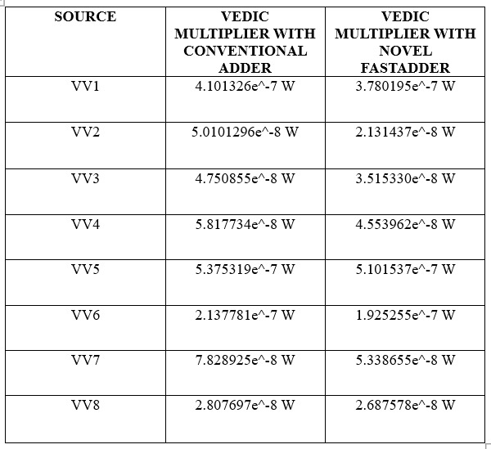
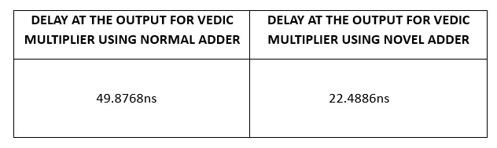
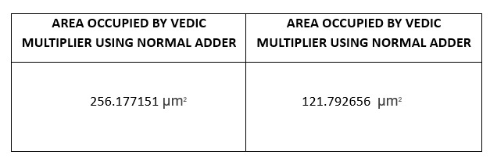
RESULTS :
We have took output for our novel implementation of Vedic multiplier consist of fast fulladder that has 10 transistors and output of normal Vedic multiplier that has normal fulladder consist of 32 transistors
Power Consumption
Time Delay
Area Calculation

Slide 10
Conclusion
In conclusion, the project successfully achieved its objective of reducing time delay, power consumption, and area occupation in the 4-bit Vedic multiplier design. This was accomplished by implementing a fast adder with only 10 transistors, as opposed to the conventional CMOS logic requiring 24 transistors. By using this efficient fast adder, a 2-bit Vedic multiplier was created, serving as a foundational component of the 4-bit Vedic multiplier. This approach not only optimized performance but also enhanced the overall efficiency and scalability of the multiplier design, making it a valuable advancement in digital circuitry.

