Slide 1
Setting up Zeppelin with Spark and Flink under the hood
Trevor Grant
@rawkintrevo
Github.com/rawkintrevo
Trevor.d.grant@gmail.com

Slide 2
Download
Ubuntu 14.04 Virtual Disk
VM Machine

Slide 3
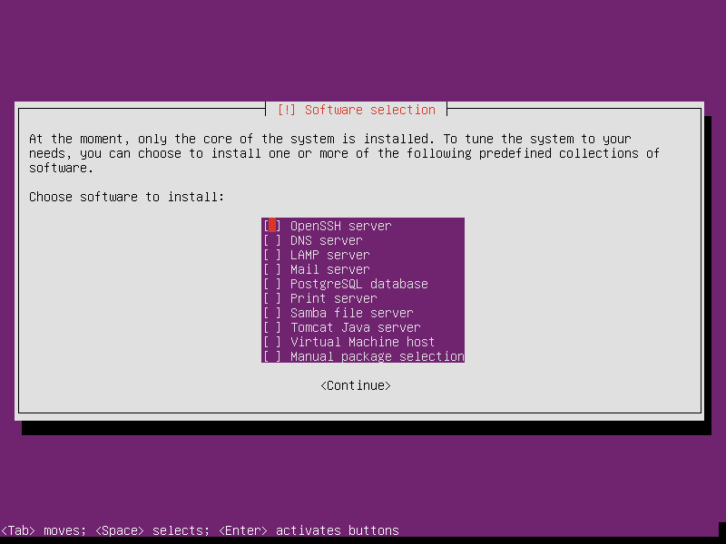
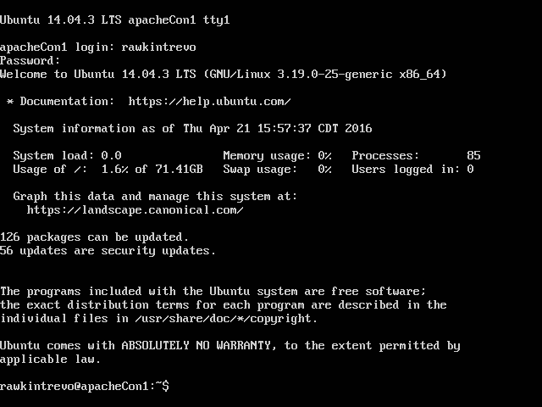
Create New VM- Install Ubuntu 14.04LTS
Start Machine with Ubuntu ISO
Don’t install anything but core. We’ll get what we need later.
If all went well it should boot up to this.

Slide 4
Basic Programs
Git:
sudo apt-get install git
sudo apt-get install openssh-server
sudo apt-get install openjdk-7-jdk openjdk-7-doc openjdk-7-jre-lib

Slide 5
Upgrade to Maven 3.3.9
mvn -version
sudo apt-get purge maven maven2
wget "http://www.us.apache.org/dist/maven/maven-3/3.3.9/binaries/apache-maven-3.3.9-bin.tar.gz"
tar -zxvf apache-maven-3.3.9-bin.tar.gz
sudo mv ./apache-maven-3.3.9 /usr/local
sudo ln -s /usr/local/apache-maven-3.3.9/bin/mvn /usr/bin/mvn

Slide 6
Clone/Build Zeppelin
Note: We’re Data Cowboys (and Cowgirls) so we’re going to be running against master for most demos and then at the end show how to do this against special releases.
Git clone https://github.com/apache/incubator-zeppelin
Cd incubator-zeppelin
Mvn clean package -DskipTests

Slide 7
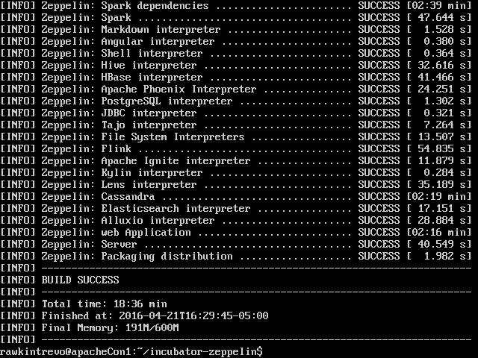
Success

Slide 8
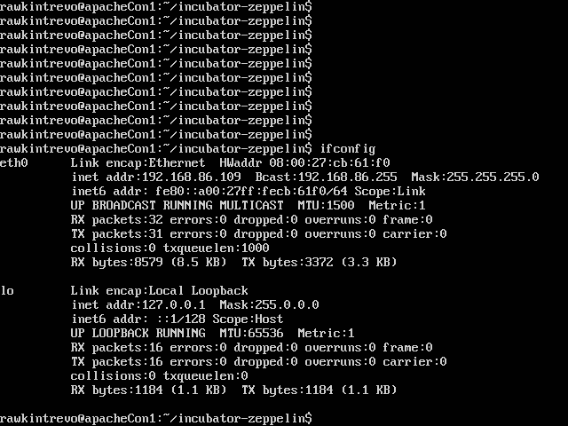
Ifconfig

Slide 9
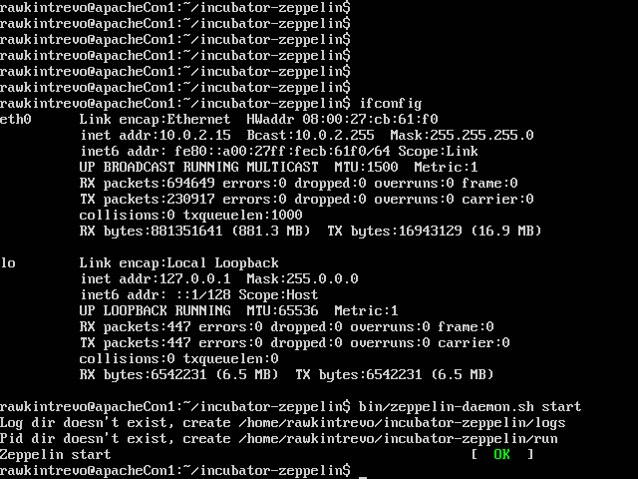
Start Zeppelin

Slide 10

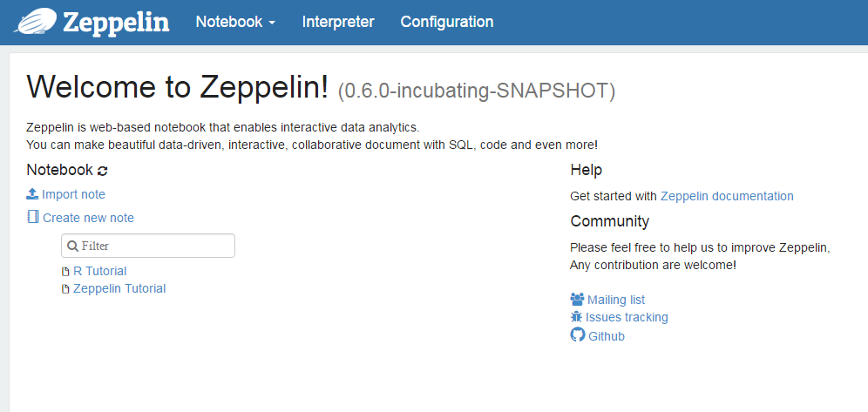
Open Zeppelin
In Chrome open <ip>:8080
Should look like this…

Slide 11
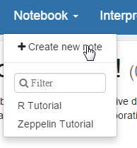
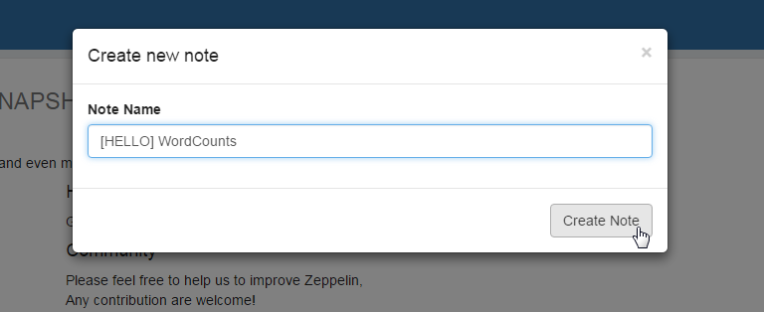
Create a new note
Create new note
Give it a creative name.

Slide 12
Simple Word Counts
Flink WordCount Code
https://gist.github.com/rawkintrevo/ad206879753733f5a536
Spark WordCount Code
https://gist.github.com/rawkintrevo/888ceef526751603b72b
Copy and Paste Code into Notebook

Slide 13
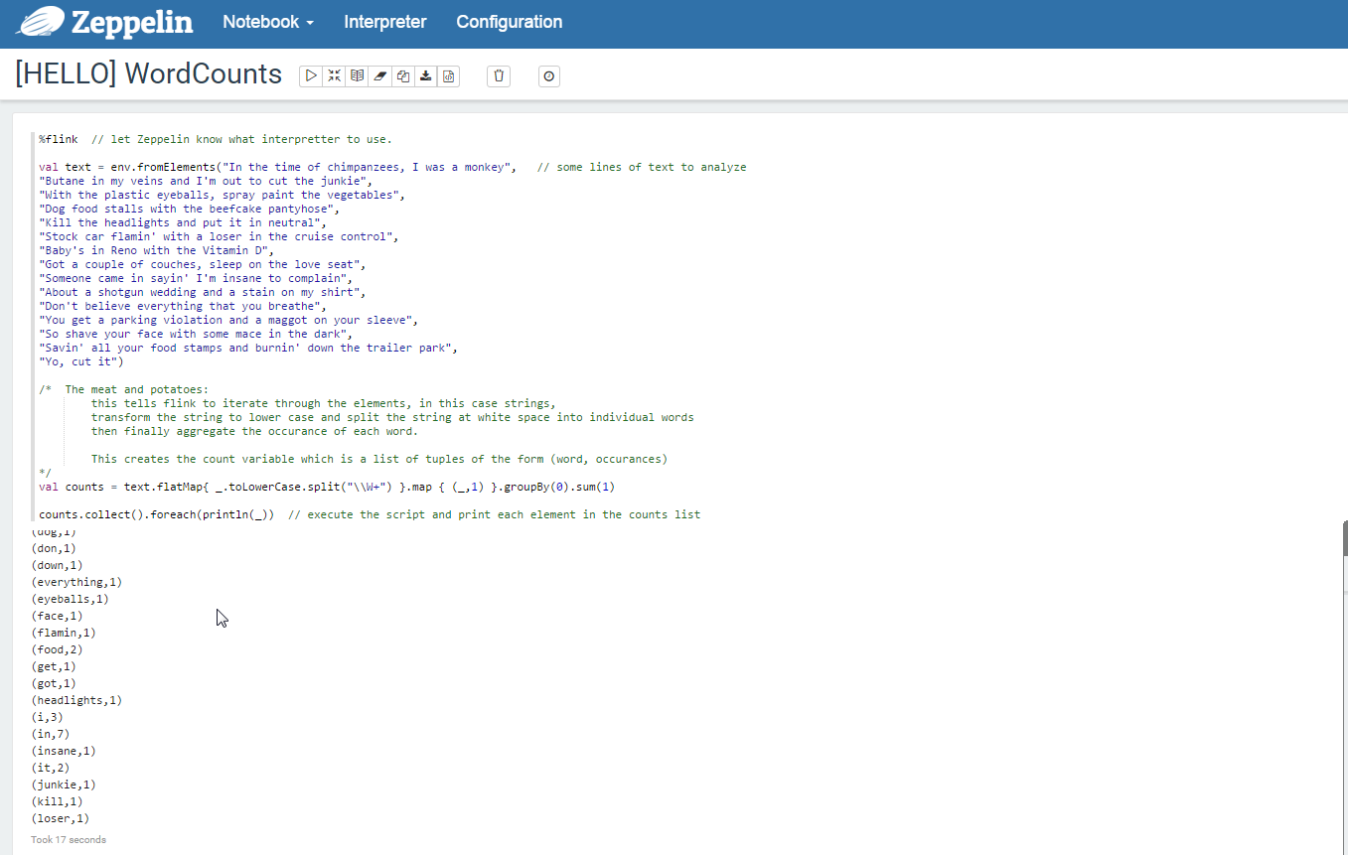

Slide 14

You did it!
You just ran your first Flink and your first Spark program.

Slide 15
The End.

Slide 16


Slide 17
Bonus Material
I made funny joke

Slide 18
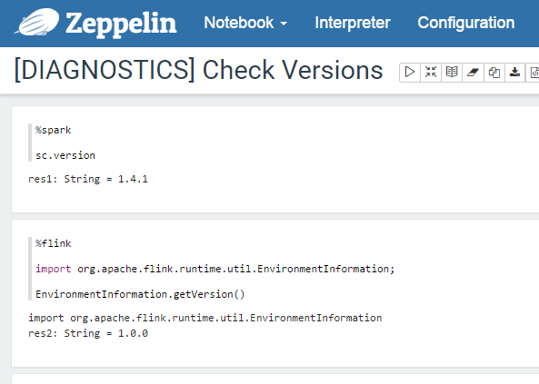
Check Versions
Create a notebook called something like “[DIAGNOSTICS] Check Version”

Slide 19
I want to be an open-source cow(boy/girl)
Meanwhile, back at the ranch shell
cd $HOME
git clone https://github.com/apache/flink
git clone https://github.com/apache/spark
We’re not going to do this
Spark takes forever to build.
I was having issues when doing it on my virtual machine (random machine aborts)

Slide 20
Spark from Binaries
wget “http://mirrors.ocf.berkeley.edu/apache/spark/spark-1.6.1/spark-1.6.1-bin-hadoop1.tgz”
tar –xvzf spark-1.6.1-bin-hadoop1.tgz
ln spark-1.6.1-bin-hadoop1 spark

Slide 21
Build Flink 1.0.2-RC3
cd flink
git checkout release-1.0.2-rc3
mvn clean install –DskipTests
install is a key word here (earlier we just packaged). This installs jars to local maven repository. More on that in a second.
(Why not 1.1-SNAPSHOT e.g. Master? Be patient young Jedi).

Slide 22
Build Spark 1.6.2 (if you had cloned it)
cd $HOME/spark
sudo apt-get install r-base r-base-dev
git checkout branch-1.6
MASTER is on 2.0, we could hack this, but a bit more advanced.
mvn clean install –Psparkr –DskipTests

Slide 23
Check version in maven repo
cd $HOME/.m2/repository/org/apache/flink/flink-core
ls to see available version…
1.0.0 , 1.0.2, 1.1-SNAPSHOT available.

Slide 24
Build Zeppelin against specific versions
cd $HOME/incubator-zeppelin
bin/zeppelin-daemon.sh stop
mvn clean package –DskipTests –Ppyspark –Psparkr –Pspark-1.6 –Dflink.version=1.0.2
Note on Flink Version. 1.0.2 is a release candidate, and not in the public repositories. You have to build install to install Flink v.1.0.2 to the local repositories, otherwise you will get errors (because Zeppelin can’t find the version you are talking about).

Slide 25
Start Flink and Spark
$HOME/incubator-zeppelin/bin/zeppelin-daemon.sh start
$HOME/flink/build-target/bin/start-cluster.sh
$HOME/spark/sbin/start-all.sh

Slide 26
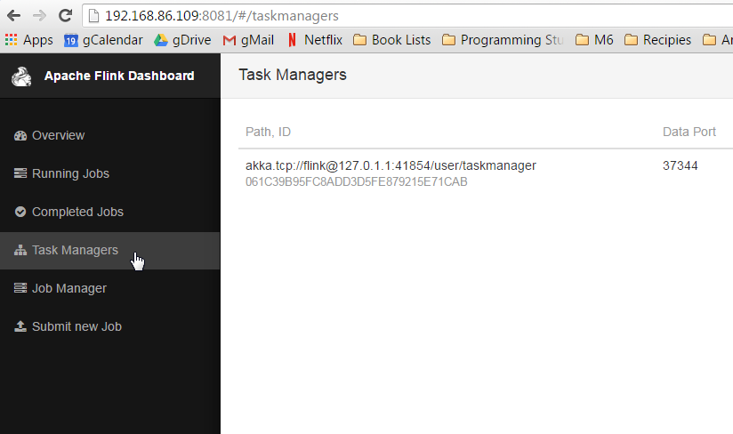
Check WebUIs: Flink
http://192.168.86.109:8081/

Slide 27
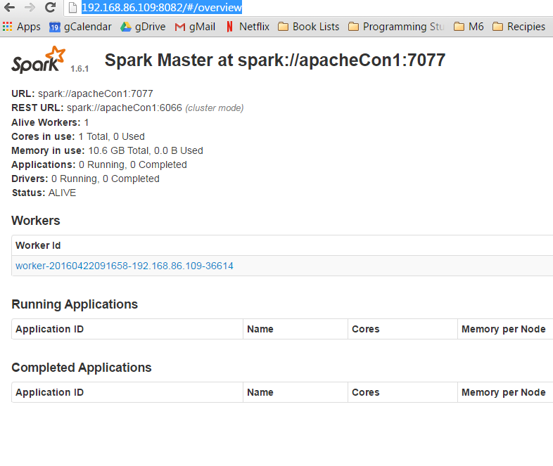
Check WebUIs: Spark
http://192.168.86.109:8082/
Write this address down. You’ll need it in a sec.

Slide 28
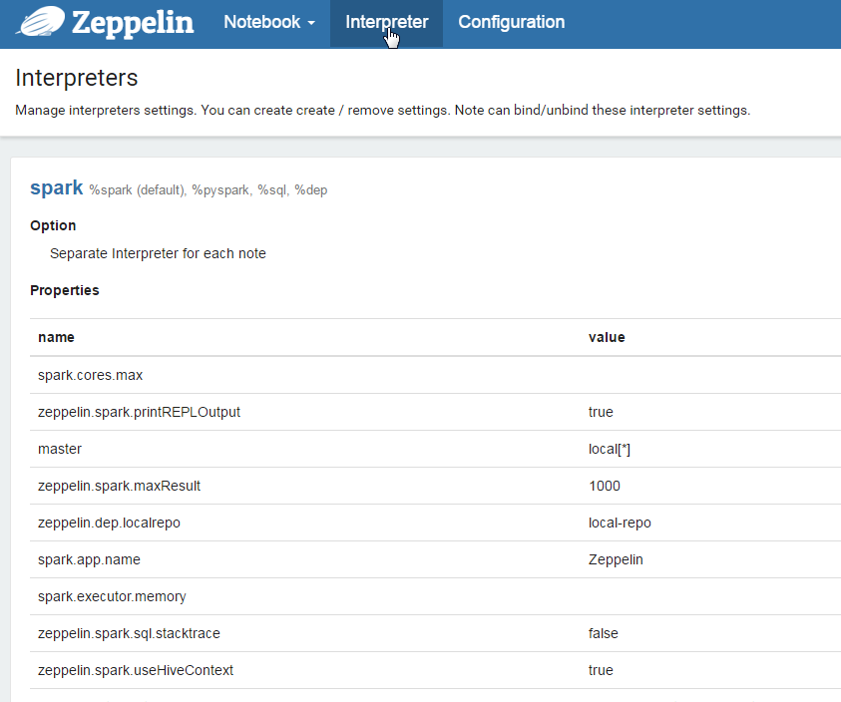
Connect Zeppelin to Clusters

Slide 29
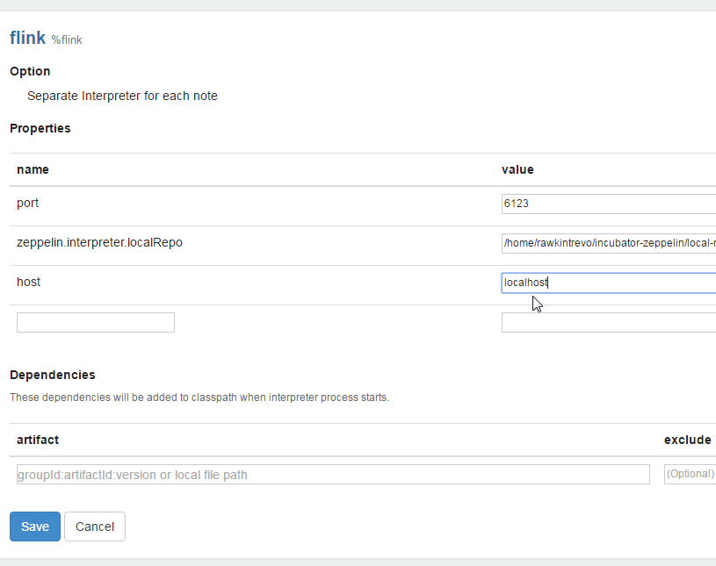
Connect Zeppelin to Clusters
Change ‘host’: local -> localhost
Don’t forget to click ‘Save’ !!

Slide 30
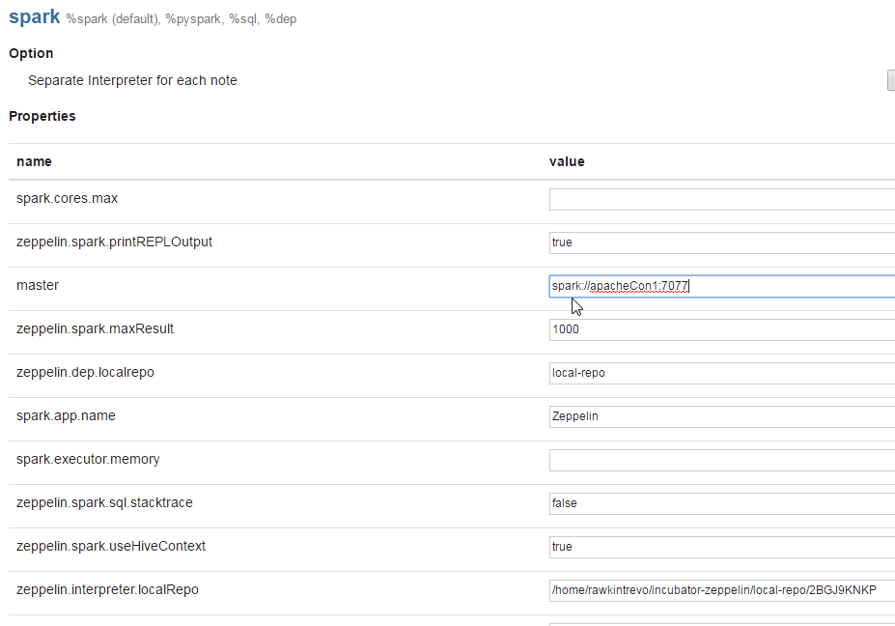
Connect Zeppelin to Clusters
Change ‘master’: local[*] -> value found on previous page
Don’t forget to click ‘Save’ !!

Slide 31
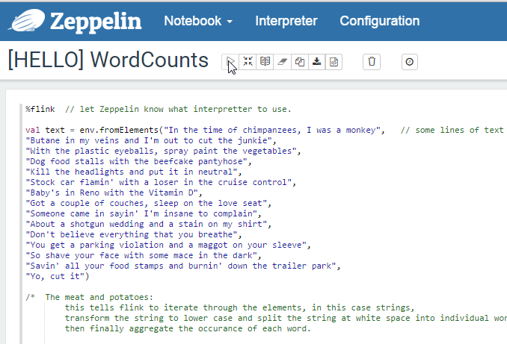
Rerun WordCounts notebook
Click ‘RunAll’ at top

Slide 32
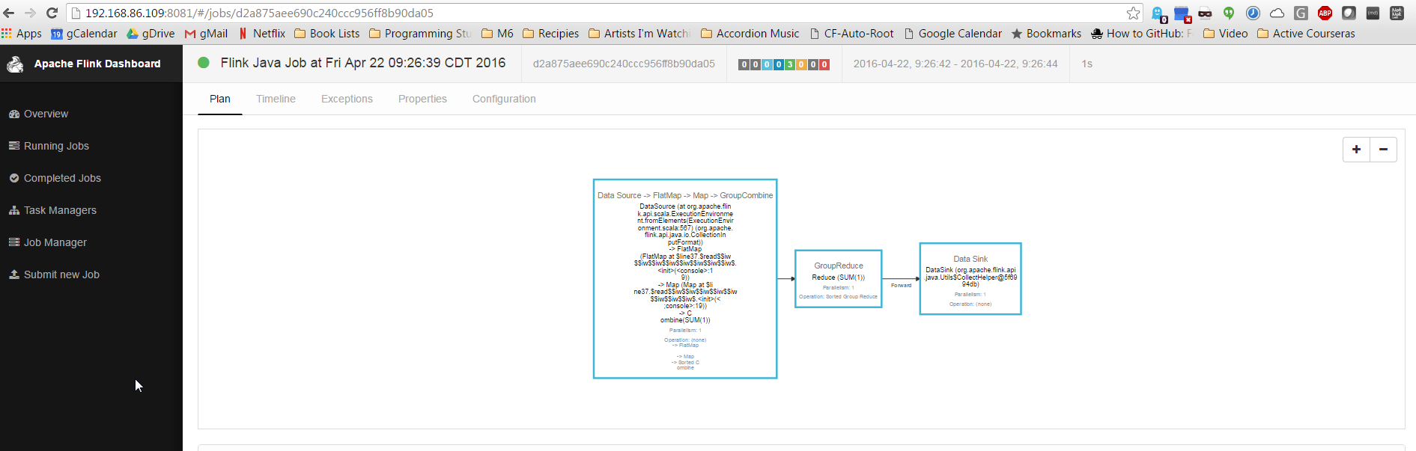
Flink WebUI for completed Job

Slide 33
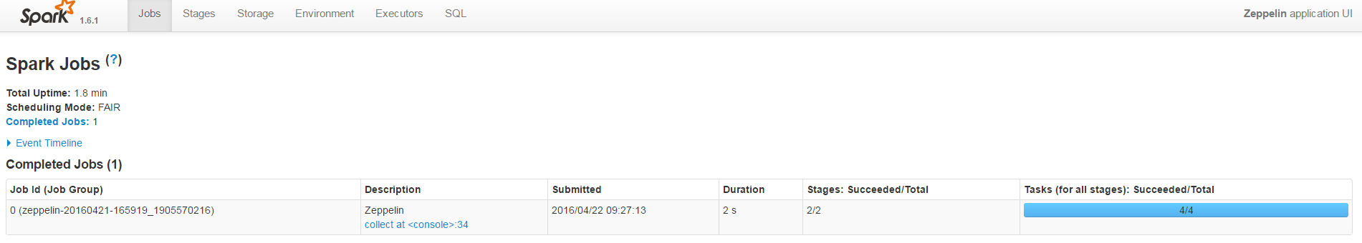
Check UIs again
Spark JobUI at port 4040

Slide 34
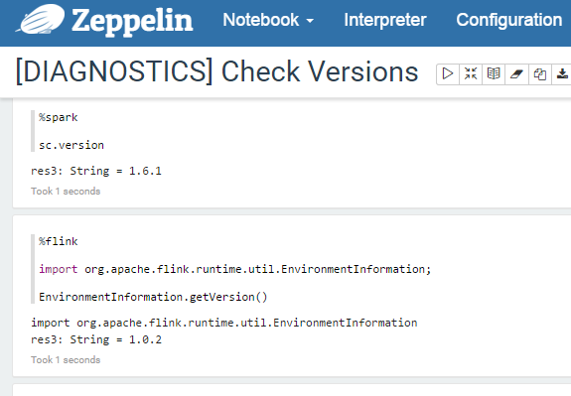
Check Versions again
Flink at 1.0.2, Spark at 1.6.1

Slide 35
If using SparkR
sudo pico /etc/apt/sources.list
Add the following line:
deb https://cloud.r-project.org/bin/linux/untutu trusty/
sudo apt-key adv –keyserver keyserver.Ubuntu.com –recv-keys E084DAB9
^^source
sudo apt-get update
sudo apt-get install r-base

Slide 36
SparkR part 2
R
^^ type at shell to start R
In R:
install.packages(“evaluate”)
^repeat for “knitr”, “repr”, “htmltools”, “base64enc”
“glmnet”, “pROC”, “data.table”, “caret”, “sqldf”, wordcloud”,
“rCharts”, “googleVis”, “ggplot2”

Slide 37
SparkR part 3
cd $HOME/incubator-zeppelin
cp conf/zeppelin-env.sh.template conf/zeppelin-env.sh
pico conf/zeppelin-env.sh
Uncomment SPARK_HOME, set value to $HOME/spark
export SPARK_HOME=$HOME/spark
chmod +x conf/zeppelin-env.sh
cp conf/zeppelin-site.xml.template conf/zeppelin-site.xml

Slide 38
Pre-Merge a PR (Zeppelin)
Map Visualization
https://github.com/apache/incubator-zeppelin/pull/765
cd $HOME/incubator-zeppelin
bin/zeppelin-daemon.sh stop
git remote add –f madhuka_fork https://github.com/Madhuka/incubator-zeppelin
git config --global user.email “foo”
git config --global user.name “bar”
git merge madhuka_fork/leaflet-map
Fix merge issues if any.
mvn clean package –DskipTests –Ppyspark –Psparkr –Pspark-1.6 –Dflink.version=1.0.2
Start Zeppelin

Slide 39
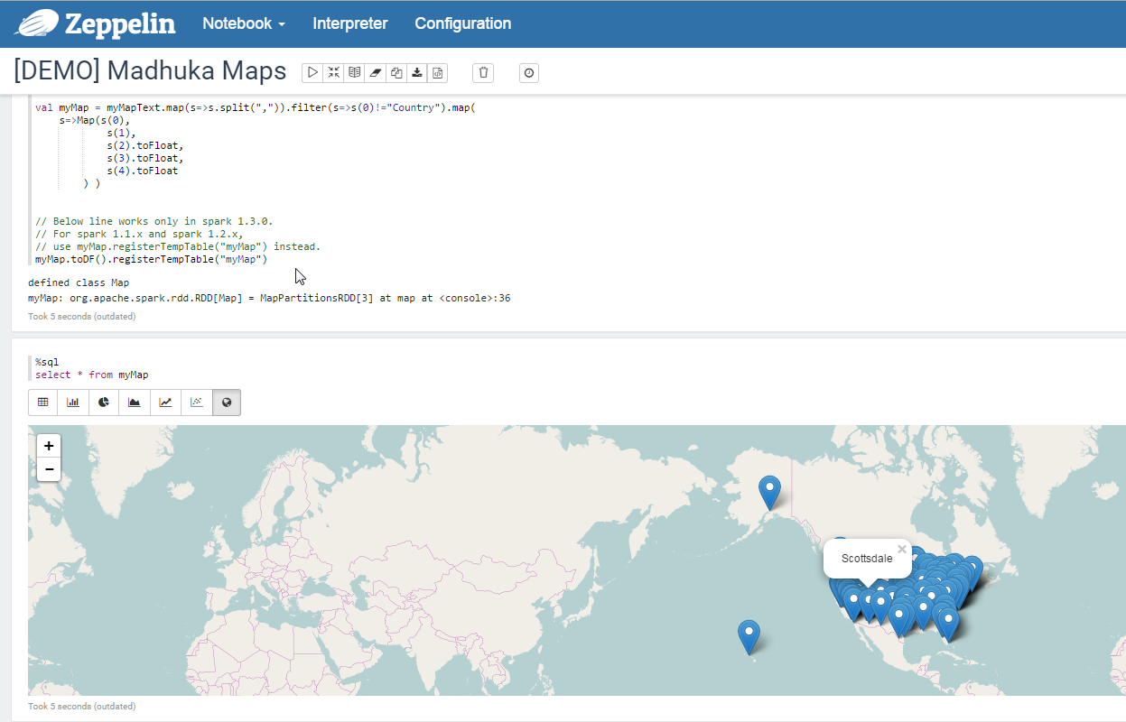
Madhuka Maps
http://madhukaudantha.blogspot.com/2015/08/tutorial-with-map-visualization-in.html

Slide 40
Loading Dependencies
FlinkML Demo

Slide 41
Possibly End of Line

Slide 42
Build Flink 1.1-SNAPSHOT
1.1 Introduces streaming into shell interpreter!
cd flink
git checkout master
mvn clean install –DskipTests
install is a key word here (earlier we just packaged). This installs jars to local maven repository. More on that in a second.

Slide 43
Merge Bug Fix (If still needed)
Merge regression fix (if not merged yet)
https://issues.apache.org/jira/browse/FLINK-3701
https://github.com/apache/flink/pull/1913
git add remote mxm_fork https://github.com/mxm/flink
git fetch mxm_fork
git merge mxm_fork/FLINK-3701 master (check this)
Merge my updated interpreter.

Slide 44
Merge a feature Branch (Flink)
Warm Starts and Evaluation Framework
Clear Repositories

Slide 45
Spark Streaming Example

