Slide 1
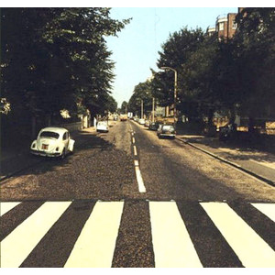
WAX TRACKS
Too lazy to walk to Wax Tracks?
Order online instead.

