Slide 1

Department of
Computer Sc. & Engineering
Welcome to Project Presentation
MOODLE: Module Object Oriented Dynamic Learning Environment
Submitted By
Akshay Kumar (Regd. No. 2001209003)
Group #
CSE 23
Under the Supervision of
Akshaya Kumar Dash
Designation, Department of CSE

Slide 2
Background of the Study
To develop a user-friendly learning management system (LMS) to enhance online education experiences.
Limited resources, Geographical constraints and high fees pose significant barriers.
User preferences, industry standards, and technological advancements are analysed with the evolving needs of our target audience.
Objective
Silicon Institute of Technology, Bhubaneswar
To propose innovative solutions and advancements in educational technology
Areas like user engagement, content delivery, and platform security can further be progressed.
To seamlessly integrate advancements, ensuring adaptability and scalability
2

Slide 3
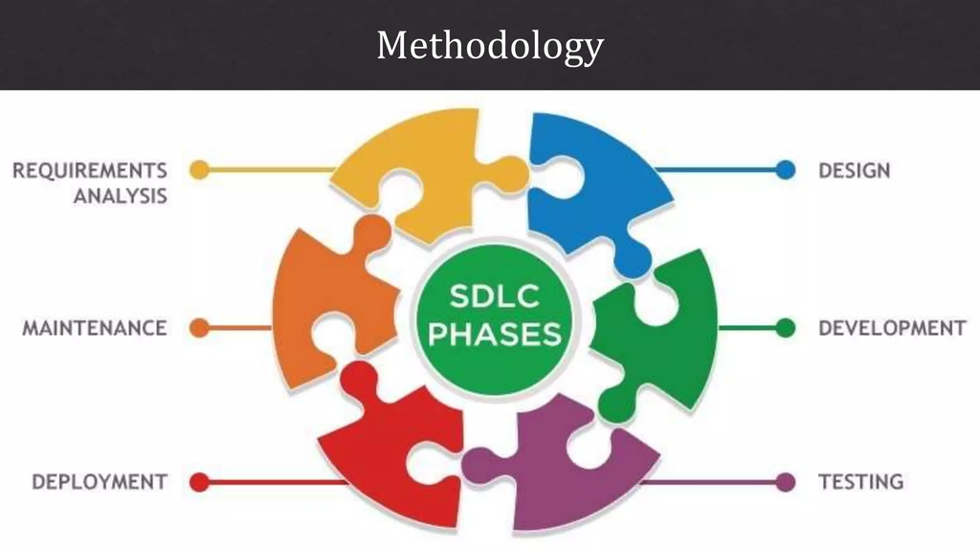
Problem Definition
Problem Statement
The problem statement involves designing a learning management system (LMS) that efficiently manages course content, communication and integrates to address challenges in online education.
Silicon Institute of Technology, Bhubaneswar
3

Slide 4
Work Flow Diagram
Gather requirements for the LMS prototype development project.
Formulate a detailed plan outlining scope, timeline, resources, and budget of Agile and Iterative model.
Identify some common drawbacks such as limited flexibility, potential for scope creep, and complexity in managing larger projects.
Introduce hybrid approaches combining aspects of Agile and Iterative models to balance flexibility and structure in LMS development.
Silicon Institute of Technology, Bhubaneswar
Conduct thorough analysis and simulations to validate the effectiveness and feasibility of the proposed hybrid approach.
Explore additional criteria such as scalability, maintainability, and user satisfaction to evaluate the proposed hybrid model comprehensively.
Implement the validated hybrid approach in real-world LMS projects, monitor performance, and iterate based on feedback for continuous improvement.
4

Slide 5
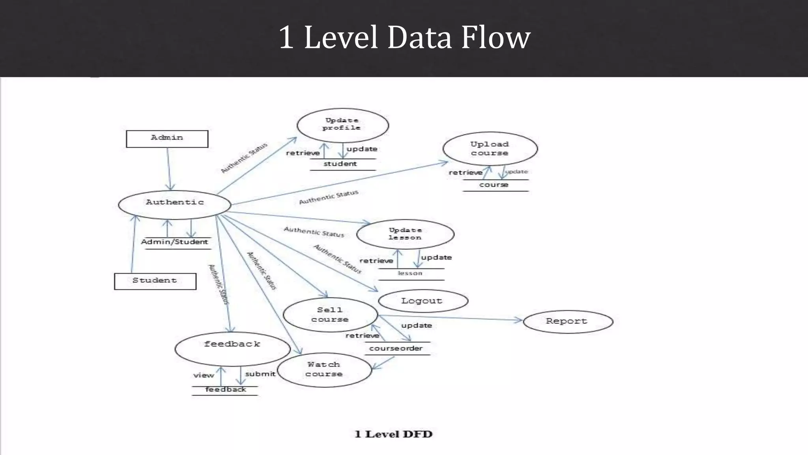
DFD Diagram
3/6/2024
Silicon Institute of Technology, Bhubaneswar
5

Slide 6
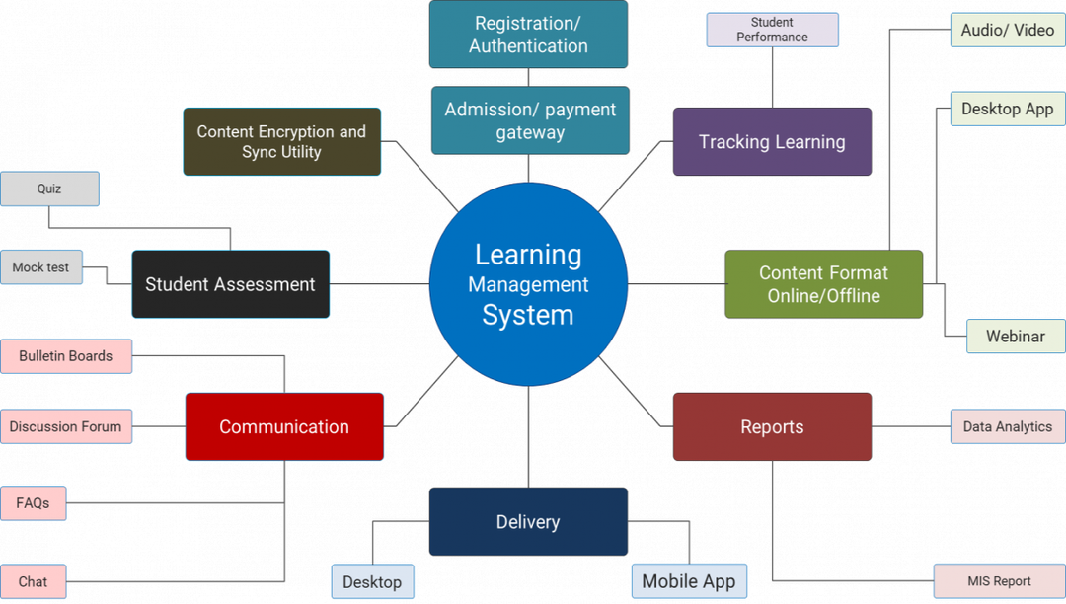
Silicon Institute of Technology, Bhubaneswar
6

Slide 7
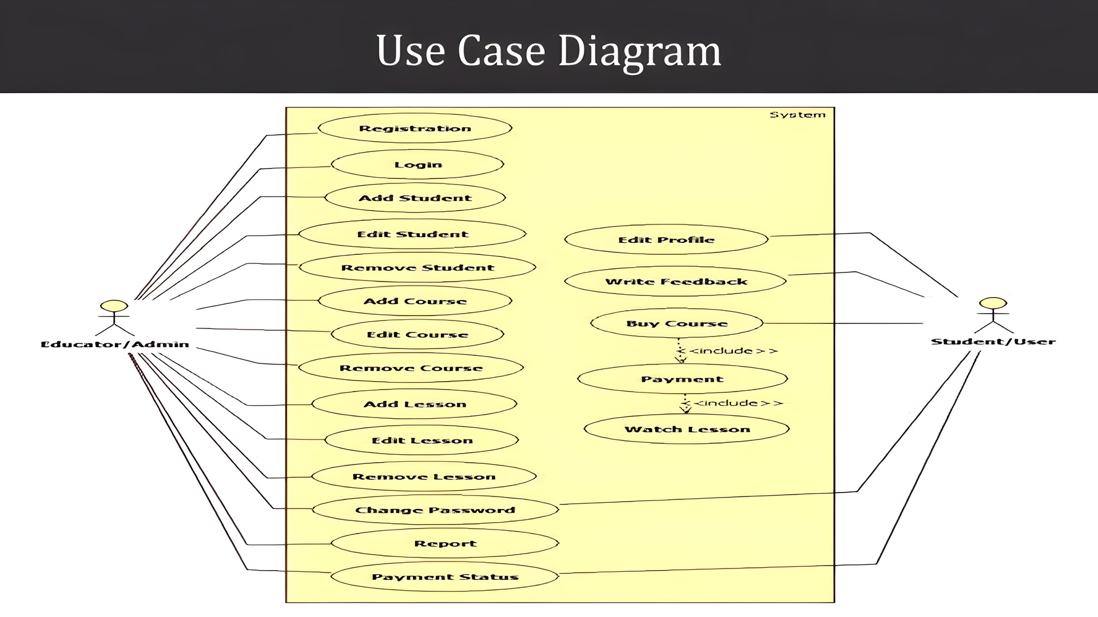
Use Case Diagram
Silicon Institute of Technology, Bhubaneswar
7

Slide 8
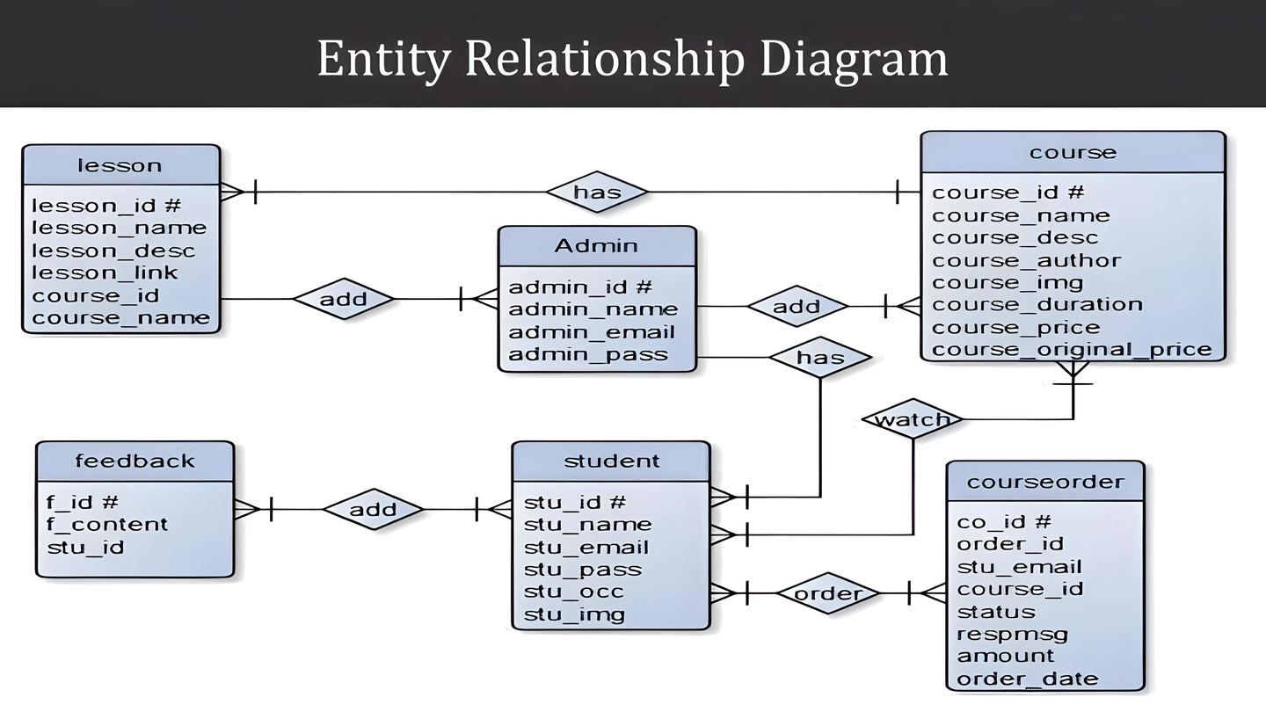
Entity Relationship Diagram
Silicon Institute of Technology, Bhubaneswar
8

Slide 9
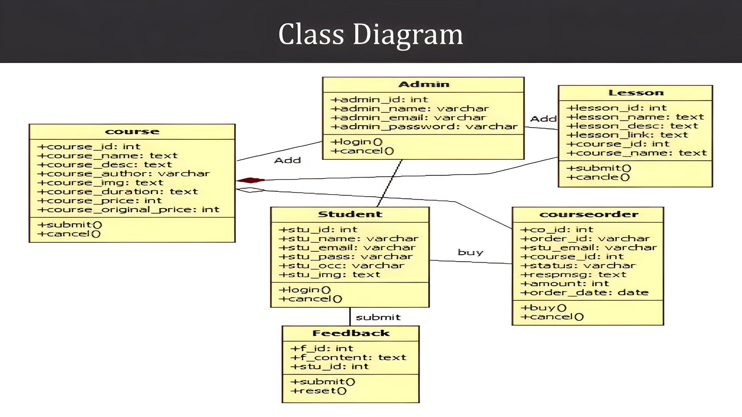
Class Diagram
Silicon Institute of Technology, Bhubaneswar
9

Slide 10
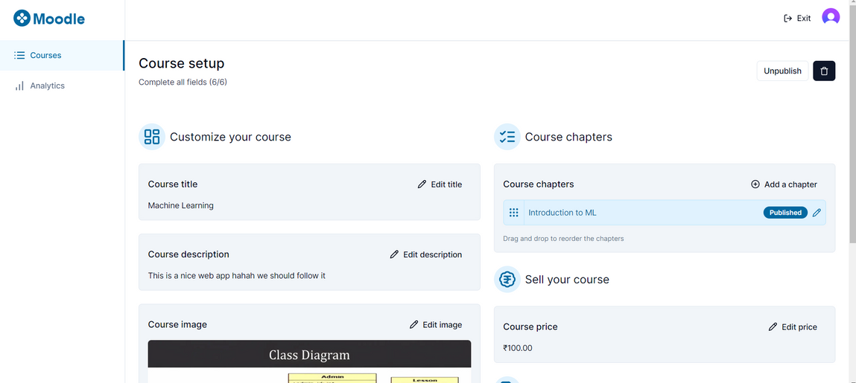
Results Obtained
10

Slide 11
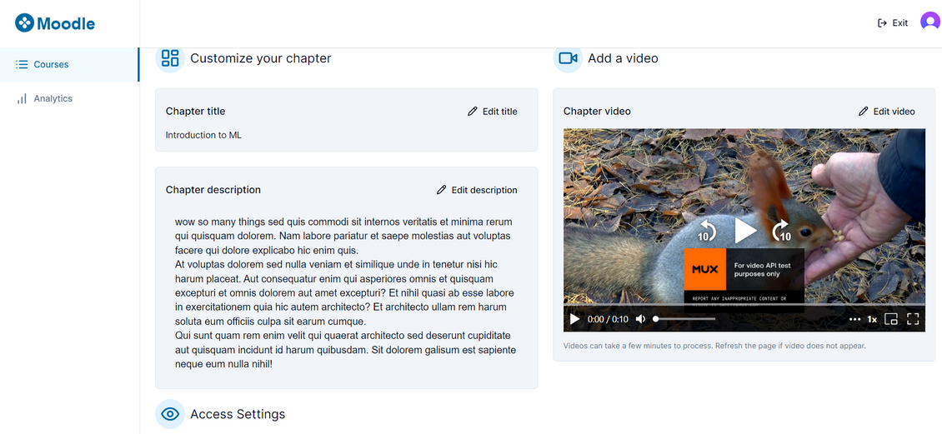
Results Obtained
11

Slide 12
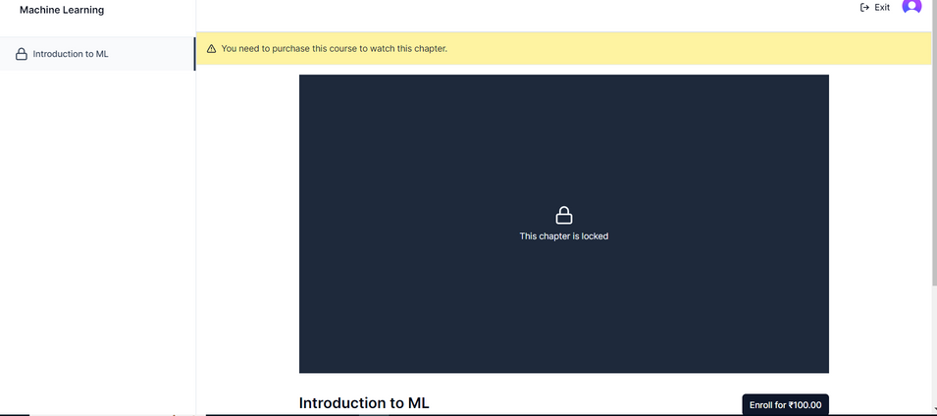
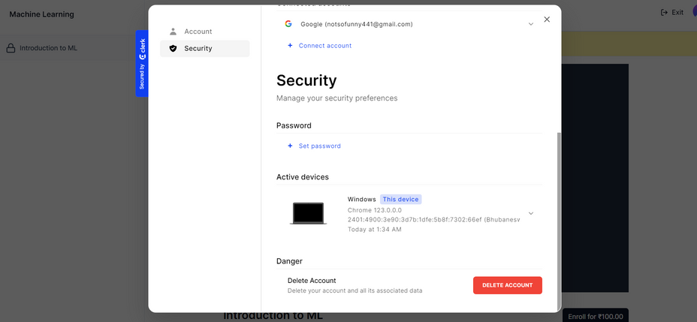
Results Obtained
12

Slide 13
Our Contribution
The main facet of this work is the development of a cutting-edge learning management system (LMS), facilitating efficient course management and user engagement.
This initiative significantly contributes to society by democratizing education, breaking down geographical barriers, and providing access to learning opportunities for individuals from diverse backgrounds.
Furthermore, the LMS platform empowers users with the tools and resources necessary for personal and professional growth, thus enhancing human potential and fostering lifelong learning.
Moreover, by promoting remote learning and reducing the need for physical infrastructure, the LMS prototype contributes to environmental sustainability efforts, thereby indirectly benefiting the ecosystem and supporting conservation initiatives.
Silicon Institute of Technology, Bhubaneswar
13

Slide 14
Conclusion and Future works
The LMS prototype offers efficient course management and engagement.
Its adaptability and scalability surpass other approaches
Initial targets of democratizing education were achieved.
Limitations include technical challenges and user adoption issues.
Continued refinement and partnerships can enhance impact and reach
Silicon Institute of Technology, Bhubaneswar
The Work Ahead
User analytics for personalized learning experiences and collaborative features to facilitate group projects and discussions.
Expanding accessibility options for differently-abled users, ensuring inclusivity in online education.
14

Slide 15
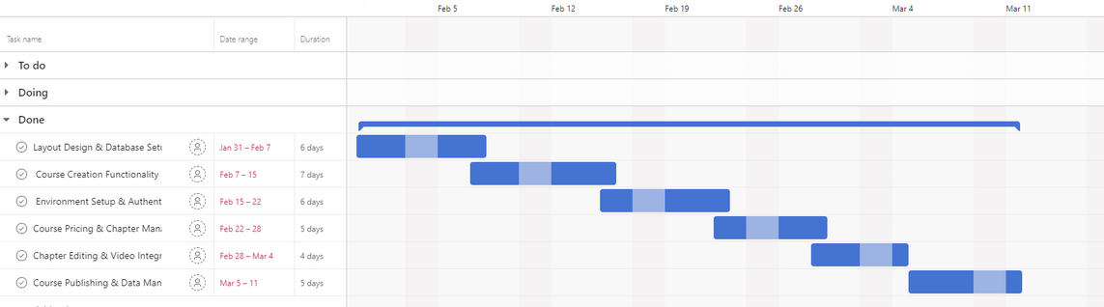
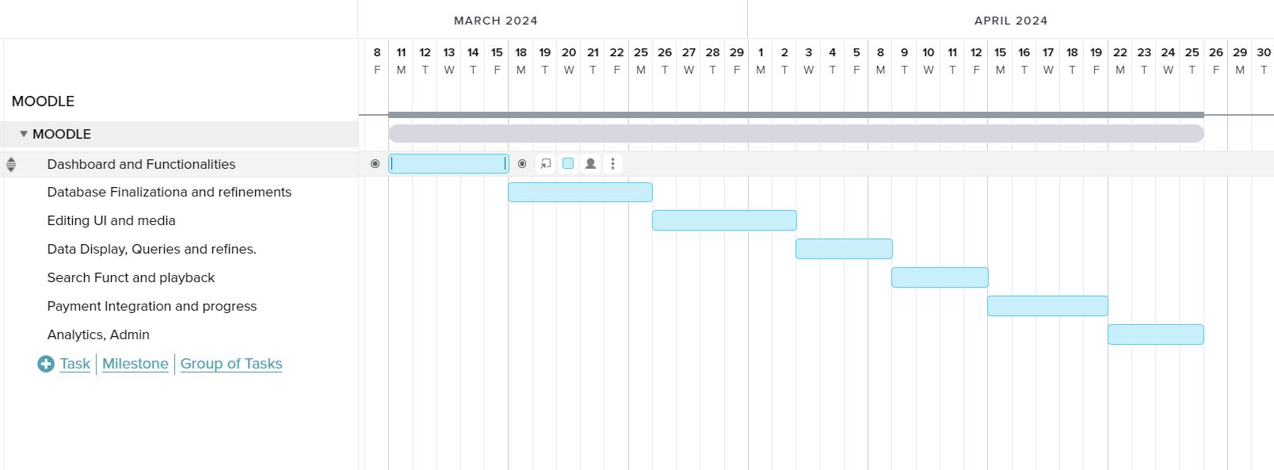
Project Timeline
Silicon Institute of Technology, Bhubaneswar
15

Slide 16
References
[1] MDN Web Docs, https://developer.mozilla.org/en-US/ .
[2] Tailwindcss Docs, https://tailwindcss.com/docs
[3] Next.js documentation.
[4] StackOverflow community.
[5] Discord, and Github community posts
[6] Prisma docs, https://www.prisma.io/docs/orm
Silicon Institute of Technology, Bhubaneswar
16
References to be shown in IEEE Format

Slide 17



Silicon Institute of Technology, Bhubaneswar
17

