Slide 1
Spiword
A blogging site

Slide 2
Website purpose
The purpose of this mini site is to provide a platform to the creator or blogger.
Anyone can share there views or opinion to the public.
This website will also serve as a local environment that allows for writer to share there thoughts.

Slide 3
Problem Statement
Any other platform does not provide full details of a blogger.
Upload large using files using cloud storage share the link.
Others can remove your blog without permission your permission.
Loose data
Download your content.

Slide 4
TARGET AUDIENCE
Blogger
Content Writer
Student

Slide 5
INTERFACE
Attractive
Simple
Easy to Use

Slide 6
REQUIREMENT
OS ( Windows, Ubuntu , MacOs )
Server
Any web browser ( Chrome, mozilla, etc.)

Slide 7
Languages
HTML5
CSS3
Bootstrap
JavaScript
PHP
Database

Slide 8
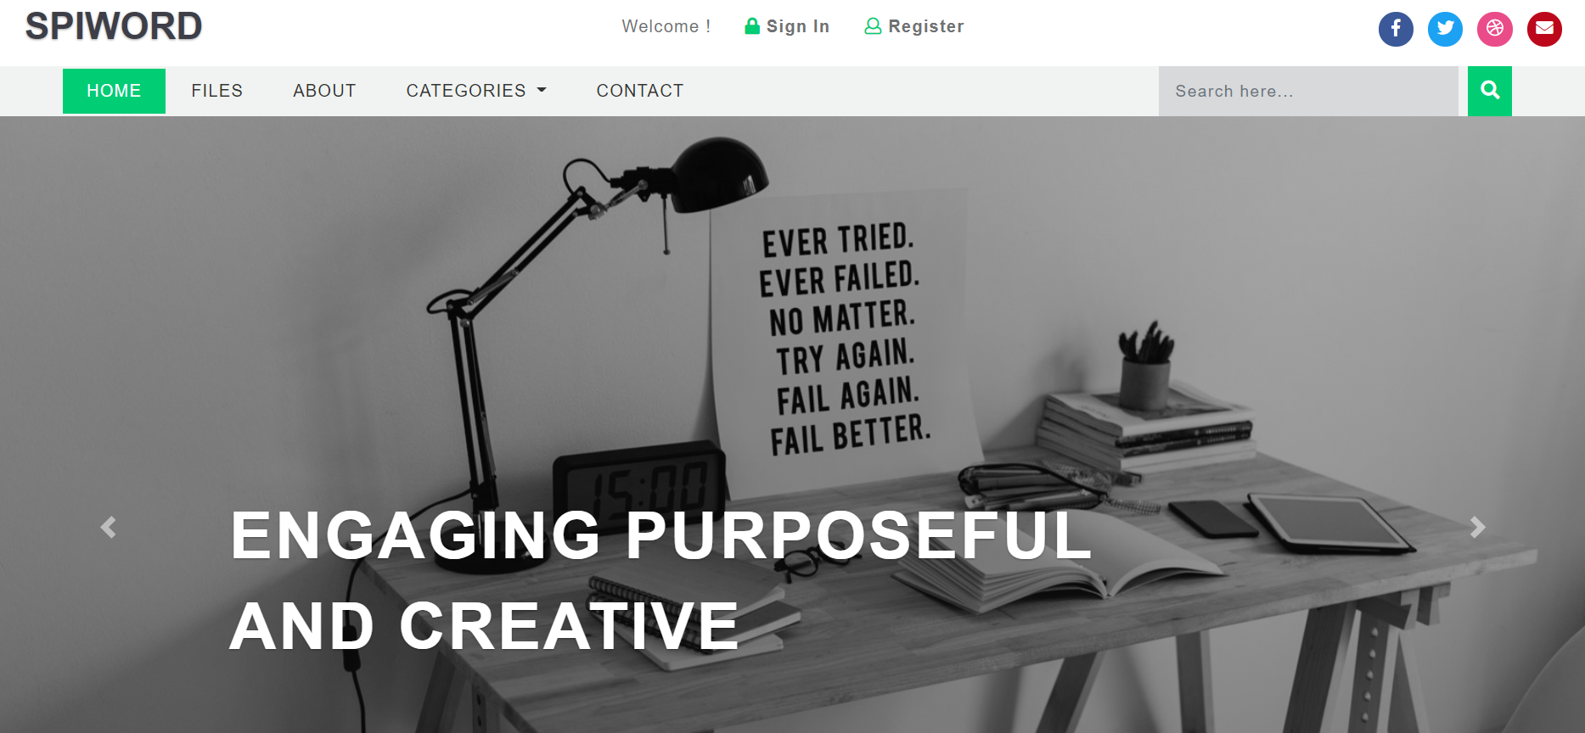
Home Page

Slide 9
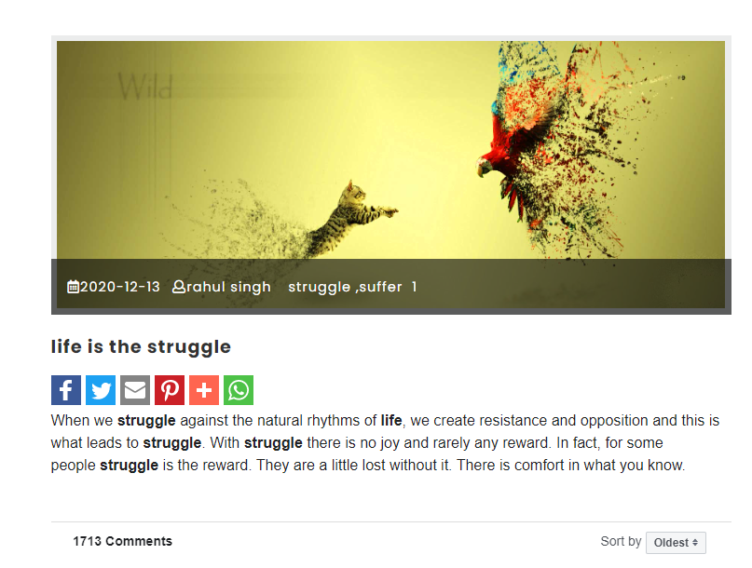
Blog

Slide 10
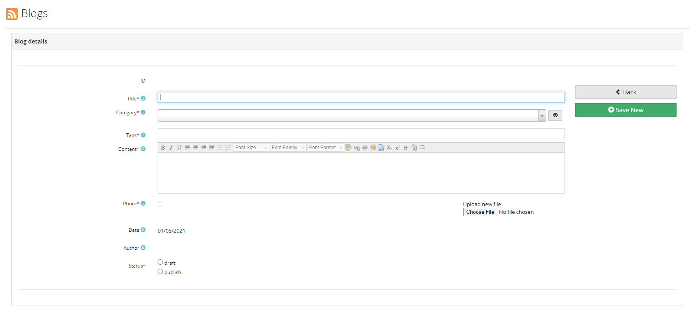
Blog Editor

Slide 11
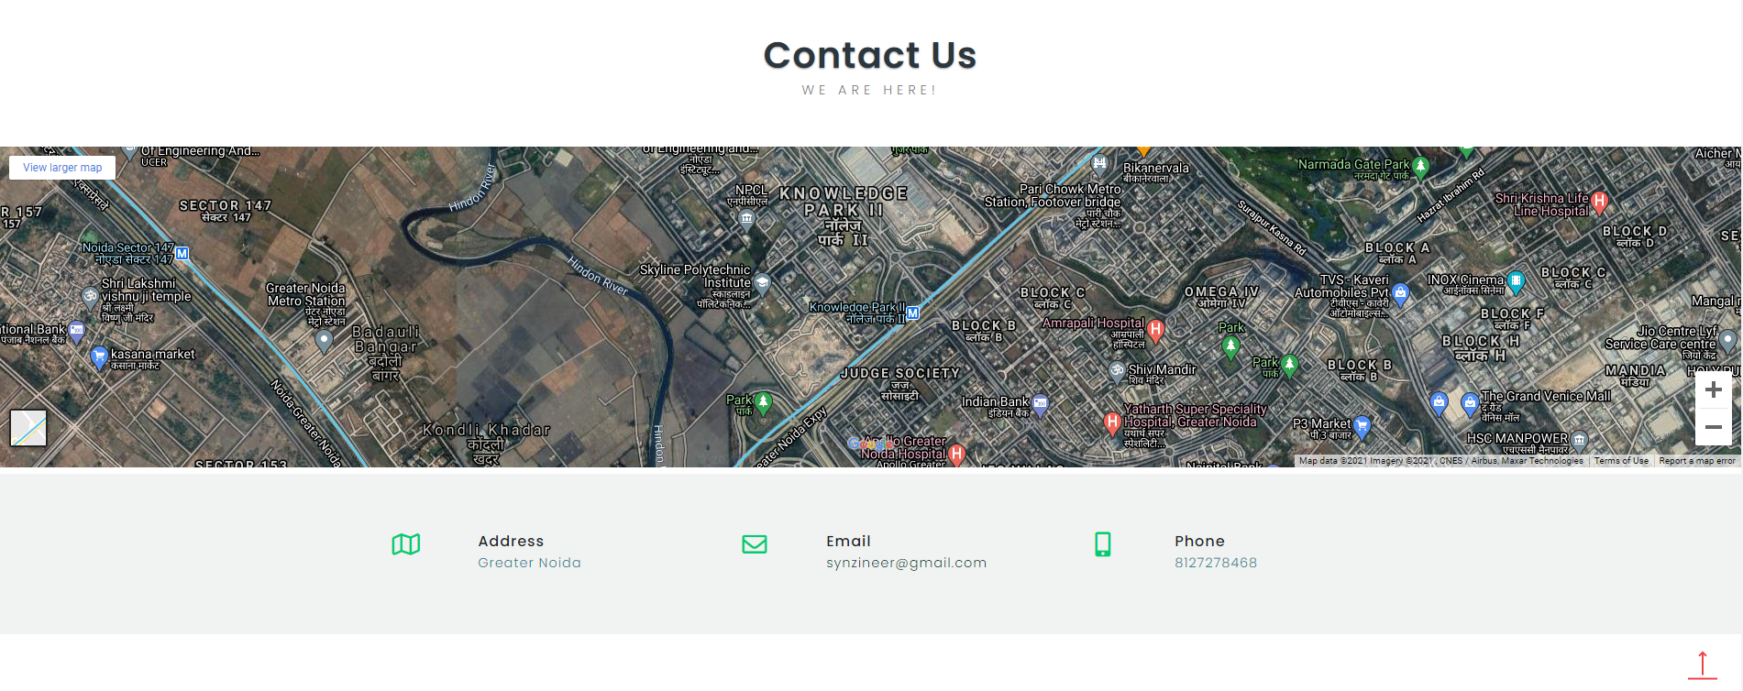
CONTACT US

Slide 12
Thank You
Rahul Singh
1900970109007
Preetam Kumar Jaisawal
1809710077

