Slide 1
Validating ORAC cloud retrievals with EarthCARE
Framework progress — cloud_cci meeting
Rui Song • University of Oxford / NCEO
April 2026 • ESA cloud_cci

Slide 2
Objectives & scope
Independent EarthCARE references for ORAC L2 cloud properties
• Goal: build a reproducible validation framework for ORAC cloud retrievals against EarthCARE L2 products.
• Variables in scope: cloud optical thickness (cot), effective radius (cer), top height (cth), water path (cwp), thermodynamic phase.
• Reference instruments: active sensors (ATLID lidar, CPR radar) and active+passive synergy (AM, AC, ACM) products only.
• Out of scope: MSI-only passive products (M-COP, M-CM, M-AOT) — too close to ORAC's own measurement domain to be independent.
• Deliverables for this milestone: data access module, collocation grid, statistics pipeline, first inter-comparison results.
Cloud_cci progress — ORAC × EarthCARE validation • Oxford / NCEO • 2 / 12

Slide 3
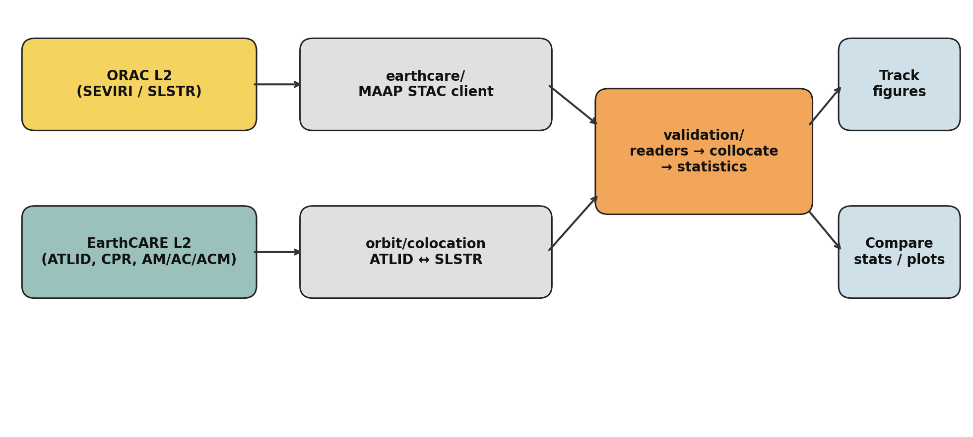
Validation framework — overview
• Three layers: (i) ORAC + EarthCARE inputs, (ii) data access & space-time collocation, (iii) statistics and figures.
• All layers are now in place; the EarthCARE → ORAC statistics layer is the next focus (slide 11).
Cloud_cci progress — ORAC × EarthCARE validation • Oxford / NCEO • 3 / 12

Slide 4
EarthCARE reference products
Active and synergy L2; primaries highlighted
Code | MAAP type | Instruments | Validates ORAC
A-CTH | ATL_CTH_2A | ATLID | cth
A-TC | ATL_TC__2A | ATLID | phase, cldtype, mask
A-EBD | ATL_EBD_2A | ATLID | cot (∫ extinction)
A-ICE | ATL_ICE_2A | ATLID | ice cer, cwp
C-CLD | CPR_CLD_2A | CPR | cwp, cer
C-TC | CPR_TC__2A | CPR | cth, phase
AM-CTH ★ | AM__CTH_2B | ATLID + MSI | cth across MSI swath
AC-TC | AC__TC__2B | ATLID + CPR | phase, cldtype, mask
ACM-CAP ★ | ACM_CAP_2B | ATLID + CPR + MSI | cot, cer, cwp, phase
• Primary references: AM-CTH (cloud-top across the MSI swath) and ACM-CAP (flagship variational retrieval).
• ATLID/CPR L2a serve as nadir-only fall-back references and for cross-checking the synergy products.
Cloud_cci progress — ORAC × EarthCARE validation • Oxford / NCEO • 4 / 12

Slide 5
earthcare/ — ESA MAAP data-access module
• Python client for the ESA MAAP STAC catalogue (EarthCAREL2Validated_MAAP).
• Catalogue search is anonymous; downloads use a 90-day offline token (env var or ~/.maap/offline_token), exchanged automatically for short-lived access tokens.
• Per-product spatial / temporal search; output layout: earthcare_data/<PRODUCT_TYPE>/YYYY/MM/DD/<file>.h5.
• Both Python API and CLI: `python -m earthcare {list-products | describe | search | download}`.
• Currently mirrored locally: ATL_CTH_2A, ATL_EBD_2A, AM__CTH_2B, ACM_CAP_2B.
from earthcare import MaapCatalog
cat = MaapCatalog()
items = cat.search('AM-CTH', start='2025-02-01T00:00:00Z',
end='2025-02-02T00:00:00Z', bbox=(-30,-60,60,60))
for it in items[:3]: cat.download_item(it, 'earthcare_data')
Cloud_cci progress — ORAC × EarthCARE validation • Oxford / NCEO • 5 / 12

Slide 6
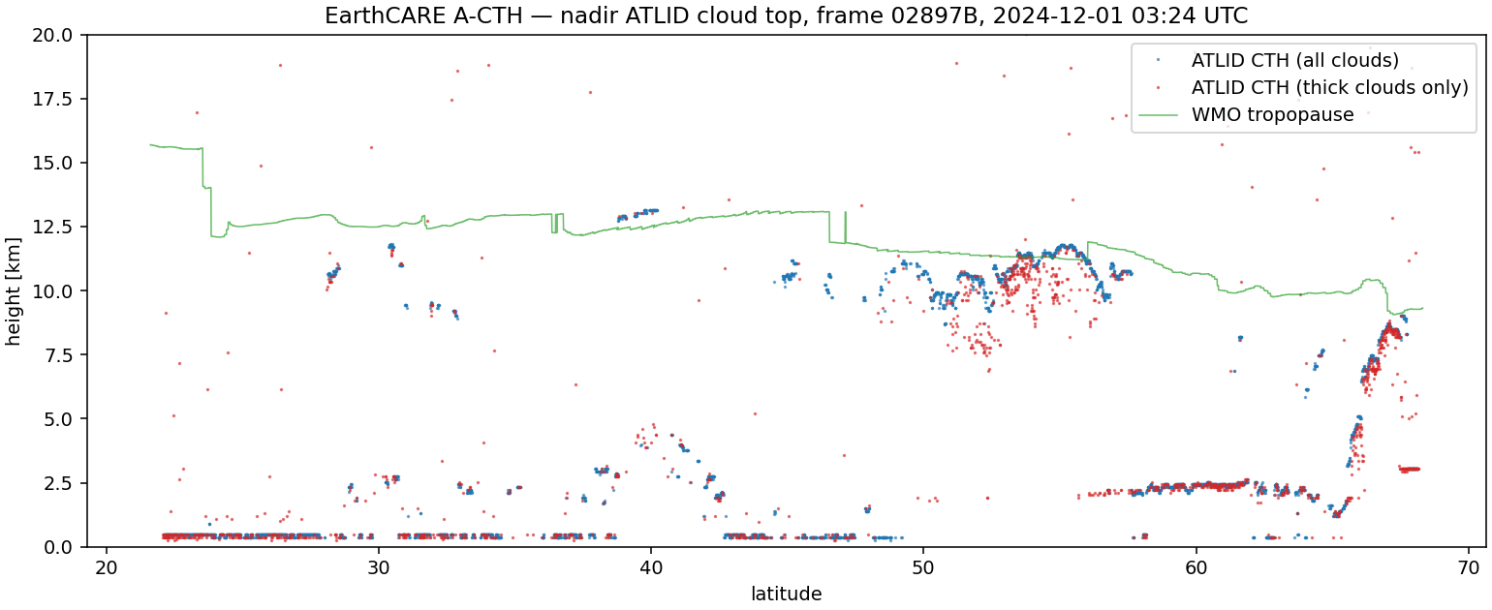
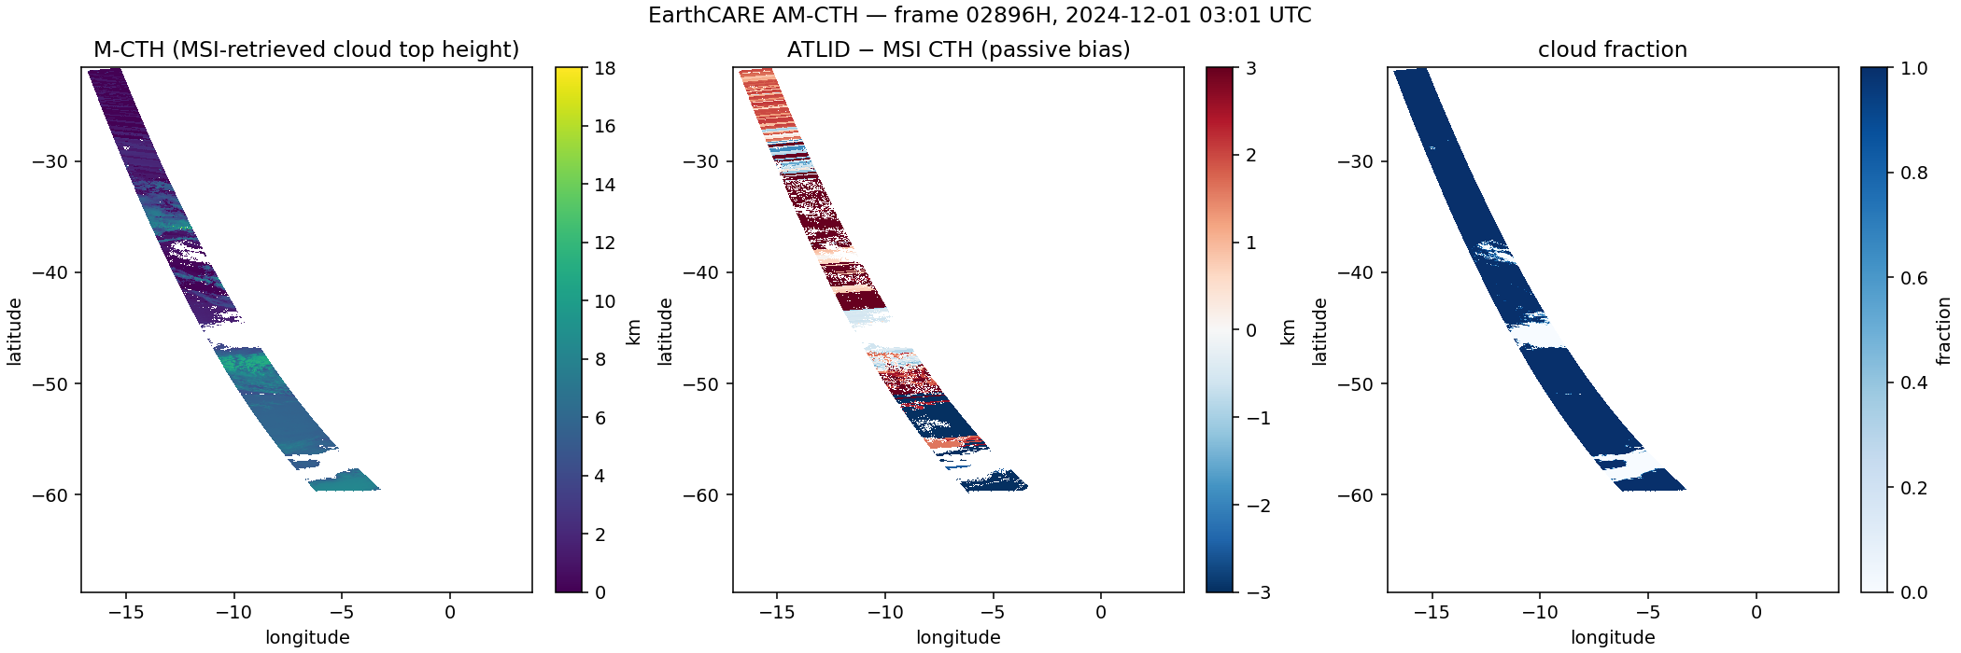
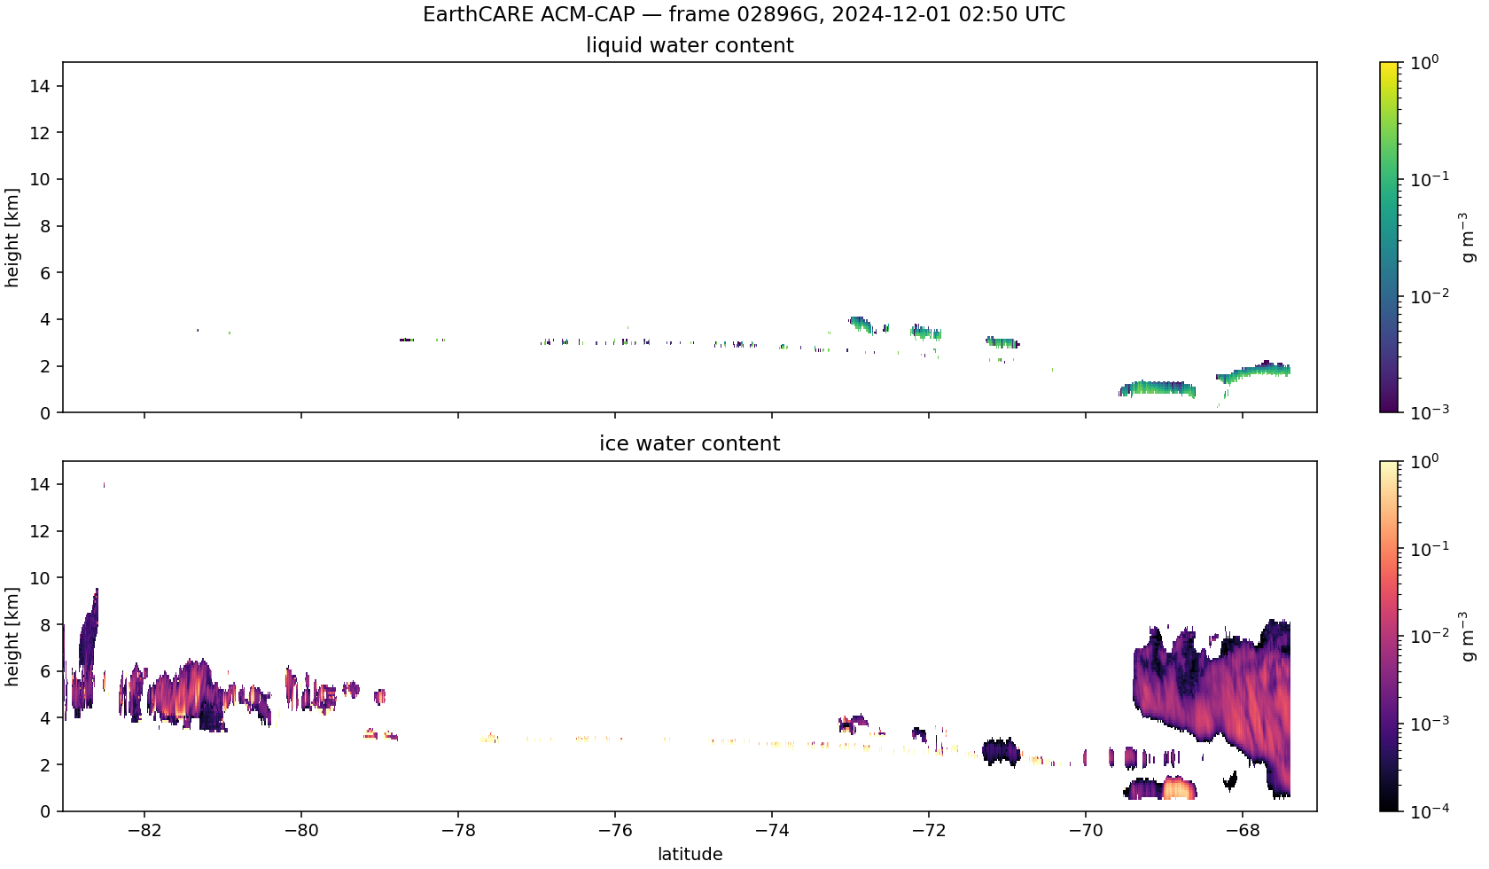
EarthCARE products — example frames
A-CTH — ATLID nadir cloud-top height
AM-CTH — ATLID+MSI synergy CTH (frame)
ACM-CAP — active+passive curtain
• Generated by scripts/make_earthcare_test_figures.py from locally mirrored frames.
• Confirms readers / projection / variable extraction for both nadir (ATLID) and synergy (AM, ACM) products.
• These three are the templates for ORAC ↔ EarthCARE comparison plots in the next milestone.
Cloud_cci progress — ORAC × EarthCARE validation • Oxford / NCEO • 6 / 12

Slide 7
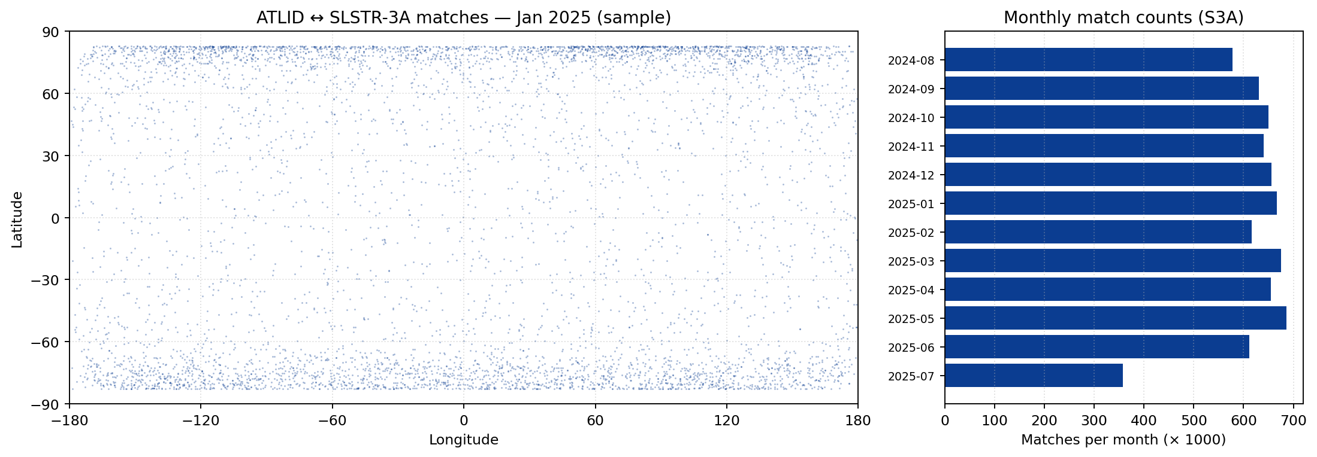
ATLID ↔ SLSTR collocation grid
12 months × S3A & S3B — computed on JASMIN via SLURM
• ATLID nadir track (sampled central points) matched to per-orbit SLSTR-3A / 3B swath polygons.
• Match criterion: lat/lon point-in-polygon plus a configurable time window; closest-in-time match retained.
• Output: orbit/colocation/atlid_slstr3{a,b}_matches_YYYY-MM.csv (one file per month per platform).
• Aug-2024 → Jul-2025 covered for both S3A and S3B; ~10–20k matches per month per platform.
Cloud_cci progress — ORAC × EarthCARE validation • Oxford / NCEO • 7 / 12

Slide 8
validation/ — pipeline modules
• readers.py — ORAC L2 + EarthCARE H5 readers; common record schema.
• collocate.py — swath ↔ swath / nadir matching (uses the orbit/colocation tables).
• reference.py — wraps the EarthCARE reference variables per product.
• statistics.py — bias, RMSE, MAE, correlation, slope/intercept, by surface and QC mode.
• compare_figures.py — R10 vs R11 inter-comparison plots and CSV.
• track_figures.py — per-track case-study panels with coastlines / borders / ice mask.
• water_cloud_figures.py / cth_figures.py — variable-specific spatial maps.
# CLI entry point
python -m validation \
compare --variable cot_water \
--month 2026-02 \
--retrievals R10 R11 \
--qc strict
python -m validation \
track --frame 09865H \
--label marine-stratocumulus
Cloud_cci progress — ORAC × EarthCARE validation • Oxford / NCEO • 8 / 12

Slide 9
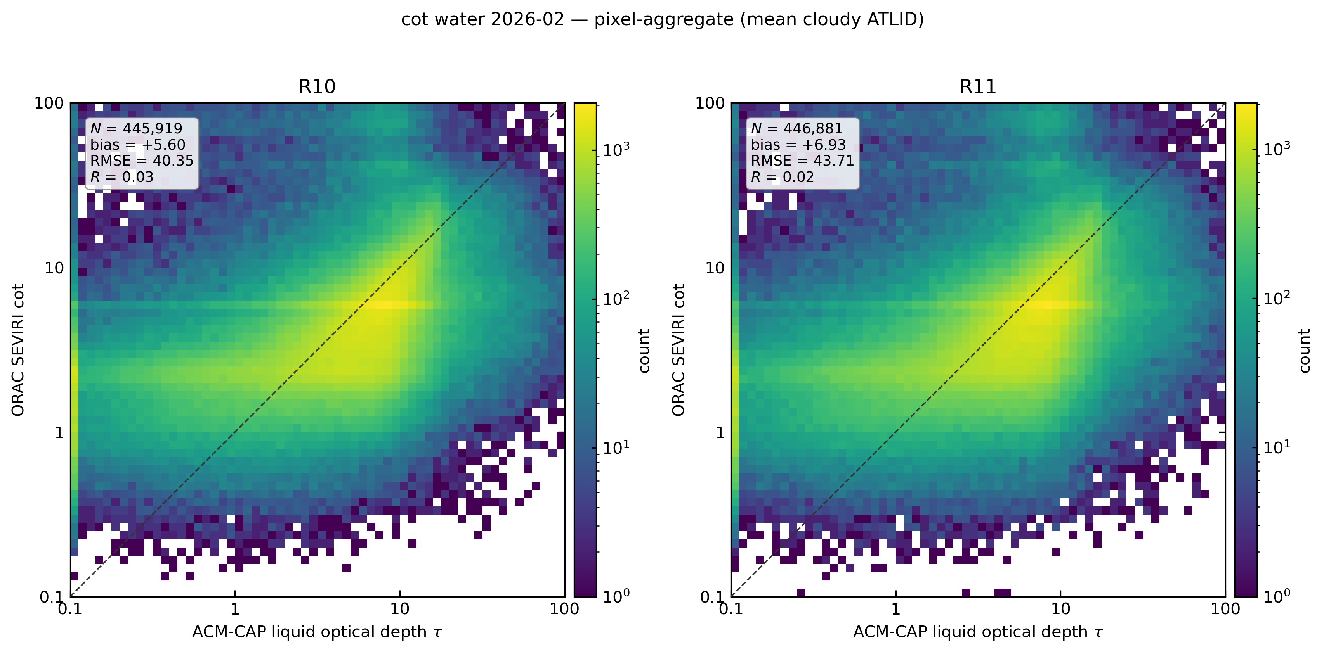
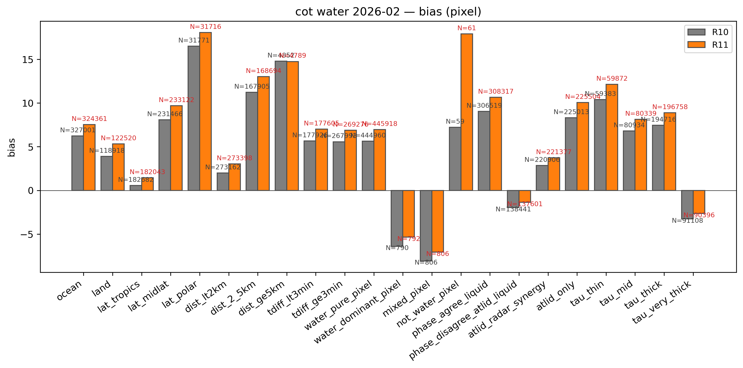
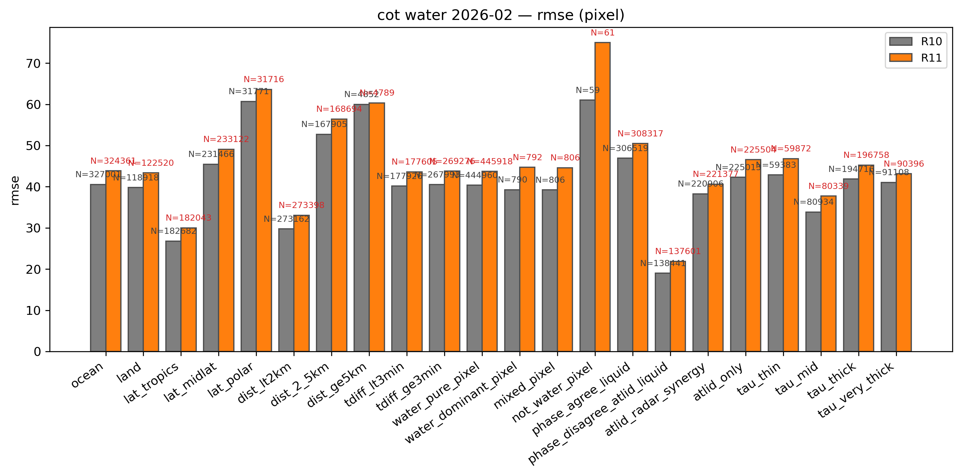
Inter-comparison — R10 vs R11 (cot_water, Feb 2026)
Pixel-level, strict QC
Scatter (R10 / R11 vs reference)
Bias map
RMSE map
• All-pixel summary (qc_strict): R10 bias = +5.60, RMSE = 40.4 | R11 bias = +6.93, RMSE = 43.7 (n ≈ 4.5×10⁵).
• R11 currently shows slightly higher bias and RMSE than R10 in cot_water at pixel level — worth flagging for the cot_water surface stratification (ocean / land / coast) shown in the by-surface panels.
• These plots use the existing ORAC reference; the EarthCARE (ACM-CAP) reference will replace it as the canonical truth in the next milestone.
Cloud_cci progress — ORAC × EarthCARE validation • Oxford / NCEO • 9 / 12

Slide 10
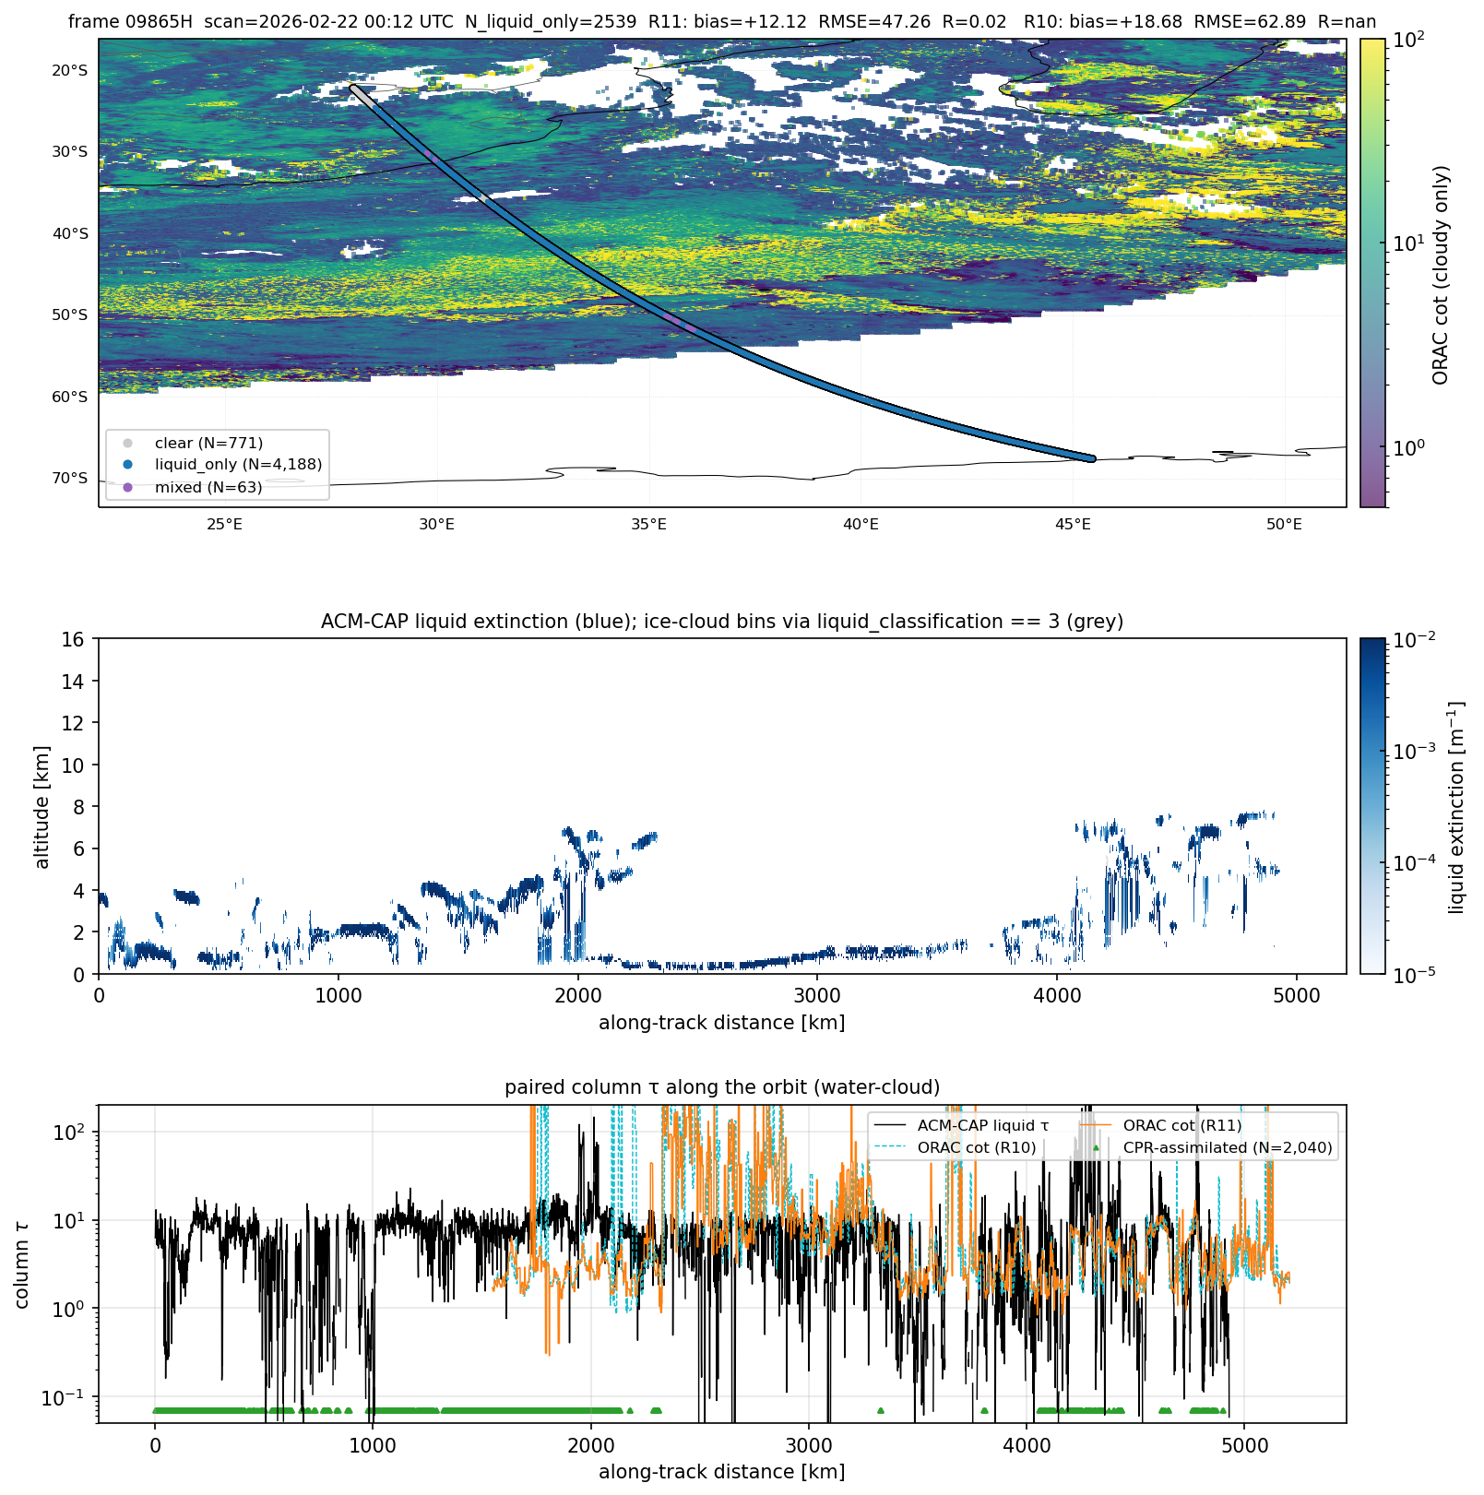
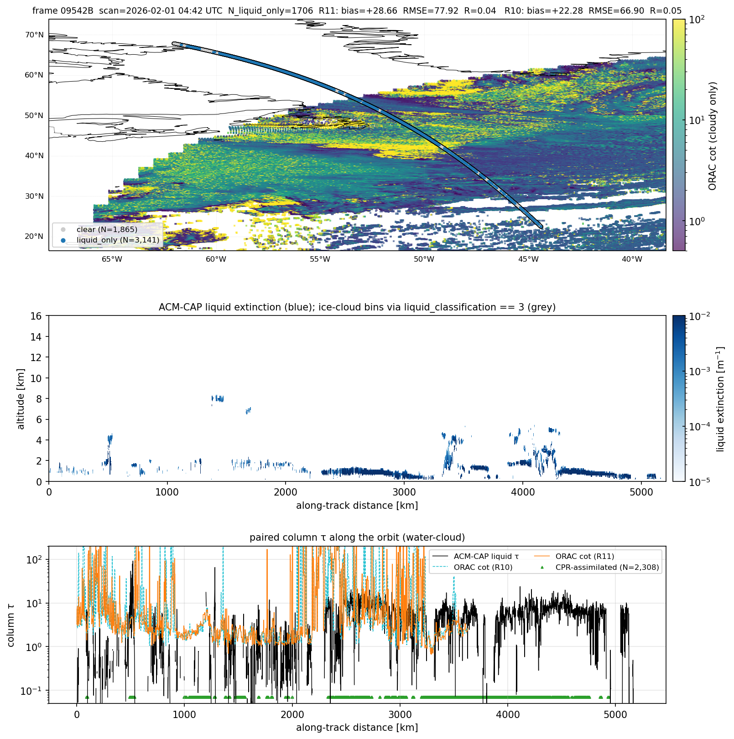
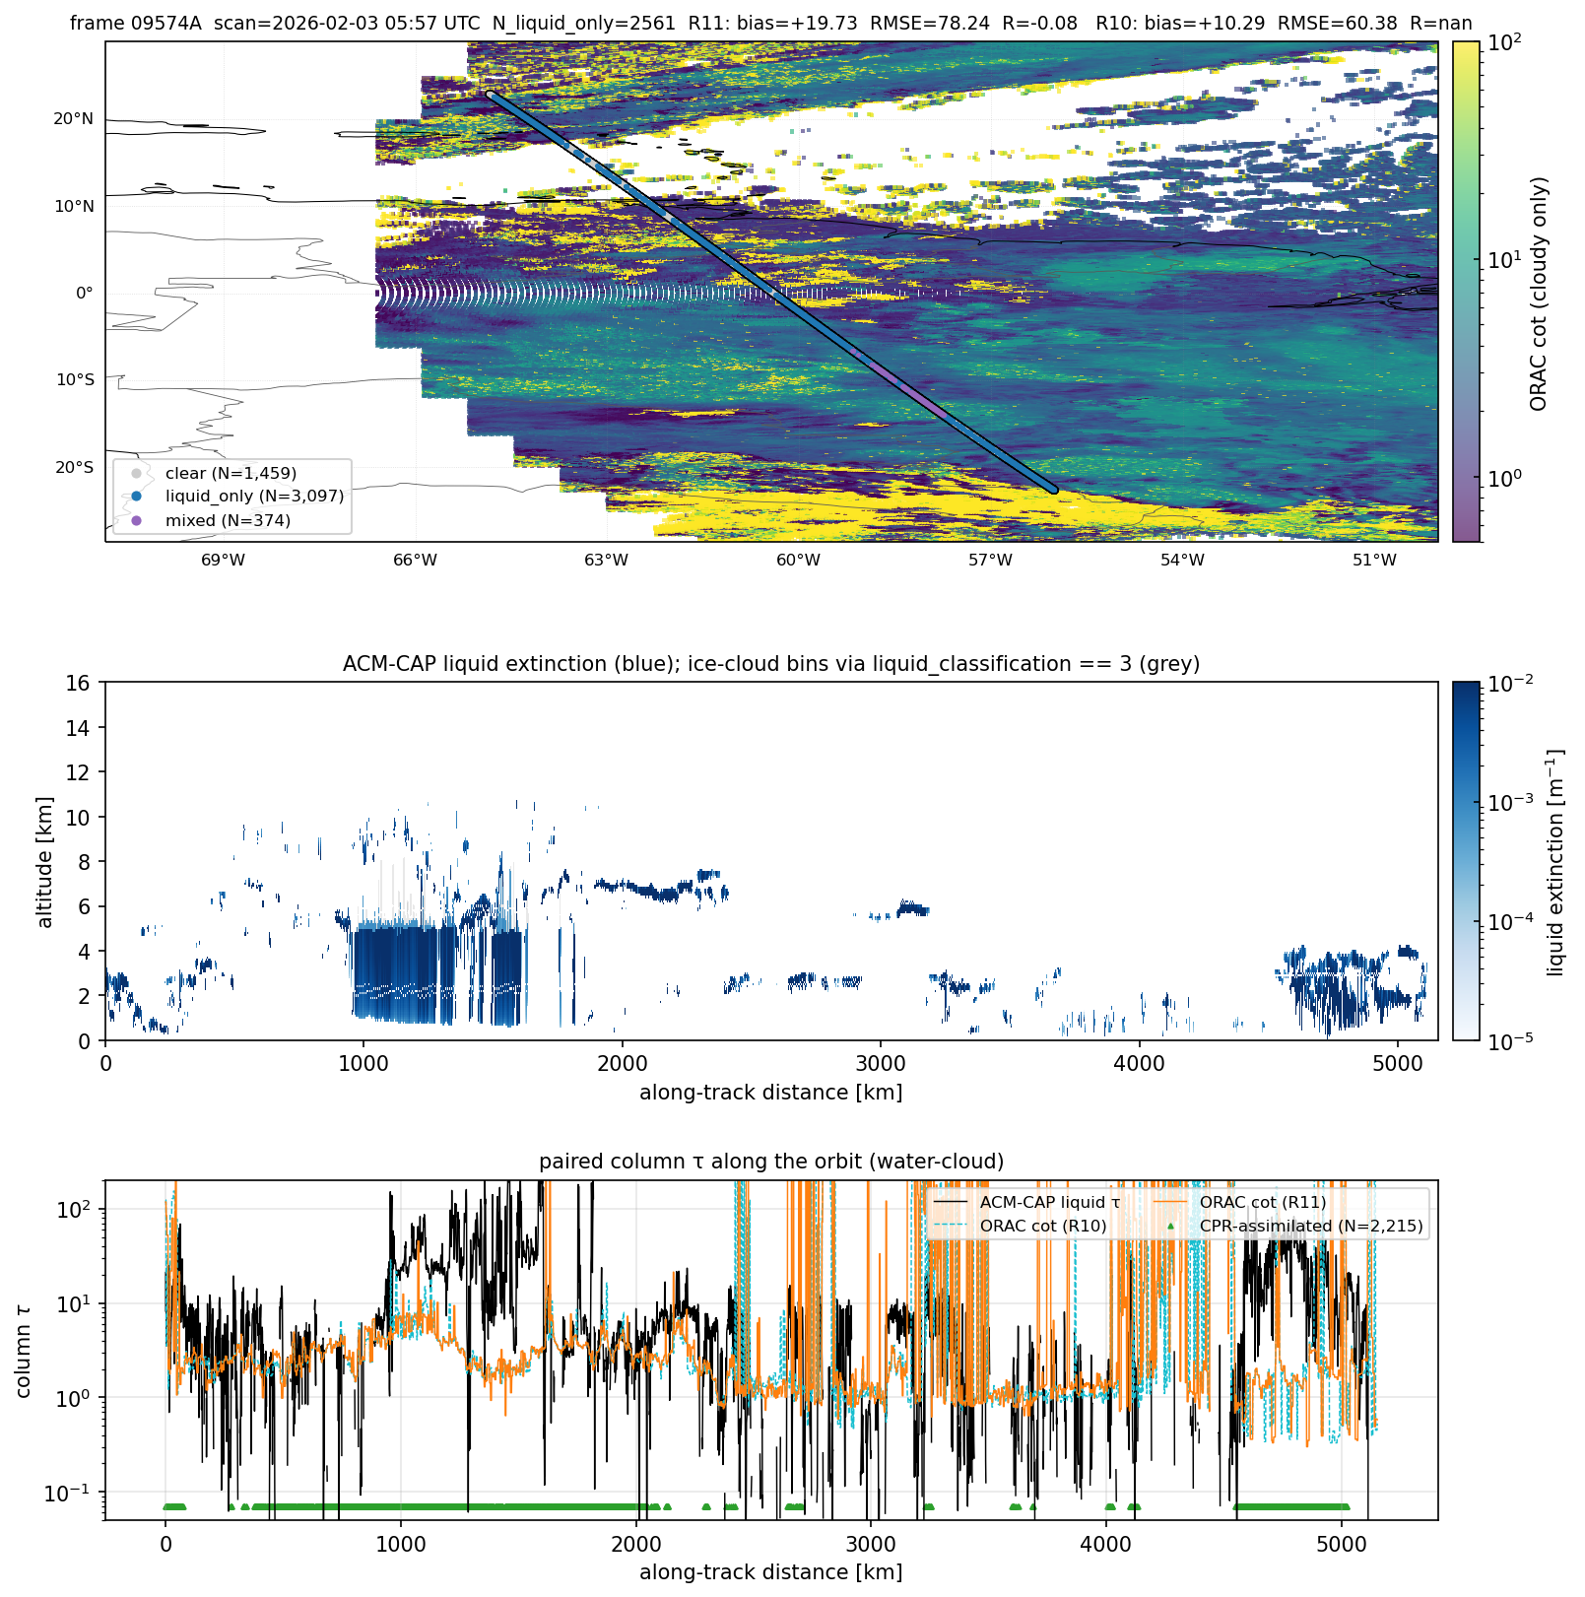
Case-study tracks — R10 vs R11
10 frames sampled across regimes; 3 shown
Marine stratocumulus (09865H)
North Atlantic (09542B)
Tropical Atlantic (09574A)
• Track panels include coastlines, country borders, and an ice mask (liquid_classification == 3).
• Full set of 10 cases covers Arctic, North Africa, North/Tropical Atlantic, Western Europe, Indian Ocean, S. America, S. Indian Ocean, marine Sc, tropical mixed.
Cloud_cci progress — ORAC × EarthCARE validation • Oxford / NCEO • 10 / 12

Slide 11
Status & next steps
Completed
Next
• earthcare/ MAAP STAC client (search + download).
• Local mirror: A-CTH, A-EBD, AM-CTH, ACM-CAP test frames.
• ATLID ↔ SLSTR collocation grid (12 months × S3A & S3B).
• validation/ pipeline (readers, collocate, statistics, figures).
• R10 vs R11 inter-comparison — cot_water, cer_water, cth (Feb 2026).
• 10 case-study tracks across regimes.
• Connect ACM-CAP (cot/cer/cwp/phase) and AM-CTH (cth) as the canonical references inside validation/statistics.py.
• Bulk-download EarthCARE frames over the SEVIRI / SLSTR disk for the colocation period (Aug-2024 → Jul-2025).
• Extend collocation from ATLID-only to MSI footprint matching for AM-CTH / ACM-CAP comparisons.
• Add ice-cloud cases (A-ICE, C-CLD) to the case-study set.
• Automate monthly statistics and version regression checks.
Cloud_cci progress — ORAC × EarthCARE validation • Oxford / NCEO • 11 / 12

Slide 12
Summary
• Validation framework end-to-end in place: data access, collocation, statistics, figures.
• First inter-comparison results (R10 vs R11) reproducible from the pipeline.
• Next milestone: swap the reference layer from ORAC-internal to EarthCARE (AM-CTH / ACM-CAP).
Questions / discussion

