Slide 1
Validating ORAC SLSTR cloud retrievals against EarthCARE
Sentinel-3A × EarthCARE — December 2025
Continuous validation: CTH · water/ice COT · CER · CWP | Categorical: cloud mask · phase (A-TC)
Notes:
Framing. We've extended our SEVIRI x EarthCARE validation framework to ORAC retrievals on Sentinel-3A SLSTR, using EarthCARE as the reference, for December 2025. The story I'll build to is two independent limitations of the polar-daytime solar retrieval - a bright-surface optical-depth saturation, and an intrinsic liquid phase bias - while the thermal cloud-top height and the effective radius come out well. The sample is about 0.6 million matched pixels.

Slide 2
Progress to date
From collocation framework to a complete Antarctic-summer validation
• Collocation pipeline built & characterised — polar simultaneous-nadir-overpass geometry, ±60 min / 3 km, density map + Δt/distance sensitivity.
• Continuous validation complete — CTH (both hemispheres), water-COT, ice-COT, CER, CWP, all against EarthCARE and median-primary with confidence intervals.
• Root cause established — passive τ saturation over bright surfaces; surface-type stratification; independent radar+lidar water-path check.
• Categorical validation closed — NEW: cloud mask + phase vs A-TC; ice-detection skill (POD_ice) measurable for the first time.
• Fully written up & reproducible — six variable reports + summary + this deck; all version-controlled.
• Ready for review — remaining extensions need new processing (Arctic month, Sentinel-3B, other seasons), not further analysis of this sample.
Notes:
Quick status before the detail. The collocation pipeline is built and characterised. Every continuous variable is validated against EarthCARE. We've done the root-cause analysis behind the biases. And - new since the last meeting - we've closed the two-way phase validation using A-TC, which lets us report ice-detection skill for the first time. All of it is written up as reports plus this deck, and it's reproducible. What remains needs new data processing - a summer Arctic month, Sentinel-3B, other seasons - not more analysis of what we have.

Slide 3
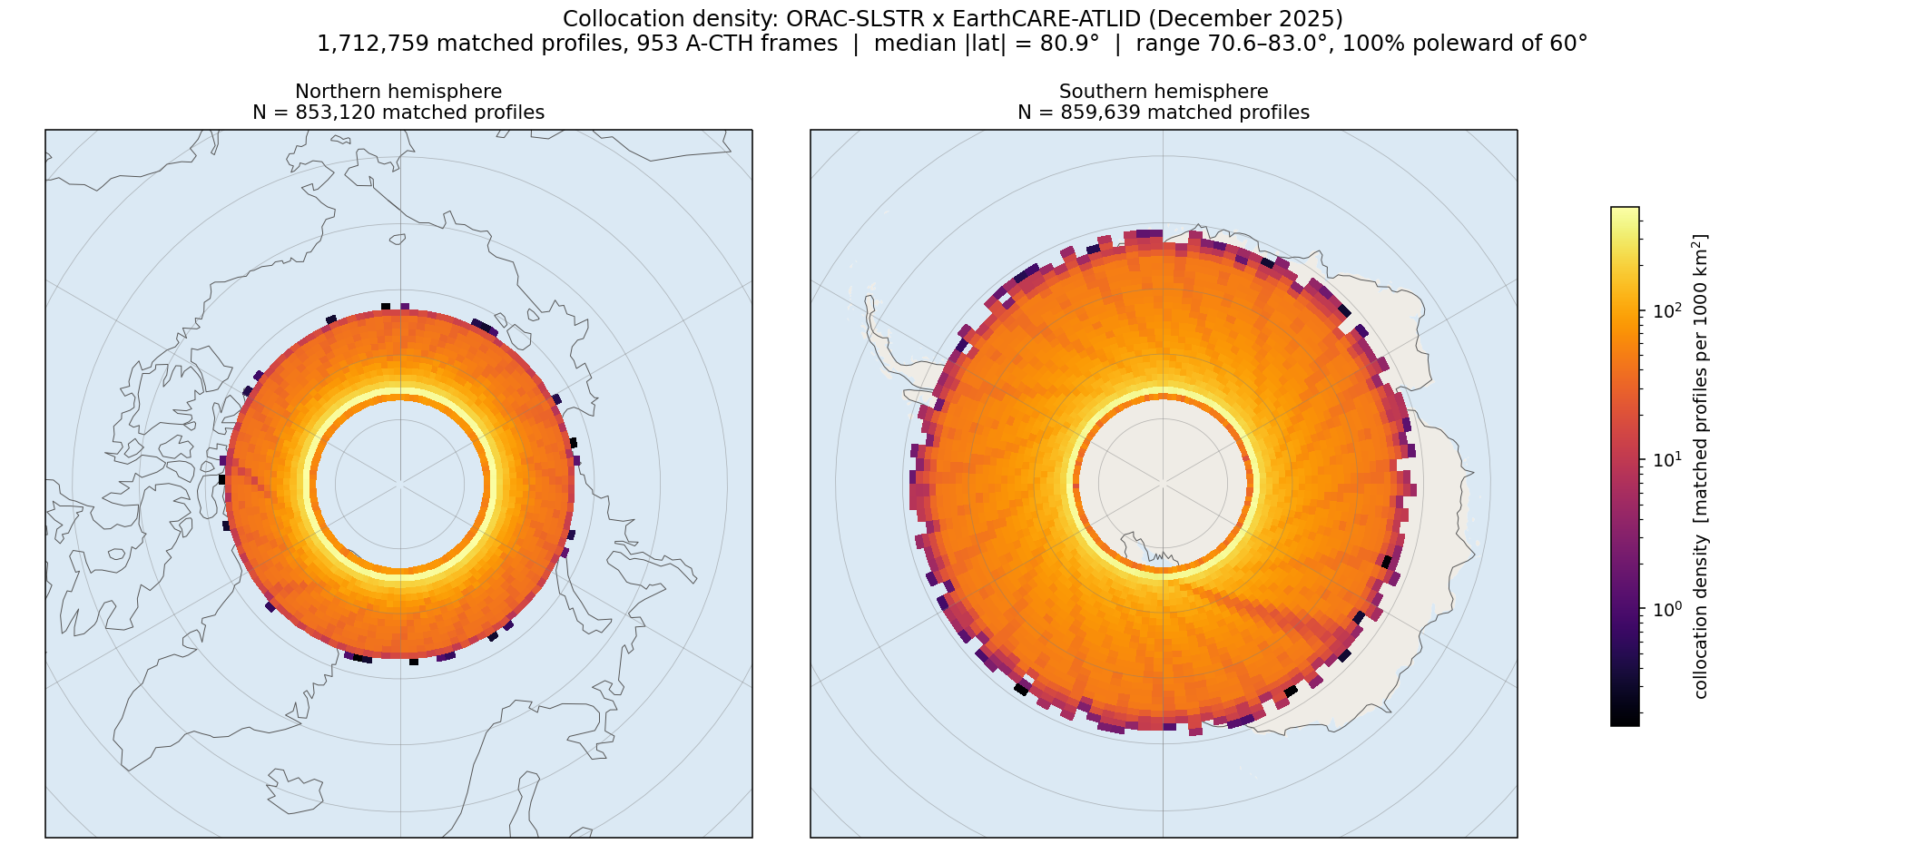
Scope & collocation — a polar comparison by orbital mechanics
Simultaneous-nadir-overpass geometry of two sun-synchronous orbiters
• SLSTR and EarthCARE are both sun-synchronous → their tracks coincide only near the poles (~70–83°). Every match is polar — not a choice.
• Match: temporal gate ±60 min + nearest pixel < 3 km (SLSTR ≈ EarthCARE ≈ 1 km footprint).
• Solar retrievals need daylight → December = Antarctic polar day → the COT/CER/CWP/phase sample is 100% Southern Hemisphere; thermal CTH also samples the Arctic (night).
• References: A-CTH (height) · ACM-CAP (liquid COT/CER, radar+lidar LWP) · A-EBD (ice COT) · A-TC (phase & cloud mask).
Notes:
Why this is a polar study: two sun-synchronous orbiters only coincide near the poles, so every collocation is polar - that's orbital mechanics, not a choice. We match within an hour and 3 km, and both footprints are about a kilometre. The key consequence: the solar retrievals need daylight, and in December that's Antarctic polar day, so the entire optical-depth, effective-radius, water-path and phase sample is Southern Hemisphere. Only the thermal cloud-top height, which works at night, also sees the Arctic. The map shows where the crossings concentrate - a dense polar band, sparse elsewhere.

Slide 4
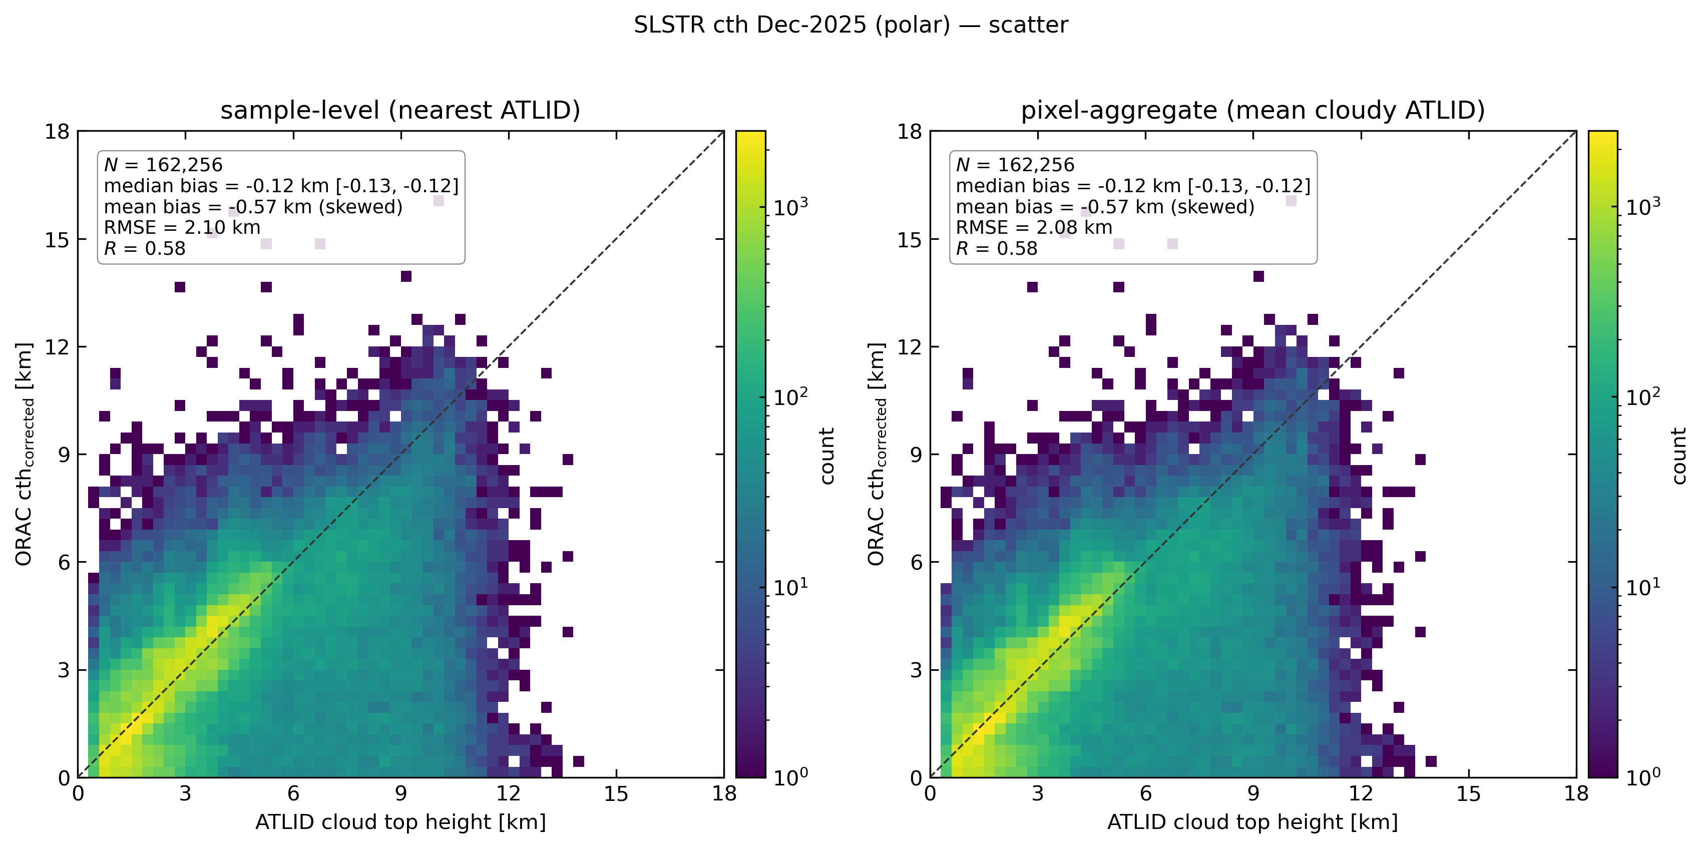
Cloud-top height — the strong result
ORAC vs A-CTH, both hemispheres (thermal retrieval works day & night)
• Median CTH bias −0.25 km (Antarctic, polar day) — the thermal cloud-top retrieval survives the polar regime.
• Arctic (polar night) −0.95 km: ~4× larger, a night-vs-day + winter-sea-ice regime contrast, not a pole effect.
• The one variable that samples both hemispheres; the headline −0.57 km 'polar' number blends the two regimes.
Notes:
Cloud-top height is our strongest result. Over the Antarctic in daylight the median bias is a quarter of a kilometre - the thermal 11-micron retrieval holds up in the polar regime. The Arctic, in polar night in December, is about four times worse at minus 0.95 km; that's a night-versus-day and winter-sea-ice contrast, not something about the pole itself. Worth flagging: the often-quoted minus 0.57 km 'polar' number is really a blend of these two very different regimes, so I prefer to quote them split.

Slide 5
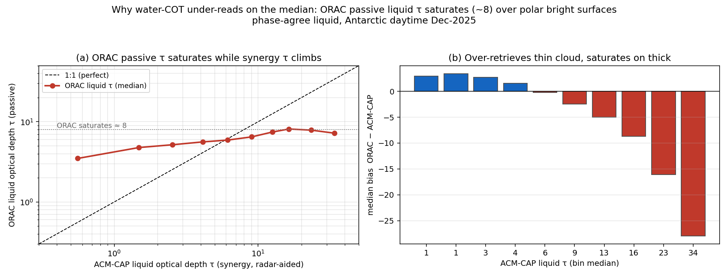
Water-cloud optical depth — the passive retrieval saturates
ORAC vs ACM-CAP (radar-aided synergy), phase-agree liquid
• Report the MEDIAN: −4.8. The quoted '+3 mean' is a skew artefact of a high-τ tail (it even flips sign).
• ORAC's passive liquid τ is pinned ~5–8 across the entire ACM-CAP range (0.6→34): it over-reads thin cloud, saturates on thick, and cannot correlate (r_log ≈ 0.1).
• It is ORAC saturating, not the radar reference being high (CPR changes the bias by ~1 τ).
Notes:
Water-cloud optical depth. First a methodological point: report the median, not the mean. Optical depth is heavy-tailed, and the mean gets dragged positive by a few thick-cloud pixels - it even flips sign. On the median, ORAC underestimates by about 5. The cause is saturation: ORAC's passive liquid optical depth is stuck around 5 to 8 across the whole reference range, from below 1 up to 34. So it over-reads thin cloud, saturates on thick cloud, and can't correlate. And it's genuinely ORAC saturating - using the radar in the reference changes the answer by only about 1, so the reference isn't the problem.

Slide 6
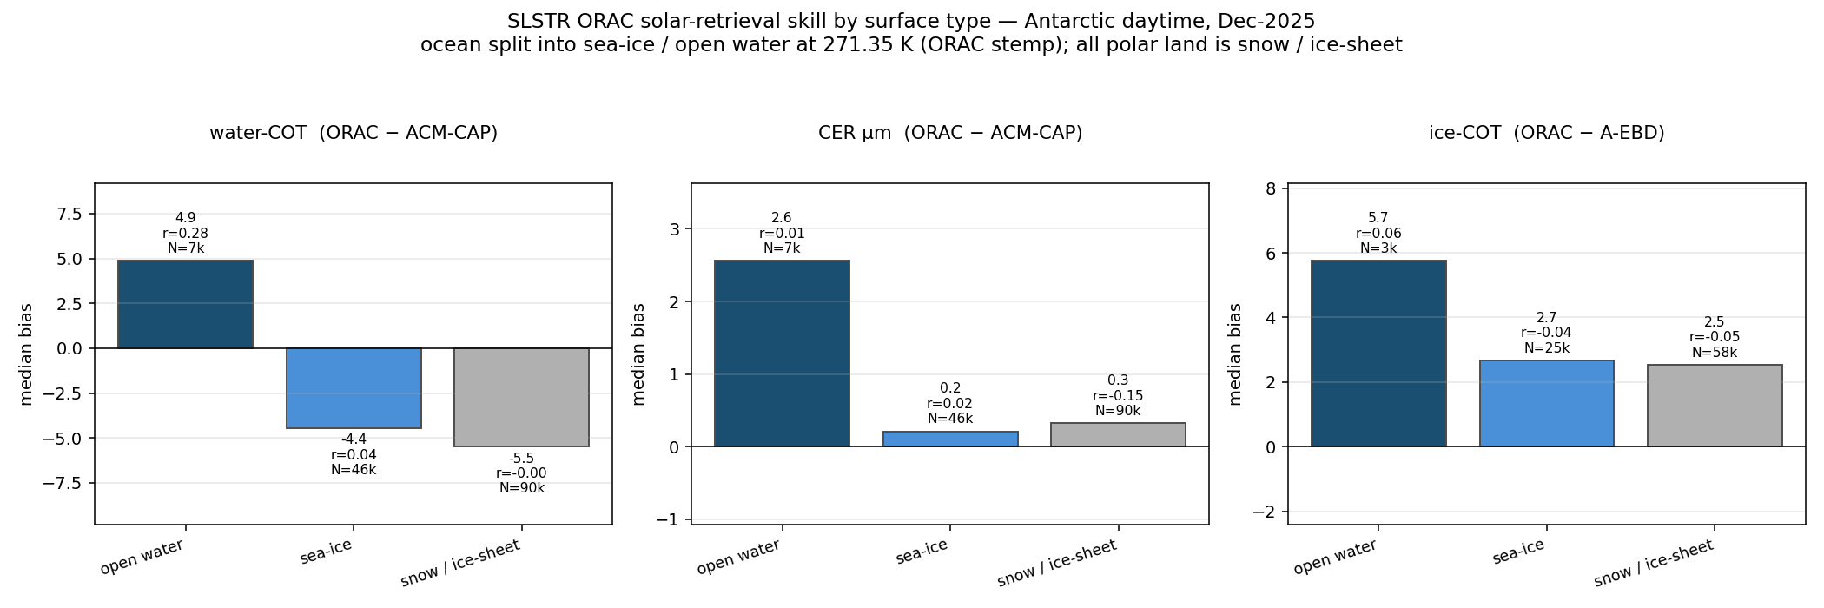
The deficit is cryospheric — the surface, not the phase
Solar-retrieval skill split by ORAC surface type
• Water-COT correlates (r = +0.28) and over-reads ONLY over open water; over sea-ice & ice-sheet (95% of the scene) r → 0 and bias is −4 to −5.
• Same clouds, only the background changed → the τ saturation is the bright-surface radiative regime, not an algorithm bug.
• CER is surface-robust (median +0.2 / +0.3 µm over sea-ice / ice-sheet): trustworthy droplet size even where τ is unconstrained.
Notes:
This is the key slide for the cause. If we split by surface type, water optical depth only behaves like a working retrieval - positive correlation, slight over-read - over open water. The instant the surface is sea-ice or ice-sheet, which is 95% of the scene, the correlation collapses to zero and it under-reads by 4 to 5. Same clouds, only the background changed - so the saturation is a bright-surface radiative effect, not a bug. And note the contrast: effective radius stays accurate over the cryosphere, so droplet size is trustworthy even where optical depth isn't.

Slide 7
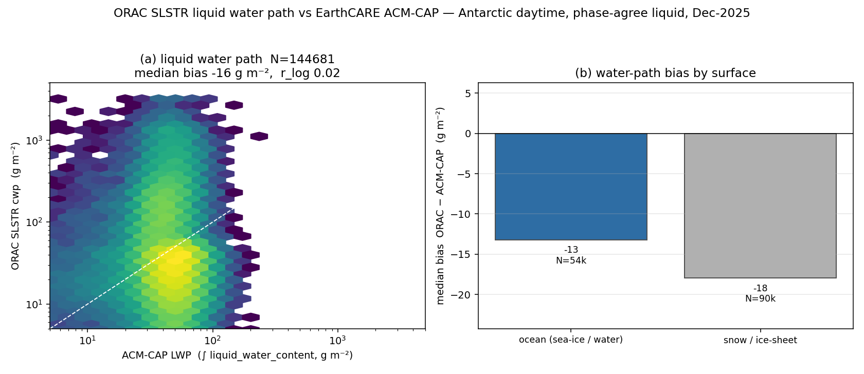
Liquid water path — the saturation reaches the water budget
ORAC cwp vs an independent ACM-CAP water-content reference (LWP)
• ORAC liquid water path runs 34% low on the median (30 vs 47 g m⁻²), decorrelated, worse over ice sheet (−18) than ocean (−13).
• Validated against radar+lidar liquid-water-content — a reference that never sees τ — so it confirms the τ saturation propagates into the water budget.
• Fixed by the same surface-albedo advance, not a CWP-specific change.
Notes:
Does the optical-depth problem matter for the water budget? Yes. ORAC's liquid water path runs about a third low on the median, decorrelated, and worse over the ice sheet. What makes this convincing is the reference: we integrated EarthCARE's radar-plus-lidar liquid water content, a measurement that never uses optical depth - so it independently confirms the saturation propagates into the water path. Same fix required: better handling of the bright surface albedo.

Slide 8
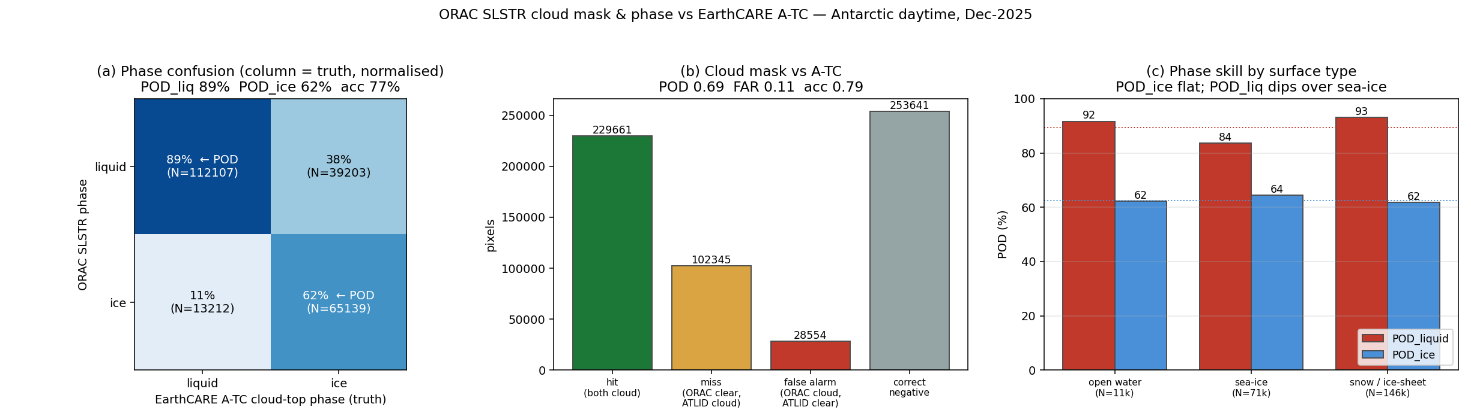
Cloud mask & phase vs EarthCARE A-TC — the two-way contingency
Categorical validation (POD_ice, previously unmeasurable)
• Cloud mask: POD 0.69, FAR 0.11 — conservative; the missed 31% is 88% thin cirrus the lidar sees and a passive imager cannot.
• Phase: POD_liquid 89.5%, POD_ice 62.4% → ORAC has a liquid bias, calling 38% of ice cloud tops 'liquid'.
• This bias is SURFACE-INDEPENDENT (62–64% over open water, sea-ice, ice-sheet) — an intrinsic limitation, distinct from the surface-driven τ saturation.
• Polar liquid is ~100% supercooled; ORAC handles it well (89.5%).
Notes:
The categorical validation, and the part that's new since last time. Against A-TC, which classifies every lidar bin, we can finally score both phases. Liquid detection is good at about 90%, but ice detection is only 62% - ORAC calls 38% of ice cloud tops liquid. That's a liquid bias. Crucially it's surface-independent - 62 to 64% over open water, sea-ice and ice-sheet alike - so it's a different, intrinsic limitation, separate from the surface-driven saturation. On the cloud mask, ORAC is conservative: it catches 69% with a low false-alarm rate, and what it misses is 88% thin cirrus that the lidar sees and a passive imager physically cannot. Read POD as: of all the real ice clouds, what fraction did ORAC catch.

Slide 9
All variables at a glance — December 2025
Headline metric per variable (median-primary; N = pixel-level matches)
Variable | EarthCARE ref. | Headline metric | Verdict
Cloud-top height | A-CTH | median −0.25 km (S, day) / −0.95 km (N, night) | Strong
Water-cloud COT | ACM-CAP | median −4.8 (passive τ saturates ~5–8) | Regime-limited
Ice-cloud COT | A-EBD | median +2.0 (mean +7 skewed) | Weak corr.
Effective radius | ACM-CAP | median +1 µm (robust bias, no skill) | Robust bias
Liquid water path | ACM-CAP LWP | median −16 g m⁻² (−34%) | Inherits τ
Cloud mask | A-TC | POD 0.69 · FAR 0.11 (misses = thin cirrus) | Conservative
Cloud phase | A-TC | POD_liq 90% · POD_ice 62% (liquid bias) | Liquid-biased
Notes:
A one-look summary of every variable. The green rows are trustworthy - cloud-top height and effective radius, plus a conservative cloud mask. The amber rows are regime-limited - the optical depths and the water path, all tied to the same saturation. The red row is the phase, our clearest weakness. If you take one thing from this table: the thermal and microphysical-shape products are solid; the solar optical-depth magnitude and the phase are where the work is.

Slide 10
Summary — what is validated, and what is next
Every EarthCARE-validatable dimension of the Dec-2025 sample is complete
• VALIDATED (all median-primary, with confidence intervals):
– CTH · water-COT · ice-COT · CER · CWP · cloud mask · phase — plus collocation methodology, surface-type & phase stratification.
• THE UNIFYING STORY — two independent limitations of the polar-daytime solar retrieval:
– (1) bright-surface optical-depth SATURATION (surface-driven; propagates into CWP; spares open water),
– (2) an intrinsic LIQUID PHASE BIAS (POD_ice 62%; surface-independent).
– Thermal CTH is strong (−0.25 km); CER is robust. These are the trustworthy products over the cryosphere.
• NEXT STEPS (require new processing, not further analysis):
– Arctic / boreal-summer month (Arctic sea-ice & Greenland) · Sentinel-3B · other seasons.
Notes:
To close. Everything is validated and defensible as an Antarctic-summer daytime study, with cloud-top height also bi-hemispheric. The unifying message is two independent limitations: a surface-driven optical-depth saturation that also hits the water path, and an intrinsic liquid phase bias. The reliable products are cloud-top height and effective radius. The next steps all require new processing rather than more analysis - a boreal-summer month to test the Arctic, Sentinel-3B for a second platform, and other seasons. Happy to take questions.

