Slide 1
Evaluating contributions of point-of-care data to inform forecasts of influenza
Minh Tam Hoang
Department of Mathematics and Statistics
Mount Holyoke College
Summer 2019

Slide 2
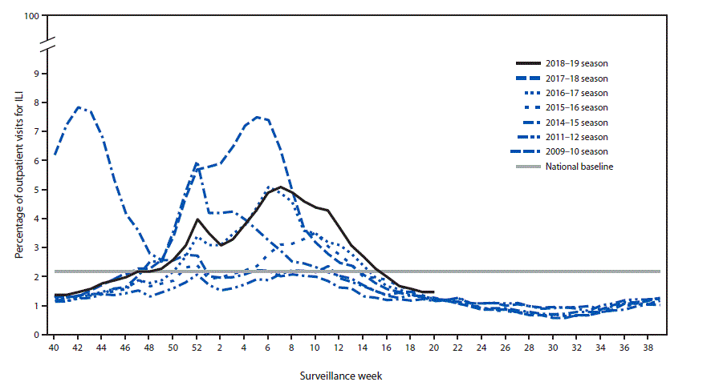
Background-motivation
A 2019 CDC study reports that the influenza virus is responsible for 37.4 million to 42.9 million symptomatic illnesses and 36,400-61,200 deaths in the States annually.
Significant changes in the influenza virus activity challenge public health agencies in preparation and response to the outbreak of flu.
Percentage of outpatient visits for influenza-like illness reported to CDC in the States in the last ten years.
Real-time forecast of influenza transmission allows the generation of the short-term activity of influenza and the assessment of forecast accuracy.
Jernigan. D et al.; Weekly June 21, 2019,68(24);544–551

Slide 3
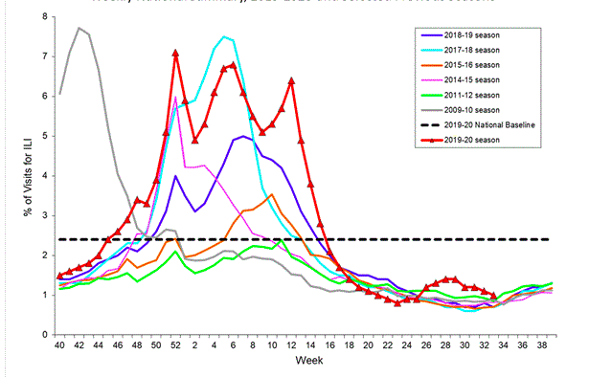
Background - motivation
Specific trends in the flu activity in the last ten years:
The annual influenza season consists of intensity peaks during:
  Mid-December to late January (holiday season)
  Mid-February to April/early May
The influenza activity stays below the baselines(low-severity) in the remaining months.
The seasonal component should be considered in the generation of the influenza forecast.
Exponential smoothing method is a potential candidate in the flu forecast as this method:
  Describe the observed data
  Describe the unobserved components or states such as trend, seasonal that change over time
Percentage of visits for influenza-like illness (ILI) reported to CDC¹
- Evaluate contributions of point-of-care data and past influenza data to inform short-term forecasts of influenza using the exponential smoothing method
- Implement cross-validation techniques to assess the predictive performance of each model.

Slide 4
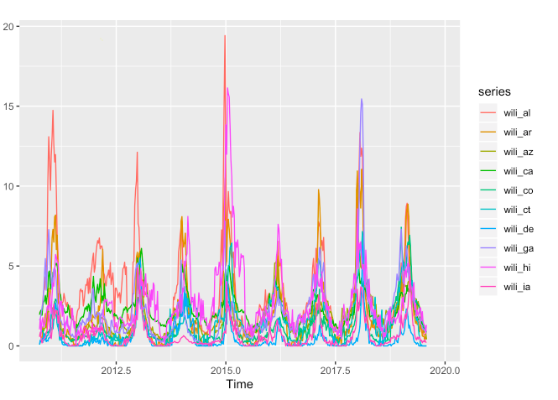
Materials
Surveillance data
  The percentage of outpatient visits to health care providers for influenza-like illness(ILI) which was collected through the U.S. Outpatient Influenza-like Illness Surveillance Network (ILINet).
  ILINet consists of outpatient healthcare providers in all 50 states.
  ILI includes cases that have fever(>=100ºF), cough, and sore throat.
Internet-related data
  Influenza-related Wikipedia search frequencies for influenza symptoms such as fever(>=100ºF), cough, and sore throat.
Percentage of outpatients visits for IIL in a few states from 2010 to 2019.

Slide 5
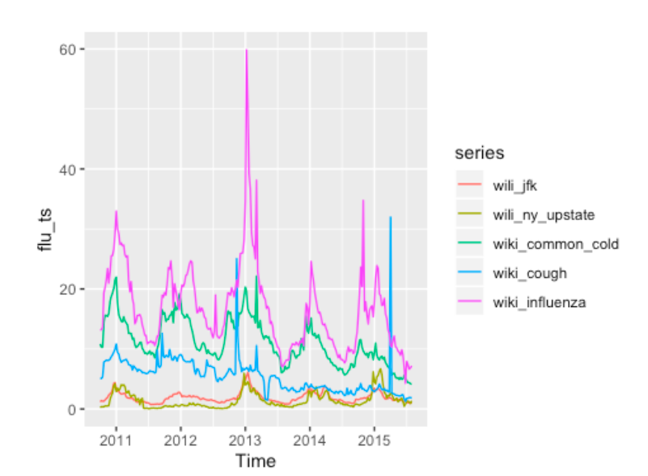
Methods-results
1) Vector Autoregressive models
Vector Autogressive (VAR) model
VAR(2)
VAR(3)
Box-Cox transformation
Log-transformation

Slide 6
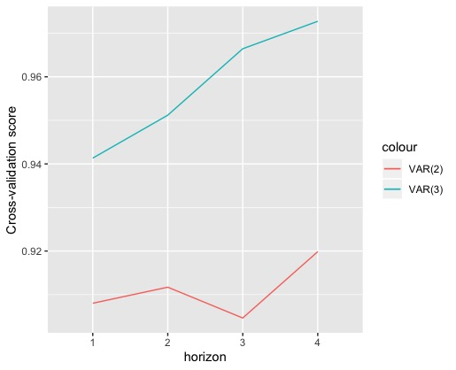
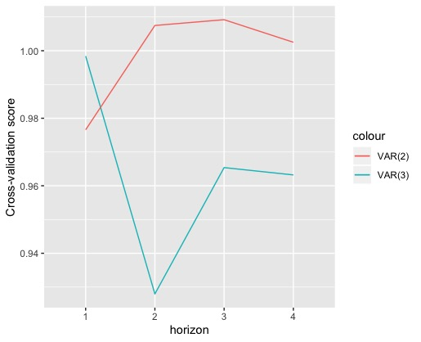
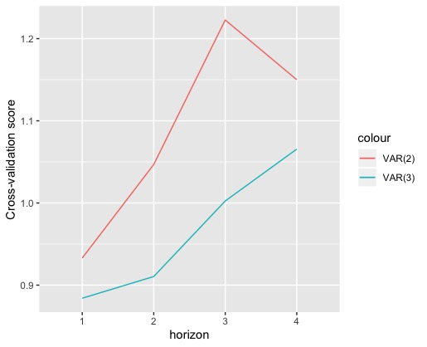
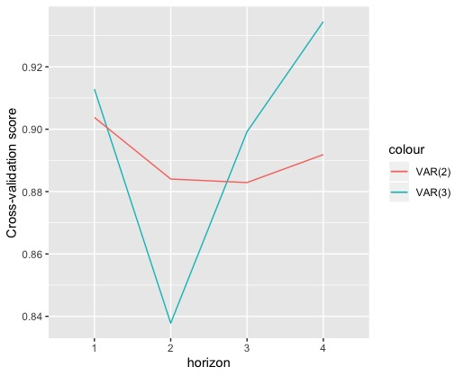
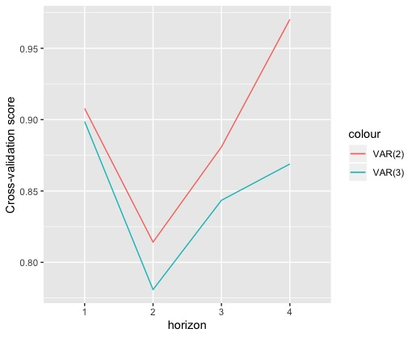
Forecasting without outside data (Wiki data)
No transformation
Box-Cox Transformation
➔ VAR(3) with log transformation gives
the best model for forecasting flu in JFK with the lowest CV scores.
➔ The values of forecast accuracy
measures are better when the Wiki data was involved in the forecasting.
Forecasting with outside data (Wiki data)
No transformation
Box-Cox Transformation
Log-transformation

Slide 7
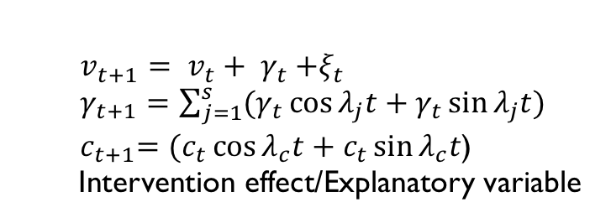
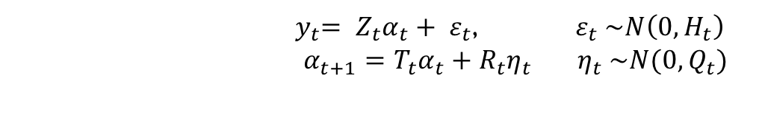
Methods-results
1I) Exponential Smoothing models
a) General Equation:
Observation equation
${ y}_{t}= Z_{t}α_{t}+ ε_{t}$, $ε_{t} \sim N\left(0,H_{t}\right)$
$α_{t+1}=T_{t}α_{t}+R_{t}η_{t}$ ${ η}_{t} \sim N(0,Q_{t})$
State equation
Trend component
$v_{t+1}= v_{t}+ γ_{t}{+ξ}_{t}$
$γ_{t+1}=\sum_{j=1}^{s}{(γ_{t}\cos{λ_{j}t}+γ_{t}\sin{λ_{j}t})}$
${ c}_{t+1}=(c_{t}\cos{λ_{c}t}+c_{t}\sin{λ_{c}t}$)
Intervention effect/Explanatory variable
Seasonal component (trigonometric form)
State vector can consist of
Cycle component

Slide 8
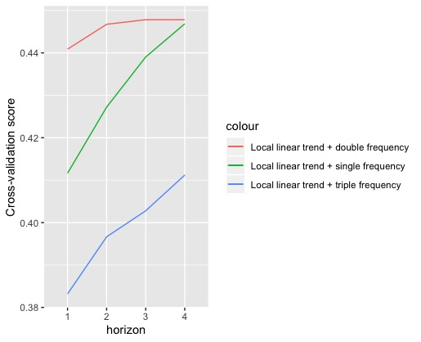
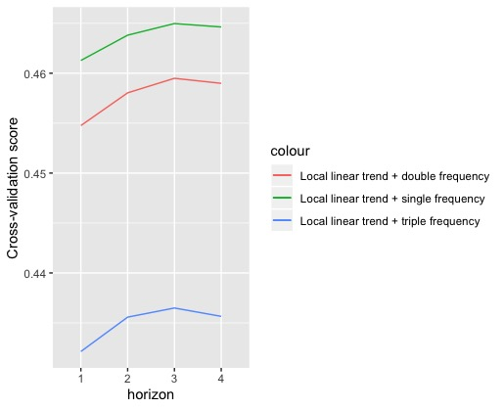
Forecasting with Wiki data (New York JFK)
Without holiday season effect
With Christmas week and New Year’s effect
With Christmas week effect
In comparison with VAR models, Exponential Smoothing models obtain lower cross-validation errors, suggesting the better performance in flu forecasting.
Christmas week and New Year’s do not have significant effect on the behavior of flu activity when the model only consider single cycle of frequency and double cycle of frequency.
The model of local linear trend, triple cycles of frequency, log transformation, and holiday effect is better at forecasting compared to other models shown in the plots.

Slide 9
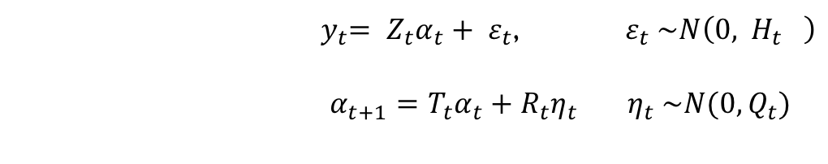
Methods-results
1I) Exponential Smoothing models
b) Developing procedure for estimating the co-variance matrix H
${ y}_{t}= Z_{t}α_{t}+ ε_{t}$, $ε_{t} \sim N\left(0,{ H}_{t} \right)$
$α_{t+1}=T_{t}α_{t}+R_{t}η_{t}$ ${ η}_{t} \sim N(0,Q_{t})$
b.1Procedure
Start the initial model with identity H matrix
Optimize over the initial parameters of the model and allow the diagonal matrix H to be optimized (based on Nelder-Mead and quasi-Newton algorithms)
Replace the identity H matrix by the optimized H matrix in the initial model
Re-optimize the initial model with the most updated H matrix
Perform a smooth maximum (LogSumExp) onto the optimized H matrix

Slide 10

Methods-results
1I) Exponential Smoothing models
c) Kalman filter recursion
${ y}_{t}= Z_{t}α_{t}+ ε_{t}$, $ε_{t} \sim N\left(0,{ H}_{t} \right)$
$α_{t+1}=T_{t}α_{t}+R_{t}η_{t}$ ${ η}_{t} \sim N(0,Q_{t})$; ${ α}_{t} \sim N(a1,P_{t})$
Kalman filter recursion to predict the state vector and its corresponding co-variance matrix
$${ K}_{t}= T_{t}P_{t}Z_{t}^{′}+F_{t}^{−1}$$
Kalman Gain
Begin with N(a₁, P_{t}), calculate $a_{t|t},a_{t+1},P_{t|t},P_{t+1}$ from $P_{t}$ and $a_{t}$ recursively for t = 1,…,n.
Durbin J., Koopman S.J.; Time series analysis by State Space Models

Slide 11
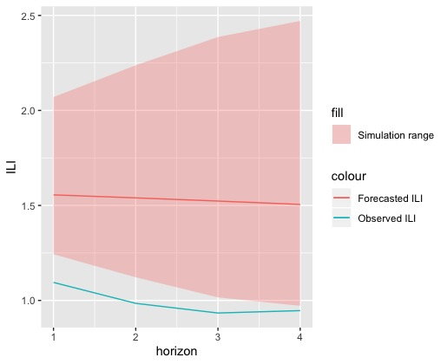
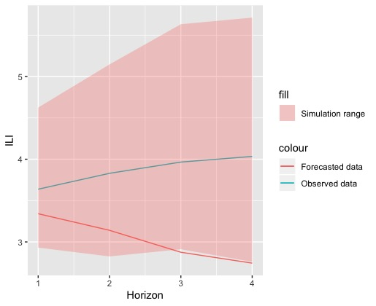
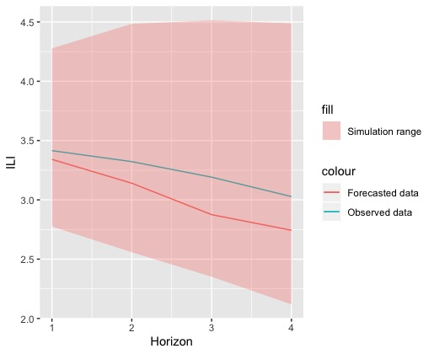
July 2018
October 2018
California
California
Both the forecasted ILI and observed ILI fall into the region obtained from simulation via Kalman Filtering
The forecasts from the model with the optimized H matrix are not so deviant from the observed ones.
However, the pattern of the observed and the forecasted are opposite in some cases.
January 2019
March 2019
California
California

Slide 12
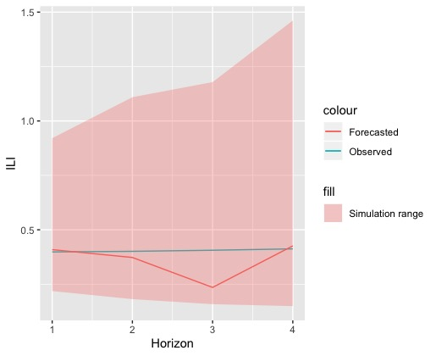
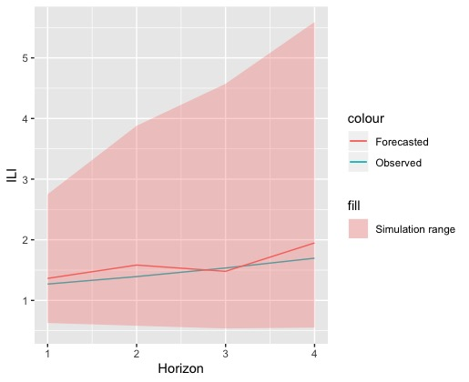
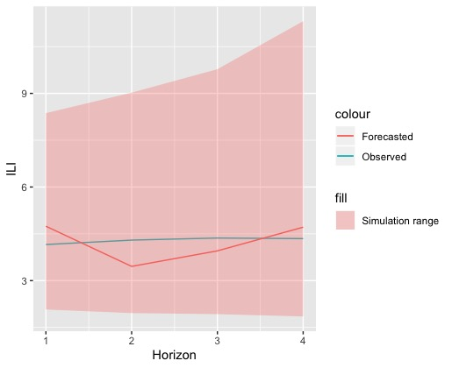
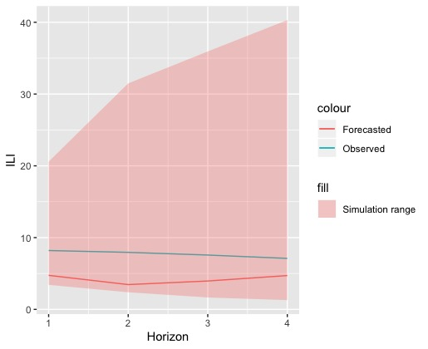
July 2018
South Carolina
October 2018
South Carolina
Both the forecasted ILI and observed ILI fall into the region obtained from simulation via Kalman Filtering
The simulation range is too broad in the January and March 2019 forecasts.
January 2019
South Carolina
March 2019
South Carolina

Slide 13
CONCLUSIONS
Holiday seasons (Christmas, New Year’s) show significant effect on the percentage of outpatients visits for ILI, suggesting an effect on the flu activity in general.
Exponential smoothing models have better predictive performance than VAR models.
The procedure for estimating covariance matrix is effective in improving the forecast accuracy.
Acknowledgement:
Dr. Evan Ray
LYNK UAF

