Slide 1
CollectionSpace Service Behind the scenes
June 2009 Face-to-face
Sanjay Dalal
Richard Millet
U.C. Berkeley IST/Data Services

Slide 2
Agenda
Develop a simple service using JAX-RS
Use Nuxeo for document management
Two server deployment
Deploy and test a service
Data model for CollectionObject
Develop, deploy and test CollectionObject

Slide 3
CollectionObject Data Model
Goals of the Data Model
Extensible
The data model allows the addition of custom fields/elements to the default schema.
Flexible
An object’s data, rather than tightly bound, is loosely associated with the object.
???

Slide 4
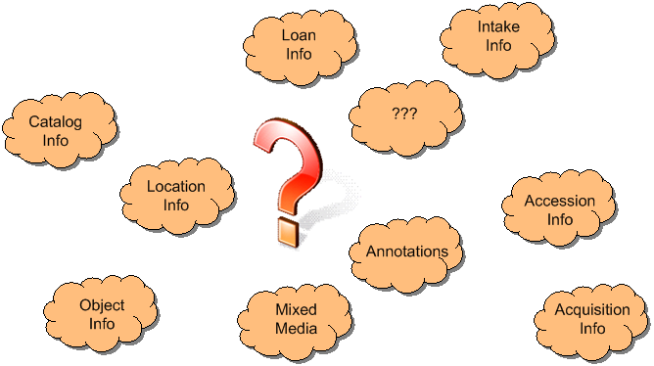
What is a CollectionObject?
Objects in a collection have a plethora of data associated with them. CollectionObjects help manage an object’s information and associations.

Slide 5
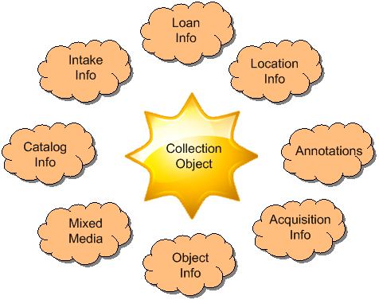
CollectionObject Is the Hub
CollectionObject is the hub around which an object’s information is associated and linked.

Slide 6
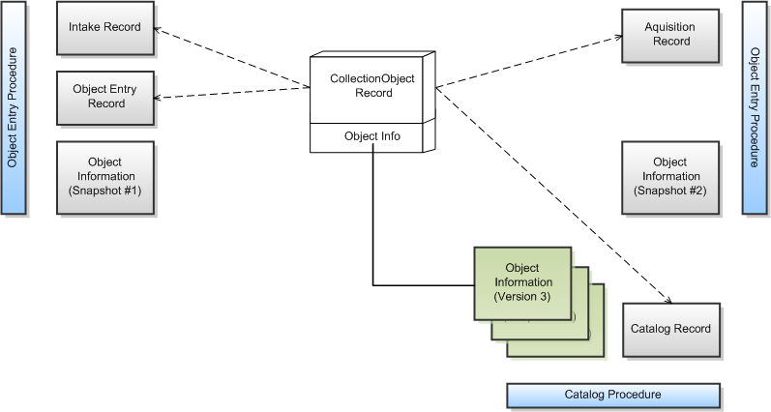
Mainstay of Object Data
From the CollectionObject, you can get to all data associated with an object.

Slide 7
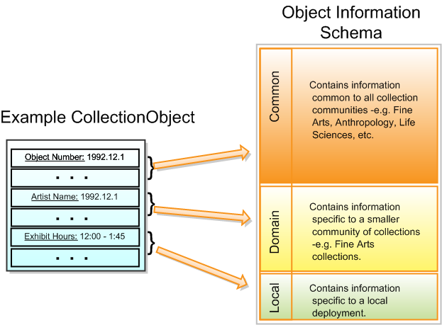
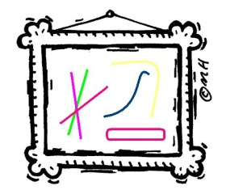
Object Information Schema
The schema is extensible with three major parts: Common, Domain, and Local.

Slide 8
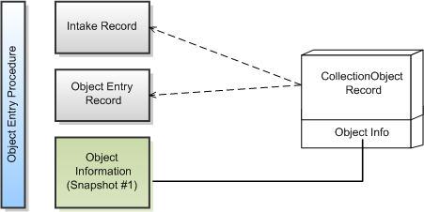
Object Intake/Entry
CollectionObject created and associated with Intake and Object Entry records. CollectionObject refers to the new Object Information record.

Slide 9
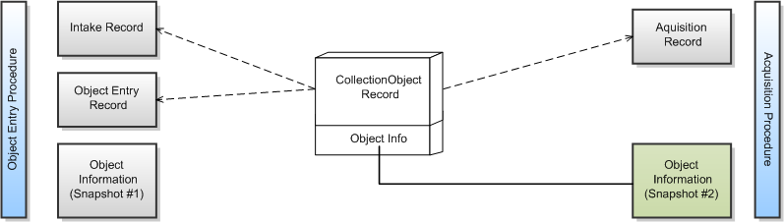
Acquisition
Acquisition record created and associated with CollectionObject. CollectionObject refers to the new Object Information record.

Slide 10
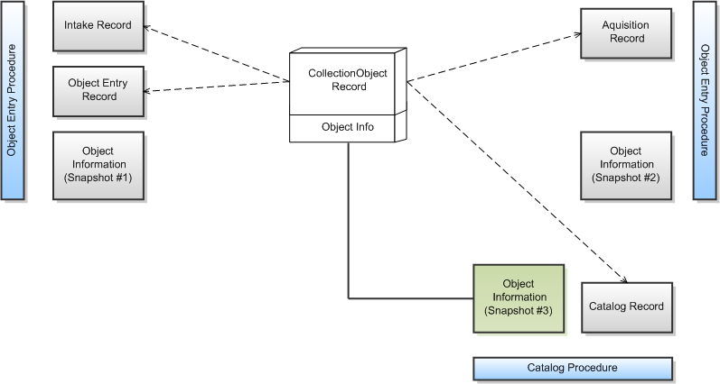
Cataloged
Catalog record created and associated with CollectionObject. CollectionObject refers to the new Object Information record.

Slide 11
A Catalog Change
A change creates new version of Object Information record. CollectionObject refers to the new Object Information record.

