Slide 1
CollectionSpace Service Behind the scenes
June 2009 Face-to-face
Sanjay Dalal
Richard Millet
U.C. Berkeley IST/Data Services

Slide 2
Agenda
Splitting the service layer
A CollectionSpace service
Contract, Document Type, RESTful Resource, Package
Data model for CollectionObject
Develop, deploy and test CollectionObject

Slide 3
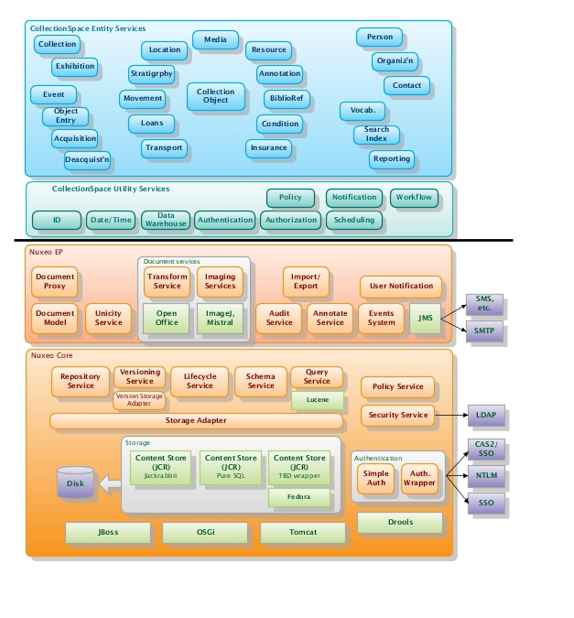
Service layer cake

Slide 4
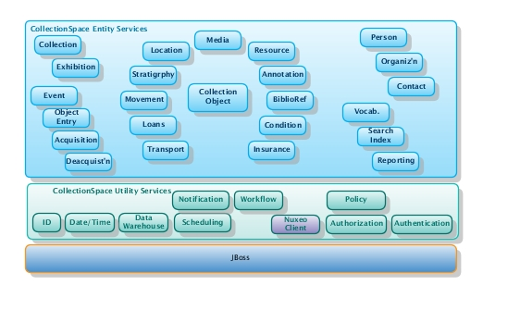
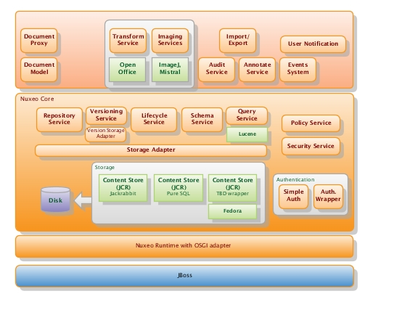
Splitting the cake ☹
Why?
Prototypical Nuxeo RESTful APIs (only for document repository, no support for XML complex type)
Nuxeo’s Java Local APIs force to run inside Nuxeo container
Co-located (same addressspace) CS and Nuxeo using Java Remote APIs was not possible due to classloading issues

Slide 5
CollectionObject service
Contract (schema and APIs)
RESTful Resource using JAX-RS
Package and Deploy

Slide 6
CollectionObject Entity Schema

Slide 7
Nuxeo document type for CollectionObject OSGI-INF/core-types-contrib.xml
<?xml version="1.0"?>
<component name="org.collectionspace.collectionobject.coreTypes">
<extension target="org.nuxeo.ecm.core.schema.TypeService" point="schema">
<schema name="collectionobject" prefix="collectionobject-core" src="schemas/collectionobject.xsd"/>
</extension>
<extension target="org.nuxeo.ecm.core.schema.TypeService" point="doctype">
<doctype name="CollectionObject" extends="Document">
<schema name=“collectionobject-core"/>
<schema name=“collectionobject-anthropology"/>
<schema name="collectionobject-hearstmuseum.berkeley.edu"/>
</doctype>
</extension>
</component>

Slide 8
collectionobject.xsd
<?xml version="1.0" encoding="UTF-8" standalone="yes"?>
<xs:schema
xmlns:xs="http://www.w3.org/2001/XMLSchema"
xmlns:ns="http://collectionspace.org/collectionobject/"
xmlns="http://collectionspace.org/collectionobject/"
targetNamespace="http://collectionspace.org/collectionobject/"
version="0.1">
<xs:element name="objectNumber" type="xs:string"/>
<xs:element name="otherNumber" type="xs:string"/>
<xs:element name="briefDescription" type="xs:string"/>
<xs:element name="comments" type="xs:string"/>
<xs:element name="distFeatures" type="xs:string"/>
<xs:element name="objectName" type="xs:string"/>
<xs:element name="responsibleDept" type="xs:string"/>
<xs:element name="title" type="xs:string"/>
</xs:schema>
* flat schema – used due to limitations of Nuxeo RESTful APIs. No more needed with Nuxeo Java Remote APIs.

Slide 9
Develop JAX-RS Resource
@Path("/collectionobjects")
@Consumes("application/xml")
@Produces("application/xml")
public class CollectionObjectResource extends CollectionSpaceResource {
@POST
public Response createCollectionObject(CollectionObject co) { … }
@GET
@Path("{id}")
public CollectionObject getCollectionObject(@PathParam("id") String id) { .. }
@PUT
@Path("{id}")
public CollectionObject updateCollectionObject(@PathParam("id") String id, CollectionObject theUpdate) { … }
@DELETE
@Path("{id}")
public void deleteCollectionObject(@PathParam("id") String id) { … }
@GET
public CollectionObjectList getCollectionObjectList(@Context UriInfo ui) { … }
}

Slide 10
Develop JAX-RS Resource
@POST
public Response createCollectionObject(CollectionObject co) {
…
RepositoryInstance repoSession = getRepositorySession();
DocumentRef nuxeoWspace = new IdRef(CS_COLLECTIONOBJECTS_WORKSPACE_UID);
DocumentModel wspaceCOs = repoSession.getDocument(nuxeoWspace);
String wspacePath = wspaceCOs.getPathAsString();
String docType = “CollectionObject";
String id = IdUtils.generateId("New " + docType);
DocumentModel coDoc = repoSession.createDocumentModel(wspacePath, id, docType);
fillDocument(co, coDoc);
coDoc = repoSession.createDocument(coDoc);
repoSession.save();
co.setId(coDoc.getId());
…
UriBuilder path = UriBuilder.fromResource(CollectionObjectResource.class);
path.path("" + co.getId());
Response response = Response.created(path.build()).build();
return response;
}

Slide 11
Register resource with JAX-RS Application
public class CollectionSpaceApplication extends Application {
private Set<Object> singletons = new HashSet<Object>();
private Set<Class<?>> empty = new HashSet<Class<?>>();
public CollectionSpaceApplication() {
singletons.add(new CollectionObjectResource());
}
@Override
public Set<Class<?>> getClasses() {
return empty;
}
@Override
public Set<Object> getSingletons() {
return singletons;
}
}

Slide 12
Package Nuxeo document type as OSGI component (jar META-INF/MANIFEST.MF)
Manifest-Version: 1.0
Bundle-ManifestVersion: 1
Bundle-Name: NuxeoCS
Bundle-SymbolicName: org.collectionspace.collectionobject;singleton:=true
Bundle-Version: 1.0.0
Bundle-Localization: plugin
Bundle-Vendor: Nuxeo
Require-Bundle: org.nuxeo.runtime,
org.nuxeo.ecm.core.api,
org.nuxeo.ecm.core,
org.nuxeo.ecm.core.api,
org.nuxeo.ecm.platform.types.api,
org.nuxeo.ecm.platform.versioning.api,
org.nuxeo.ecm.platform.ui,
org.nuxeo.ecm.platform.forms.layout.client,
org.nuxeo.ecm.platform.publishing.api,
org.nuxeo.ecm.platform.ws
Provide-Package: org.collectionspace.collectionobject
Nuxeo-Component: OSGI-INF/core-types-contrib.xml,
OSGI-INF/ecm-types-contrib.xml,
OSGI-INF/layouts-contrib.xml

Slide 13
Package resource as web-app (war WEB-INF/web.xml)
<context-param>
<param-name>javax.ws.rs.Application</param-name>
<param-value>
org.collectionspace.hello.services.CollectionSpaceApplication
</param-value>
</context-param>
<context-param>
<param-name>resteasy.servlet.mapping.prefix</param-name>
<param-value>/cspace-nuxeo</param-value>
/context-param>
<listener>
<listener-class>
org.jboss.resteasy.plugins.server.servlet.ResteasyBootstrap
</listener-class>
</listener>
<servlet>
<servlet-name>Resteasy</servlet-name>
<servlet-class>org.jboss.resteasy.plugins.server.servlet.HttpServletDispatcher
</servlet-class>
</servlet>
<servlet-mapping>
<servlet-name>Resteasy</servlet-name>
<url-pattern>/cspace-nuxeo/*</url-pattern>
</servlet-mapping>

Slide 14
Deployment

