Slide 1
CollectionSpace Service Behind the scenes
June 2009 Face-to-face
Sanjay Dalal
U.C. Berkeley IST/Data Services

Slide 2
Agenda
Interfacing with Nuxeo
A CollectionSpace service
Nuxeo Document Type
RESTful Resource
Deployment Architecture
Multi-tenancy aspects

Slide 3
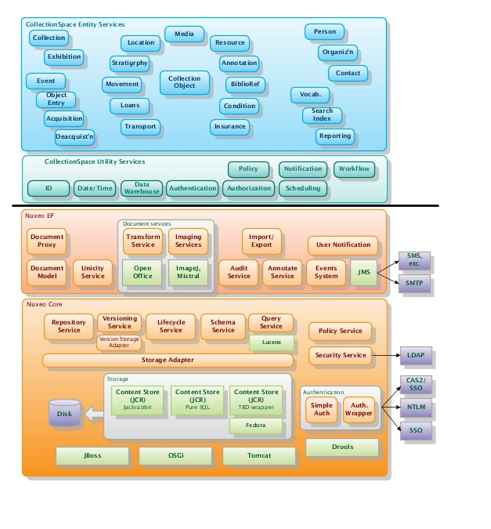
Service layer cake

Slide 4
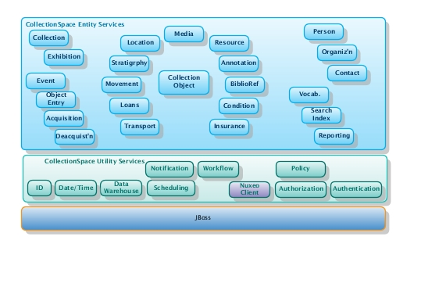
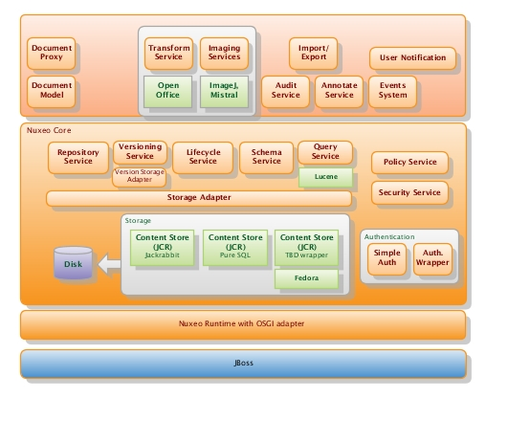
Splitting the cake
Nuxeo
Java Remote
APIs
Nuxeo Client
Why?
Prototypical Nuxeo RESTful APIs (only supports document repository, no support for XML complex type, have to use export vs. get)
Nuxeo’s Java Local APIs force to run inside the Nuxeo container
Co-located (same addressspace) CS and Nuxeo using Java Remote APIs was not possible due to class loading issues

Slide 5
CollectionObject service
Contract
Schema
APIs
RESTful Resource using JAX-RS

Slide 6
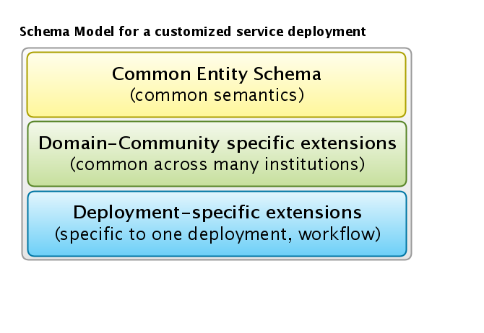
CollectionObject Entity Schema

Slide 7
Nuxeo document type for CollectionObject OSGI-INF/core-types-contrib.xml
<?xml version="1.0"?>
<component name="org.collectionspace.collectionobject.coreTypes">
<extension target="org.nuxeo.ecm.core.schema.TypeService" point="schema">
<schema name="collectionobject-common" prefix="collectionobject-common" src="schemas/collectionobject-common.xsd"/>
…
/>
</extension>
<extension target="org.nuxeo.ecm.core.schema.TypeService" point="doctype">
<doctype name="CollectionObject" extends="Document">
<schema name=“collectionobject-common"/>
<schema name=“collectionobject-anthropology"/>
<schema name="collectionobject-hearstmuseum.berkeley.edu"/>
</doctype>
</extension>
</component>

Slide 8
collectionobject-common.xsd
<?xml version="1.0" encoding="UTF-8" standalone="yes"?>
<xs:schema
xmlns:xs="http://www.w3.org/2001/XMLSchema"
xmlns:ns="http://collectionspace.org/collectionobject/"
xmlns="http://collectionspace.org/collectionobject/"
targetNamespace="http://collectionspace.org/collectionobject/"
version="0.1">
<xs:element name="objectNumber" type="xs:string"/>
<xs:element name="otherNumber" type="xs:string"/>
<xs:element name="briefDescription" type="xs:string"/>
<xs:element name="comments" type="xs:string"/>
<xs:element name="distFeatures" type="xs:string"/>
<xs:element name="objectName" type="xs:string"/>
<xs:element name="responsibleDept" type="xs:string"/>
<xs:element name="title" type="xs:string"/>
</xs:schema>
* flat schema – used due to limitations of Nuxeo RESTful APIs. No more needed with Nuxeo Java Remote APIs.

Slide 9
Develop JAX-RS Resource
@Path("/collectionobjects")
@Consumes("application/xml“) @Produces("application/xml")
public class CollectionObjectResource extends CollectionSpaceResource {
@POST
public Response createCollectionObject(CollectionObject co) { … }
@GET @Path("{id}")
public CollectionObject getCollectionObject(@PathParam("id") String id) { .. }
@PUT @Path("{id}")
public CollectionObject updateCollectionObject(@PathParam("id") String id, CollectionObject theUpdate) { … }
@DELETE @Path("{id}")
public void deleteCollectionObject(@PathParam("id") String id) { … }
@GET
public CollectionObjectList getCollectionObjectList(@Context UriInfo ui) { … }
}

Slide 10
Develop JAX-RS Resource
@POST
public Response createCollectionObject(CollectionObject co) {
…
RepositoryInstance repoSession = getRepositorySession();
DocumentRef nuxeoWspace = new IdRef(CS_COLLECTIONOBJECTS_WORKSPACE_UID);
DocumentModel wspaceCOs = repoSession.getDocument(nuxeoWspace);
String wspacePath = wspaceCOs.getPathAsString();
String docType = “CollectionObject";
String id = IdUtils.generateId("New " + docType);
DocumentModel coDoc = repoSession.createDocumentModel(wspacePath, id, docType);
fillDocument(co, coDoc);
coDoc = repoSession.createDocument(coDoc);
repoSession.save();
co.setId(coDoc.getId());
…
UriBuilder path = UriBuilder.fromResource(CollectionObjectResource.class);
path.path("" + co.getId());
Response response = Response.created(path.build()).build();
return response;
}

Slide 11
Register resource with JAX-RS Application
public class CollectionSpaceApplication extends Application {
private Set<Object> singletons = new HashSet<Object>();
private Set<Class<?>> empty = new HashSet<Class<?>>();
public CollectionSpaceApplication() {
singletons.add(new CollectionObjectResource());
}
@Override
public Set<Class<?>> getClasses() {
return empty;
}
@Override
public Set<Object> getSingletons() {
return singletons;
}
}

Slide 12
Package Nuxeo document type as OSGI component (jar META-INF/MANIFEST.MF)
Manifest-Version: 1.0
Bundle-ManifestVersion: 1
Bundle-Name: NuxeoCS
Bundle-SymbolicName: org.collectionspace.collectionobject;singleton:=true
Bundle-Version: 1.0.0
Bundle-Localization: plugin
Bundle-Vendor: Nuxeo
Require-Bundle: org.nuxeo.runtime,
org.nuxeo.ecm.core.api,
org.nuxeo.ecm.core,
org.nuxeo.ecm.core.api,
org.nuxeo.ecm.platform.types.api,
org.nuxeo.ecm.platform.versioning.api,
org.nuxeo.ecm.platform.ui,
org.nuxeo.ecm.platform.forms.layout.client,
org.nuxeo.ecm.platform.publishing.api,
org.nuxeo.ecm.platform.ws
Provide-Package: org.collectionspace.collectionobject
Nuxeo-Component: OSGI-INF/core-types-contrib.xml,
OSGI-INF/ecm-types-contrib.xml,
OSGI-INF/layouts-contrib.xml

Slide 13
Package resource as web-app (war WEB-INF/web.xml)
<context-param>
<param-name>javax.ws.rs.Application</param-name>
<param-value>
org.collectionspace.hello.services.CollectionSpaceApplication
</param-value>
</context-param>
<context-param>
<param-name>resteasy.servlet.mapping.prefix</param-name>
<param-value>/cspace-nuxeo</param-value>
/context-param>
<listener>
<listener-class>
org.jboss.resteasy.plugins.server.servlet.ResteasyBootstrap
</listener-class>
</listener>
<servlet>
<servlet-name>Resteasy</servlet-name>
<servlet-class>org.jboss.resteasy.plugins.server.servlet.HttpServletDispatcher
</servlet-class>
</servlet>
<servlet-mapping>
<servlet-name>Resteasy</servlet-name>
<url-pattern>/cspace-nuxeo/*</url-pattern>
</servlet-mapping>

Slide 14
Deployment Architecture

Slide 15
Multi-tenancy aspects
CollectionSpace as a web-based software service that is centrally deployed and maintained and where collections of different institutions are managed.
One or more Berkeley museums sharing the same CollectionSpace deployment
One or more small and mid-size museums using CollectionSpace service provided by a 3rd party

Slide 16
Multi-tenancy aspects
Security, Storage, Metadata, Administration, Runtime
Security
Account (tenant, user) registration
Choosing ID provider(s) during authentication
Authorization and access control
Audit trail

Slide 17
Multi-tenancy aspects
Storage
Nuxeo repository
Domain per tenant, repository per tenant, hybrid
File system
Metadata
Configuration, Customization, Extensions, Access control policies, roles and resources
Administration
Delegated administration, import/export

