Slide 1
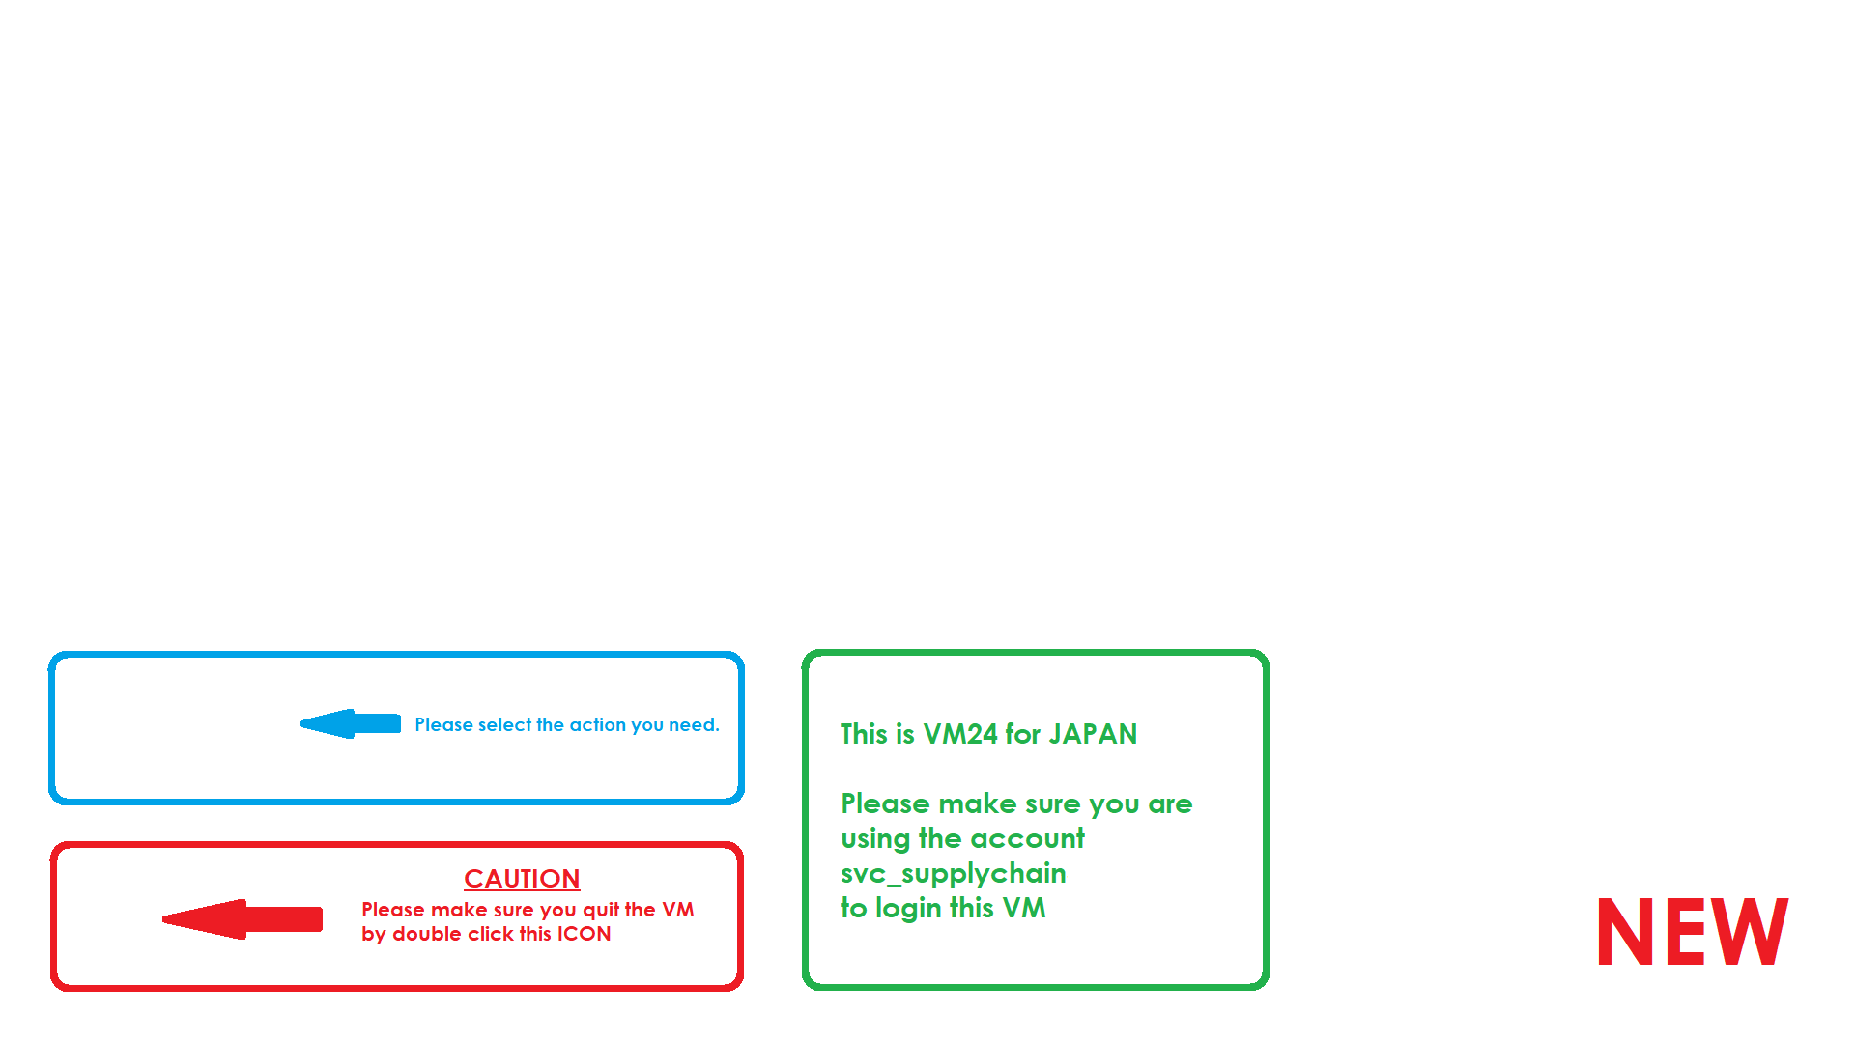
This is VM22 for APAC MGT

Slide 2
Please select the action you need.
This is VM91 for Development
Please make sure you are using the account svc_supplychain
to login this VM
NEW
Please make sure you quit the VM by double click this ICON

Slide 3
Please select the action you need.
This is VM92 for Development
Please make sure you are using the account svc_supplychain
to login this VM
NEW
Please make sure you quit the VM by double click this ICON

Slide 4
Please select the action you need.
This is VM91 for SC Projects 2
Please make sure you are using the account svc_supplychain
to login this VM
Please make sure you quit the VM by double click this ICON
NEW

Slide 5
Please select the action you need.
This is VM92 for Development
Please make sure you are using the account svc_supplychain
to login this VM
Please make sure you quit the VM by double click this ICON
NEW

Slide 6
Please select the action you need.
This is VM24 for APAC MGT
Please make sure you are using the account svc_supplychain
to login this VM
CAUTION
Please make sure you quit the VM by double click this ICON
NEW

