Slide 1
Job queues
2/12/25, 9:48 AM Job queues | Anyscale Docs
A job queue enables sophisticated scheduling and execution algorithms for Anyscale Jobs. This feature improves resource utilization and reduces provisioning times by enabling multiple jobs to share a single cluster.
Anyscale supports flexible scheduling algorithms, including FIFO (first-in, first-out), LIFO (last-in, first-out), and priority-based scheduling.
Job processing
Anyscale job queues optimize resource utilization and throughput by using sophisticated scheduling to run multiple jobs on the same cluster.
Submission: The typical Anyscale Job submission workflow adds the job to the specified queue.
Scheduling: Based on the scheduling policy, Anyscale determines ordering of the jobs in the queue and picks jobs at the top of the queue for scheduling. Anyscale schedules no more than the specified max-concurrency jobs for running on a cluster at the same time.
Execution: Jobs run until completion, including retries up to the specified number of
max_retries .
Anyscale provisions a cluster when you submit the first job in a queue, and continues running until there are no more jobs in the queue and it idles.
Create a job queue
Creating a job queue is similar to creating a standalone Anyscale Job. In your job.yaml file, specify additional job queue configurations:
CLI Python SDK
Ask AI

Slide 2

2/12/25, 9:48 AM Job queues | Anyscale Docs
entrypoint: python hello_world.py working_dir:
"https://github.com/anyscale/docs_examples/archive/refs/heads/main.zip"
name: JOB_NAME
# Use compute_config and image_uri to create the cluster.
# compute_config and image_uri must be the same for all jobs in a given queue.
compute_config: COMPUTE_CONFIG:1 image_uri: IMAGE:1
job_queue_config:
priority: 100 # Valid when `execution_mode: PRIORITY`; 0 is highest priority, 2^64 is lowest. Jobs of equal priority execute in arrival order.
job_queue_spec:
name: JOB_QUEUE_NAME
execution_mode: PRIORITY # Scheduling algorithm; can also be FIFO (first-in, first-out) or LIFO (last-in, first-out).
max_concurrency: 5 # Max number of jobs that can run concurrently; limit 100.
idle_timeout_s: 3600 # Set to 0 to disable idle termination.
Replace the following:
JOB_NAME : (Optional) Name for the job.
COMPUTE_CONFIG:1 : Name of an existing registered compute config with a version number. Omitting specific version would entail using the latest version.
IMAGE:1 : URI of an existing image with a version number. Omitting specific version would entail using the latest version.
JOB_QUEUE_NAME : Name of the job queue that Anyscale uses to add other jobs to this queue.
See the API reference for JobQueueConfig and JobQueueSpec .
IMPORTANT
If this is the first job for a job queue, Anyscale creates a new cluster based on
job_queue_spec , compute_config , and image_uri . For subsequent jobs, use the sa
me

Slide 3

2/12/25, 9:48 AM
config to associate with the existing queue.
Job queues | Anyscale Docs
The submission will fail if you submit a job with the same job queue name but a different
job_queue_spec , compute_config , or image_uri .
NOTE
If you don't specify compute_config or image_uri , Anyscale uses the cloud default or the current workspace ones.
Add jobs to an existing queue
You can reuse the above job_queue_spec , compute_config , and image_uri to submit jobs to an existing queue.
Alternatively, you only need to specify target_job_queue_name in the job.yaml :
CLI Python SDK
entrypoint: python hello_world.py working_dir:
"https://github.com/anyscale/docs_examples/archive/refs/heads/main.zip"
job_queue_config: priority: 100
target_job_queue_name: JOB_QUEUE_NAME
Replace JOB_QUEUE_NAME with the name of the queue you're targeting. Then, submit the job to add it to the queue:
anyscale job submit -f job.yaml
Terminate all jobs in a queue

Slide 4
2/12/25, 9:48 AM Job queues | Anyscale Docs
To terminate all running jobs in the queue, use the Terminate running jobs button on the upper right corner of the Job queue page. Note that Anyscale doesn't terminate pending jobs.
Terminate a specific job in a queue
If the job is still Pending, you can terminate it from the Job page or by using the CLI:
anyscale job terminate --id 'prodjob_...'
If the job is Running, you need to terminate it in the Anyscale terminal:
Go to Job page, click the Ray dashboard tab, click the Jobs tab. Find and copy the
Submission ID for the job you want to terminate.

Slide 5
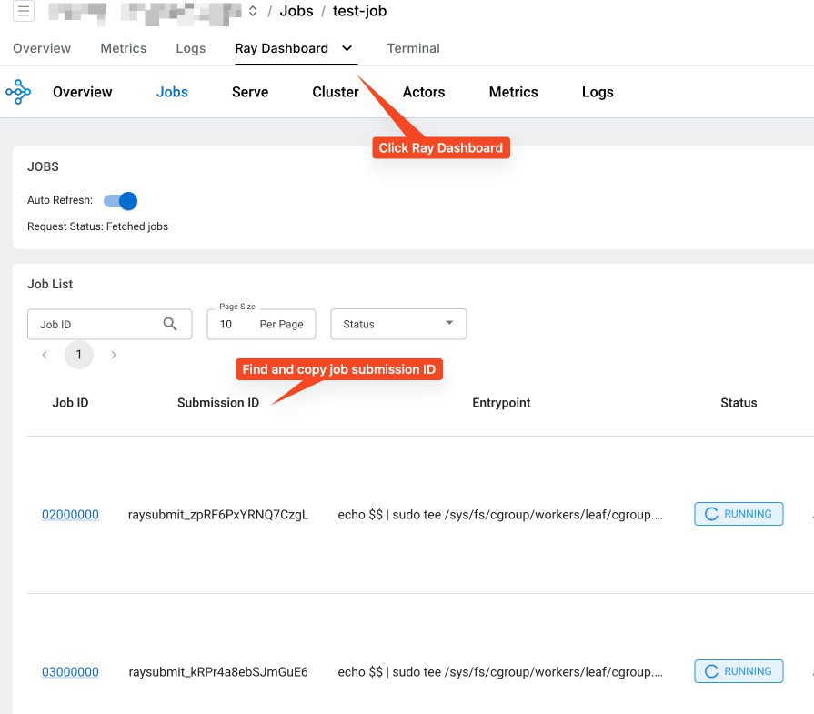
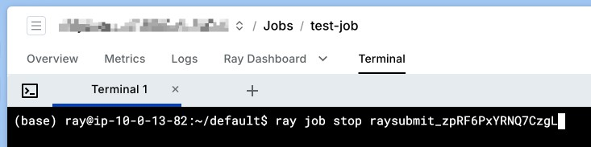
2/12/25, 9:48 AM
Job queues | Anyscale Docs
Open the Terminal tab and run ray job stop 'raysubmit_...' .

