Slide 1
segmentation

Slide 2
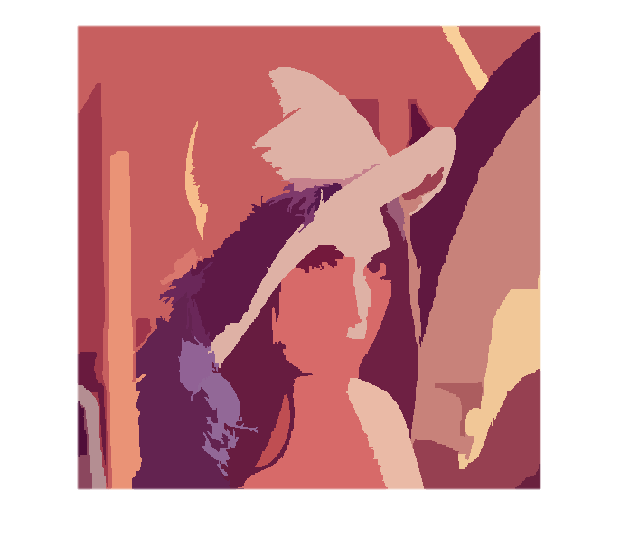
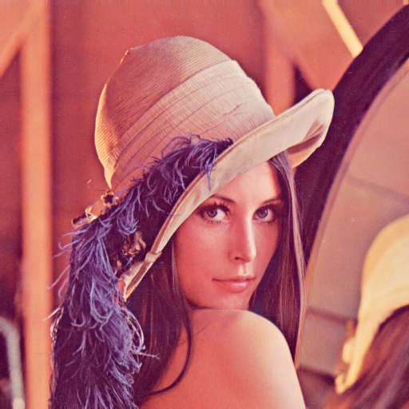
Color Image Segmentation by RGB

Slide 3
Some Advices Last times
Use YCbCr instead of RGB
Consider about the edge for three channels
Test the best parameters for the variables

Slide 4
The Variables that Modified
th: the threshold that vary two regions
diff_factor: a vector that contains three elements, multiply it with the difference of two elements to get the modified difference. Eg. the difference of two pixels is [1,2,3] and the diff_factor is [1,0.5,1.5], then the modified difference is |1|*1 + |2|*0.5+|3|*1.5 = 6.5.
lambda: a vector that contains three elements, multiply it with the matrix that convoloved by gaussain function to add some edge information when calculating difference of two pixels.

Slide 5
The Result
The image can be found at https://github.com/ray-qwer/DJJ_Image_Segmentation/tree/modified_segment/fast_algo_image

Slide 6
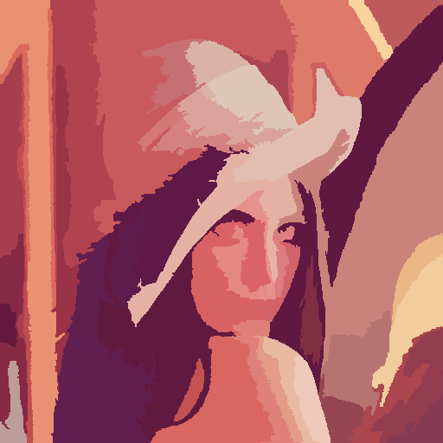
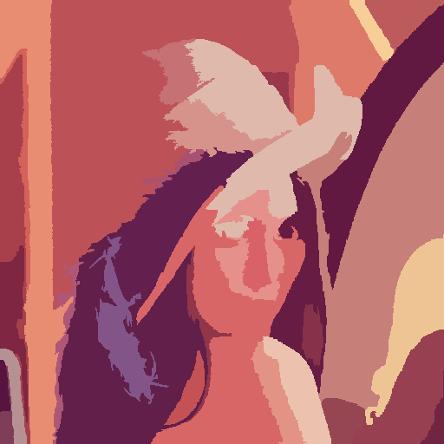
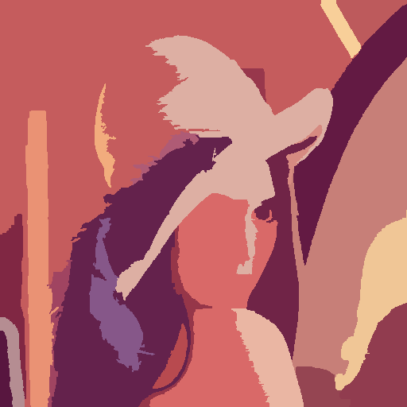
Threshold
diff_factor:[1, 1, 1], lambda:[0.1, 0.1, 0.1]
The region is much larger when threshold is bigger.
th=17
th=25
th=33

Slide 7
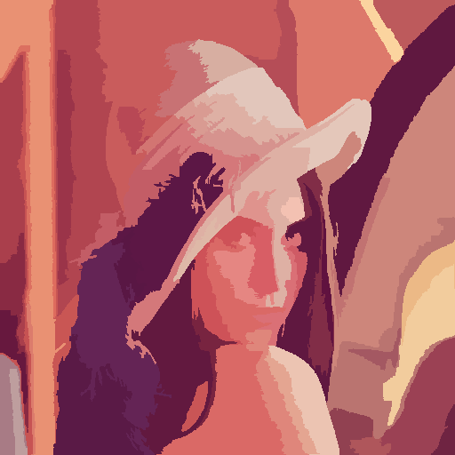
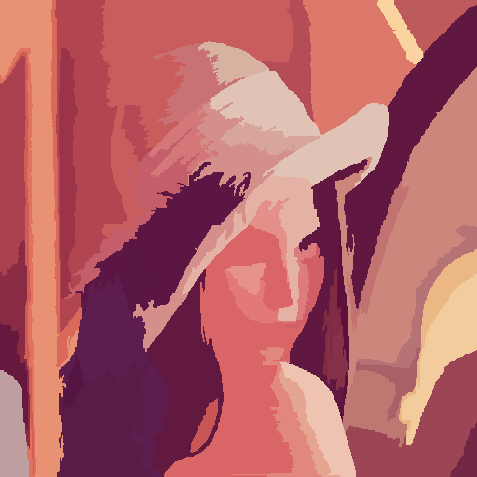
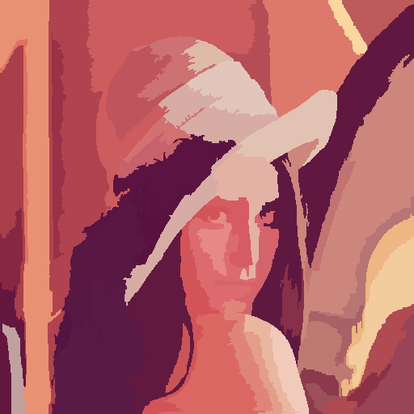
lambda
The structure is [Y, Cb, Cr]
th = 25; diff_factor = [1, 1, 1]
The border of background is much sharper when lambda is larger.
L = [0.1,0.1,0.1]
L = [1.1,1.1,1.1]
L = [1.9,1.9,1.9]

Slide 8



Diff factor
The structure is [Y, Cb, Cr], and sum of three elements is 3
Diff_factor = [y, 1+(1-y)/2, 1+(1-y)/2]
th = 25; lambda=[1,1,1]
Y=0.5
Y=1
Y=1.5

Slide 9
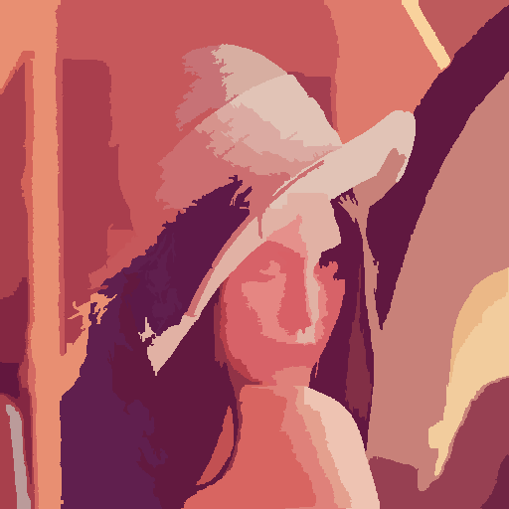
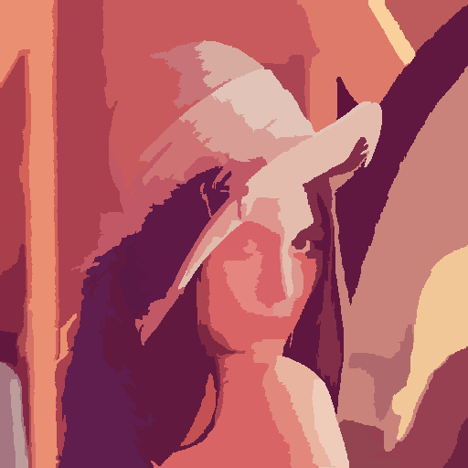
Other experiments
Because the Cr is more obvious in “lena.png”, so I adjust Cr in diff_factor to a little larger than Cb and reverse it.
Diff_factor: [1, 1.5, 0.5] and [1, 0.5, 1.5]
I think the right one is much better. It may because the diff factor enhance the difference of Cb, which is not that obviouse in origin figure.
[1, 0.5, 1.5]
[1, 1.5, 0.5]

Slide 10
Question
What is a “good segmentation”?
The combination of little region may need to be changed if use different parameters.

