Slide 1
MIPS Final Project Presentation
Group 8
B06901071 何承叡
B06901058 陳聖佑

Slide 2
Outline
Baseline -- result & optimization
Branch prediction -- result & analysis
L2 cache -- result & analysis
MultDiv -- result

Slide 3
Baseline
1
Result & Optimization

Slide 4

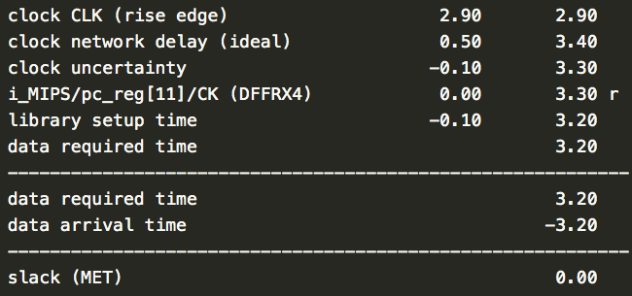
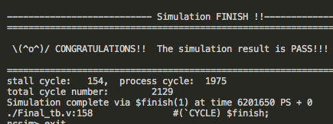
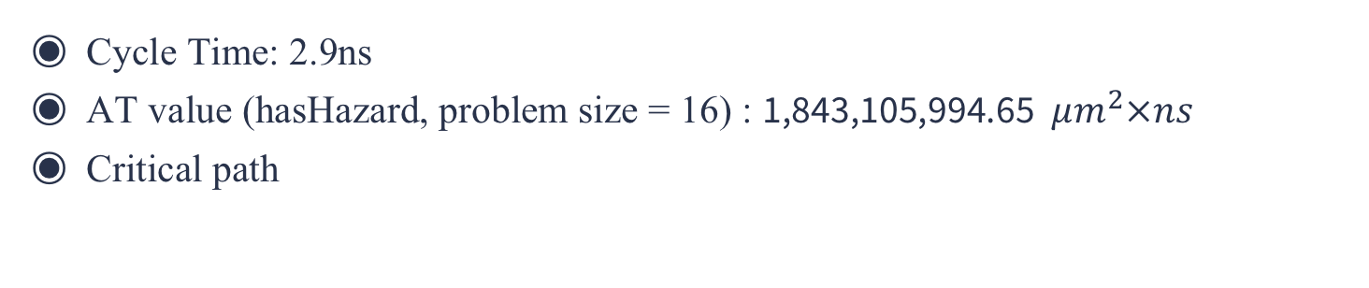
Baseline
Cycle Time: 2.9ns
AT value (hasHazard, problem size = 16) : 1,843,105,994.65 $μm^{2}×ns$
Critical path
IF
ID
WB
control
=
…
pc
forward
IF/ID
ID/EX
MEM/WB

Slide 5
Baseline
Cycle Time: 2.9ns
AT value (hasHazard, problem size = 16) : 1,843,105,994.65 $μm^{2}×ns$
Critical path
IF
ID
WB
control
=
…
pc
forward
IF/ID
ID/EX
MEM/WB

Slide 6

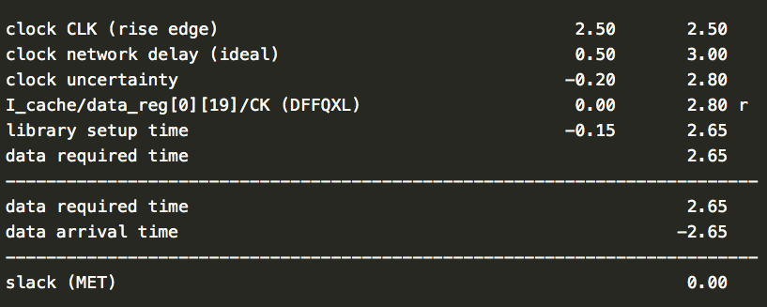
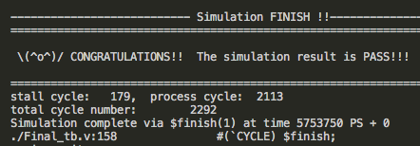
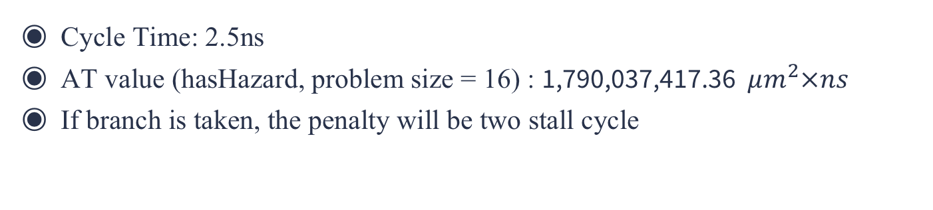
Baseline Optimization
Cycle Time: 2.5ns
AT value (hasHazard, problem size = 16) : 1,790,037,417.36 $μm^{2}×ns$
If branch is taken, the penalty will be two stall cycle
IF
ID
WB
control
branch address
=
…
pc
forward
IF/ID
ID/EX
MEM/WB

Slide 7
Branch Prediction
2
Analysis & Optimization

Slide 8
2-bit Branch Prediction
Methdology
correct
wrong
Taken1
Taken2
correct
wrong
wrong
wrong
NotTaken2
NotTaken1
correct
correct

Slide 9
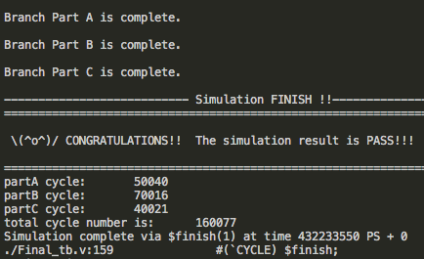
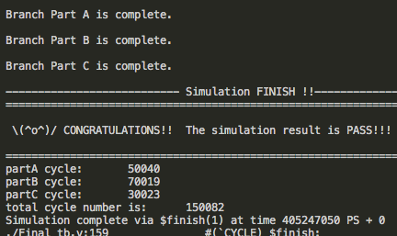
2-bit Branch Prediction
Cost Cycle Difference (No Branch Prediction – 2-bit Branch Prediction)
Never branch: 0
Interleave branch: -3
Always branch: 9998
No Branch Prediction
2-bit Branch Prediction
(nb_notBr, nb_interBr, nb_Br) = (10000, 10000, 10000)

Slide 10

Branch Prediction with Local History Table
Methdology
N=2
When branch pattern is 1010…
=> 1
01 => 0
History Table
N bit
To Do
0010
$$2^{N}$$
Branch History
.
.
.

Slide 11
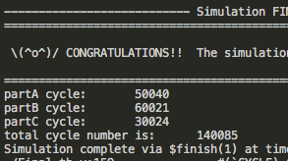
Branch Prediction with Local History Table
Cost Cycle Difference (No Branch Prediction – 2-bit Branch Prediction)
Never branch: 0
Interleave branch: 9995
Always branch: 9997
2-bit Branch Prediction
with Local History Table
No Branch Prediction
(nb_notBr, nb_interBr, nb_Br) = (10000, 10000, 10000)

Slide 12
Cost Cycle Comparison
 | hasHazard | I_mem_BrPred
 | Problem Size = 47 | Never Branch | Interleave Branch | Always Branch | Total
No Branch Prediction | 16466 | 50040 | 70016 | 40021 | 160077
1-bit | 16491 | 50040 | 70007 | 30023 | 150070
2-bit | 17458 | 50040 | 70019 | 30023 | 150082
History Table | 15352 | 50040 | 60021 | 30024 | 140085
(nb_notBr, nb_interBr, nb_Br) = (10000, 10000, 10000)

Slide 13

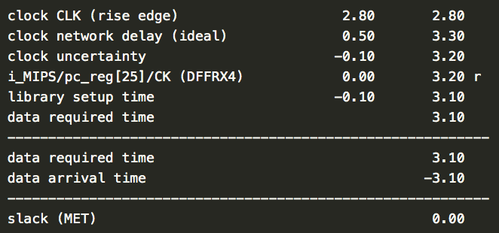
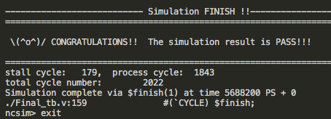
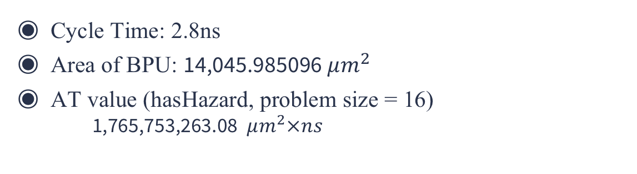
Branch Prediction Gate Level
Cycle Time: 2.8ns
Area of BPU: 14,045.985096 $μm^{2}$
AT value (hasHazard, problem size = 16)
1,765,753,263.08 $μm^{2}×ns$

Slide 14
L2 Cache
3
Result & Analysis

Slide 15
L2 Cache
Separate
32blocks & 4 words
MP1=MP2=8cycles, HT2=2cycles
 | I cache | D cache
MR1 | 0.04% | 10%
MR2 | 80% | 1.7%
CPI(original) | 1.003 | 1.8
CPI(+L2cache) | 1.003 | 1.214
improvement | 0% | -32%

Slide 16
Multiply&Divide
4
Result

Slide 17
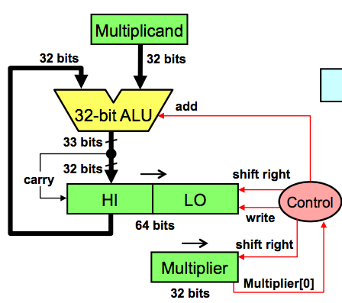
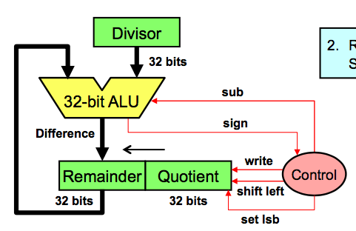
Multiplication & Division
Methdology
multiply
divide

Slide 18

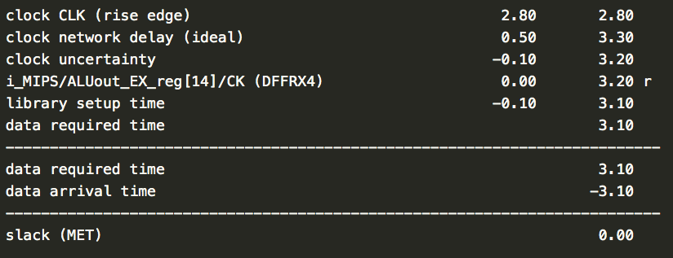
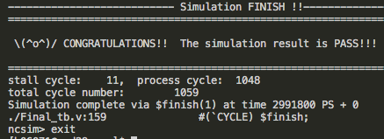
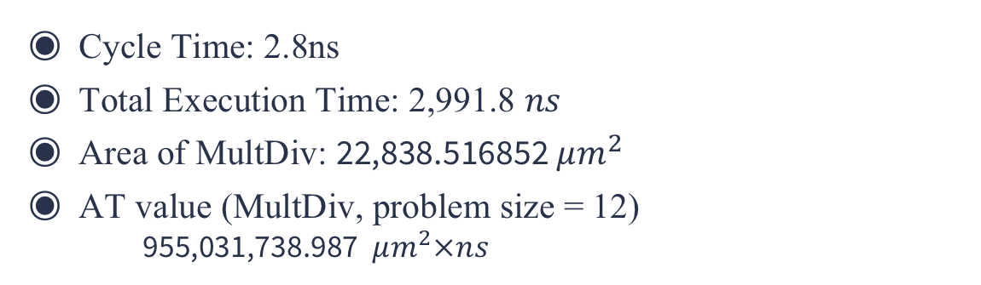
Multiplication & Division
Cycle Time: 2.8ns
Total Execution Time: 2,991.8 $ns$
Area of MultDiv: 22,838.516852 $μm^{2}$
AT value (MultDiv, problem size = 12)
955,031,738.987 $μm^{2}×ns$

Slide 19
Thanks for Your Listening

