Slide 1
LibraryFind
®
Better Discovery. Easy Delivery.

Slide 2
LibraryFind Vision
Universal platform for scholarly activity
Better discovery
Easy delivery
Open source, easily adoptable
Extensible

Slide 3
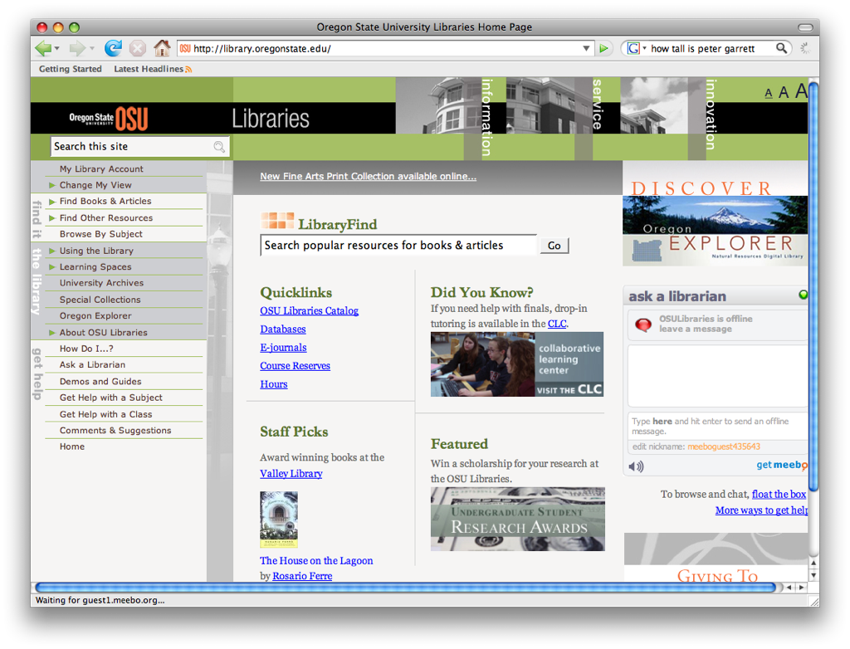

Slide 4
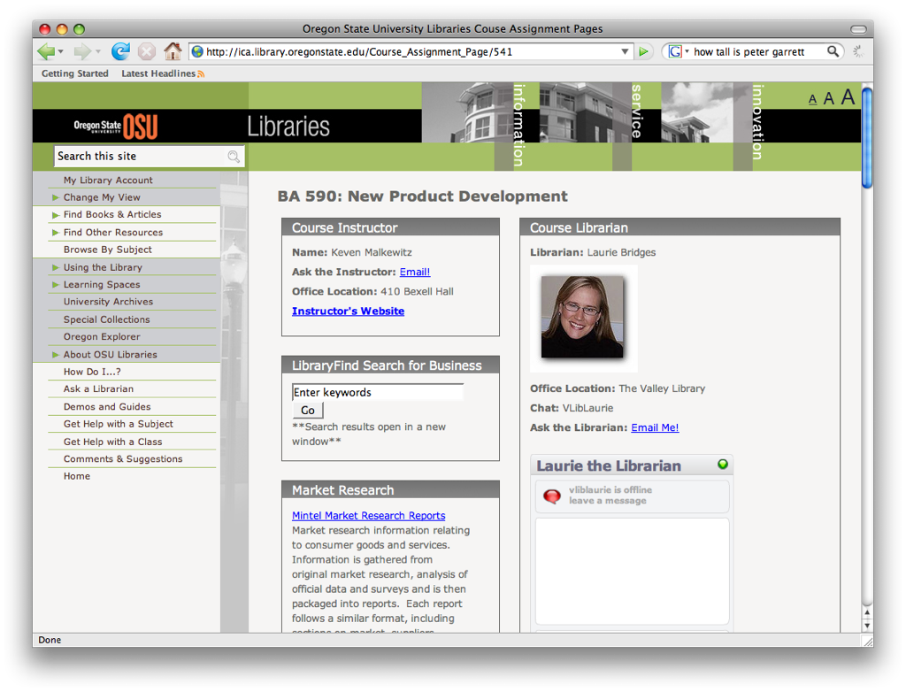

Slide 5
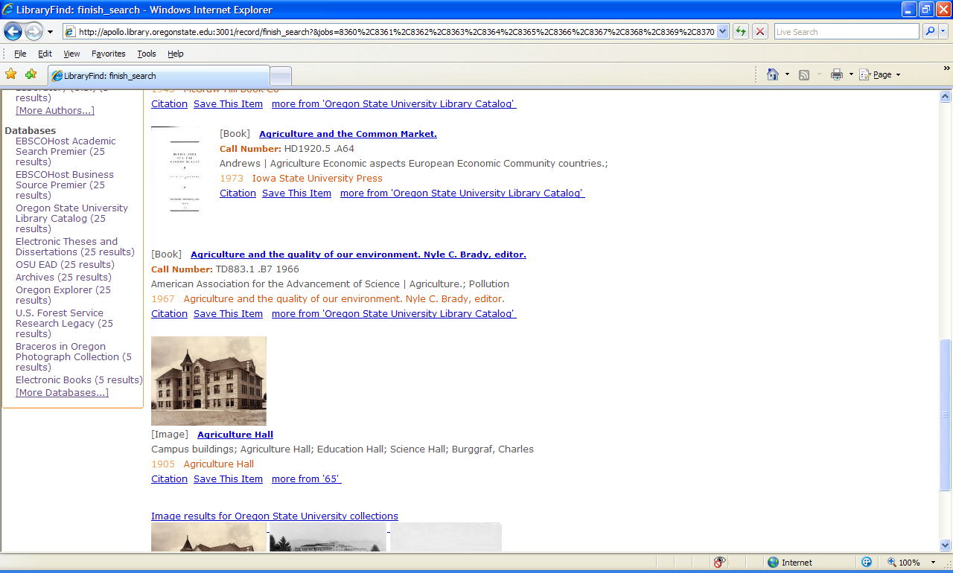

Slide 6
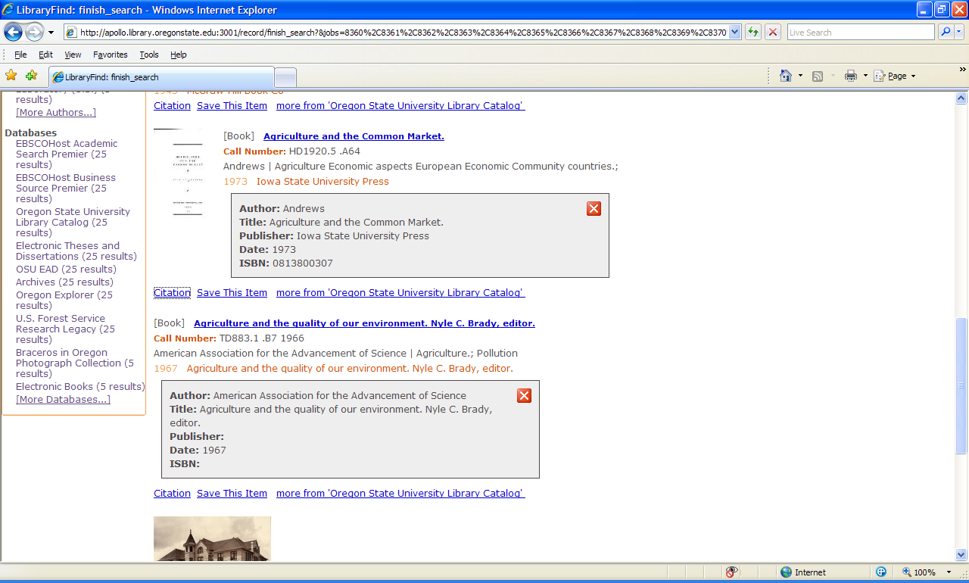

Slide 7
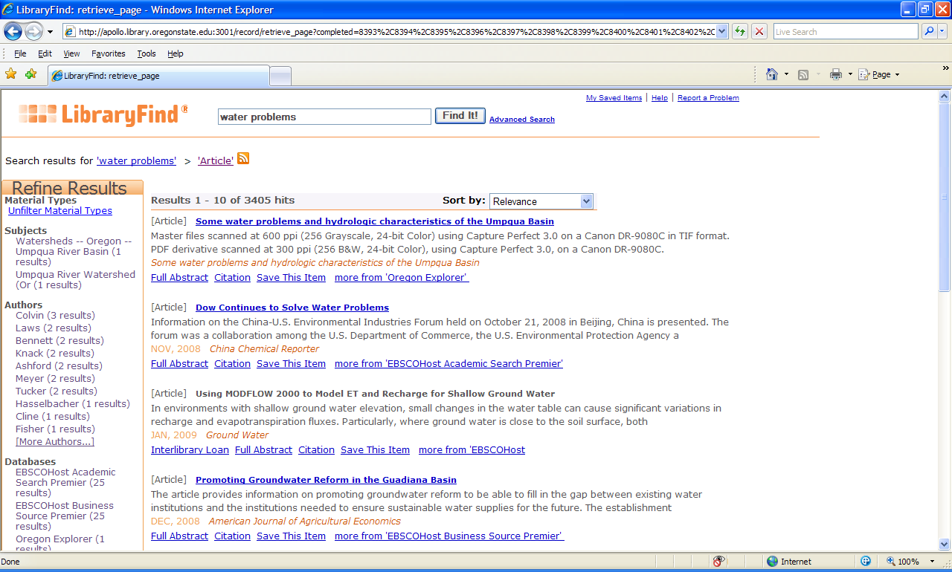

Slide 8
(some user-noticed)
LibraryFind Features
Two-click workflow
Facets for browsing / limiting
Ability to sort by relevance or date
Breadcrumb trail
Quick citation information
Link to resource collection
RSS Linking

Slide 9
(some under-the hood)
LibraryFind Features
“Look-ahead” OpenURL resolution
Smart ILL link display
Dynamic, on-the-fly facet creation
Extensively user-tested user interface
Search caching
Ability to locally index harvestable collections

Slide 10
(some more under-the-hood)
LibraryFind Features
Extensible, customizable (XML-backend)
Web-based administration
COinS support
Open Source

Slide 11
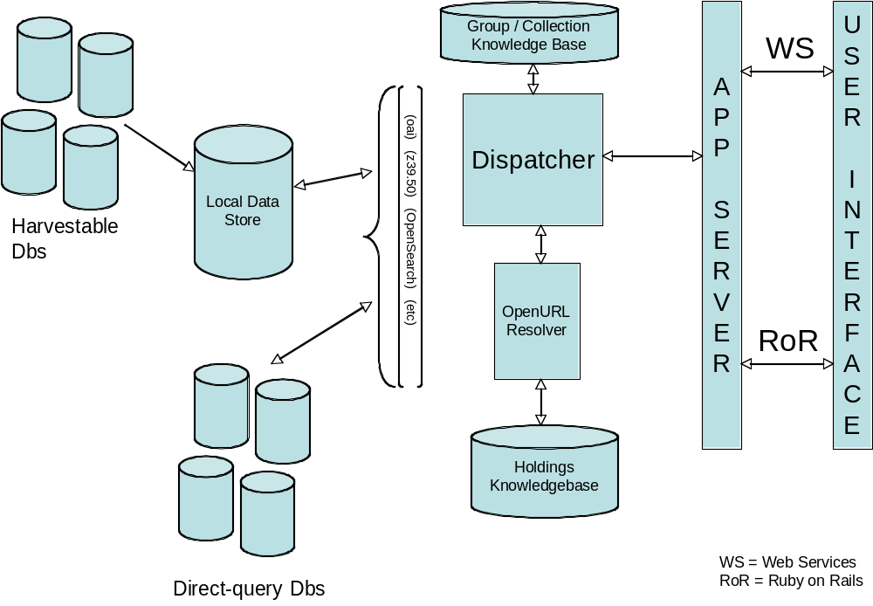
LibraryFind
Architecture

Slide 12

0.9 Federated Search Engine
Tracer
Query Engine
Job
Queue
Listener

Slide 13
LibraryFind – Behind the scenes
LibraryFind is a unique metasearch tool for a couple of reasons:
    Integrated OpenURL resolution
    Both a harvester/indexer and federated search tool
    Metadata driven knowledge-base
    Implements a 2-tier caching system

Slide 14
LibraryFind – Behind the scenes
OpenURL
  LibraryFind utilizes OpenURL to accomplish its two click workflow (search => get)
  OpenURL resolution works two ways:
    Utilizing LF’s build-in OpenURL resolver (requires coverage information to be managed within the application)
    Utilizing an externally supported OpenURL resolver (coverage information is managed remotely)

Slide 15
LibraryFind – Behind the scenes
Harvester/Indexer
  LibraryFind has the ability to harvest
    OAI & MARC repositories
    incremental harvests

Slide 16
LibraryFind – Behind the scenes
Federated Search tool
  Utilizes a metadata-based knowledge-base system
    Allows for the use of abstract connection classes rather than hardcoded connectors
    Makes adding new resources and sharing the knowledge-base with other institutions possible

Slide 17
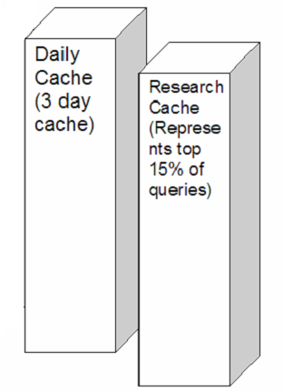
LibraryFind – Behind the scenes
Caching System Infrastructure

Slide 18
LF Technologies
Ruby on Rails
MySQL
Lucene (Ferret)
web services (REST, SOAP/WSDL)

Slide 19
Protocols
Z39.50 / SRU / SRW
OAI-PMH
OpenSearch
SOAP / WSDL
COinS

Slide 20
LibraryFind UI
Template-based UI generation
  Utilizes Rails model
    views/layouts templates helpers etc.
language files (for UI I18 support)
  (todo – support for I18 searches on all protocols)

Slide 21
Default Templates
2 default templates
  General template (mixes articles/images)
  Image template (for image view)

Slide 22
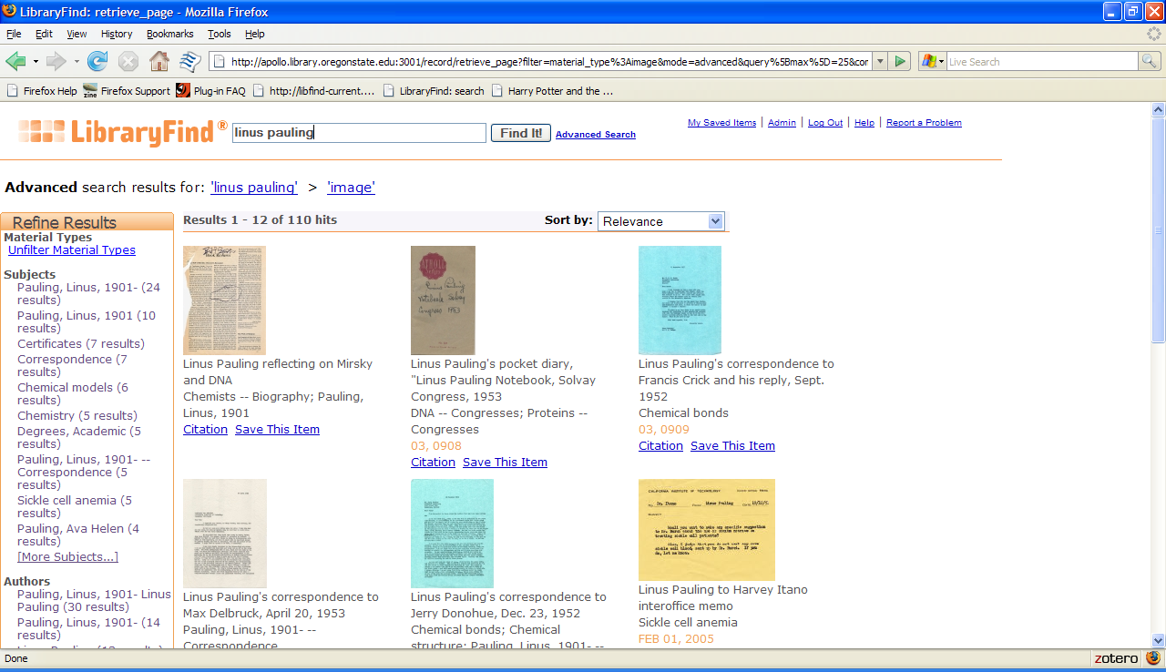
Image Template

Slide 23
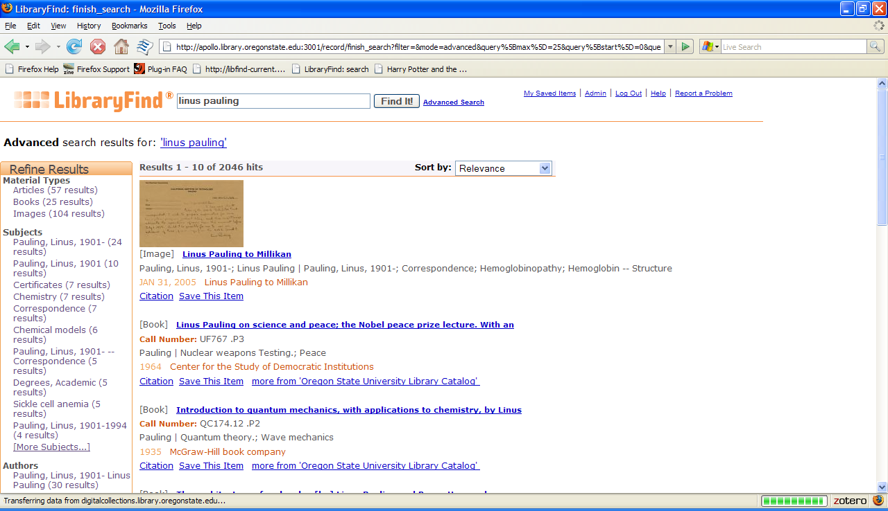
Mixed Template

Slide 24
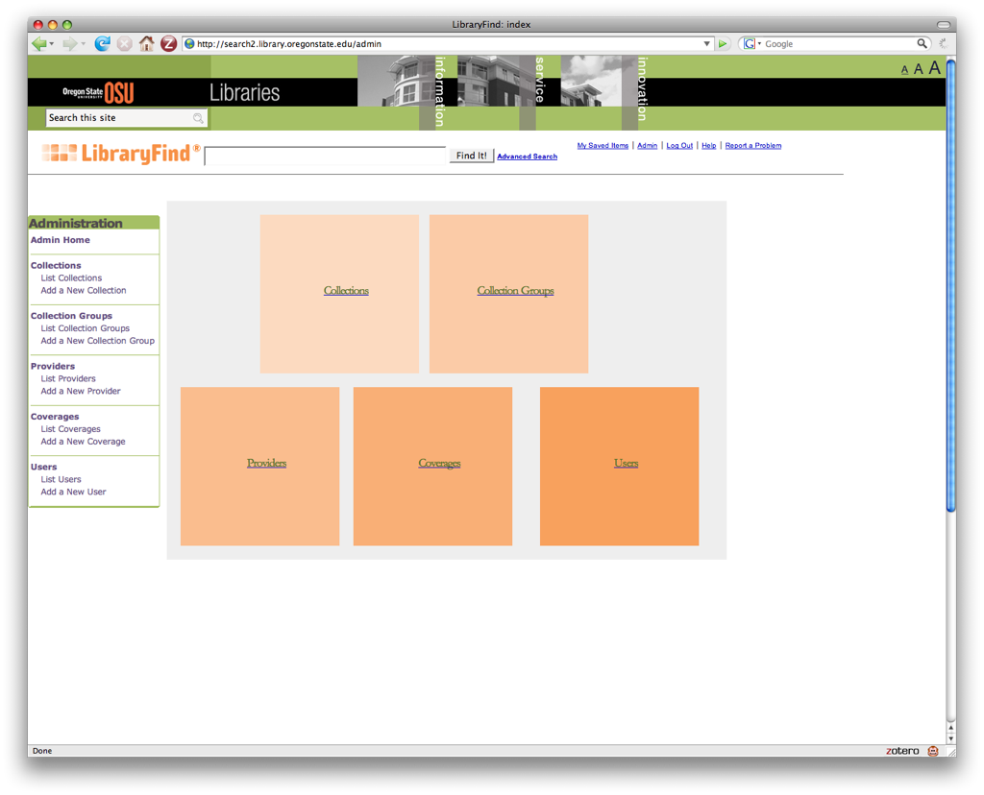
Admin UI

Slide 25
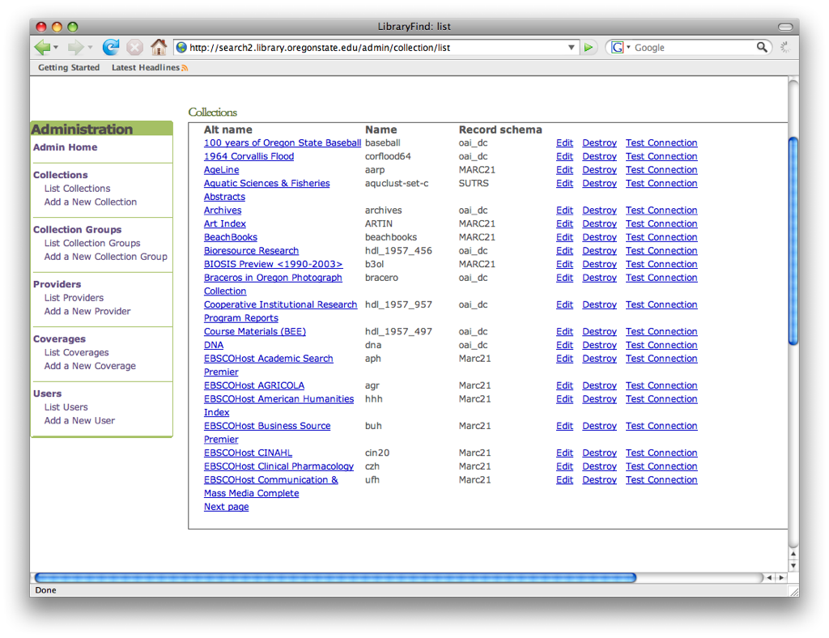

Slide 26
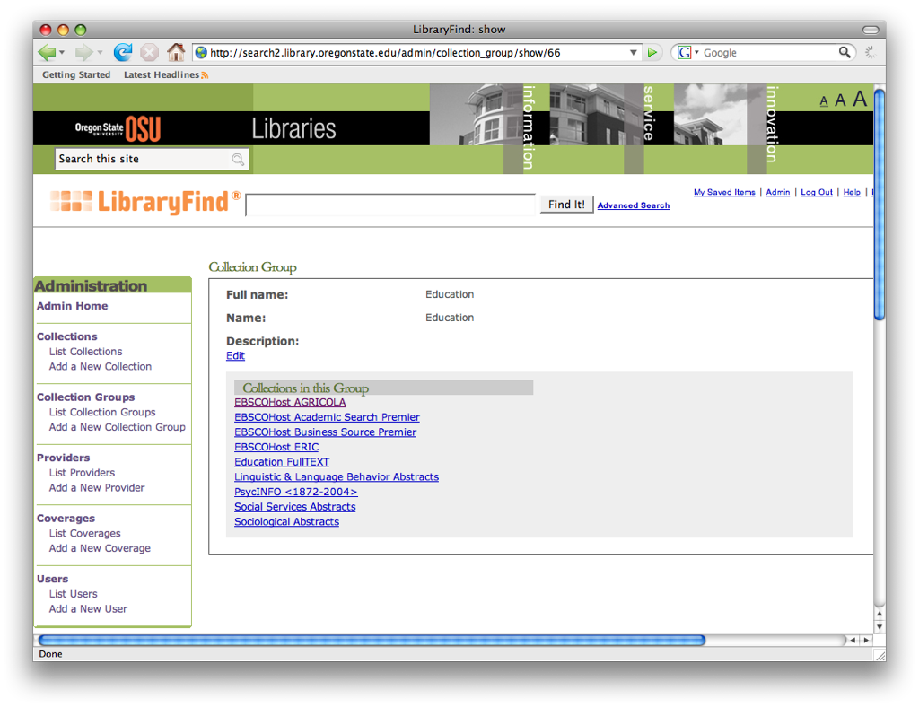

Slide 27
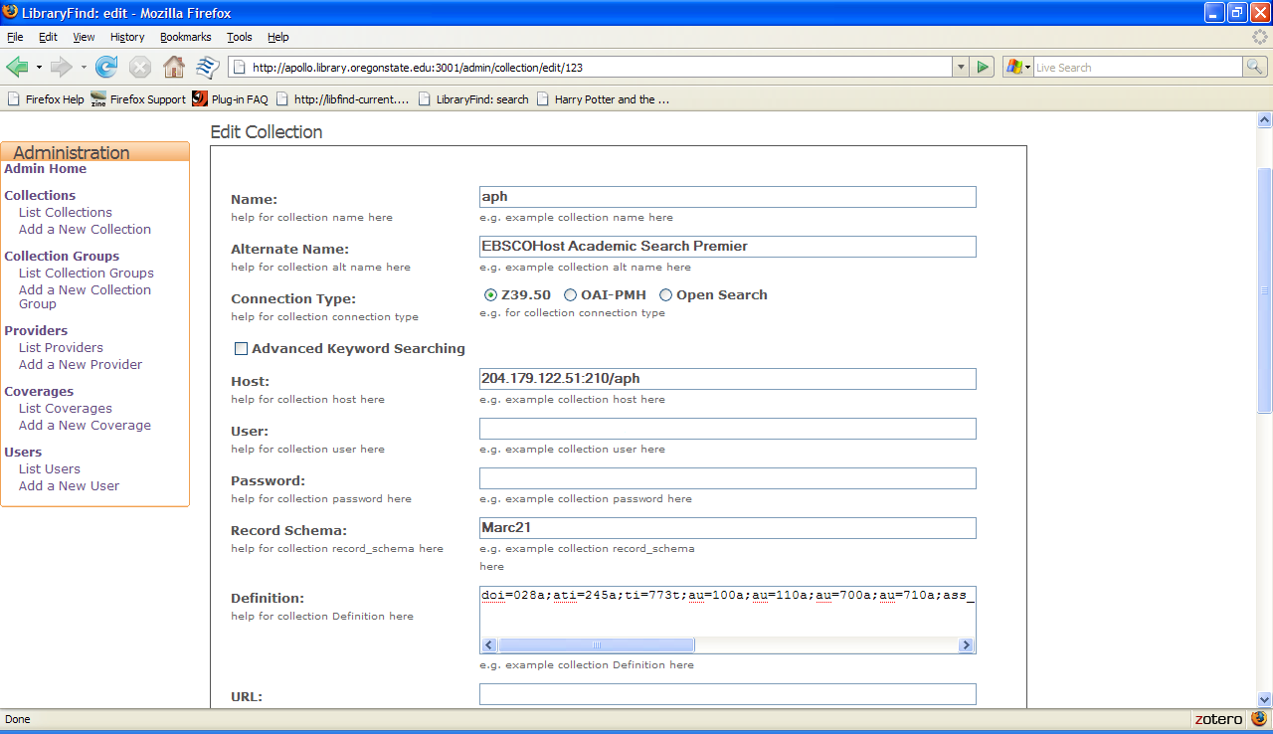

Slide 28
Challenges
Ruby
  Good lack of XML support as part of the language
  Lack of good, built in thread support
  Installation/deployment challenges
  Coming to grips the Ruby philosophy of making things work and then optimize (i.e., figuring out where the language still needs optimized)

Slide 29
Challenges
Working with content providers
  For OpenURL API like Serials solutions and SFX
  Article/metadata providers
    No standard search API interfaces
    or, the need to sign non-disclosures which may limit the ability to provide connector information as part of the project

Slide 30
Challenges
Building and maintaining the connector knowledge-base
  Both for OSU and users wanting to use LibraryFind
Building and maintaining the OpenURL server components/database
  Finding ways to work closer with groups like Serials Solutions, EbscoHost, SFX, etc.

