Slide 1
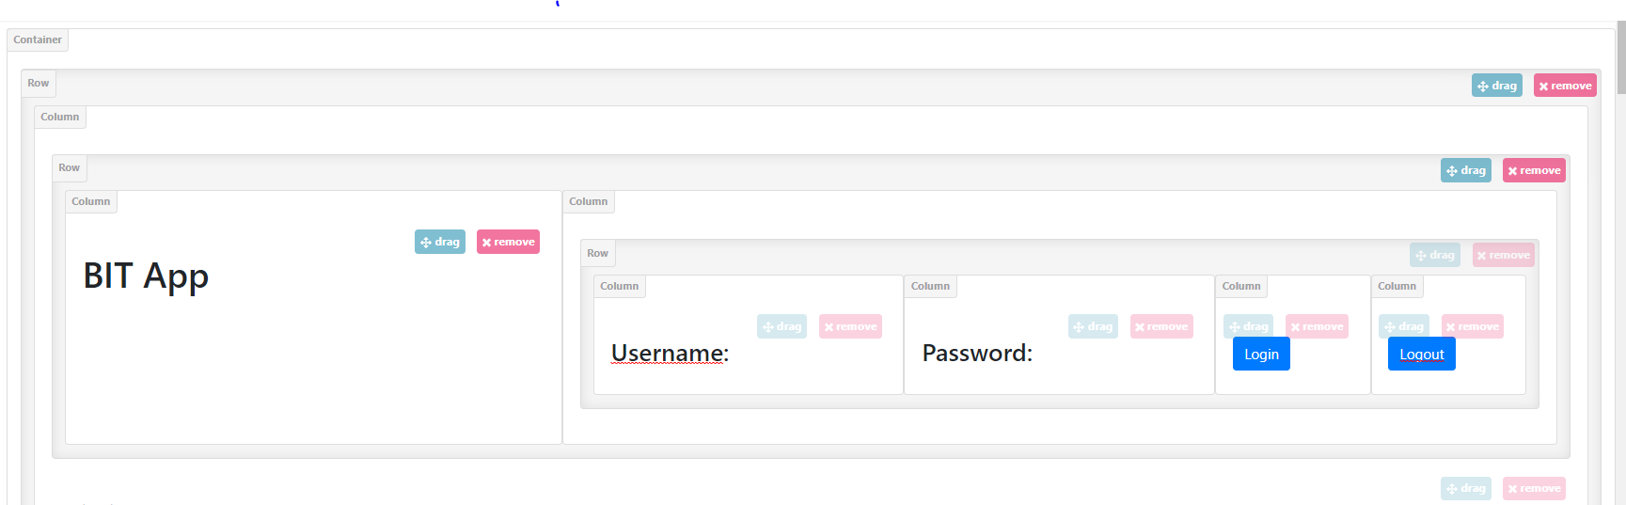



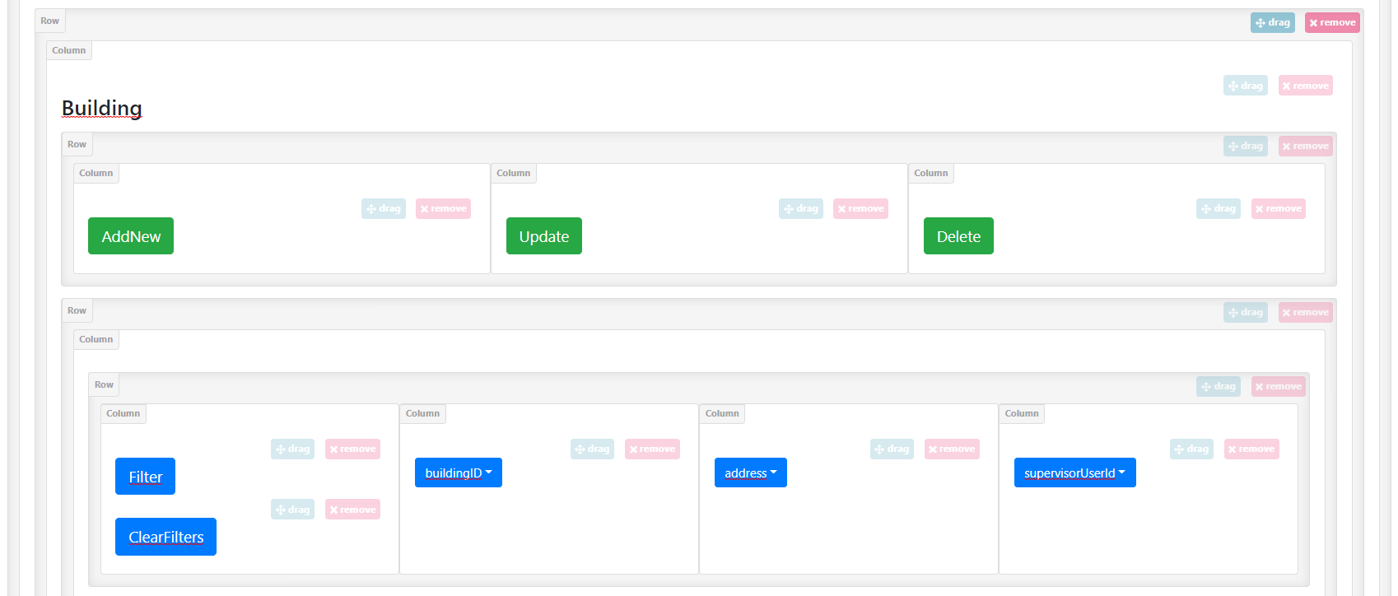



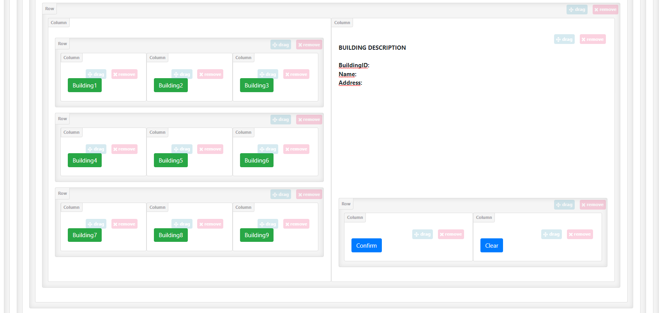

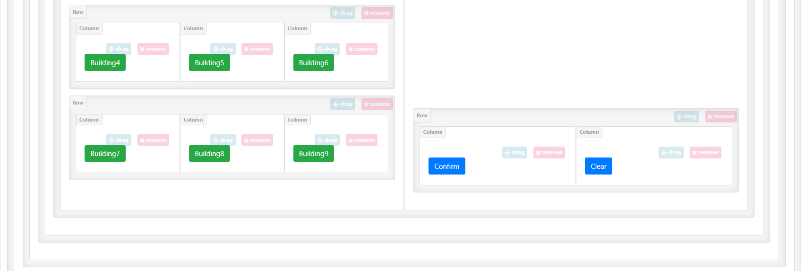
BIT APP
Logout
Buildings
Buildings
Filter
BuildingID
Filter
Clear Filters
ClearFilters
Building ID:
Name:
Address:

Slide 2
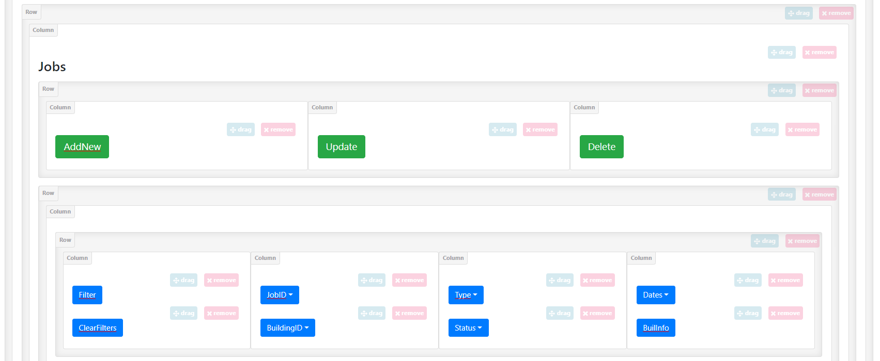


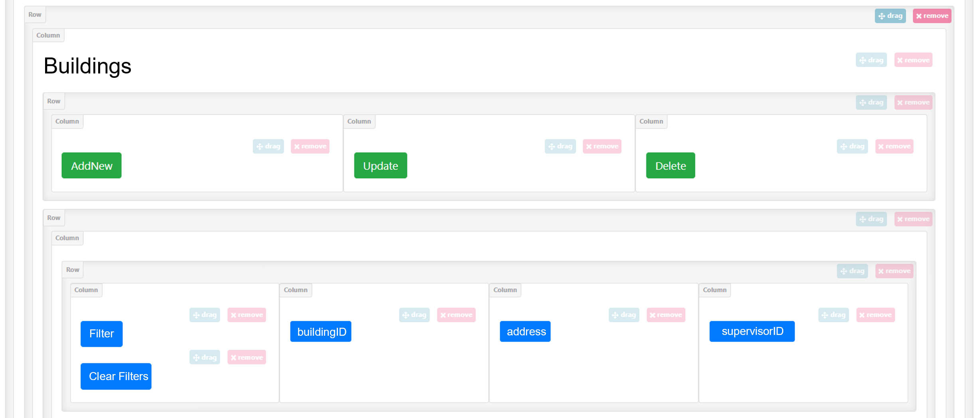
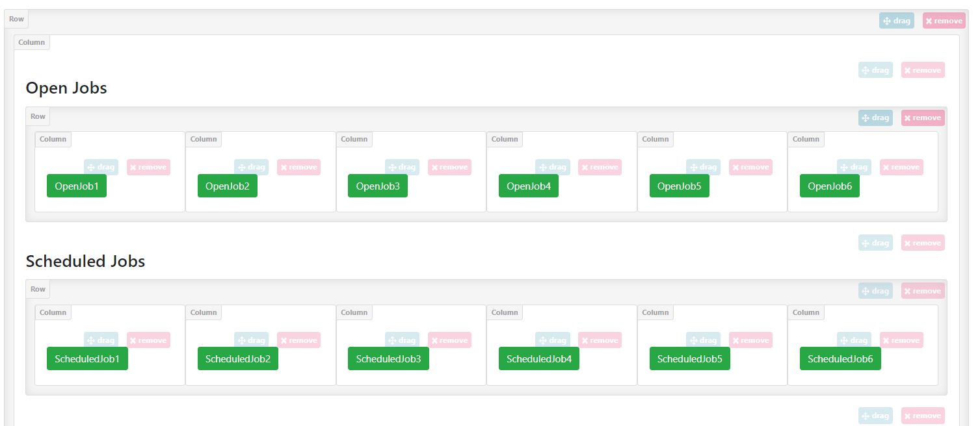
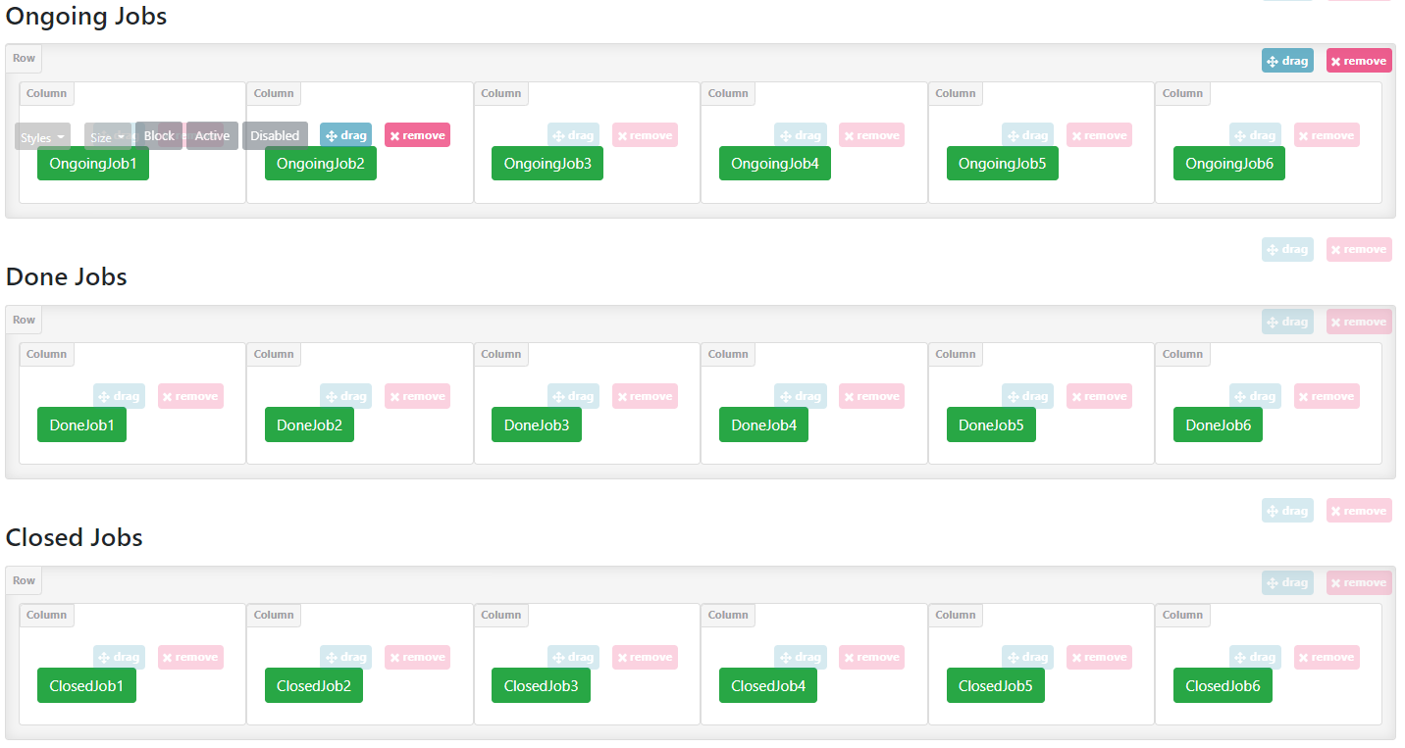
Jobs
Jobs
BIT APP
Logout
Buildings
JobID
Type
ClearFilters
BuildInfo
Filter
Clear Filters

Slide 3
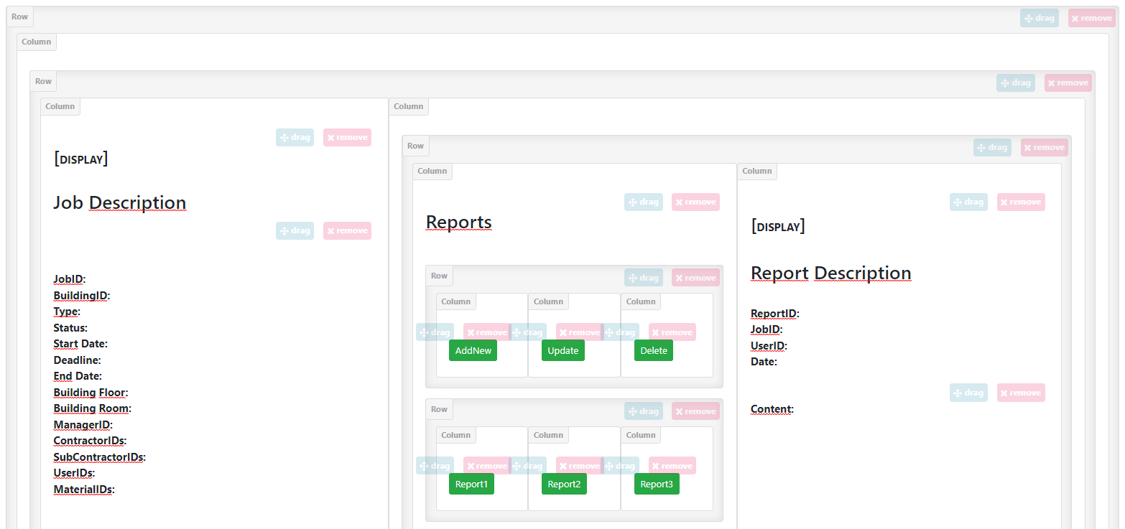
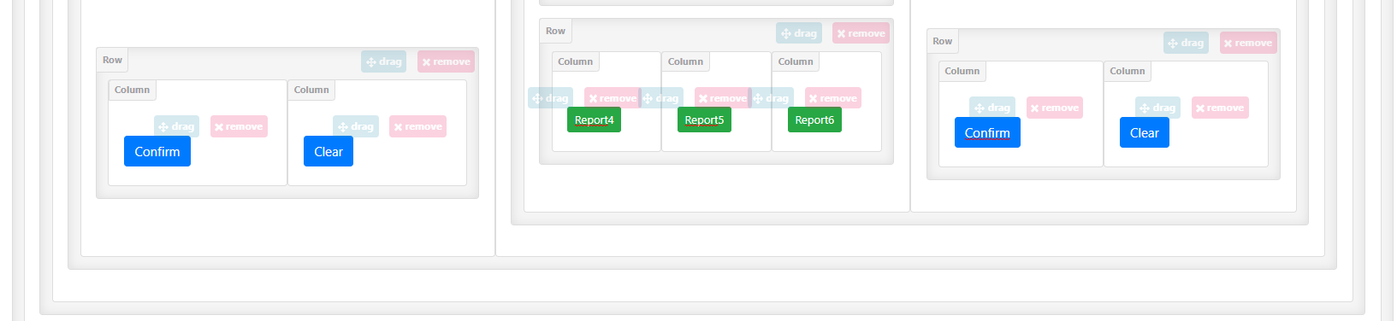
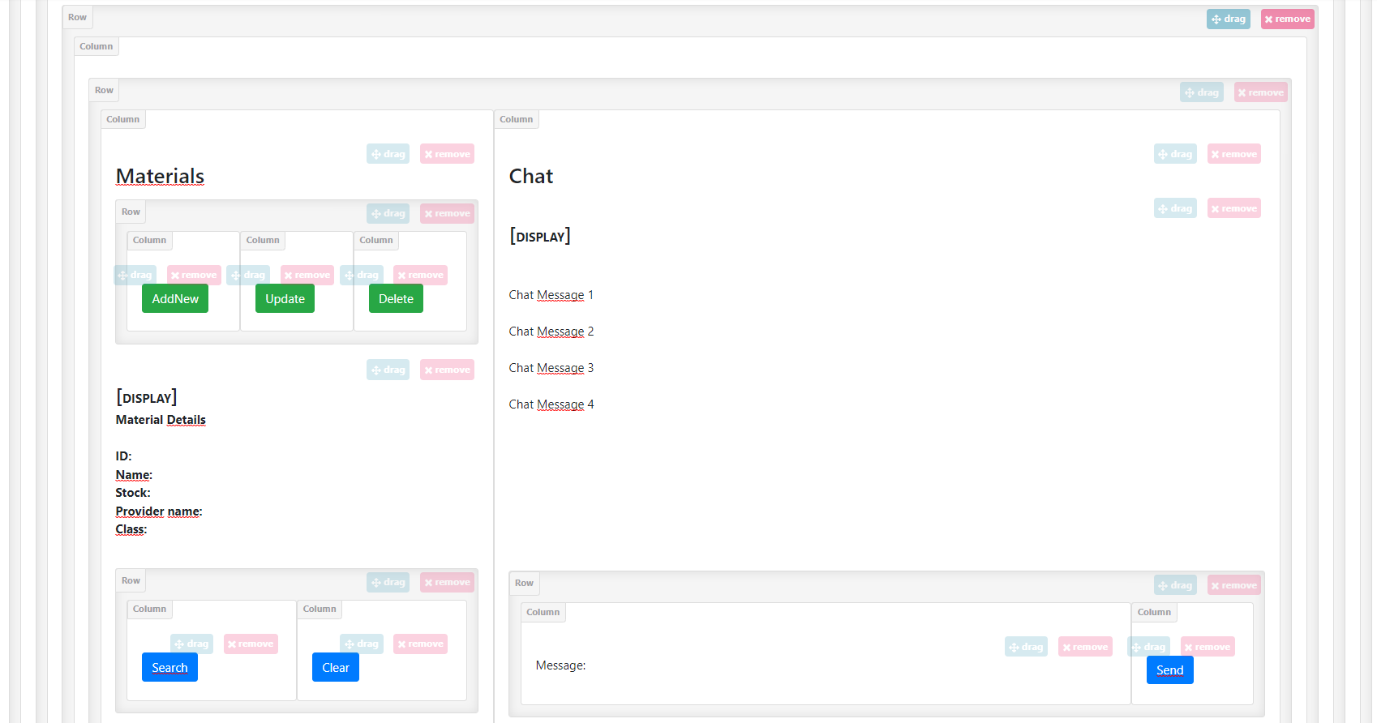

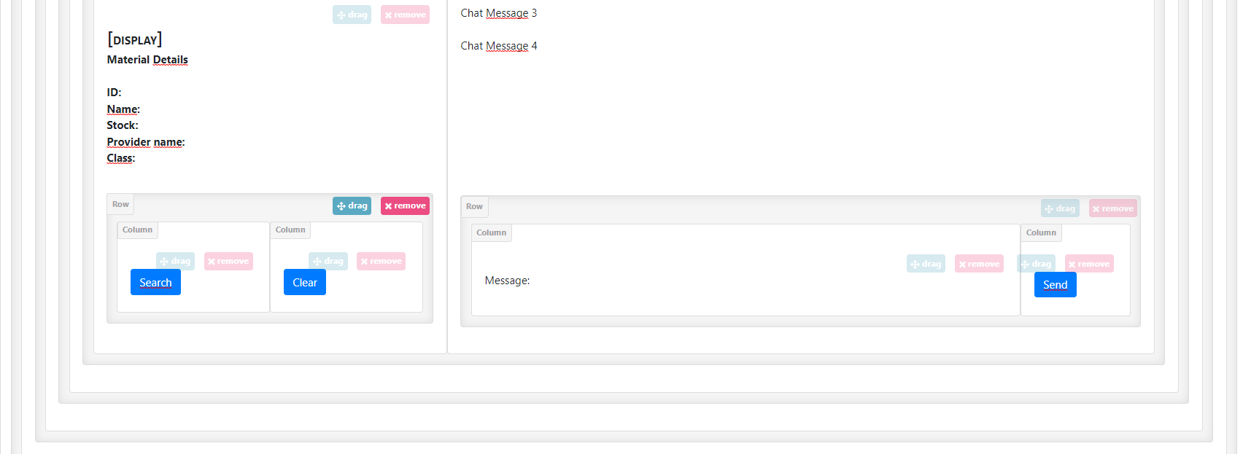

Jobs
Job Description
Reports
BIT APP
JobID:
BuildingID:
Type:
Status:
Start Date:
Deadline:
EndDate:
Building Floor:
BuildingRoom:
ManagerID:
ContractorIDs:
SubContractorIDs:
UserIDs:
MaterialsIDs:
Report Description
Logout
ReportID:
JobID:
UserID:
Date:
Content
Buildings
Report4
Report5
Report6
Filter
Clear Filters
Materials
Chat
[User 1] Chat Message 1
[User 2] Chat Message 2
[User 1] Chat Message 3
[User 2] Chat Message 4
Material Description
Material ID:
Name:
Stock:
Provider Name:
Material Class:
Search
Message: ________________________________
Send

Slide 4
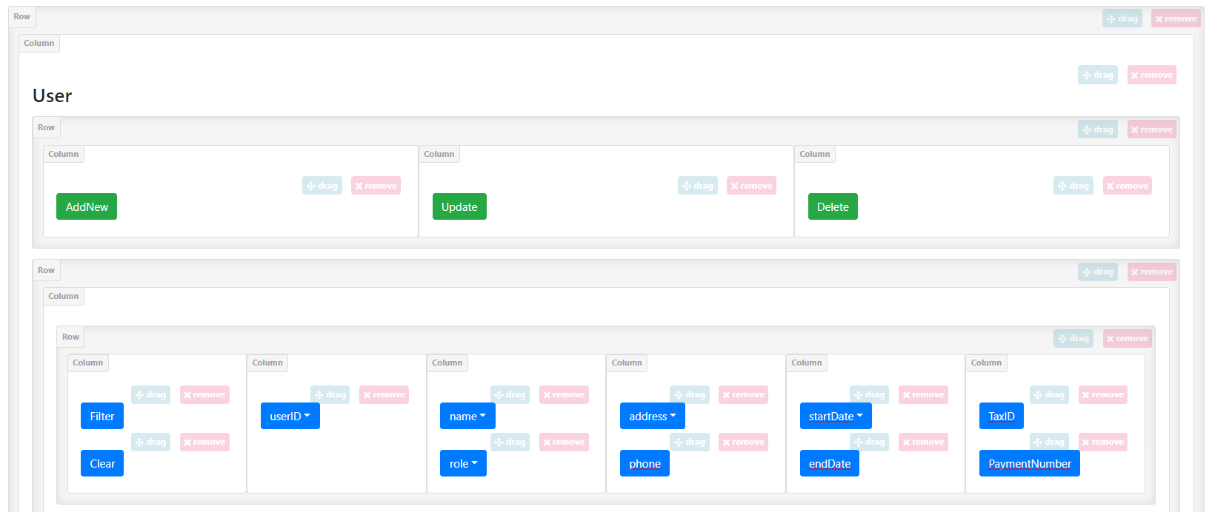
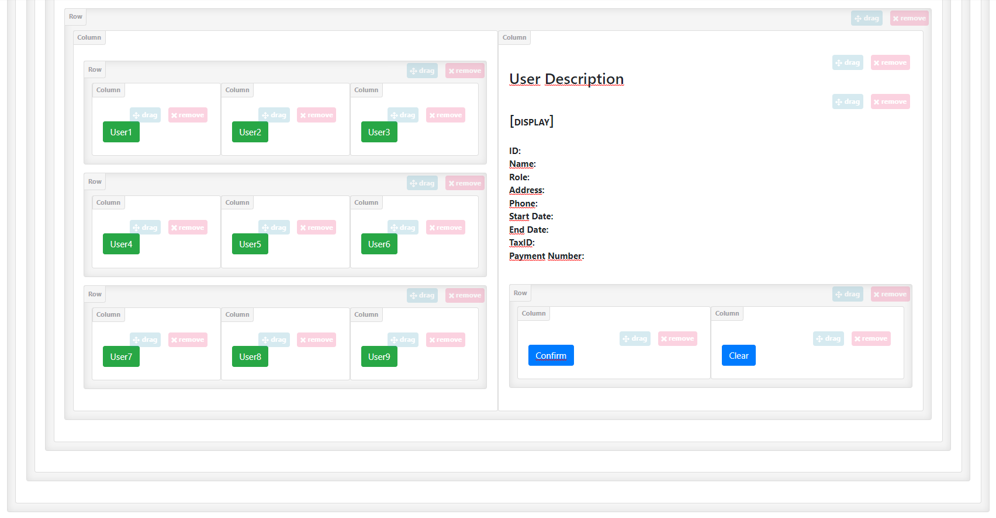

Jobs
Job Description
Reports
BIT APP
JobID:
BuildingID:
Type:
Status:
Start Date:
Deadline:
EndDate:
Building Floor:
BuildingRoom:
ManagerID:
ContractorIDs:
SubContractorIDs:
UserIDs:
MaterialsIDs:
Report Description
Logout
ReportID:
JobID:
UserID:
Date:
Content
Buildings
startDate
taxID
phone
endDate
paymentNumber
User Description
User Description
User ID
Name:
Role:
Address:
Phone:
Start Date:
End Date:
Tax ID:
Payment Number:
Name:
Address:
Filter
Phone:
Start Date:
End Date:
TaxID:
Clear Filters
PaymentNumber:
Materials
Chat
[User 1] Chat Message 1
[User 2] Chat Message 2
[User 1] Chat Message 3
[User 2] Chat Message 4
Material Description
Material ID:
Name:
Stock:
Provider Name:
Material Class:
Message: ________________________________

