Slide 1
Merge Sort
Final Project
電機所一 110061592 許睿哲

Slide 2
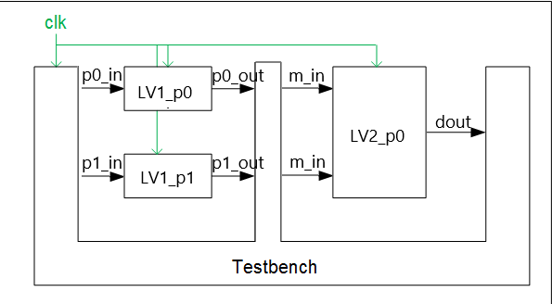
Architecture
The size of number is 32 bits.
Sorting 64 numbers.

Slide 3
STRATUS result
unroll Simulation Time
Simulation Time
 | Flatten |  |  | Completed Unroll
Degree of parallelism | 1 | 2 | 4 | 1 | 2 | 4
Time(cycle) | 8279 | 4296 | 2494 | 8730 | 4447 | 2581

Slide 4
STRATUS result
unroll Simulation Time
Area
Degree of parallelism | 1 | 2 | 4 | 1 | 2 | 4
Level1 PE(each) Area | 104204 | 96505 | 94502 | 26769 | 14066 | 7363
Level2 PE(each) Area |  | 101145 | 52515 |  | 5436 | 4238
Level3 PE(each) Area |  |  | 102055 |  |  | 5773
Total Area | 104204 | 294155 | 585093 | 26769 | 33568 | 43701

Slide 5
riscv-vp result
 | With DMA |  |  | Without DMA
2core | 1 | 2 | 2 | 1 | 2 | 2
PE | 1 | 1 | 3 | 1 | 1 | 3
Simulation time(ns) | 741,346,150 | 64,190,470 | 26,453,690 | 73,997,990 | 58,009,250 | 26,891,350
num-inst(core0) | 2,216,449 | 1,921,724 | 769,906 | 2,196,993 | 1,757,865 | 792,936
num-inst(core1) |  | 769,423 | 968,503 |  | 2,412,746 | 988,778

Slide 6
Thank You

