Slide 1
Merge Sort
Final Project - proposal
電機所一 110061592 許睿哲

Slide 2
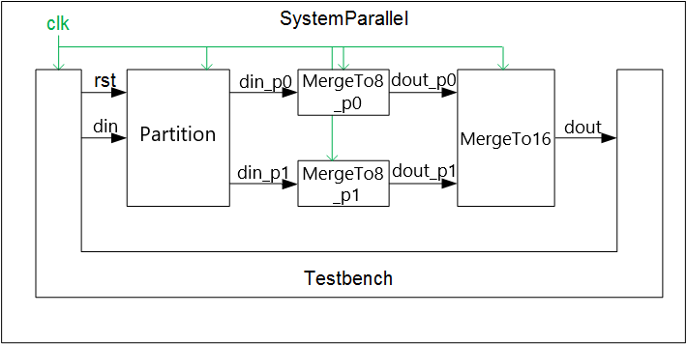
Architecture:stratus
The bandwidth of channel are 32 bits.
Sorting 16 numbers.

Slide 3
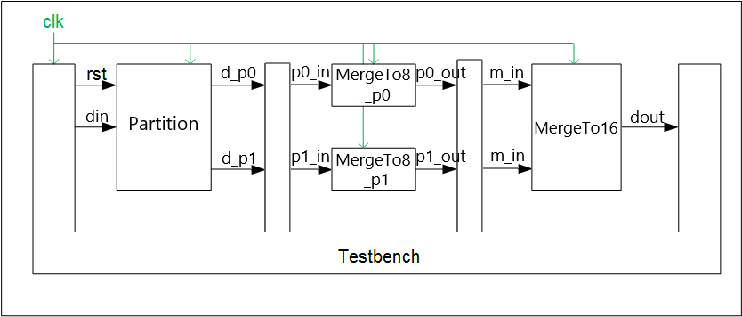
Architecture:riscv-vp
The bandwidth of channel are 32 bits.

Slide 4
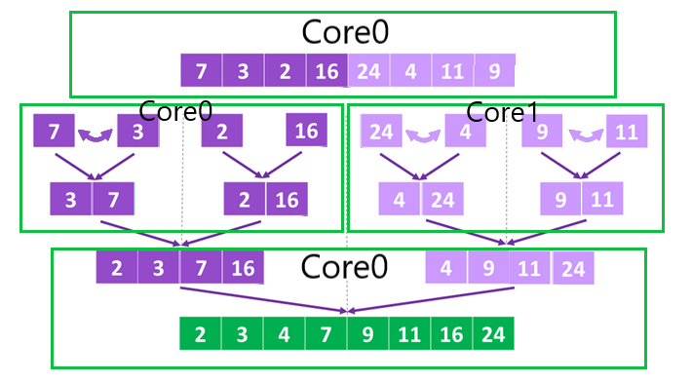
Design – MergeSort
For example,
core 0 transfer PE(partition)to .
Core0 and Core1 transfer data to PE(MergeTo4).
Use core0 to transfer data to PE(MergeTo8).

Slide 5
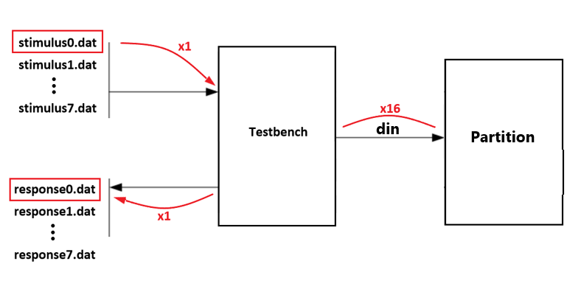
Design – PIPElineing
Input multiple files to observe pipelining.

Slide 6
Thank You

